Slide 1
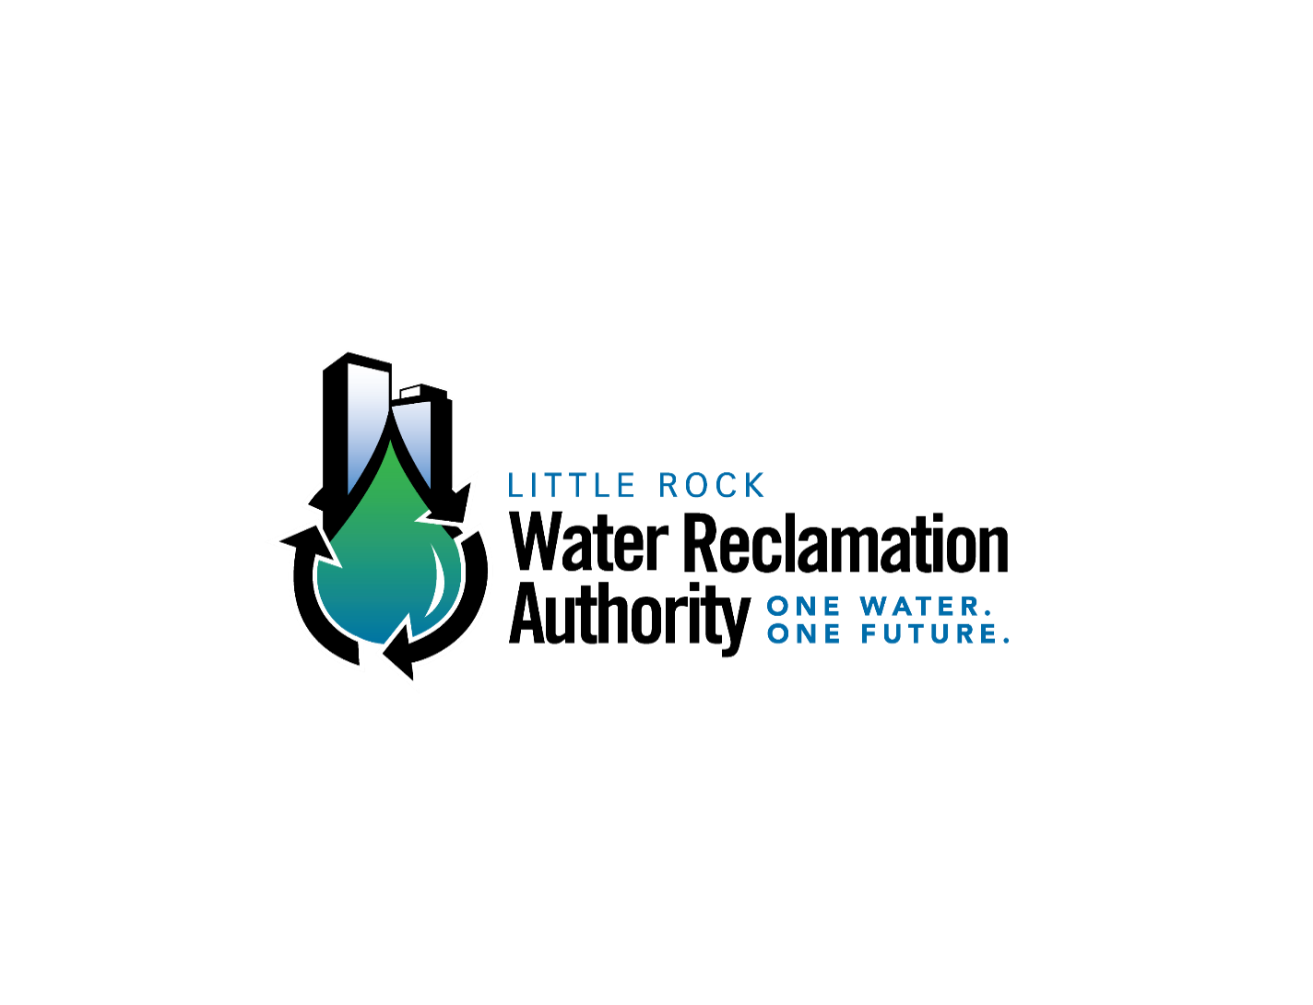

Sewer Service Line Replacement Program (SSLRP)
Les Price, P.E.
Director of Engineering Services
November 2024

Slide 2
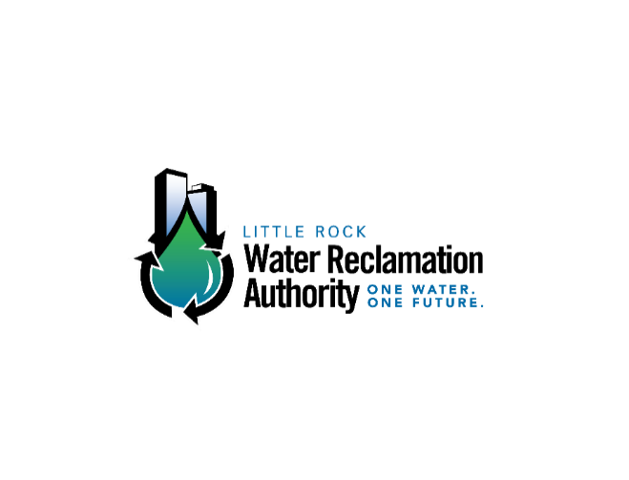
Agenda
About LRWRA
General Information of SSLRP Program
Initial Challenges
Current Challenges
Achievements

Slide 3
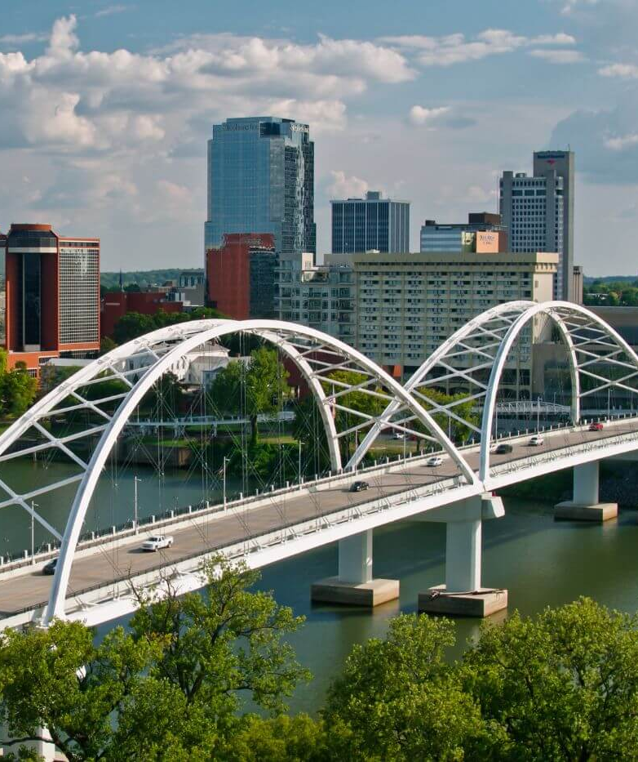
LRWRA Service Area
Profile
120 sq miles on south bank of AR River
Population 202,591
Utility Customers
Domestic 63,775
Com. & Ind. 7,199

Slide 4
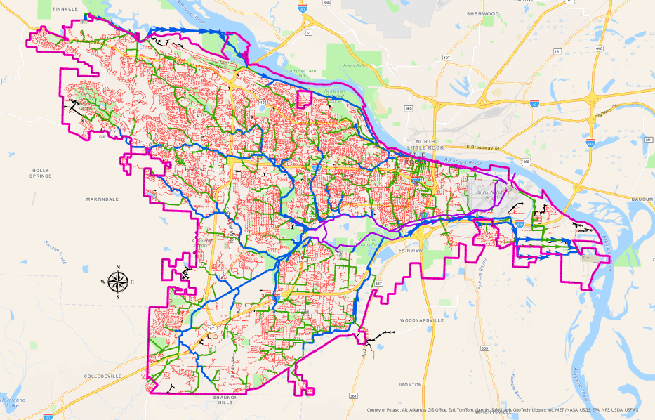

LRWRA Sewer System Overview
Gravity System
32,000+ manholes
12” & smaller – 1,163 miles
13” - 17” – 32 miles
18” & larger – 165 miles
Force System
32 pump stations
2” - 48” – 66 miles
Water Reclamation Facilities
Adams Field – 94 MGD
Fourche Creek – 48 MGD
Little Maumelle – 12 MGD
Notes:
Reference the QR code which links to the webmap on LRWRA website.
Sewer pipes and manholes dating back to 1880s with the first Sewer Improvement District in downtown Little Rock. Over the next 140 years, the collection system developed to the west and south.
Quick math: roughly 95% gravity.
Benefit afforded by the topography of our City, which allows us to take advantage of the natural drainage basins.

Slide 5
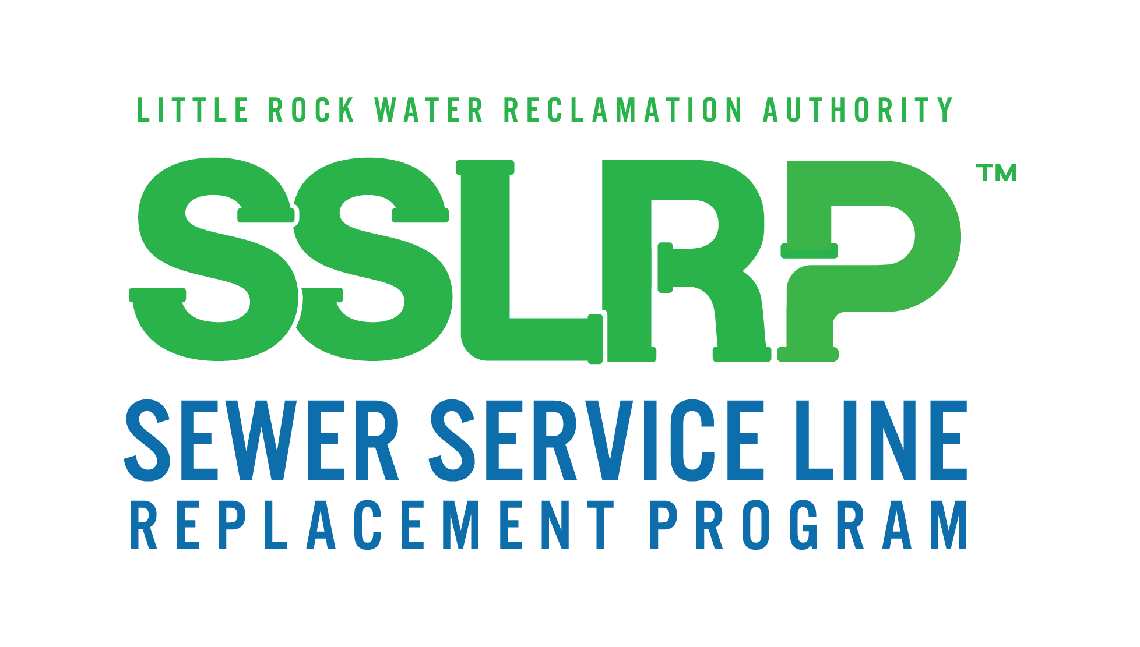
Program Created in 2013
Funded by
$1 added to monthly bill to domestic customers
ANRD SRF Loans
Purpose
To encourage the total replacement of older sewer service lines which contribute to the infiltration of storm water into the LRWRA collection system
Provides $2,500 reimbursement to domestic customers for total replacement of eligible service lines to domestic customers

Slide 6

Win for Customers, Win for LRWRA
Benefits to Customer
Reliable service
Makes replacing service line more affordable
Benefits to LRWRA
Reduction in infiltration and inflow
Supports community investment
Reduced maintenance calls

Slide 7
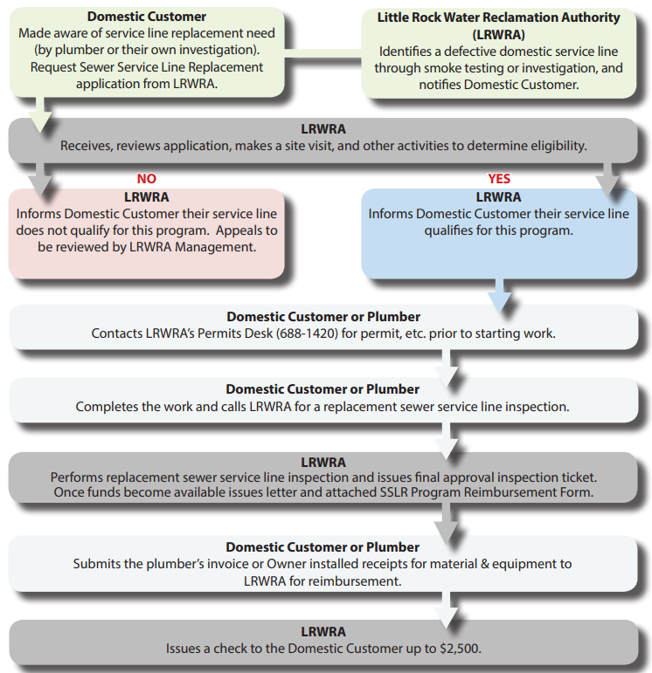
Flow Chart of Procedures

Slide 8
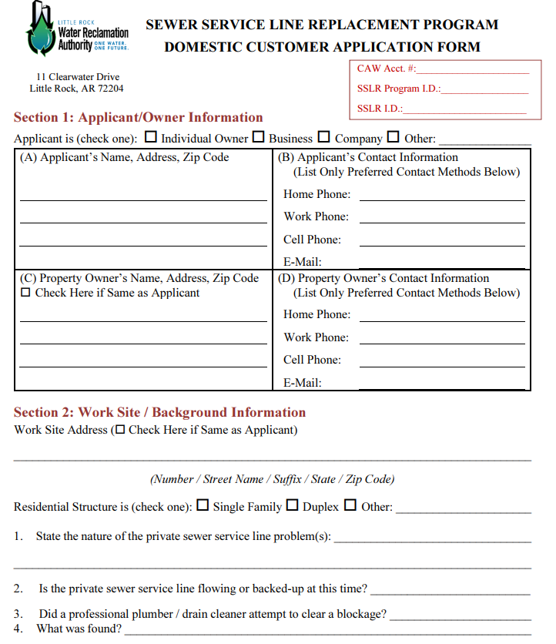
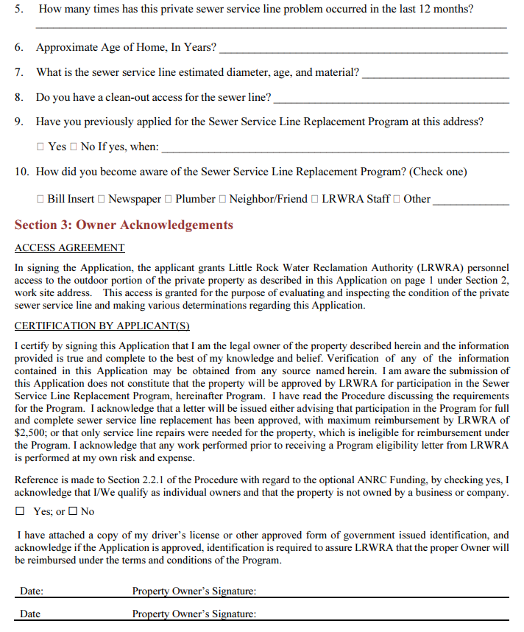

Slide 9
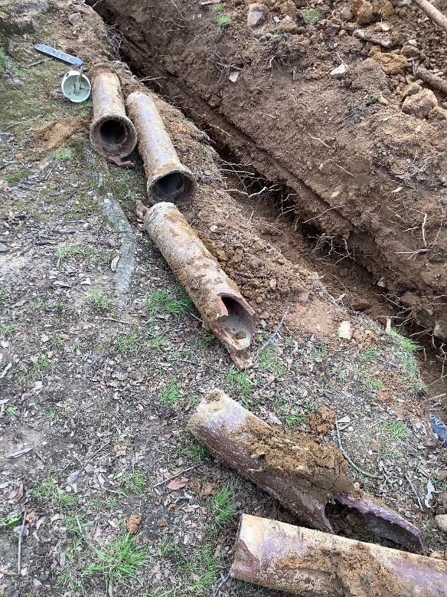
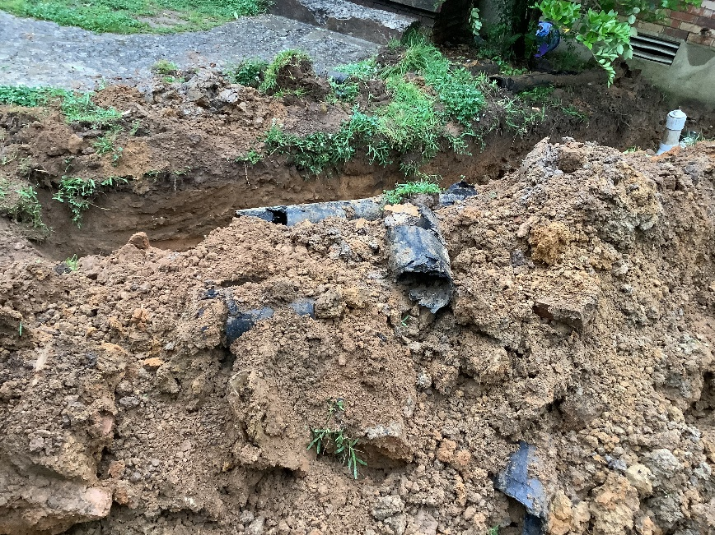
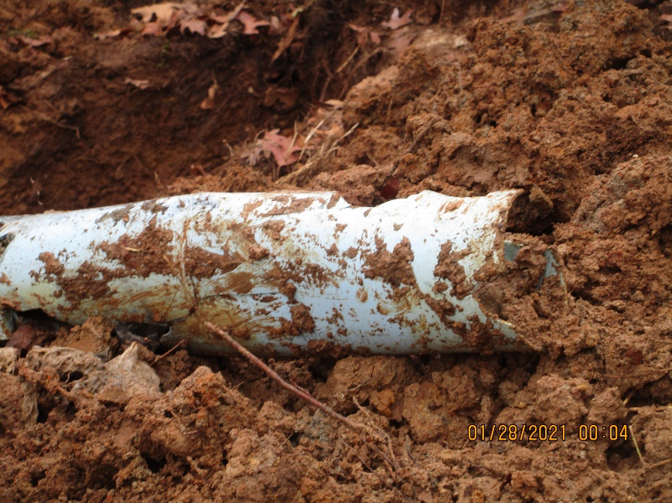

Examples of Eligible Existing Pipe
These types of materials tend to crack, break and leak
Increase infiltration
Clay
Orangeburg
Non-Compliant PVC

Slide 10
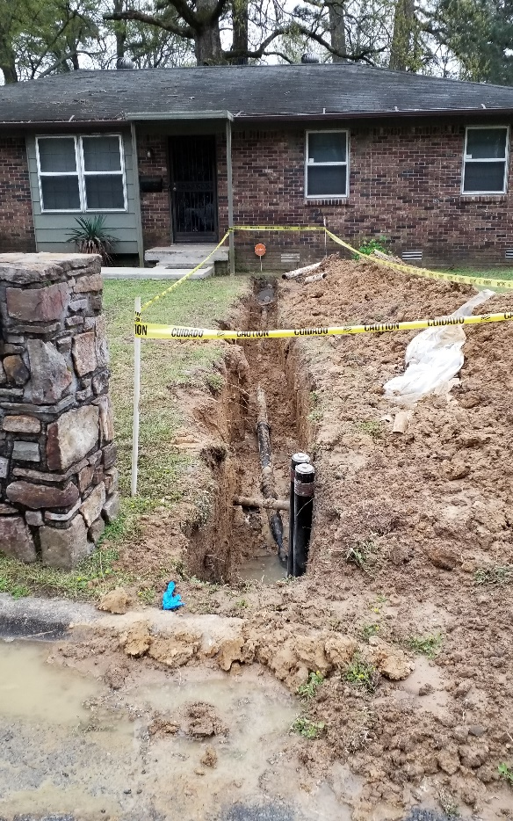
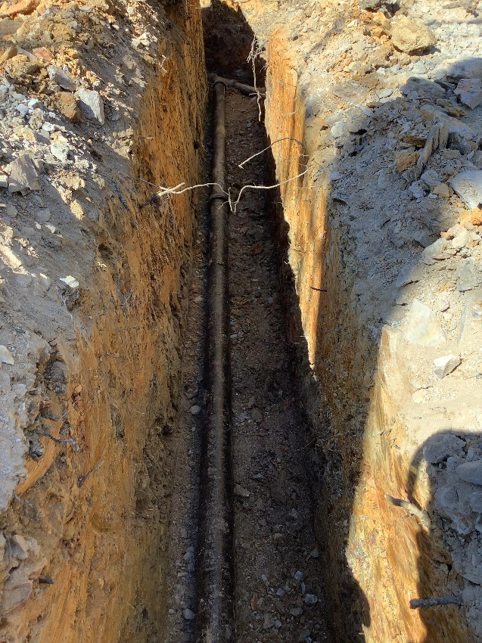
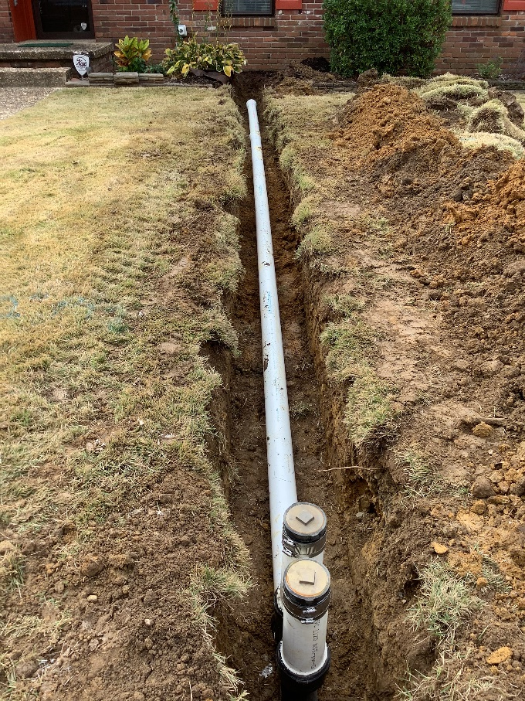
Examples of Replacement Pipe
Ductile Iron
Cast Iron
SDR 21 PVC

Slide 11
Initial Challenges of SSLRP
Initially program was a huge success which created funding issues
The $1 fee did not keep up with demand
  $1 fee generates $770,000 per year
  1st year demand was 1.1 million
Backlog and lag time of reimbursements
  Initially 6-week lag time
  Many homeowners pay the plumbing companies with the LRWRA reimbursement
Solution to Initial Challenges
Obtained SRF loan starting in 2016 - allowed lag time to decrease to 1 to 2 weeks

Slide 12
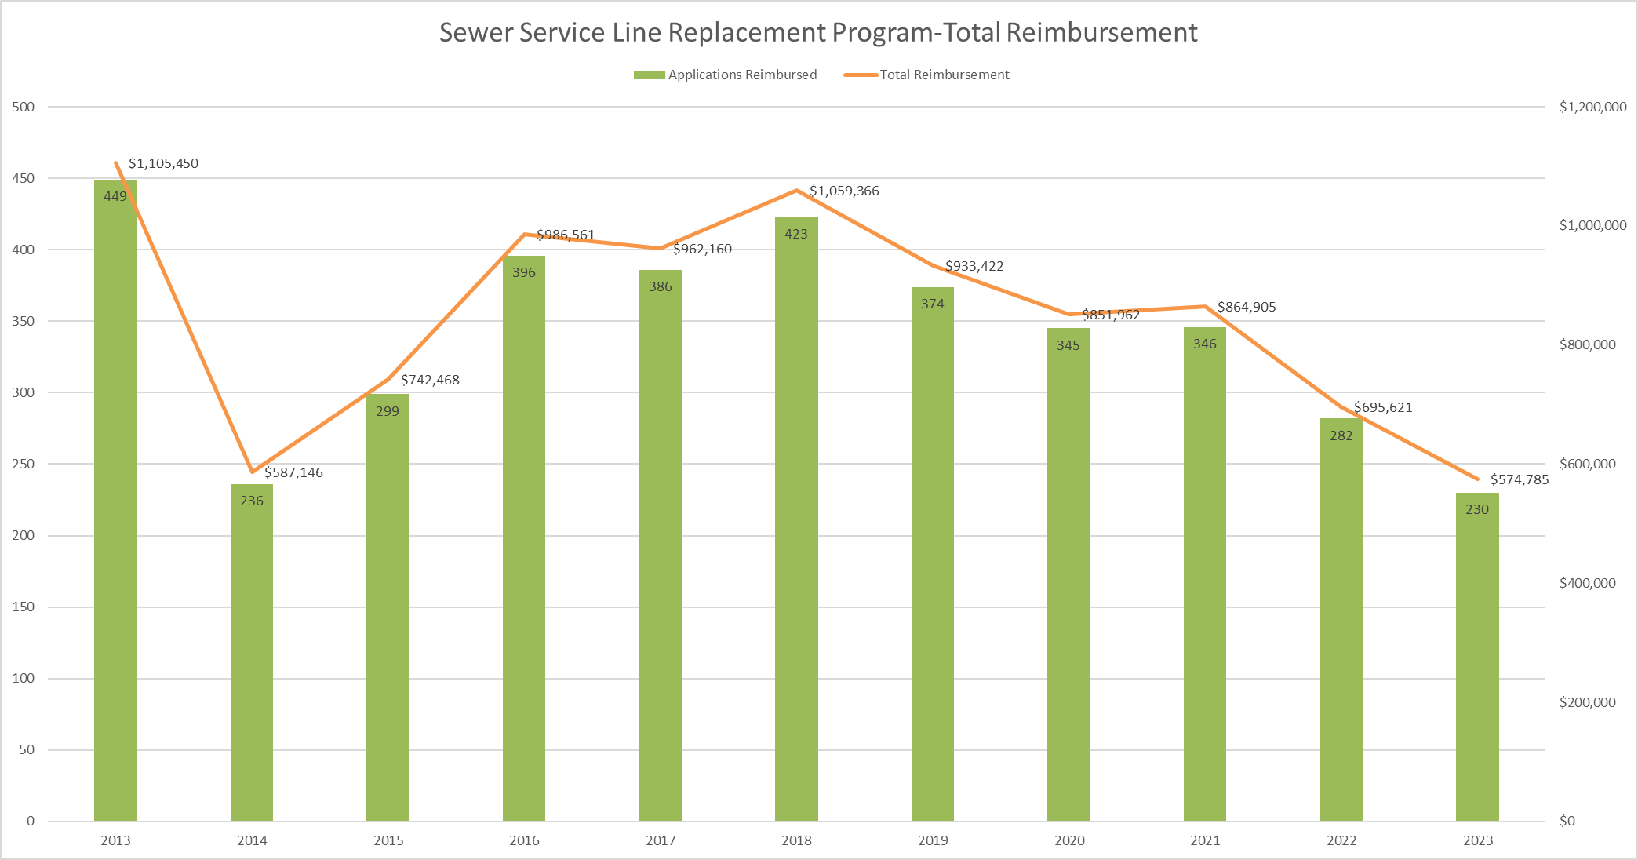

Slide 13
SRF Funding Requirements
Property must be owned by an individual
  Companies or businesses are not eligible
The replacement sewer service pipe must be placed in existing trench of old pipe or in close proximity to the old pipe.
If new pipe is cast iron or ductile iron, then it must comply with AIS requirements

Slide 14
Current Challenges of Program
Handwritten Reimbursement Form
  Deciphering bad hand-writing
  Incomplete submissions
Communicating with homeowner on the phone
  Language and accent issues
Eligibility inspections
  Plumbing companies charge extra
Requirement for total replacement
  Street cut fees
Reimbursement has not increased over time
  Average cost of replacement increased significantly over the last three years
  2023 average replacement cost is $5,295

Slide 15
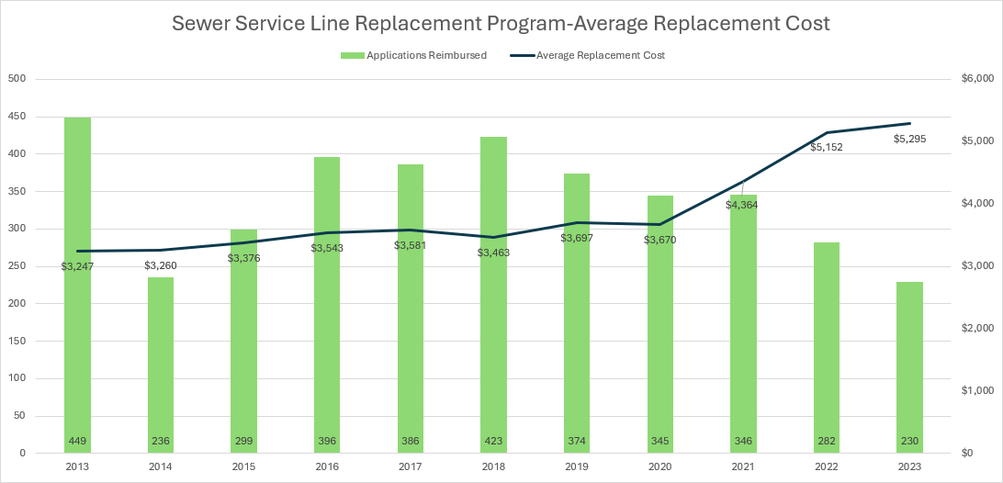

Slide 16
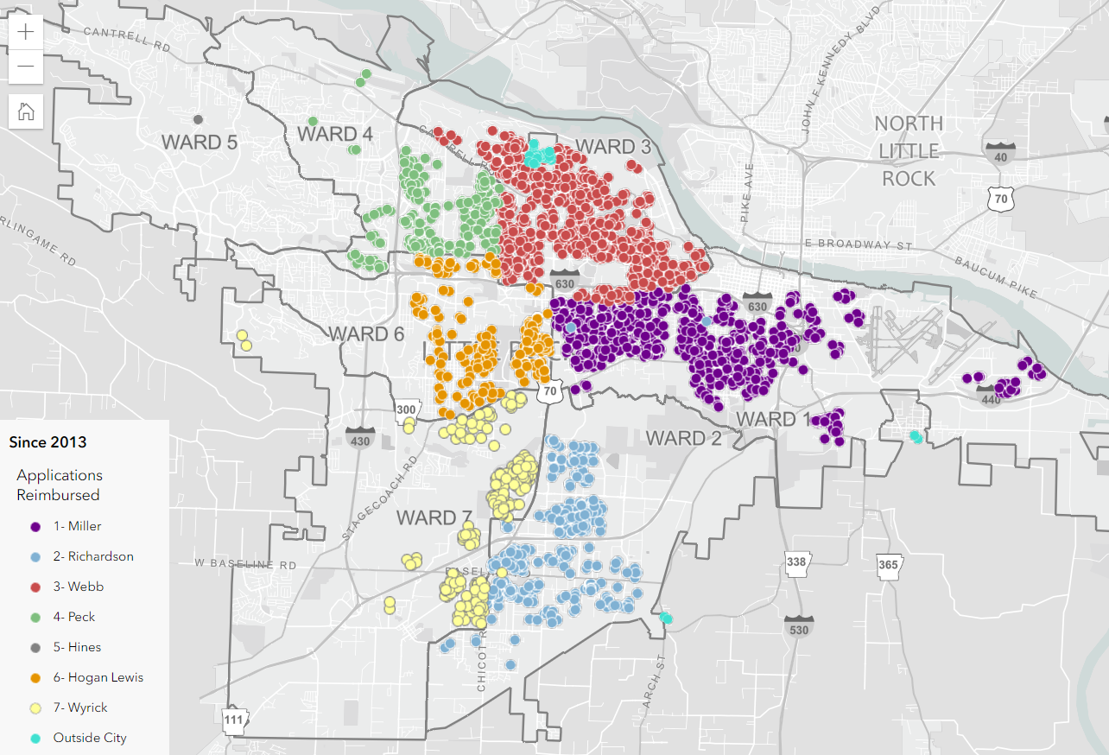
Locations of Reimbursements

Slide 17

2023 Achievements
$574,785 of reimbursements to 230 customers
2.2 MG of infiltration eliminated
Achievements Since Inception
Provided $9.4 million of reimbursements to 3,766 customers
Eliminated an estimated 224.5 MG of infiltration
Award winning program
  Pisces Award for Innovation in the SRF

Slide 18
Questions?

