Slide 1
The Inextricable Link Between Climate Resilience and Financial Resilience

Slide 2
Agenda
Workgroup Introduction and Purpose
Workgroup Reports
CRWU Overview
Perspectives on Climate Change and Financial Strength
Cross-Sector Panel Discussion
Q&A Session
Further Reading

Slide 3
Climate Finance Workgroup Introduction and Purpose
Formed in 2022 to investigate the impacts of climate change on water utility bond ratings, credit worthiness, and access to insurance
Consists of experts from credit rating agencies, investment analysts, insurance companies, academic organizations, and water sector utilities
Primary goal is to share information to foster a cross-disciplinary understanding of:
  The effects of climate risks on financial strength and credit worthiness
  How financial, insurance, and investment industries utilize this information when assessing water sector utility credit worthiness, insurability and investment ratings

Slide 4
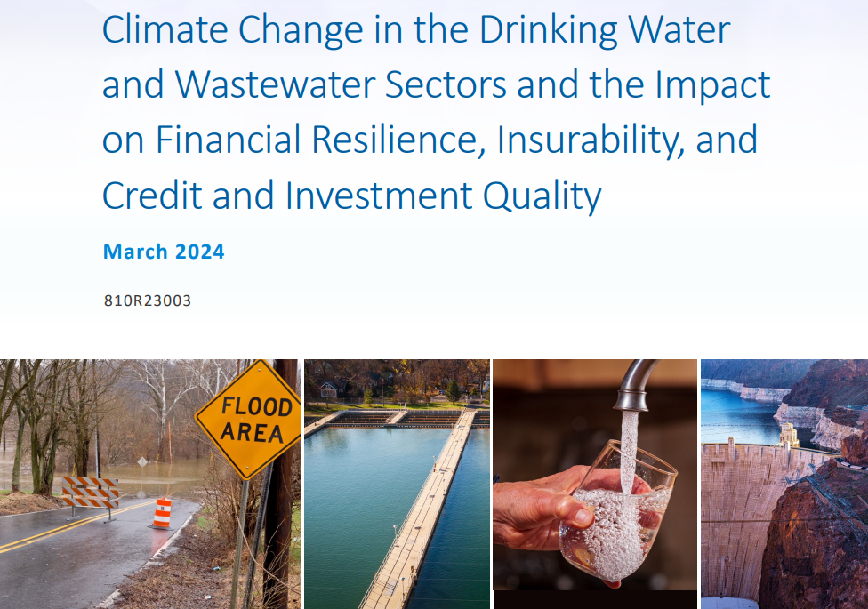
Workgroup Reports
In March 2024, the workgroup issued a report titled “Climate Change in the Drinking Water and Wastewater Sectors and the Impact on Financial Resilience, Insurability, and Credit and Investment Quality”. (Available online at https://www.epa.gov/crwu/climate-finance-working-group)
A second workgroup report will be published soon
  Further explores the topics identified in the workgroup’s first report
  Describes effective elements of climate-related disclosures and cross-sector communication

Slide 5
Creating Resilient Water Utilities’ (CRWU) Overview
The CRWU Initiative provides drinking water, wastewater, and stormwater utilities with practical tools, training, and technical assistance to increase system resilience to climate change impacts
CRWU helps promote a clear understanding of climate data and helps water sector utilities identify relevant climate risks, potential adaptation strategies, implementation options, and infrastructure financing
Examples of support offered by CRWU:
  Technical assistance exercises using the Resilient Strategies Guide (RSG) and Climate Resilience Evaluation and Awareness Tool (CREAT)
  Climate and weather data maps showing climate projection data, streamflow, snowpack, and more
  Workshops, trainings, and informational webinars

Slide 6
Perspectives on Climate Change and Financial Strength
Helen Cregger, Senior Credit Officer, Moody’s Ratings
Nikolai Sklaroff, Capital Finance Director, San Francisco Public Utilities Commission
Paul Fuller, CPCU, CEO, Allied Public Risk LLC

Slide 7
CIFA SRF Workshop
The Link Between Climate and Financial Resilience
November 2024

Slide 8
Moody’s approach to ESG

Slide 9

ESG classification incorporates credit relevant considerations
Environmental
Social
Governance
Private sector
Public sector
Private sector
Public sector
Physical climate risks
Customer relations
Access to
basic services
Financial strategy & risk management
Institutional structure
Carbon transition
Demographic and societal trends
Demographics
Management credibility & track record
Policy credibility and effectiveness
Water management
Human capital
Education
Organizational structure
Budget
management
Waste and pollution
Health and safety
Health and safety
Board structure, policies & procedures
Transparency and disclosure
Natural capital
Responsible
production
Housing
Compliance & reporting
Labor and income
Source: Moody’s Ratings

Slide 10
Environmental risk classification
Carbon transition
Physical climate risks
Water management
Current positioning for
carbon transition
Technology, market and policy risk
Actions to mitigate risk
Long-term resilience to risk of
accelerated carbon transition
Current and future effects
of climate change
Exposure to heat stress, water stress, floods, hurricanes, sea level rise and wildfires
Non-climate-related risks
Impact of economic activity
Availability, access and consumption
Innovations to enhance water use efficiency
Risk of pollution-related regulatory violations
Waste and pollution
Natural capital
Non-GHG air pollutants
Land-based accidents, spills
and leaks
Hazardous and non-hazardous waste
Circular economy
Impact on natural systems
(soil, biodiversity, forest, land,
oceans, etc.)
Dependency on goods and services derived from nature (agriculture, fiber, fish, etc.)

Slide 11
Social risk classification for private-sector issuers
Customer relations
Human capital
Demographic and societal trends
Data security and
customer privacy
Fair disclosure and labeling
Responsible distribution and marketing
Labor relations
Human resources
Diversity and inclusion
Demographic change
Access and affordability
Social responsibility
Consumer activism
Responsible production
Health and safety
Accident and safety
management
Employee health and well-being
Product quality
Supply chain management
Community stakeholder engagement
Bribery and corruption
Waste management

Slide 12
Governance risk classification for private-sector issuers
Financial strategy and risk management
Management credibility and track record
Organizational structure
Leverage policy
Capital modeling and stress
testing
M&A strategy
Dividend and capital allocation policies
Risk management polices and controls
Internal controls
Earnings and guidance accuracy
Regulatory relationships
Succession planning and key person risk
Management quality and experience
Project or subsidiary sponsor support
Loss reserve development
Servicer or manager quality
Organizational complexity
Legal and ownership structure
Insider and related-party transactions
Capital structure and organizational
funding linkage
Compliance and reporting
Board structure, policies and procedures
Regulatory violations
Civil and criminal investigations
Securities lawsuits and investigations
Bribery and corruption
Accounting policies and disclosures
Consistency and quality of financial reporting
Ownership and control
Management compensation
design and disclosure
Board of director oversight and effectiveness
Financial oversight and capital allocation

Slide 13


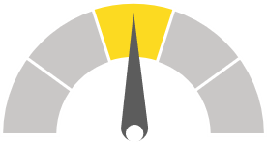


E, S and G issuer profile scoring scale
Assessed on a five-point scale
Score
Definition
E-1
S-1
G-1
 | Issuers or transactions with an issuer profile score of 1 typically have exposures to E or S issues that carry material credit benefits. For G, issuers or transactions typically have exposure to G considerations that, in the context of their sector, positions them strongly, with material credit benefits.
 | Issuers or transactions with an issuer profile score of 2 typically have exposures to E or S issues that are not material in differentiating credit quality. In other words, they could be overall slightly credit-positive, credit neutral, or slightly credit-negative. An issuer or transaction may have a IPS score of 2 because the exposure is not material or because there are mitigants specifically related to any E or S risks that are sufficient to offset those risks. Issuers or transactions with an issuer profile score of 2 typically have exposure to G considerations that, in the context of their sector, positions them as average, and the exposure is overall neither credit-positive nor negative.
 | Issuers or transactions with an issuer profile score of 3 typically have moderate credit exposures to E or S risks. These issuers may demonstrate some mitigants specifically related to the identified E or S risks, but they are not sufficiently material to fully offset the risks. Issuers or transactions with an issuer profile score of 3 typically have moderate credit exposure to G risks that, in the context of the sector, positions them below average.
 | Issuers or transactions with an issuer profile score of 4 typically have high credit exposures to E or S risks. These issuers may demonstrate some mitigants specifically tied to the E or S risks identified, but they generally have limited effect on the risks. Issuers or transactions with an issuer profile score of 4 typically have high credit exposure to G risks that, in the context of their sector, positions them more weakly than issuers with an issuer profile score of 3.
 | Issuers or transactions with an issuer profile score of 5 typically have very high credit exposures to E or S risks. While these issuers or transactions may demonstrate some mitigants specifically related to the identified E or S risks, they are not meaningful relative to the magnitude of the risks. Issuers or transactions with an issuer profile score of 5 typically have very high credit exposure to G risks that in the context of their sector, positions them more weakly than issuers with an issuer profile score of 4.
E-2
S-2
G-2
E-3
S-3
G-3
E-4
S-4
G-4
E-5
S-5
G-5
Source: Moody’s Ratings

Slide 14
ESG credit impact score (CIS) scale
Score
Definition
ESG Considerations have a positive impact on the current rating which is higher than it would have been in the absence of ESG considerations.
CIS - 1
ESG considerations do not have a material impact on the current rating.
CIS - 2
ESG considerations have a limited impact on the current rating, with potential for greater negative impact over time.
CIS - 3
ESG considerations have a discernible impact on the current rating, which is lower than it would have been if ESG risks did not exist. The negative impact of ESG considerations on the rating is higher than for an issuer scored CIS-3.
CIS - 4
ESG considerations have a pronounced impact on the current rating, which is lower than it would have been if ESG risks did not exist. The negative impact of ESG considerations on the rating is higher than for an issuer scored CIS-4.
CIS - 5

Slide 15
Moody’s Ratings ESG scores explained
Our scores are NOT an opinion about sustainability performance or ESG disclosures
  Credit Impact Score (CIS)
  Issuer Profile Scores (IPS)
  Reflects the impact of ESG on the credit rating
  NOT a combination of E, S and G-IPS
  IPS is our assessment of the issuer’s exposure to Environmental (E), Social (S) or Governance (G) risks / benefits material to credit risk including relevant mitigants
  Example of Score
  Example of Score
  ENVIRONMENTAL
  SOCIAL
  GOVERNANCE
CIS-4
E-4
S-2
G-1
  Indicates the extent to which the credit rating would have been different in the absence of ESG issues
  Places ESG in the context of other rating considerations
  CIS-1 assigned only if the credit rating is better because of ESG factors
  Scores are global and comparable across sectors
  Incorporate management’s action/mitigants
  E-1, S-1 or G-1 assigned only when considerations have material credit benefits
5
4
3
2
1
Scoring scale:

Slide 16
Scoring Outcomes
ESG Scoring for Water and Sewer Utilities
Credit Impact Score (CIS)
Environmental Issuer Profile Score
Social Issuer Profile Score
Governance Issuer Profile Score
132
160
130
108
82
65
53
25
26
29
16
3
6
7
2
0
1
0
3
4
CIS-5 CIS-4 CIS-3 CIS-2 CIS-1
E- 5
E- 4
E- 3
E- 2
E- 1
S-5
S-4
S-3
S-2
S-1
G- 5
G- 4
G- 3
G- 2
G- 1
Source: Moody’s Ratings

Slide 17
Scoring Outcomes
Environmental Issuer Profile Scores
Physical Climate Risks
Carbon Transition
Water Management
Natural Capital
Waste and
EIPS
Pollution
160
110
207
155
182
209
85
25
26
18
47
26
2 0
E- 5 E- 4 E- 3 E- 2 E- 1
Source: Moody’s Ratings
0
0
0
0
6
0
2
9
0
2
3
0
0 0
4
0
5 4 3 2 1
5
4
3
2
1
5
4
3
2
1
5 4 3 2 1
5 4 3 2 1

Slide 18
Scoring Outcomes
Social Issuer Profile Scores
SIPS
Customer Relations
Demographic and Societal Trends
Human Capital
Health and Safety
Responsible Production
154
130
200
123
212
207
53
42
57
29
29
18
1 0
S- 5 S- 4 S- 3 S- 2 S- 1
Source: Moody’s Ratings
0
2
11
0
1
0
0
1
0
0
0
6
0
0
2
0
5
4
3
2
1
5
4
3
2
1
5
4
3
2
1
5
4
3
2
1
5
4
3
2
1

Slide 19
Scoring Outcomes
Governance Issuer Profile Scores
Financial Strategy and Risk Management
Board Structure, Policies and Procedures
130
Management Credibility and Track Record
Compliance and Reporting
175
GIPS
Organizational Structure
108
96
100
111
90
192
82
83
3 4
16
3
6
8
2
10
20
0
0
0
2
30
6
0
1
0
0
0
G-5 G-4 G-3 G-2 G-1
5
4
3
2
1
5
4
3
2
1
5
4
3
2
1
5
4
3
2
1
5
4
3
2
1
Source: Moody’s Ratings

Slide 20





Ratings and ESG Scores
Moody's Long-Term Rating Scale
Investment Grade
Non-Investment Grade
0
Aaa
Aa1
Aa2
Aa3
A1
A2
A3
Baa1 Baa2 Baa3 Ba1
Ba2
Ba3
B1
B2
B3
Caa1
Caa2
Caa3
Ca
C
1
2
3
4
5
Location and color of each bubble indicate the average CISfor the scored issuers in a given rating category. Relative size of each bubble indicates the number of scored issuers in a given rating category. Source: Moody’s Ratings

Slide 21
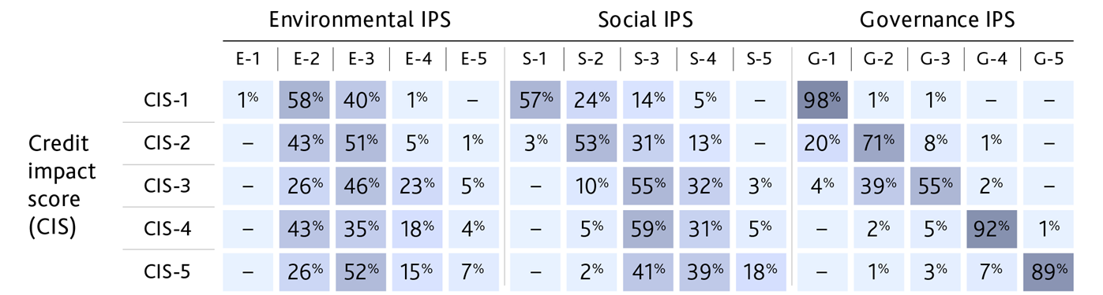
Governance has more influence on credit strength and ratings than E and S
Nearly all of the entities for which the credit impact of ESG considerations is CIS-1 have relative governance strengths (G-1). A much smaller percentage have positive exposure to social considerations (57%) and environmental considerations (1%).
More than 90% of entities for which the credit impact is CIS-4 or CIS-5 have relative governance weaknesses, as indicated by their governance issuer profile scores (G-4) or (G-5)
Distribution of E, S and G IPS by CIS
Note: These tallies, combined with those for governance below, exceed 100% because many entities have multiple exposures across environmental, social and governance categories.
Source: ESG – Global: Measuring the credit impact of environmental, social and governance risks, Moody’s Ratings, 26 April 2023.

Slide 22
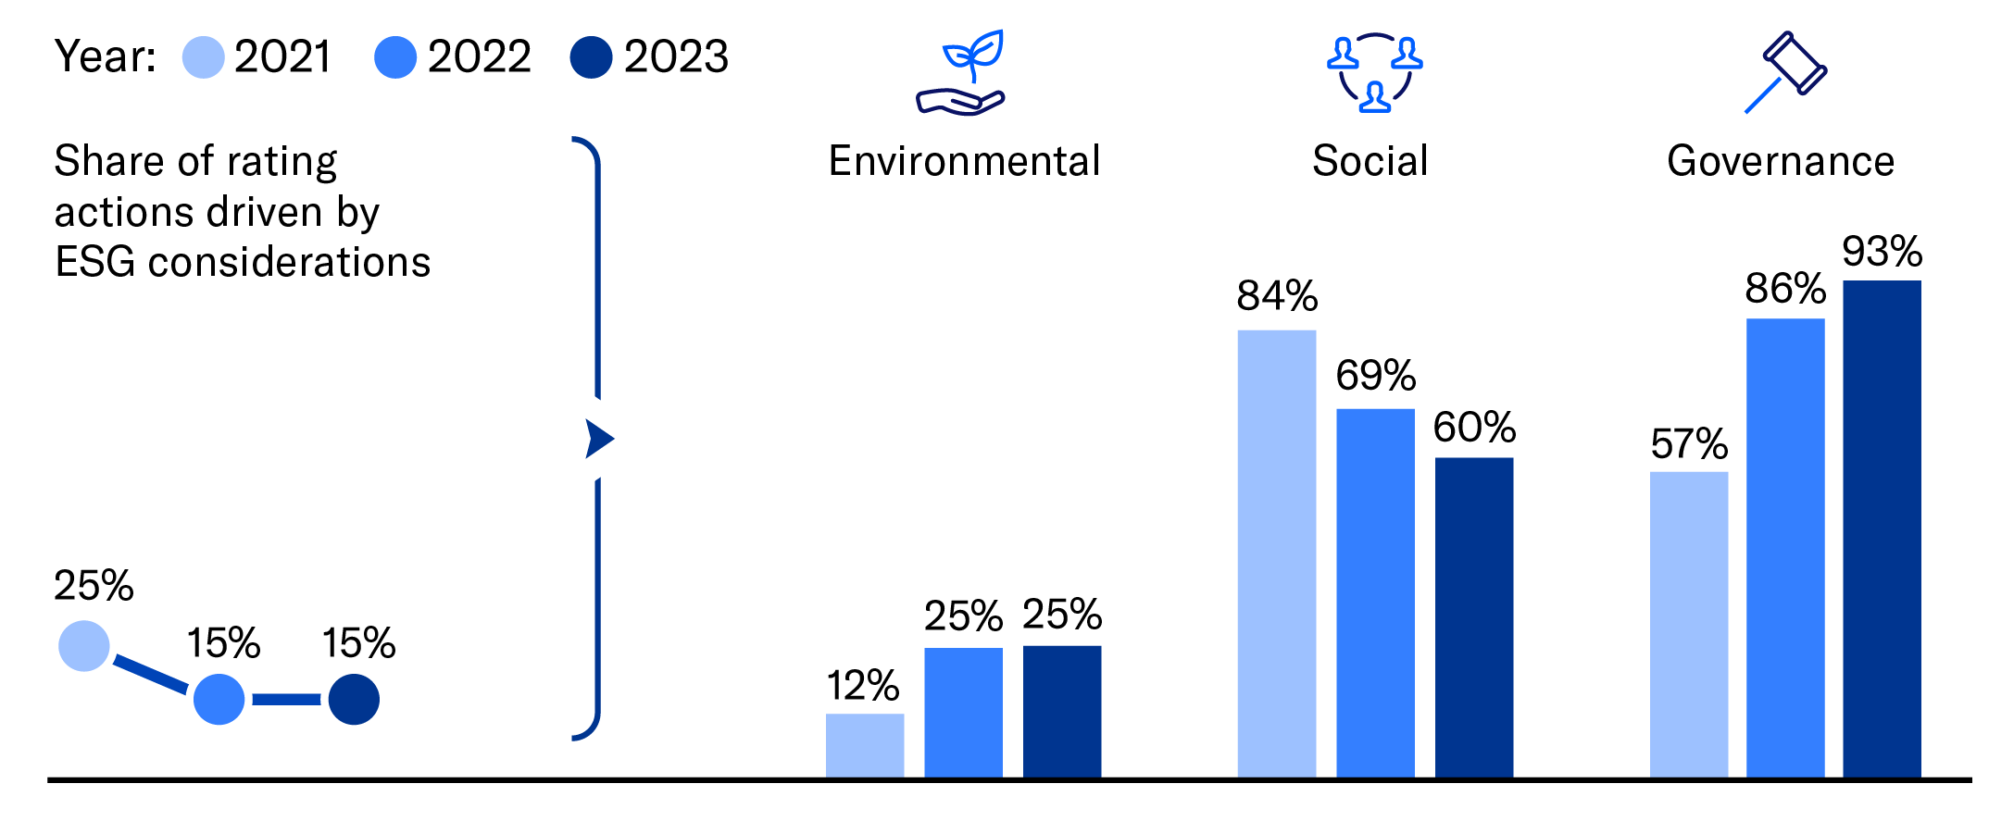
ESG factors were key drivers of 15% of rating action announcements in 2023, steady from 2022
Of the 1,396 rating actions published in 2023 citing ESG factors as a key driver, 93% cited governance, 60% social and 25% environmental risks.
References to governance factors increased as issuers contended with macroeconomic risks that challenged financial policies and risk management strategies.
The share of rating actions driven by ESG factors was higher in 2021 than in 2022 and 2023 due to the outsized credit impact of COVID-19 through the social risk channel.
Share of rating action announcements driven by ESG considerations and references to environmental, social and governance risks in 2023
Note: Some rating action announcements cited more than one ESG consideration.
Source: ESG – Global: Share of rating actions citing ESG factors greatest for governments, companies, Moody’s Ratings, 18 July 2024.

Slide 23
Appendix

Slide 24
Environmental considerations – Private issuers
Risk
categories
General Considerations
Business reliance (incl. through supply chain) on carbon-intensive/GHG-intensive products, assets or operations
Trends in demand for carbon-intensive products; availability and pricing of lower-carbon substitutes
Loss of production; compliance, tax or investment costs related to policy and regulatory initiatives
Risk of stranded assets
Increased demand and policy support for alternative, low-carbon intensive products (e.g. renewables)
Adoption of scalable technologies for carbon efficiency / alternative sources of energy or raw material
Carbon transition
Physical climate risks
Presence of core physical assets, including development/construction, in areas subject to weather-and climate-related hazards
Impact of climate events and long-term trends on product/service demand
Impact of climate events and long-term trends on productivity and operating costs
Investment is undertaken or required to harden assets or to build replacement assets elsewhere, technological deployment
Presence of specific financial protections (e.g., specific reserves, insurance, cost-recovery mechanisms, etc.)
Water management
Reliance on water usage for operations; consumption patterns
Availability and cost of water; risk of water stress in geographies where enterprise consumes water
Incidence of material water usage/access restrictions that affect operations
Water-related litigation and regulatory notices and mandates
Measures undertaken for water use efficiency, wastewater management, re-cyclability
Types and production levels of non-GHG air pollutants and land-based waste
Incidence and remediation costs related to non-GHG and land-based pollution issues, incl. leaks, spills, accidents, and clean-up sites
Waste and pollution-related litigation and regulatory notices and mandates
Measures undertaken for efficient waste control and treatment, recycling and re-usability
Market demand for waste and pollution treatment solutions, recycled/re-useable products, low-waste / low-polluting products or services
Positioning of products, operating and business models to align with customer preferences for "circular economy"
Waste
and pollution
Reliance on and sustainability of natural resources to provide goods and services
Community restrictions related to the use or development of land and natural resources that affect the enterprise
Incidence of litigation and regulatory notices related to damage to natural resources, negative publicity, consumer backlash
Operating costs to prevent damage to natural resources; Legal and remediation costs related to damage to natural resources/implementation in protected areas, including follow-on effects from pollution
Reputation for stewardship and compliance with regulations and restrictions; deployment and commercialization of technologies for minimizing ecological effects
Natural capital

Slide 25
Social considerations – Private issuers
Risk
categories
General Considerations
Customer Relations
Reliance on brand perception; business mix of branded products
Customer perception of quality, safety, and essentiality of products/services and fairness of business practices (incl. marketing, advertising, labeling and disclosure)
Legal and regulatory actions related to pricing, product safety, labeling or disclosure
Strength of data security and customer privacy practices and systems, including IT
Human Capital
Quality of labor relations, incl. extent of collective bargaining arrangements, effectiveness of wage negotiations, risk of strike, employee participation in board or executive committees
Employment regulatory framework, e.g., flexibility of work rules, wage and benefit mandates
Reliance on a highly specialized workforce
Labor market supply and demand for needed skills and workforce
Hiring practices and effectiveness, incl. competitiveness of benefits, employee and skill retention, training practices
Reputation of enterprise as an employer, e.g., employee engagement, opportunity, diversity and inclusion practices
Demographic & Societal Trends
Changes in demographics (e.g. aging populations, immigration patterns) that could affect demand for enterprise's products and services, including business opportunities or challenges stemming from a reliance on specific demographic groups
Trends in social values, within or across generations, that could affect demand for enterprise's products and services or access to capital
Government social agendas that could affect demand for or supply of enterprise's products and services or its competitive landscape; extent of business in regulated or socially sensitive sectors
Health & Safety
Extent of hazardous activities in the business mix
Track record of workplace accidents and related regulatory actions or litigations
Costs related to employee safety protection, health and well-being, incl. remediation costs
Compliance with health standards; presence of a safety-conscious culture supported by employee training and rigorous policies; proactive deployment of protective technologies
Responsible Production
Extent and severity of product failures recalls or contaminations; potential for these events
Supply chain management -diversity, reputation, legality and social acceptability of dealings with suppliers, susceptibility to regulatory or geopolitical change
Track record of supply chain failures, adverse reputational events, legal and regulatory actions related to production processes and supply chain, resilience
Community stakeholder engagement and reputation

Slide 26
Governance considerations – Private issuers
Risk
categories
General Considerations
Financial Strategy & Risk Management
Management and board tolerance for financial risk
Management and board commitment to the credit profile
Risk management, including operational, treasury management, liquidity, and commodity risks
Dividend and capital allocation policies and adherence
Management and board attitude towards M&A or other types of balance-sheet-transforming events
Predictability and stability of financial policy through the economic cycles
Reliability of financial guidance
Management quality and experience, turnover, succession planning and key person risk
Predictability of support for projects/subsidiaries
Quality of relationships with regulators or policymakers
Track record of strategy execution and M&A integration
Commitment to a strong credit profile
Management Credibility & Track Record
Organizational Structure
Complex or opaque organizational structures or shareholding/ownership agreements that obscure financial results (for taxes or reporting) or blur control and accountability. Frequent changes to the organizational structure. Presence and purpose of complex financial engineering, e.g., multiple layers of holding companies; complex joint-ventures, special purpose vehicles or partnerships; cross-shareholding; opaque inter-company arrangements, incl. contingent liabilities
Related party transactions, e.g. with board members, owners or entities they control
Organizational structures that may limit financial flexibility, e.g., MLPs or REITs
Compliance & Reporting
Timeliness and accuracy of disclosures; incidence of restatements
Track record of any qualified audit opinions or auditor comments on the quality of internal control; frequent changes in auditor
Independence of the audit committee
Track record of regulatory or legal actions; investigations into financial reporting or compliance with other applicable laws; any associated penalties
Ownership structure and control (e.g., shareholding/ownership structures that concentrate control in a minority owner; controlling shareholder or family; presence of hedge funds, activist investors, private equity, government-owned or affiliates)
Design, disclosure and oversight of management compensation
Frequency of executive turnover
Board independence, committee structure, and effectiveness of oversight and capital allocation (incl. history of political interference)
Board diversity
Board Structure, Policies & Procedures

Slide 27
Reference ESG reports
  General principles for assessing Environmental, Social and Governance risks methodology
  (E) Environmental
    Environmental classification
    Environmental risk heatmap
  (S) Social
    Social risk classification (Private sector)
    Social risk classification (Public sector)
    Social risk heatmap
  (G) Governance
    Governance risk classification (Private and Public sector)

Slide 28
Helen Cregger
Vice President, Senior Credit Officer
  Helen.Cregger@moodys.com
  (415) 274-1720

Slide 30


Climate and Financial Resiliency
Nikolai J. Sklaroff, Capital Finance Director,
San Francisco Public Utilities Commission

Slide 31

San Francisco Public Utilities Commission
Notes:
Introducing the SFPUC- that despite being the San Francisco PUC that we operate across CA

Slide 32
San Francisco Public Utilities Commission

Slide 33
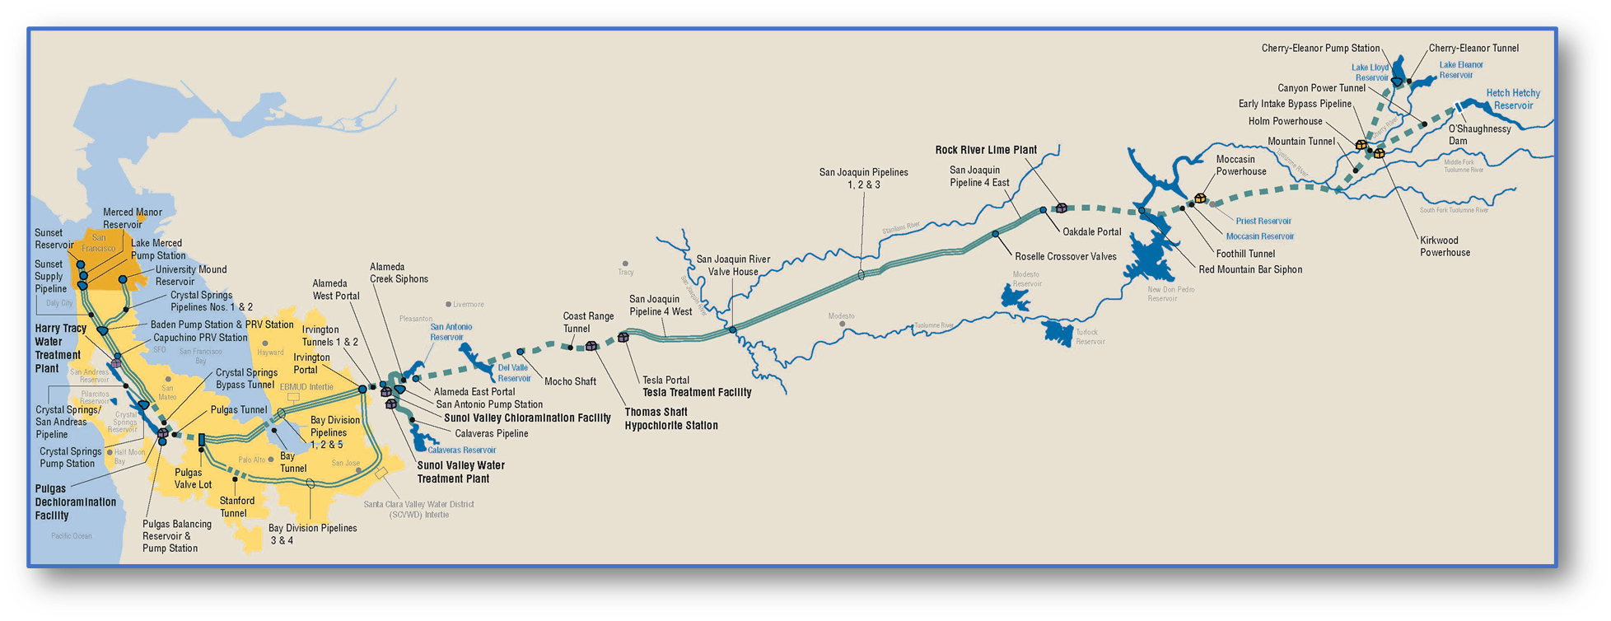
SFPUC Regional Water System
Notes:
The Regional Water System provides drinking water for 2.7 million customers which includes retail customers in the City of San Francisco and wholesale customers on the peninsula.

Slide 34
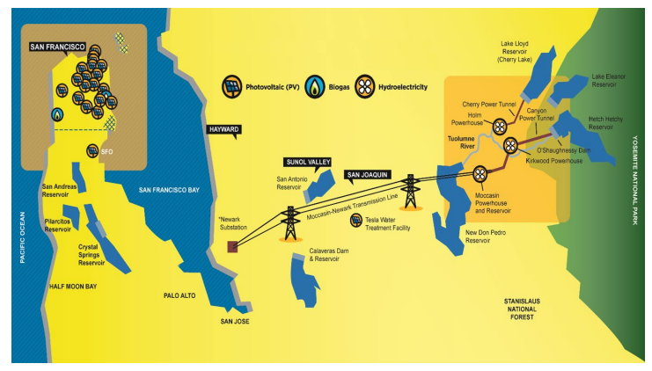
SFPUC Power Facilities
Notes:
As well as the Power Enterprise which generates hydroelectricity from the regional water system, which along with CleanPowerSF, generates almost 80% of San Francisco’s energy demands and powers San Francisco’s municipal infrastructure.

Slide 35
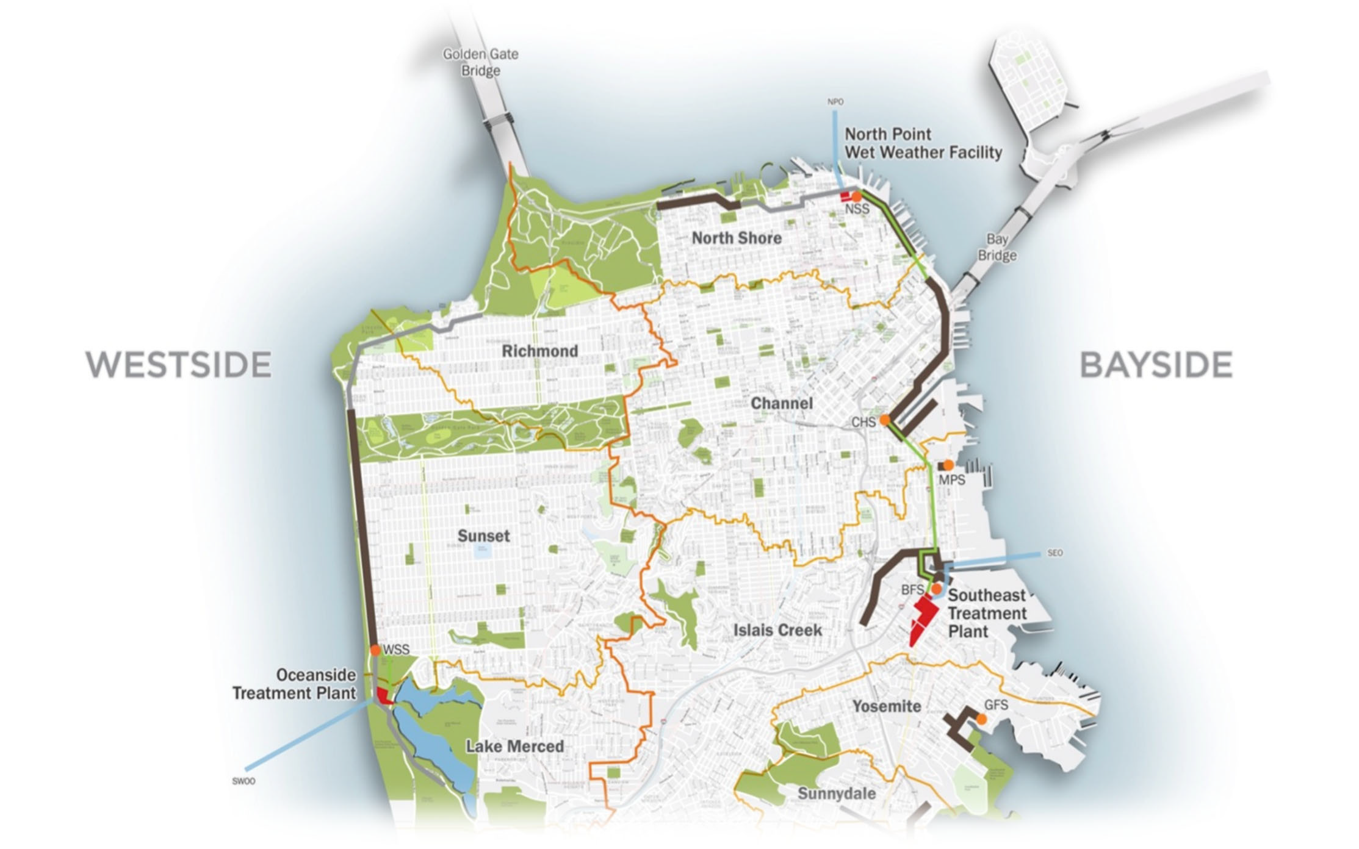
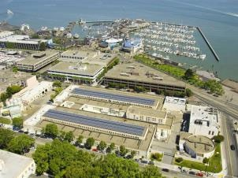
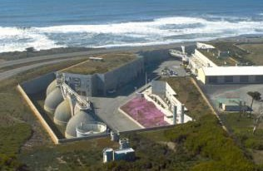


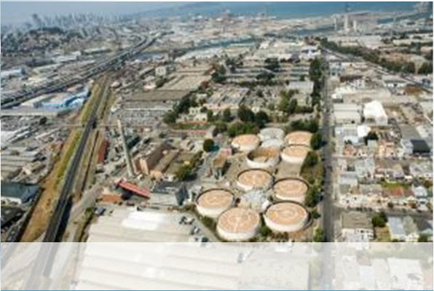
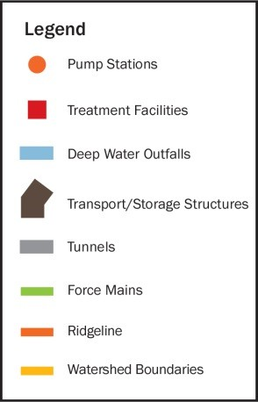
Wastewater Enterprise Overview
49 Square Miles in SF 3 Treatment Facilities 1,000+ Miles of Pipes
40 Billion Gallons Treated/Year
~942,000 Daytime Population
~804,000 Nighttime Population
North Point Wet Weather Facility
Dry Weather Cap.: n/a
Wet Weather Cap.: 150mgd
Oceanside Treatment Plant
Dry Weather Cap.: 43mgd Wet Weather Cap.: 65mgd
Southeast Treatment Plant
Dry Weather Capacity: 128mgd Peak Wet Weather Capacity: 575mgd¹
Dry Weather Cap : 85mgd Wet Weather Cap.: 250mgd
¹ Includes 110mgd of equivalent‐to‐primary treatment provided by the transport/storage structures located around the perimeter of San Francisco.
6
Notes:
Last- the Wastewater enterprise is one of the only combined sewer systems on the west coast, which treats both storm and wastewater, delivering clean water back to the Bay and the Ocean.

Slide 36
SFPUC and Capital Finance’s Mission
"Our mission is to provide our customers with high quality, efficient and reliable water, power and sewer services in a manner that is inclusive of the environmental and community interests, and sustains the resources entrusted to our care"
Within the SFPUC’s, the Capital Finance team is guided by its policy
“The SFPUC’s debt management mission is to serve, within the financial objectives and parameters established by the Commission, the capital financing needs of the respective enterprises in a cost-effective, risk- appropriate and flexible manner, through the implementation of sound financial decision-making and the use of prudent debt management practices.”
Notes:
Across all three enterprises- one mission guides our work and is centered around providing these essential services in balance with environmental and community interests which, so balancing the demands of being strong environmental stewards with maintaining affordability is really core to our mission.

Slide 37
The Intersection of Climate and Finance
Investors
Credit Banks
Disclosure Practices
Credit Ratings
Green Bonds
Rating Agencies
Governing Body
General Public
Governing Body
Bond Insurers
Federal and State Lenders
Notes:
For today’s presentation- I’d like to focus on three areas that climate and finance impact our work: our disclosure practices, our credit ratings, and our green bond program.

Slide 38
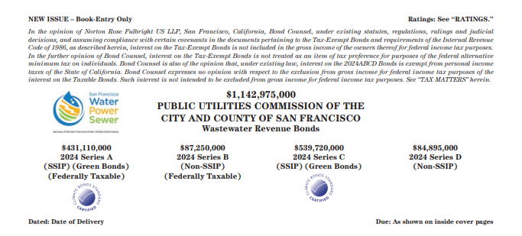
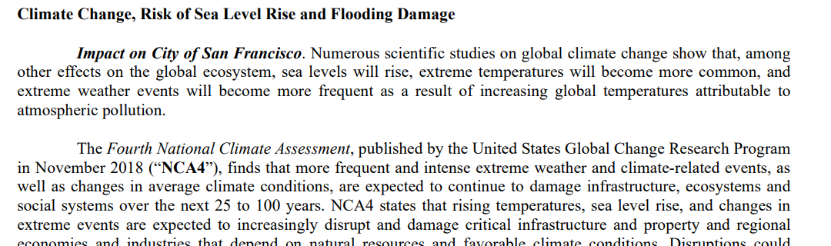
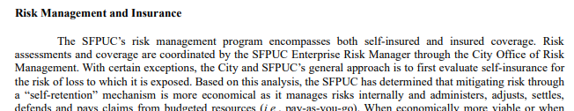
Climate Change Disclosure in Official Statements
SEC Rule 10b-5
Prohibits misstatements of material fact or misleading omissions of material fact in offer, purchase, or sale of securities
SEC Rule 15c2-12
Regulates municipal securities brokers and dealers and requires municipal issuers to provide continuing disclosure
Notes:
In San Francisco- there’s no question to us about whether Climate Change exists and we recognize the obligation under various regulations to make sure we have adequate processes in place to identify and discuss climate change threats both when we go to market, as shown in our official statements, and in our continuing disclosures.
This requires a cross-disciplinary approach throughout our department and in collaboration with other city departments to ensure that we are all disclosing consistently and appropriately.
A number of resources to support this practice are available in the latest CRWU report.

Slide 39

ESG Disclosure
Overview of ESG issue
  What does it mean?
  Why does it matter?
  Why has it become so darn
  political?
GFOA Best Practices
Regulatory views¹
Congress
Future
1. https://www.sec.gov/news/speech/sanchez-remarks-compliance-conference-120723#_ftnref28

Slide 40

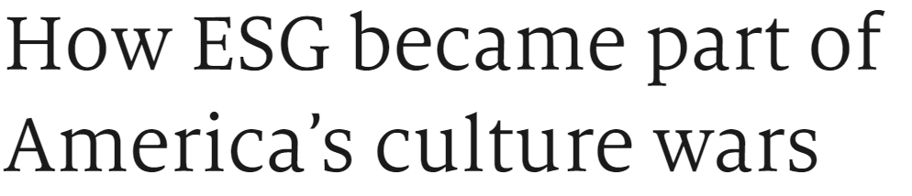




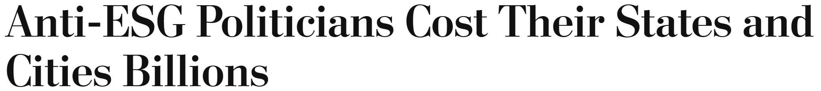

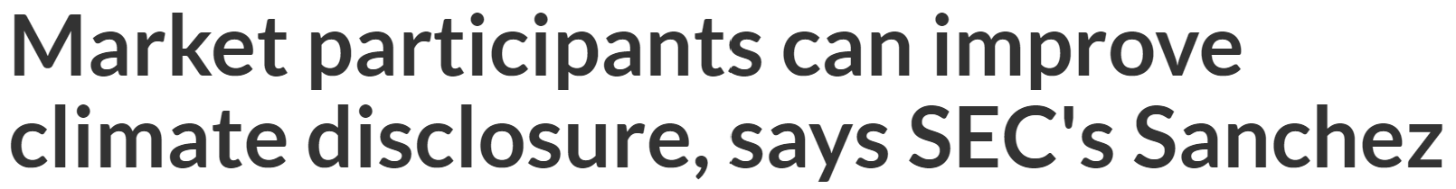
ESG in the news

Slide 41
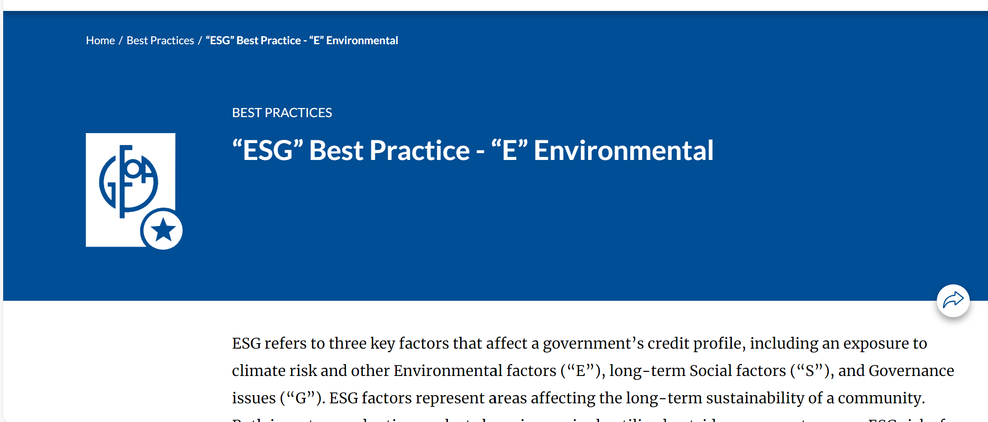
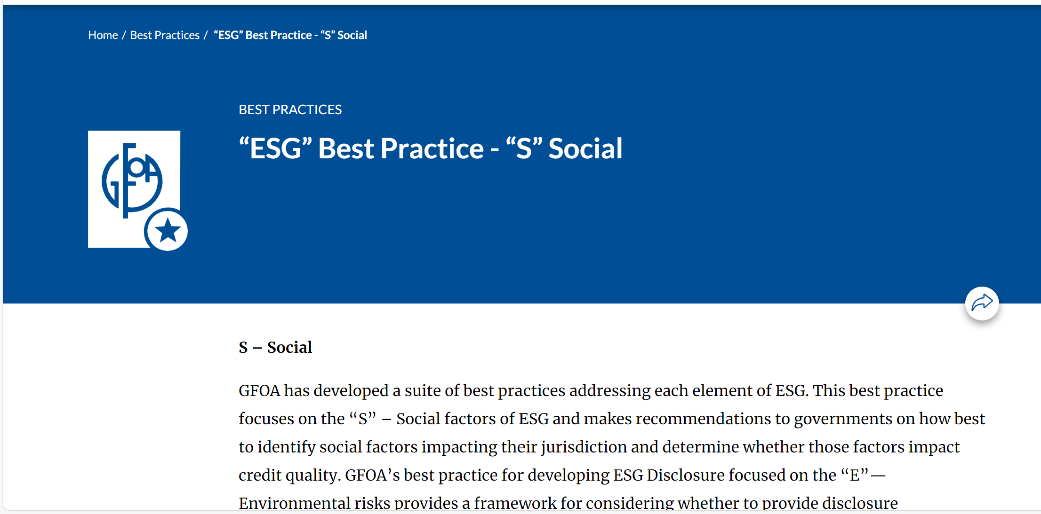
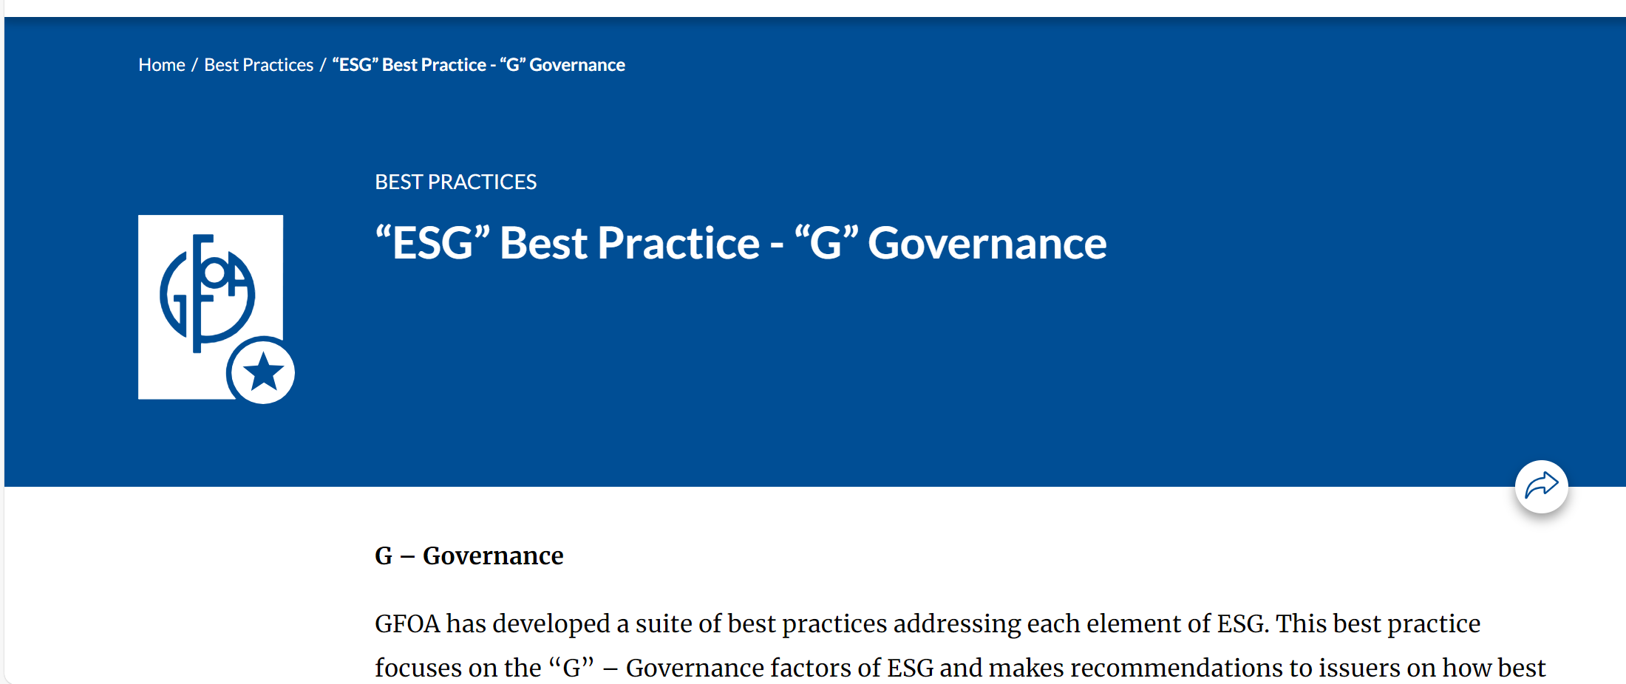
GFOA ESG Disclosure Best Practices https://www.gfoa.org/best-practices/debt-best-practices

Slide 42
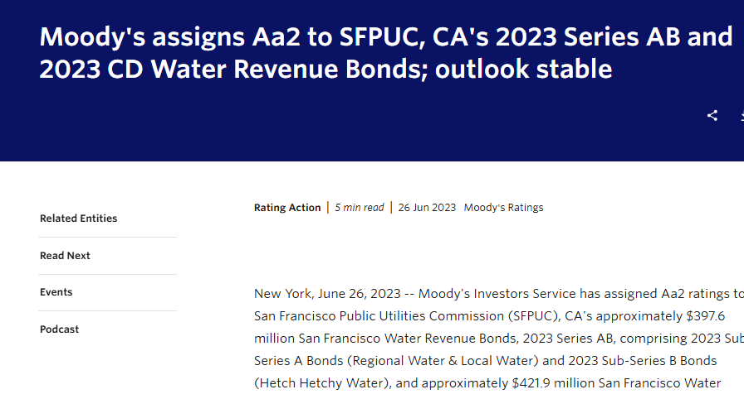
Credit Rating Agencies
“RATING OUTLOOK
The stable outlook reflects our expectation that the SFPUC's strong service area and stability of wholesale members will make scheduled rate increases manageable and support adequate coverage and strong liquidity positions. The outlook also incorporates the system's healthy supplies of stored water to offset the potential impact to supply from wildfire, seismic events or drought.”*
Source: https://www.moodys.com/research/Moodys-assigns-Aa2-to-SFPUC-CAs-2023-Series-AB-and-Rating-Action--PR_908136086
Notes:
When going to market, we are also demonstrating to rating agencies that we are managing climate change threats in concert with our financial responsibilities.

Slide 43

What Are Green Bonds?
Label applied to bonds
used to fund projects that
have positive environmental
an/or climate benefits
Other labels “Social”,
“Sustainable” and
“Sustainability-Linked” (ESSSB)
Standard bonds with a bonus
“green” feature
Source: Climate Bonds Initiative
Notes:
The SFPUC also has been a leader in Green Bonds and I’d like to discuss a bit about how the SFPUC uses green bonds and how that informs investment quality.

Slide 44
Evolution of Green Bonds
1st green bonds - 2007 European Investment Bank and World Bank
First corporate green bonds, first municipal green bonds in 2013
International Capital Market Association (ICMA) published Green Bond Principles in 2014 (updated 2021), providing voluntary process guidelines for issuing Green Bonds
Green, Social, Sustainable, and Sustainability – Linked Bonds (GSSSG) are anticipated to increase modestly to $0.95 trillion - $1.05 trillion 2024, from $0.98 trillion in 2023. The GSSSB share of the overall market may reach 14% in 2024.
U.S. Public Finance only accounts for 4% of this global market. U.S. municipal GSSSB issuance growth is anticipated to increase by 5% in 2024.
  Source: https://www.spglobal.com/_assets/documents/ratings/research/101593071.pdf, Sustainability Insights Research (spglobal.com) (S&P Global Ratings)

Slide 45
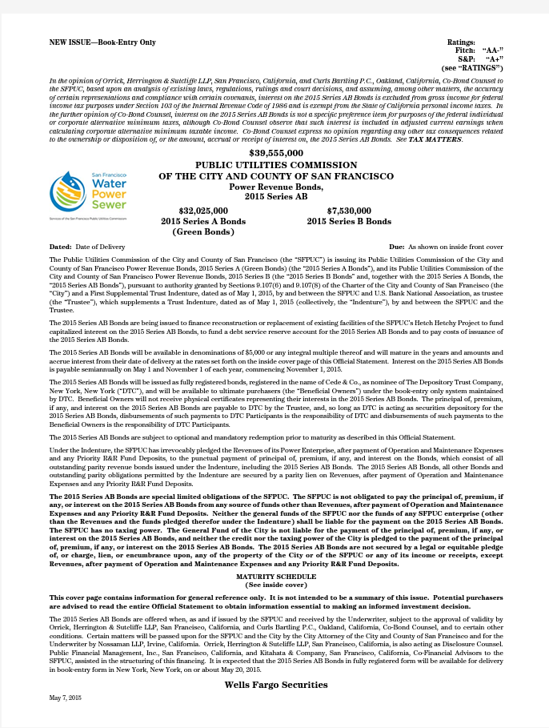
SFPUC’s First Labeled Bonds
First SFPUC Green Bonds for $30.2 million of project funds for the Power Enterprise
Proceeds funded (i) Hetch Hetchy Project hydroelectric generation facilities
Self-certified.
Retained Sustainalytics in early 2016 to review reallocation of green bonds proceeds

Slide 46
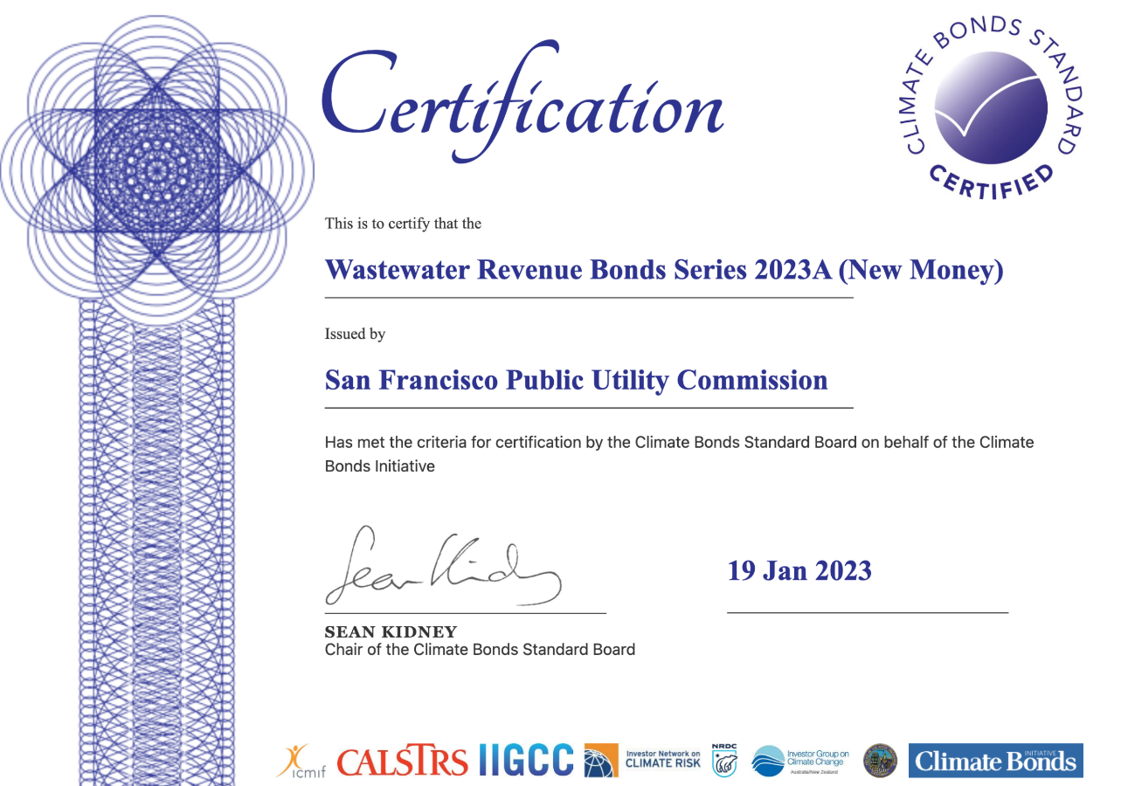
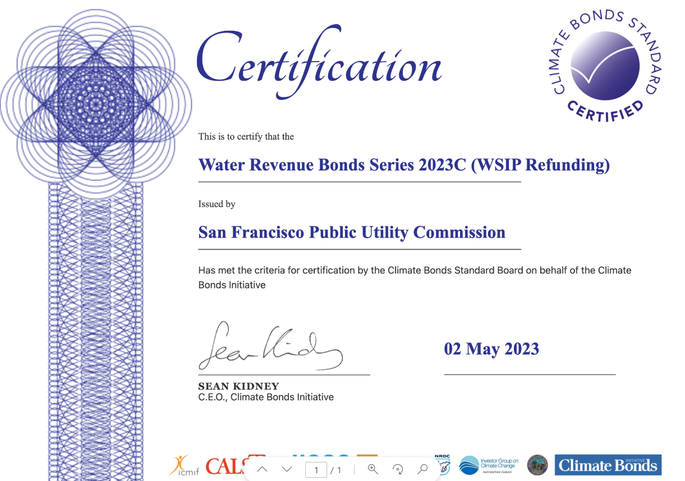
Higher Standards: Programmatic Certifications
Water System Improvement Program (WSIP) and our Wastewater Enterprise’s Sewer System Improvement Program (SSIP) each received Climate Bonds Initiative (CBI) Programmatic Certification.
International, investor-focused non-profit organization – highest certification standard.
Programmatic CBI Certification
  Alignment with ICMA Green Bond Principles
  Consistent with Paris Accord goal of limiting global temperature rise to 1.5%
  Receive third-party verification by a CBI approved verifier (Sustainalytics)

Slide 47

Leadership in Green Bonds
2004: City releases 1st Climate Action Plan
2015: 1st SFPUC Green Bonds for Power Enterprise
2017: Recognized by the Climate Bonds Initiative as the first issuer worldwide to sell bonds under its water criteria
2019 & 2021: U.S. Municipal Green Bond of the Year by Environmental Finance
2020: First US Municipality to list Green Bonds on an exchange in Europe (the London Stock Exchange)
2021: San Francisco City and SFPUC green bond programs recognized as global leader in the C40 report Cities100
2023: Record Issuance of SFPUC green bonds – nearly $4.3 billion to date
2024: Largest single green bond issuance - $971 million.

Slide 48
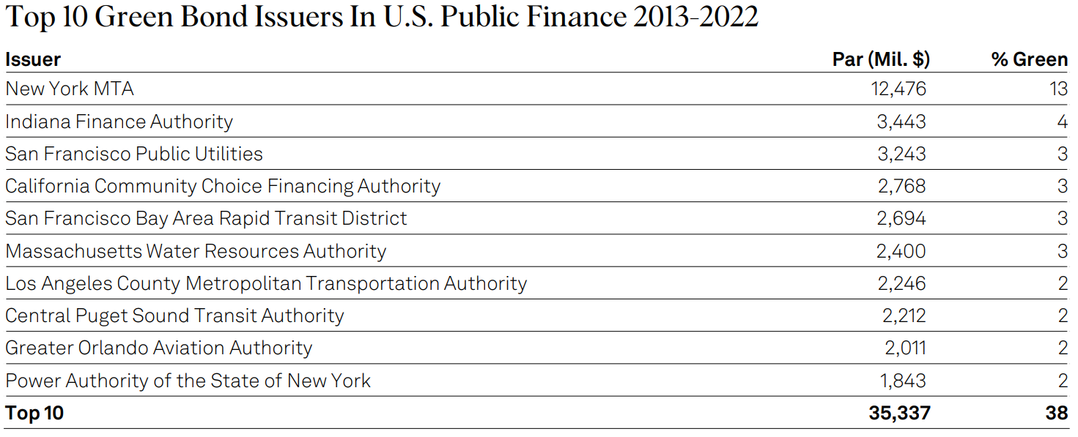

Leadership in Green Bonds
The SFPUC ranked third among the top 10 Green Bond issuers in U.S. public finance from 2013-2022*. In 2023, the SFPUC issued $1,183 million in Climate Bonds Standard certified green bonds.
*Source: U.S. Municipal Sustainable Bond Issuance Outlook 2023: Momentum To Continue (spglobal.com)

Slide 49
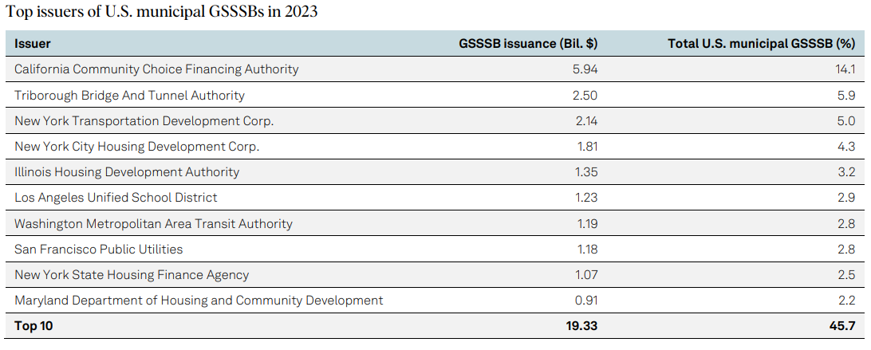
Broader Market of Labeled Bonds
The SFPUC ranked 8th among top issuers of U.S. municipal Green, Social, Sustainable, and Sustainability – Linked Bonds (GSSSBs) in 2023 with $1.18 billion in 2023 issuance which accounts for 2.8% of total U.S. municipal GSSSB issuance.
*Source: Sustainability Insights Research (spglobal.com)

Slide 50
Annual Bond Issuance
(Calendar Year)
The SFPUC has issued $5.268 billion of Green Bonds from 2015 to date

Slide 51
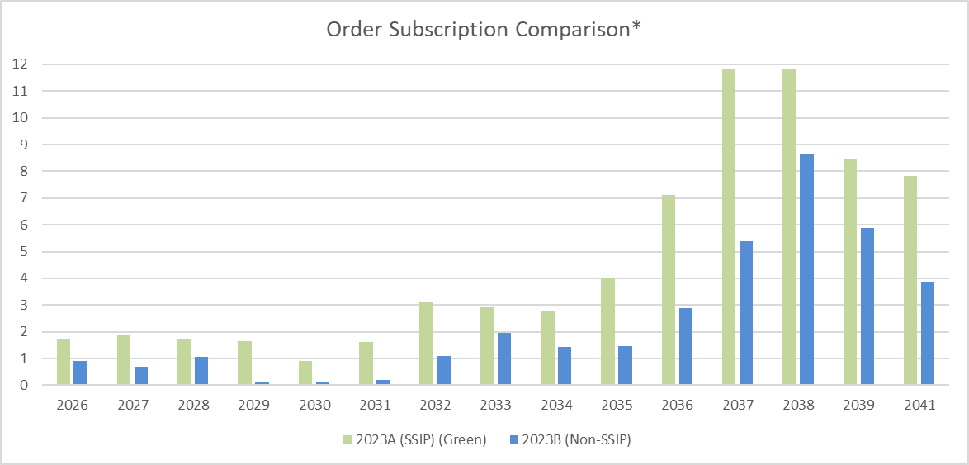
Measuring the Impact: Green Bonds Orders
(Wastewater 2023A)
Demand for Green Bonds exceeded demand for non-Green Bonds, including from prominent Green Bond investors.
Strong demand for bonds contributed to favorable pricing for entire issuance.
*Subscriptions calculated based on total Retail and Institutional orders divided by amount allocated within each maturity. Comparison is between same year maturities with 5% coupons. Source: Ipreo

Slide 52
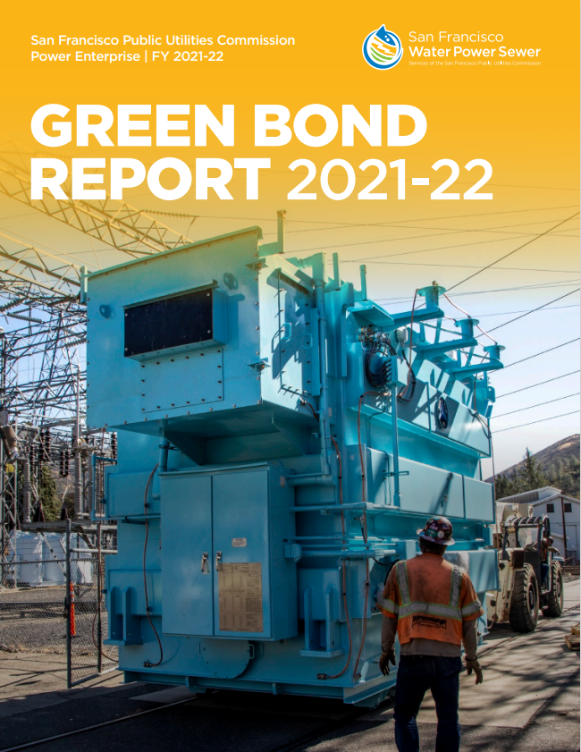
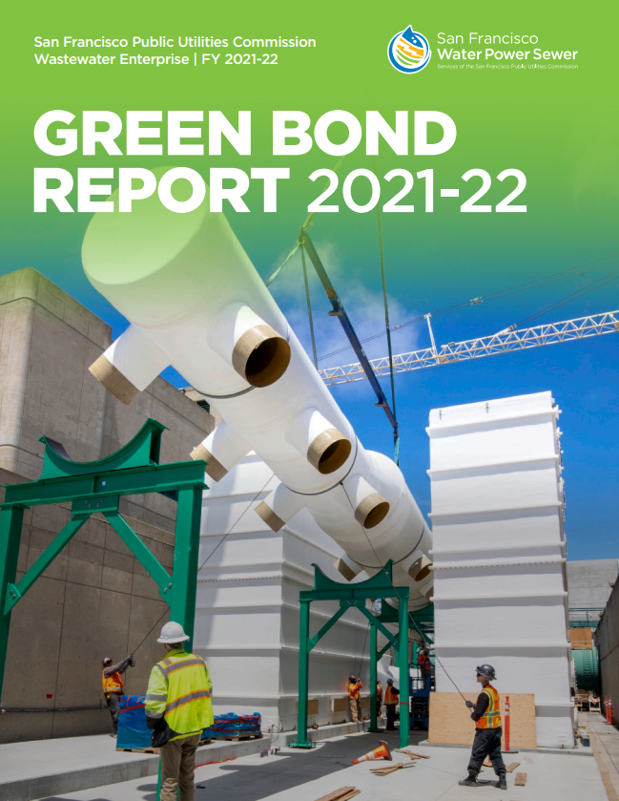
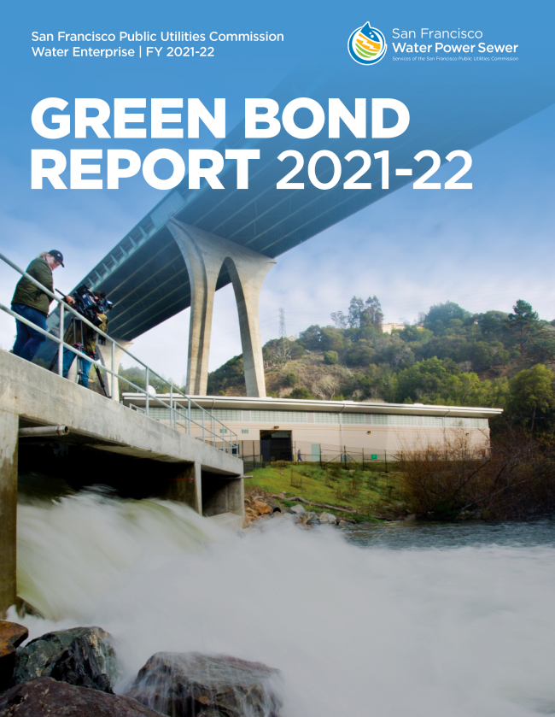
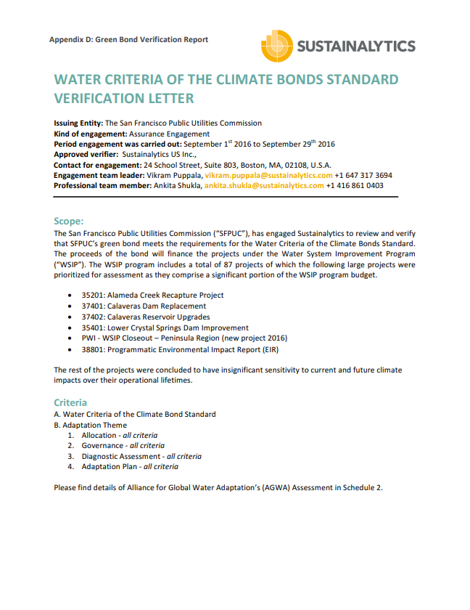
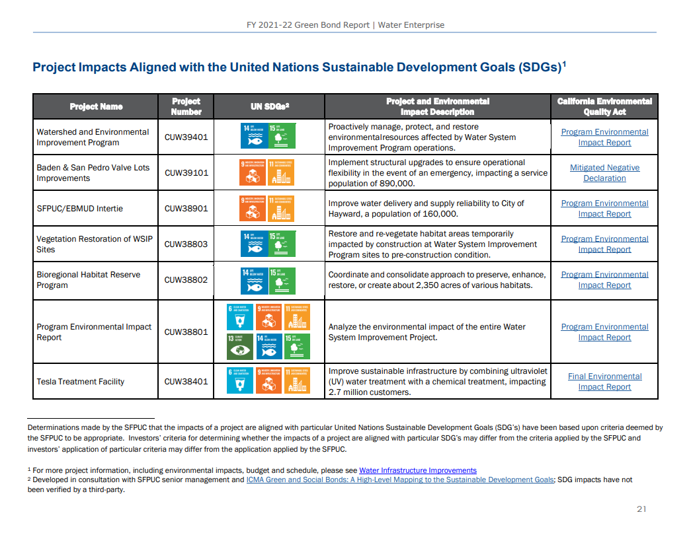
Green Bond Annual Reports
Introduction
Enterprise Green Bond Impact Report
  Green Bond Proceeds
  Project Environmental Impacts Aligned with United Nations Sustainable Development Goals (UN SDGs)
  Case Study
Appendix:
  State, City, and SFPUC Regulations, Policies and Programs
  SFPUC Green Bond Program
  SFPUC Climate and Social Inclusion Impacts Aligned to the UN SDGs
  Green Bond Verification Report (provided by third party verifier Sustainalytics)

Slide 53
Green Bond Benefits …
Benefits:
  Articulate the values of our organization
  Expand investor base
  Potential interest rate benefits in the future
  Demonstrates alignment to climate risks and environmental benefits
  Demonstrates commitment to environmental initiatives
  Earmark funds for climate projects
  Ease of explaining climate initiatives to constituents
  Fostering growth of the green bond market

Slide 54
... And Green Bond Challenges
Challenges:
  Regulatory responsibility
  Cost (time and money)
  Measuring of net metrics
  Need to embrace new processes
  Aligning reporting
  Assuring green commitments are maintained
  Conflation of green bonds with ESG politics
  Lack of central reporting
  Shifting from actions taken to impact of actions taken

Slide 55
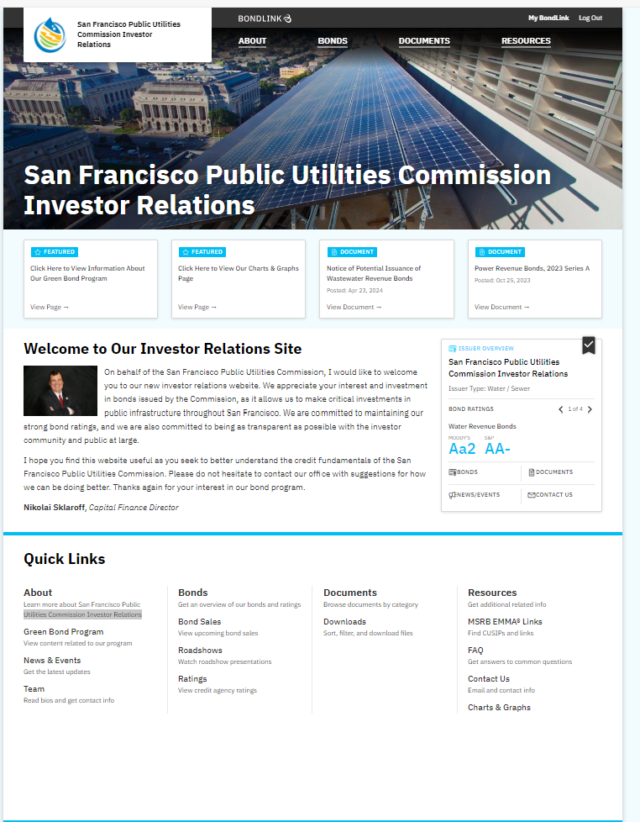
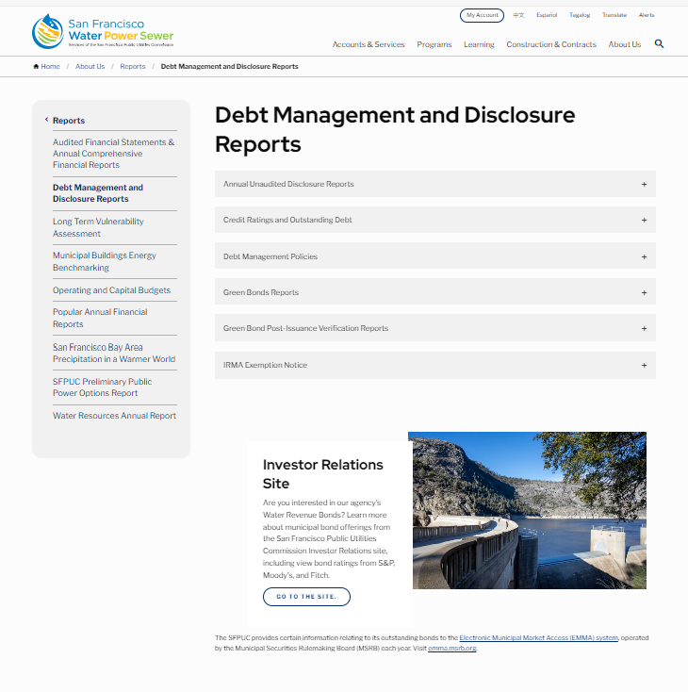
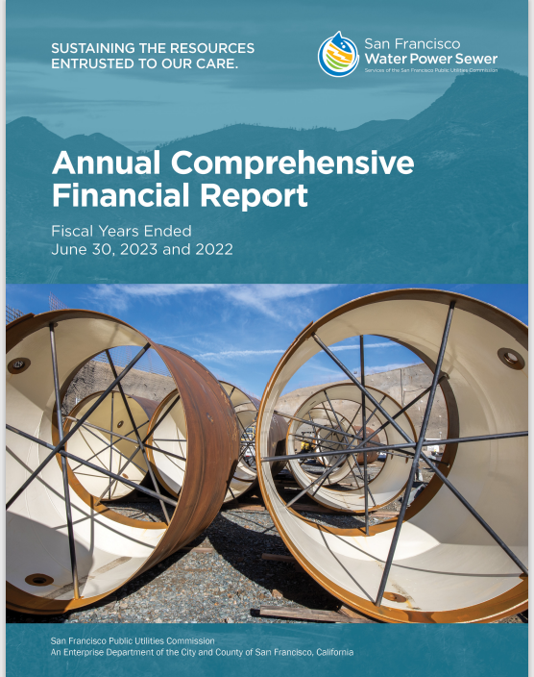
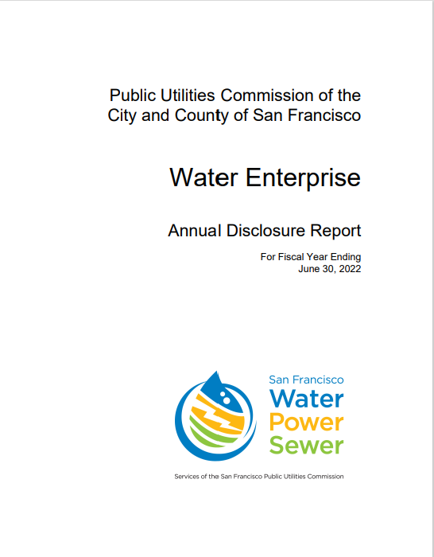
Other Venues for Presenting Our Credit Story
Notes:
Nikolai

Slide 56
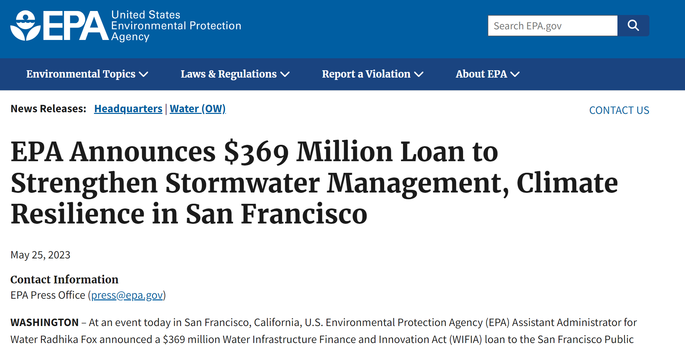
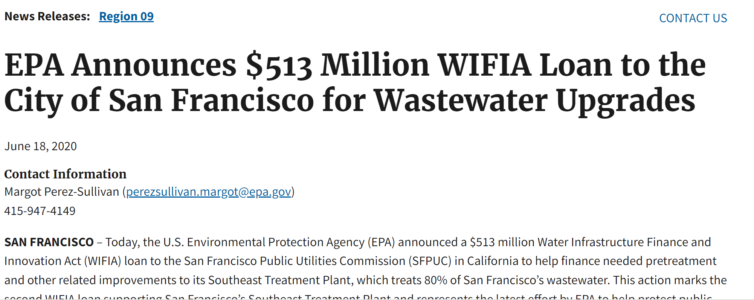
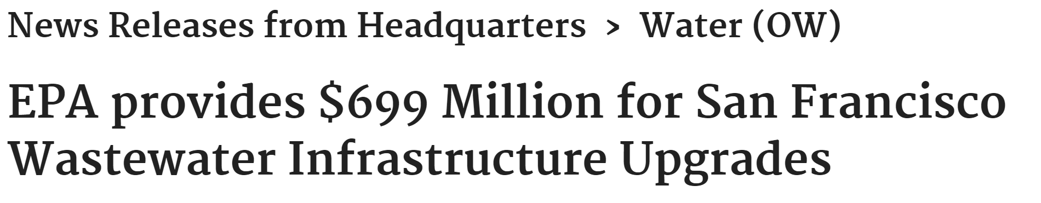
Other Important Lenders
Federal and State lending programs
Notes:
Nikolai

Slide 57
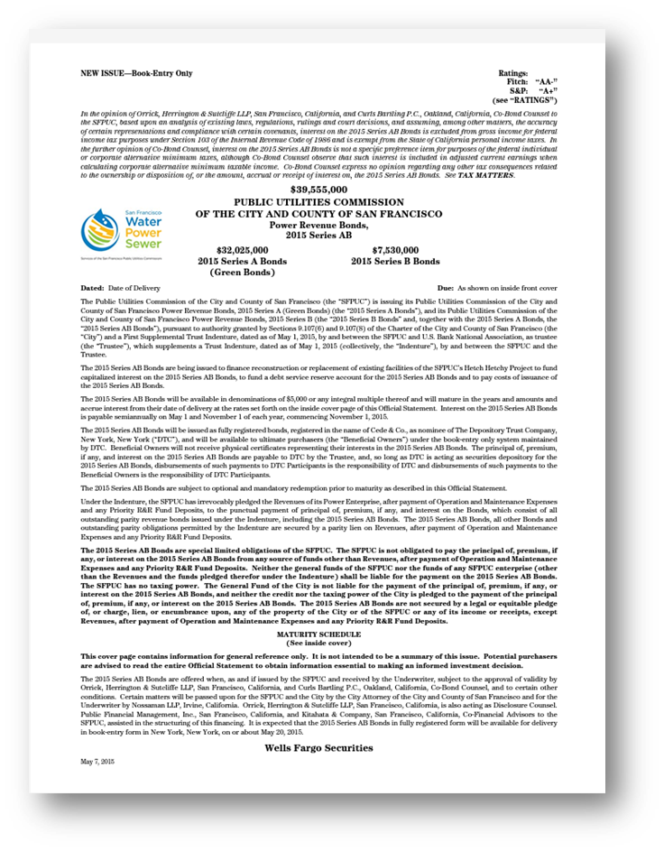
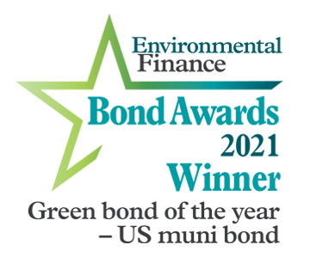

Example: Environmental Stewardship
Notes:
Nikolai

Slide 58
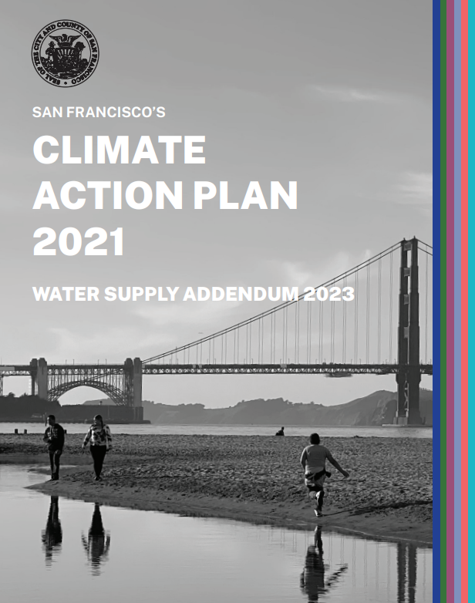
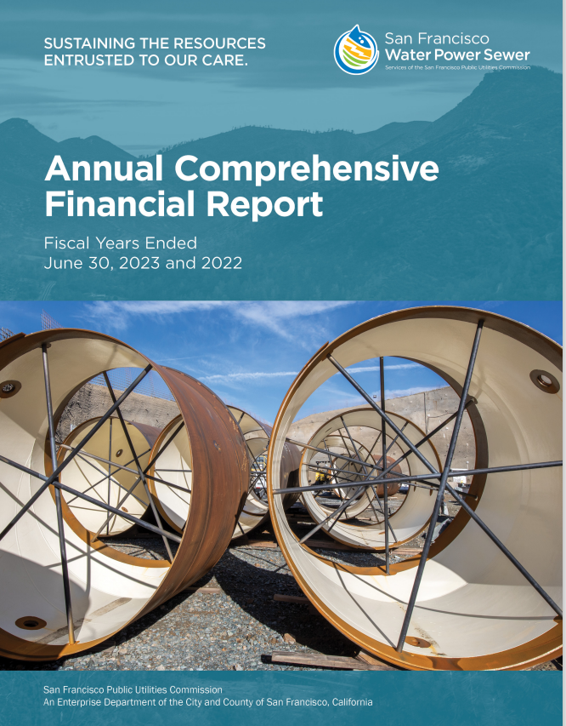
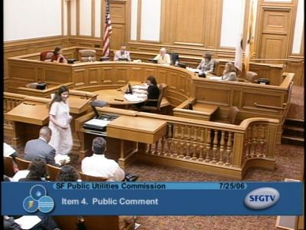

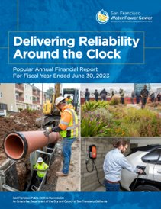
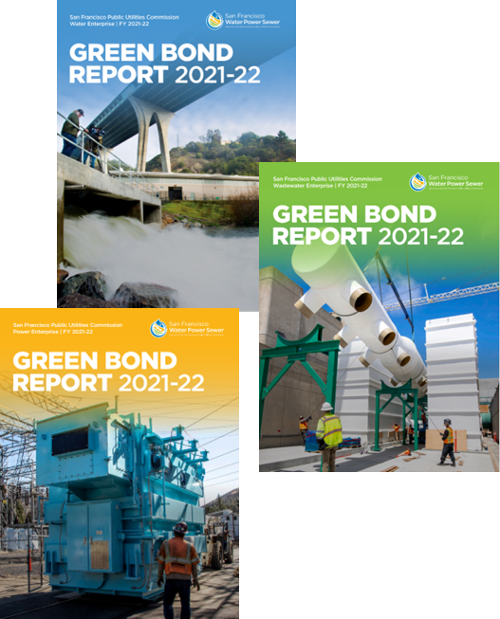
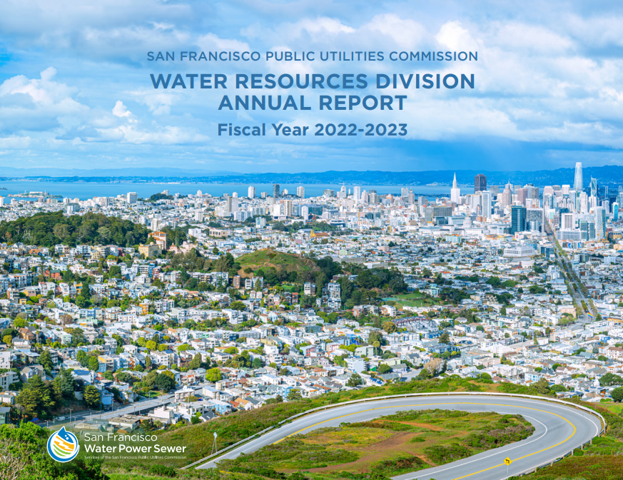

Looking at New Ways to Tell The Story
Text
Single Report
Notes:
Nikolai

Slide 59
Perspective from Insurer
Property – First Party
  Natural Disasters (3/1 Ratio)
  CAT Concerns (Wildfire, flood, wind, and earthquake)
  Expanding Geography (Derechos)
  Insurance Rationing (Exacerbating the problem)

Slide 60
Perspective from Insurer
Liability – Third Party
  Climate Litigation Contagion (Bigger than property losses)
  Misfeasance and Nonfeasance (Prevalent causes of action)
  Targeting Governing Bodies (Lack of codified policies, procedures, and treasure)
  Unique Legal Theories (Inverse condemnation)

Slide 61
Q&A Session
We will do our best to address as many questions as possible.
Notes:
Potential questions:
How can water utilities maintain operational resilience while facing increased financial pressure due to climate threats?
2. How can water utilities engage with the financial and insurance industries to disclose their climate change risk and resiliency efforts to attract investors and access insurance coverage at an affordable price?

Slide 62
CRWU Resources and Tools
The Climate Resilience Evaluation and Awareness Tool (CREAT): https://www.epa.gov/crwu/climate-resilience-evaluation-and-awareness-tool
The Climate Adaptation Funding page: https://www.epa.gov/crwu/climate-adaptation-funding-water-sector-utilities
CRWU Training and Engagement Center page: https://www.epa.gov/crwu/training-and-engagement-center
Climate and Weather Data Maps: https://www.epa.gov/crwu/climate-and-weather-data-maps

Slide 63
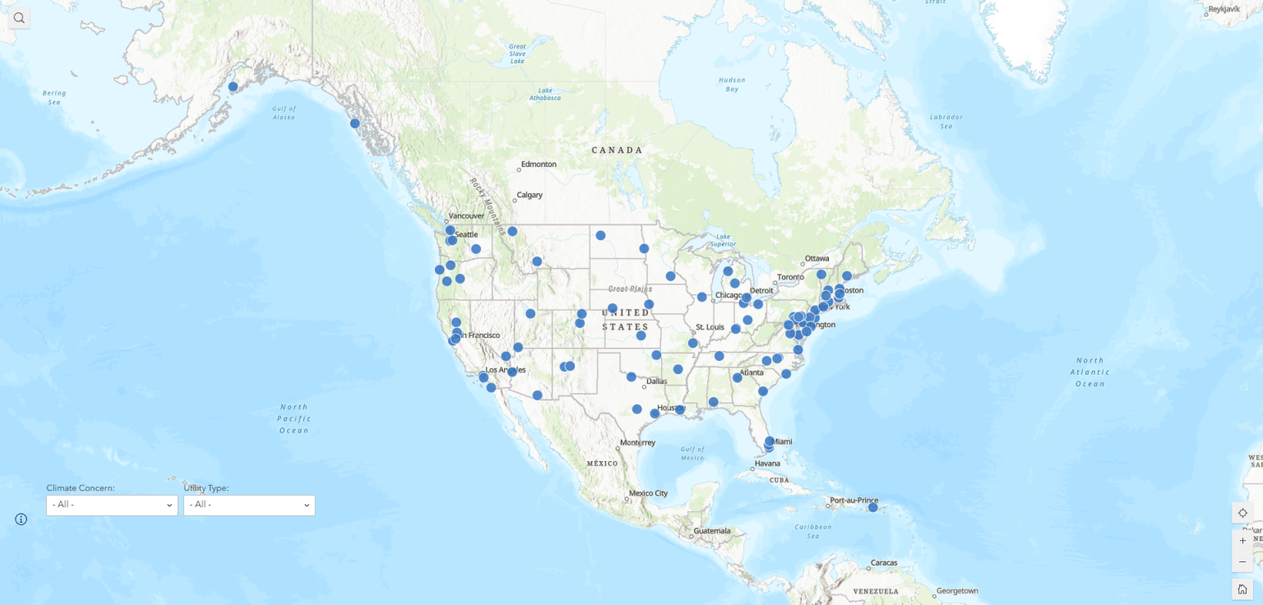
CREAT Technical Assistance Map

Slide 64
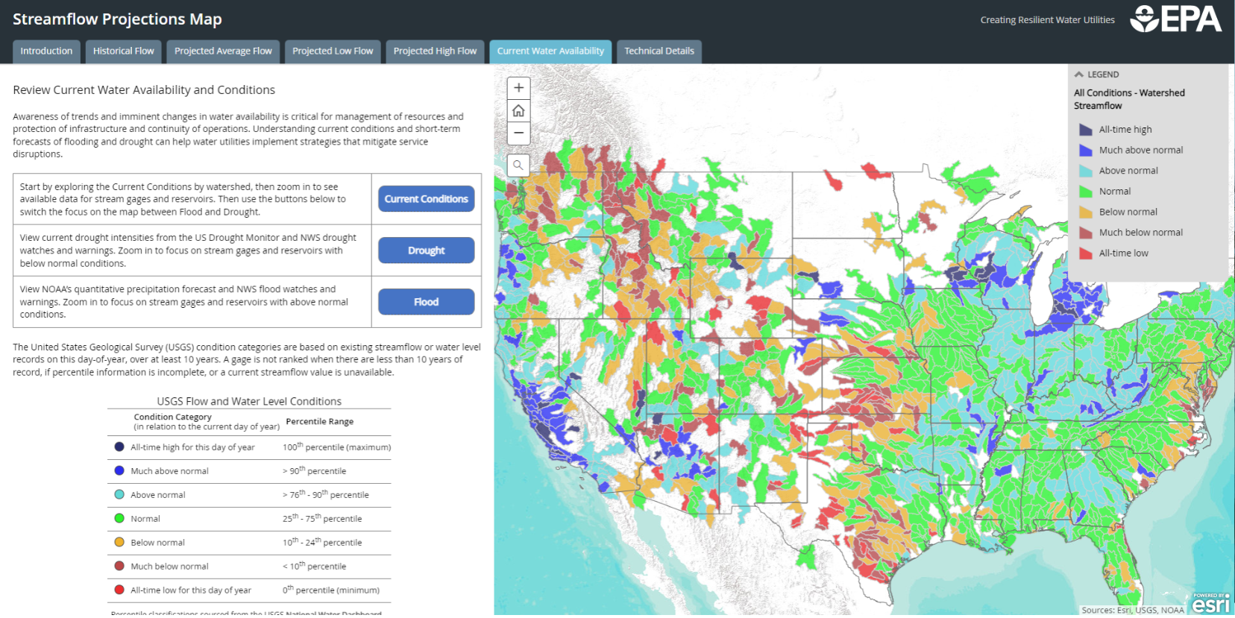
CRWU Streamflow Projections Map

