Slide 1

Equivalency in the Delaware SRF Programs
Greg Pope, P.e.
Chief of operations
Department of Natural Resources and environmental Control

Slide 2

Delaware Equivalency Approach
CWSRF | DWSRF
Projects up to the Cap Grant Amounts only | All Projects are Equivalency
Target Larger Borrowers such as Wilmington, and the Counties | Since BIL, almost all projects are funding by Cap Grants
Target Projects that are less impacted by BABA | Makes for a one size fits all approach, easier to manage.

Slide 3
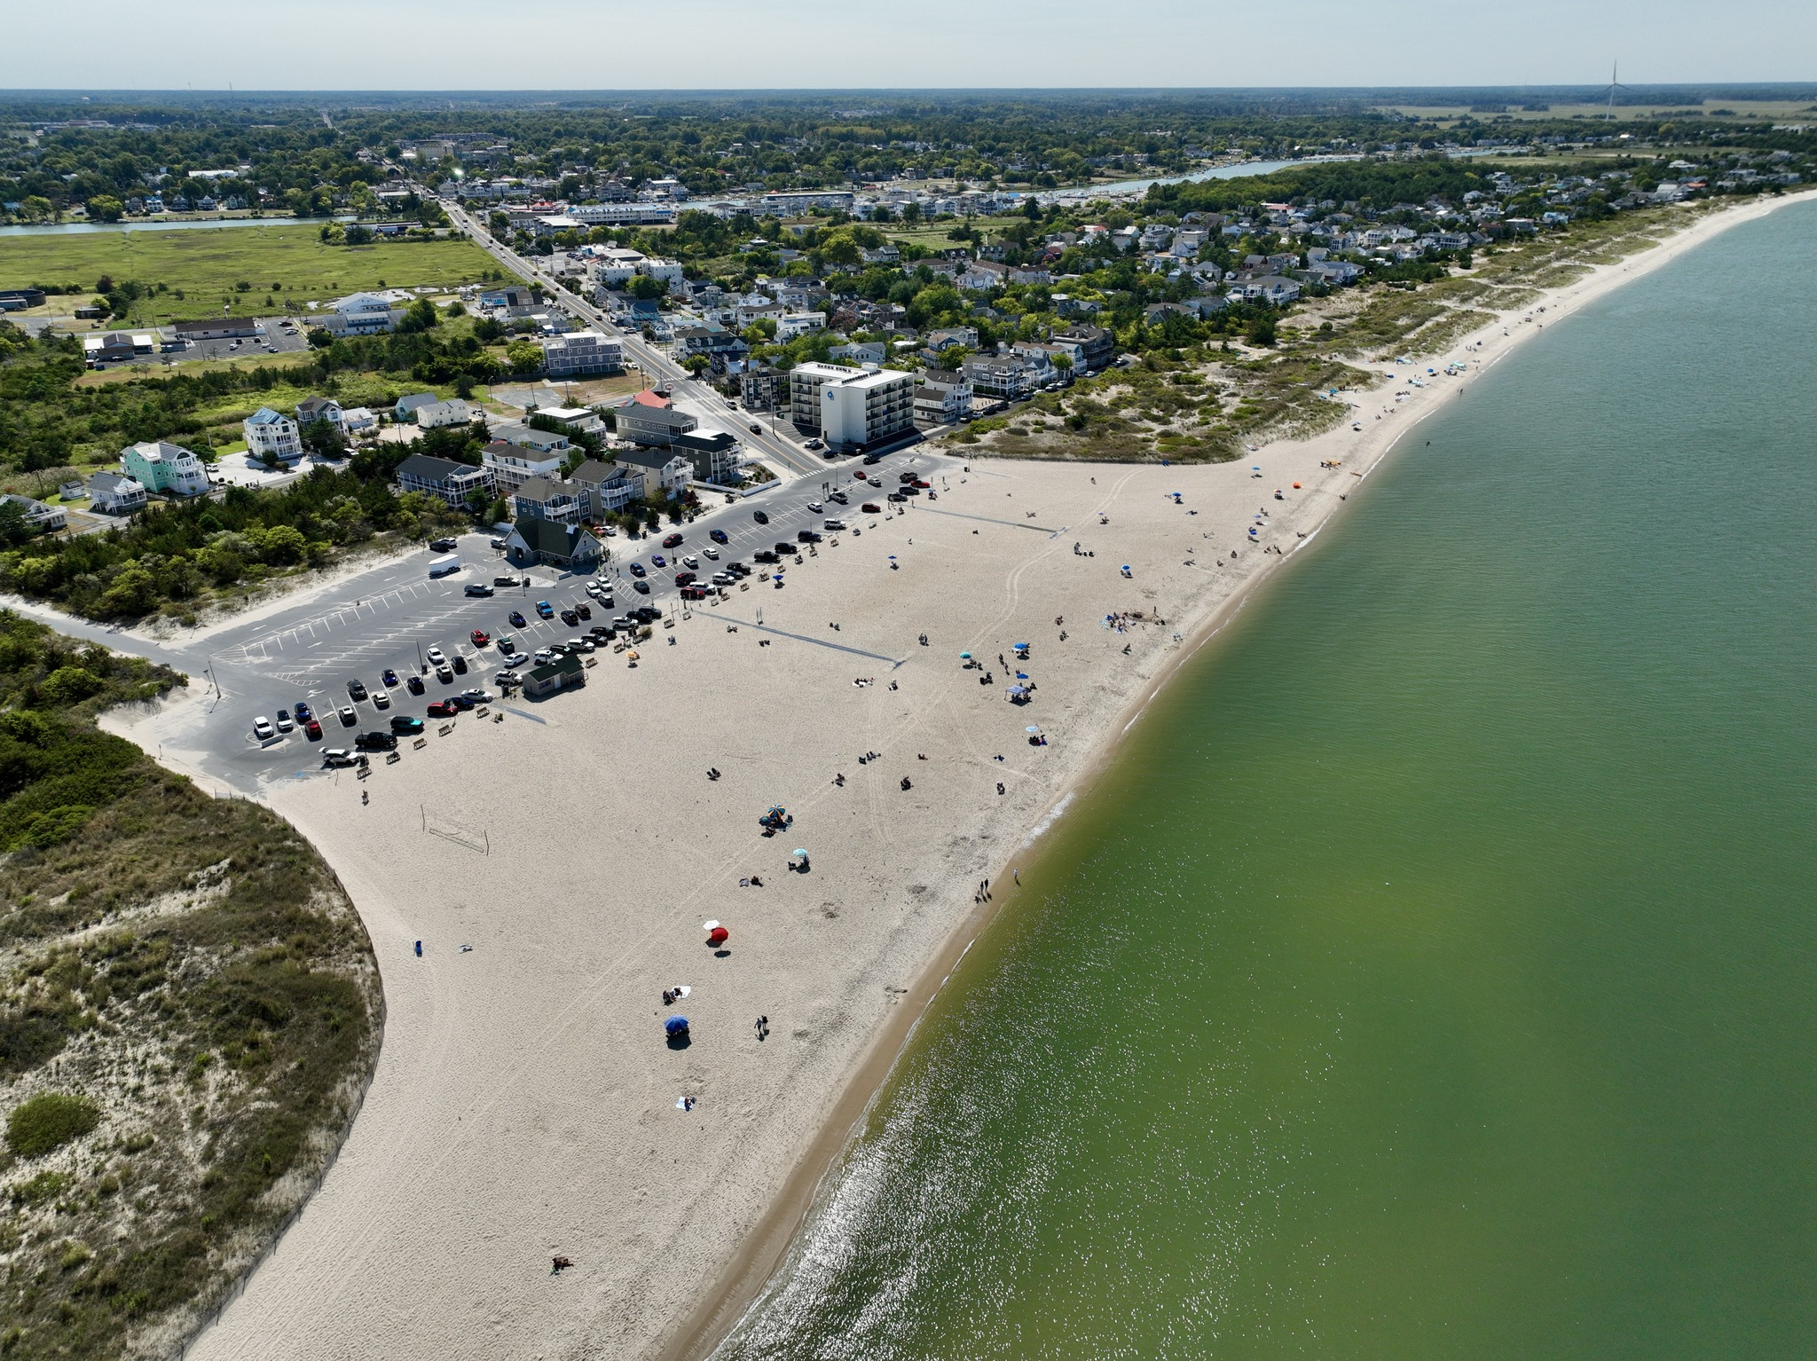
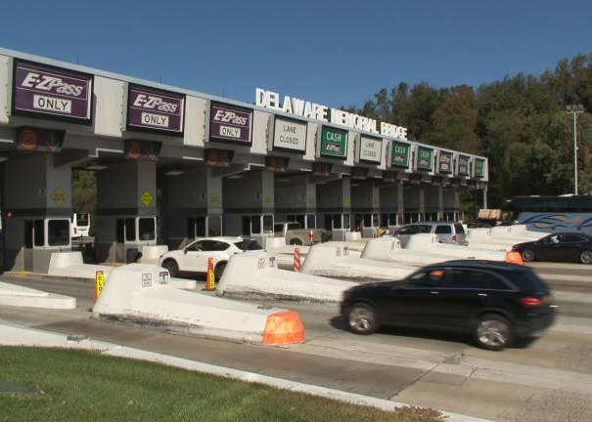
Delaware
One State, 2 Approaches
CWSRF
DWSRF
Non-Equivalency
Equivalency
Equivalency

Slide 4
Equivalency in the CWSRF
CWSRF Program Requirements
Requirements that only apply to “Equivalency” Projects
Disadvantaged Business Enterprises (DBE) - EPA’s Disadvantaged Business Enterprise (DBE) rule applies to procurement actions for projects considered equivalency
A/E Procurement - A/E Procurement applies to contracts for program management, construction management, feasibility studies, preliminary engineering, design, engineering, surveying, mapping, or architectural related services. All projects considered equivalency must comply with the elements of the procurement processes for A/E services as identified in 40 U.S.C. 1101 et seq., or an equivalent State requirement. If a borrower cannot comply with the federal requirement, a separate “non-equivalency” financing agreement will fund the architectural and engineering services
Generally Accepted Accounting Practices (GAAP) – GAAP compliance will be required as a condition of making a loan or providing other assistance from the fund
Single Audit Requirement – Applies to loan recipients receiving federal assistance greater $1,000,000+ threshold in a federal fiscal year
Prohibition on certain telecommunication & video surveillance services or equipment
Build America Buy America (BABA)
“Investing in America” Sign

Slide 5
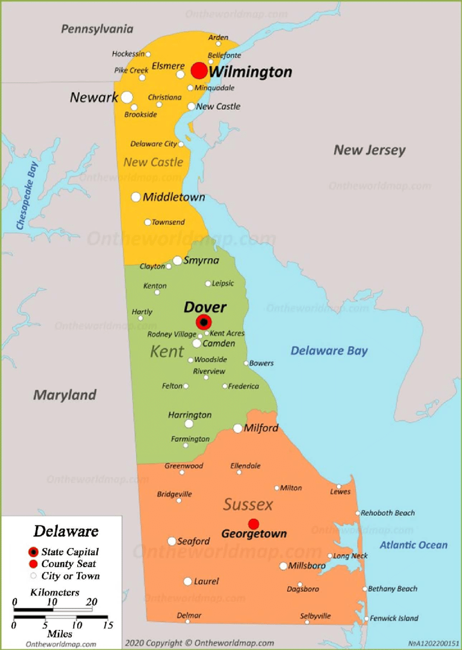
Choosing CWSRF
Equivalency Projects
How do we select which projects are equivalency?
Select larger borrowers that won’t feel the pinch of additional federal requirements i.e. Wilmington which already has a DBE program.
Select borrowers that already have a federal compliant A/E solicitation process i.e. Sussex County.
Choose projects that BABA will have less of an impact on i.e. force main and interceptor projects vs. treatment plant upgrades.
Select large $ amount projects. In FFY 2024 DE CWSRF had only 2 equivalency projects.

Slide 6
Equivalency Strategies for All
Toss them a bone
You may choose to provide lower interest rates for EQ projects
Help the Little Guy
Try to avoid applying EQ to small and disadvantaged communities
The Big Guys can handle it
Large and recurring borrowers are most likely to comply without pain
Big Bucks $$
Very large $ projects may be able to satisfy multiple year EQ requirements

Slide 7

Summary
Complying with the EPA equivalency requirement is not as hard as it seems. Talk to your EPA HQ or region for help, follow best practices from the sub-workgroup, and talk to your peers in other states.
Now go have some fun at the group event tonight!

Slide 8

Thank you. Merci. Gracias. Danke. Grazie. Arigato.
Greg Pope, P.E.
Chief of Operations
Environmental Finance
Delaware Natural Resources and Environmental Control
Greg.Pope@delaware.gov

