Slide 1


Wisconsin’s Safe Drinking Water Loan Program
DNR Environmental Loans Program
New Option for Financing Lead Service Line replacement costs on Private Property
Robin Schmidt, Chief
Environmental Loans Section
WI Department of Natural Resources
robin.schmidt@wisconsin.gov
CIFA Technical Conference, November 2016
Notes:
Thank you for the opportunity to talk with you today about the DNR Environmental Loans program.

Slide 2

SDWLP Program Background
Program provides
  Subsidized 20-year loans to municipalities for water infrastructure projects
    55% of market rate = 1.540%
  “Disadvantaged Municipality”
    33% of market rate = .924%
      population < 10,000 and
      MHI < 80% of state’s MHI
  Current market rate = 2.8%
    Note: The “Disadvantaged Municipality” criteria noted above is only for the purpose of calculating the subsidy percentage
Notes:
I’m going to specifically focus my discussion on the Clean Water Fund Program. Many of you may already be familiar with this program and I won’t go into a lot of detail about the program basics other than to say we provide subsidized loans to municipalities for their water infrastructure projects.

Slide 3

SDWLP Program Background
Municipalities comply with program requirements:
    Deadlines/Submittals
    Federal requirements
    Closing requirements
WI DNR Manages Program Implementation
    Budgets
    Eligibilities
    Financial Assistance Agreements
WI DOA Capital Finance Manages Fund
    Assesses financial viability of municipality
    Disburses payments to municipalities
    Ensures fund is maintained in “perpetuity”
Notes:
This slide and the following slide describe how we’re organized and the basics of how the program works – this slide focused on the program requirements for municipalities and the role of the Department of Administration.

Slide 4

“Regular” Principal Forgiveness (PF)
  Only awarded to “Disadvantaged” Municipalities
Percentage based on Affordability Criteria:
    population/MHI/unemployment/population trends
Percentages range from 0% to 60% of project costs
  Cap of $500,000 per municipality per year
  SFY 2017: $4 million allocated to 12 municipalities

Slide 5
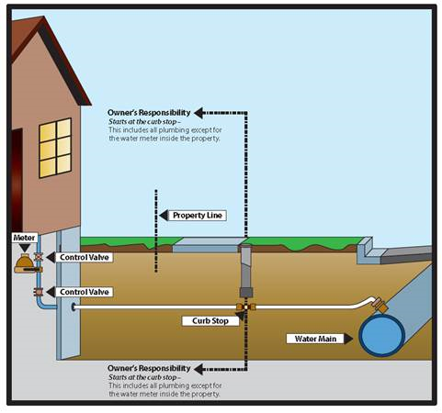
Lead Service Line Replacement
    The Problem with lead:
  Lead service lines in place in older homes
    (pre -1940s/1950s)
    Pipes from main to curb stop
    Pipes from curb stop to home
  Human health
  Increased levels when water
    chemistry changes or pipes are
    disturbed
  DNR does not recommend partial
    line replacements due to line disturbance

Slide 6

Lead Service Line Replacement
    Funding challenges – public and private ownership
      Municipally controlled (public right-of-ways)
        Revenue bonds/other traditional funding options
      Privately owned
        Non-revenue bonds; affordability
WI Public Service Commission regulates water utilities
    Approves rates
    Determines costs for which ratepayer funds can be used
      Case Law
      Code requirements
    Rate payer funds cannot be used to pay for work done on private property

Slide 7

Lead Service Line Principal Forgiveness
Underlying tenet:
  If private LSL funds are awarded as principal forgiveness,
  then they are not a debt incurred by the municipality
  and rate payer fees are not used on private property
Program Requirements:
Project must result in full lead line replacement (no reverse partial replacements)
Municipality must qualify as “Disadvantaged” using Affordability Criteria
    Must be eligible for at least 15% PF
    Calculator on web site to help municipalities make that determination

Slide 8
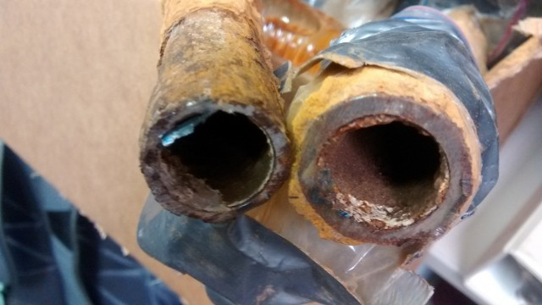
Lead Service Line Principal Forgiveness
  38 applications accepted for SFY 2017
  Funds Available: $14.5 million ( from $11.8 million due to demand)
Additional funds from unallocated PF authorities in
  SFY 2010 and SFY 2011 cap grants
Award caps:
      $1,000,000 for municipalities with population > 500,000
      $500,000 for municipalities with population <500,000, > 50,000
      $300,000 for municipalities with population < 50,000
      Licensed day care centers and schools are not subject to the cap
    Anticipate funding for SFY 2018
      $7,500,000 + ?

Slide 9
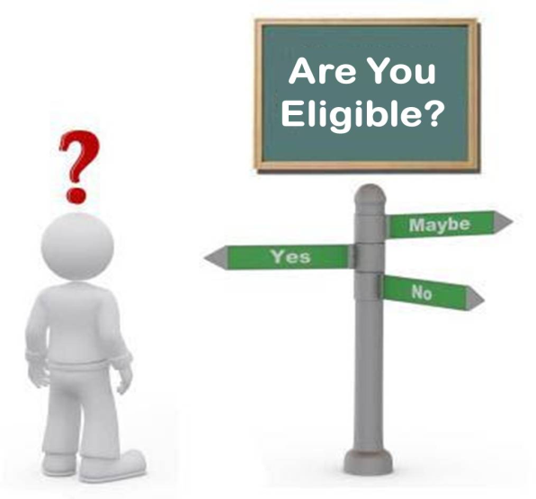
Lead Service Line Principal Forgiveness
Program options
  Criteria developed by each municipality
    Some base distribution of funds on age of children in home
    Some programs established with volunteer participation
    Some programs require homeowners to participate
    Some fully fund LSL costs/some provide cost-share
    Some contemplating income based subsidy

Slide 10

Lead Service Line Principal Forgiveness
1. Municipal Program with prequalified list of plumbers (most requested)
    To make prior partial line replacements “full”
    As planned road and pipe replacements occur
    Licensed day care centers/schools
    Could be implemented as rebate/revolving loan program
2. Municipal Contract
    Municipality contracts directly for work
      Similar options for types of work

Slide 12

Outreach Activities
Worked with League of Wi Municipalities
Presented information through Webinar and conferences
Announcements through E-Bulletin Newsletter
Web site created
  Forms
  FAQs
  Intended Use Plan
  Reference materials

Slide 13
For more information
Contact:
  Becky Scott at rebecca.scott@wisconsin.gov or
  Robin Schmidt: robin.schmidt@wisconsin.gov
Visit our web site at:
http://dnr.wi.gov/Aid/EIF.html

