Slide 1
Mississippi’s Disadvantaged Community program & Applications of Assistance
Harry D. Gong, Jr., P.E.
Engineering Coordinator
Drinking Water Revolving Loan Fund
Bureau of Public Water Supply
Mississippi State Department of Health

Slide 2
Agenda and Objectives
This presentation will cover
How Mississippi defines a disadvantaged community
How Mississippi offers assistance to these communities
Mississippi’s perception of the impacts of the programs and assistance

Slide 3
Definition of a Mississippi Disadvantaged Community
Eligible communities are those that are determined to serve a community with a median household income (MHI) below the median household income for the state of Mississippi
MHI Data used is the from the following:
“The Sourcebook of Zip Code Demographics”, Twenty-third Edition (2009)
Quick Facts Data from the US Census Bureau Website https://www.census.gov/quickfacts/table/PST045215/00
Where the affected community is included in more than one zip code area, a weighted average is used for the community’s MHI.

Slide 4
Assistance offered for Disadvantaged Communities
Subsidization of the Federal Appropriation for Loans as Loan Principal Forgiveness (PF)
Formula for determining eligible principle forgiveness is based on the median household income of the loan recipient verses the median household income average of the state ($36,311)
LR MHI > 100% NO Principle Forgiveness
90% < LR MHI < 100% 15% Principle Forgiveness
80% < LR MHI < 90% 25% Principle Forgiveness
70% < LR MHI < 80% 35% Principle Forgiveness
LR MHI < 70% 45% Principle Forgiveness
Subsidization may be used over a two year period. Subsidization remaining from a previous year may be awarded to loans which are eligible for PF over a two year time period.

Slide 5
Assistance offered for Disadvantaged Communities
Subsidization of the Federal Appropriation for Loans as Loan PF (cont.)
PF will be extended to projects until all mandated subsidy funds are obligated.
2011 = 30%; (2012-2015) = 20% to 30%; 2016 = 20%
The amount of PF given will be assigned at loan award and will not change after the project goes to the bid phase.
Due to the limited amount of PF funds, the maximum amount of PF funds a loan recipient may receive for a project will be set at $500,000.
Once subsidy funds are depleted, only standard loans will be made with DWSIRLF funds.

Slide 6
FY2011 – Cap Grant ($9,802,000)
30% Subsidization = $2,940,600
Community WS | Loan Award | Subsidization Amount
City of Corinth | $5,000,000 | $500,000
City of Batesville | $1,007,500 | $428,461
Beaver Meadow W/A | $751,714 | $394,854
City of Biloxi | $1,096,173 | $0
Jeff Davis W/A | $152,000 | $49,441
City of Laurel | $4,617,670 | $500,000
Taylorsville W/A | $948,144 | $308,301
Town of Tunica | $985,945 | $500,000
West Jackson County UD | $5,000,000 | $0
Young’s Water & Sewer | $610,300 | $259,543
Total | $20,169,446 | $2,940,600

Slide 7
FY2012 – Cap Grant ($9,341,000)
20 to 30% Subsidization = $1,868,200 to $2,802,300
Community WS | Loan Award | Subsidization Amount
*City of Columbia | $1,733,375 | $320,040
*Good Hope W/A | $2,023,352 | $492,535
City of Wiggins | $1,996,535 | $299,480
City of Port Gibson | $2,847,109 | $500,000
Conehoma W/A | $973,100 | $243,275
Town of Tchula | $439,950 | $197,978
Central Yazoo W/A | $1,509,573 | $377,393
City of Greenwood | $2,949,025 | $243,275
City of Madison | $4,793,310 | $0
West Jackson County UD | $5,000,000 | $0
Total | $24,265,329 | $2,673,976

Slide 8
FY2013 – Cap Grant ($8,764,000)
20 to 30% Subsidization = $1,752,800 to $2,629,200
Community WS | Loan Award | Subsidization Amount
Town of Baldwyn | $1,939,518 | $290,778
Center W/A | $1,372,950 | $205,943
Troy W/A | $533,000 | $79,950
City of Clinton | $1,909,855 | $0
City of Tupelo | $3,448,328 | $0
Central Rankin W/A | $835,000 | $0
Hilldale Water District | $2,346,769 | $0
New Hope W/A | $147,000 | $36,750
Town of Guntown | $975,200 | $0
City of Horn Lake | $1,542,470 | $0
Union W/A | $635,000 | $0
Total | $15,684,144 | $613,421

Slide 9
FY2014 – Cap Grant ($9,159,000)
20 to 30% Subsidization = $1,831,800 to $2,747,700
Community WS | Loan Award | Subsidization Amount
Culkin Water District | $1,726,073 | $258,911
Town of Drew | $427,500 | $149,625
Evergreen Water Association | $234,000 | $0
Hiwanee Water Association | $768,950 | $192,238
Improve Water Assoication | $352,000 | $88,000
Lampton Water Association | $1,404,000 | $491,400
Lebanon Water Association | $1,380,500 | $500,000
Mulit-Mart Water Association | $500,000 | $0
City of Richland | $947,500 | $0
City of Ridgeland | $1,080,192 | $0
Sontag-Wanilla Water Association | $482,000 | $0
Star Water Company | $600,000 | $0
City of Tupelo | $4,058,529 | $0
West Jackson County Utility District | $5,000,000 | $0
Total | $18,961,244 | $1,682,174

Slide 10
FY2015 – Cap Grant ($9,099,000)
20 to 30% Subsidization = $1,819,800 to $2,729,700
Community WS | Loan Award | Subsidization Amount
Town of Taylorsville | $885,000 | $132,750
Tunica County Utility District | $487,630 | $121,908
Bear Creek Water Association | $1,429,700 | $0
City of Brookhaven | $3,000,000 | $500,000
Town of Jumpertown | $1,013,500 | $152,025
City of Tupelo | $1,658,468 | $0
Magee’s Creek W/A | $642,500 | $224,875
Old River Water Association | $477,600 | $214,920
Center Water Association | $908,500 | $136,275
Town of Bude | $1,643,000 | $500,000
City of Pearl | $1,150,000 | $0
Jackson County Utility Auth. | $6,281,298 | $0
Total | $19,577,196 | $1,982,753

Slide 11
FY2016 – Cap Grant ($8,607,000)
20% Subsidization = $1,721,400
Community WS | Loan Award | Subsidization Amount
Tunica County Utility District | $555,844 | $138,961
Duffee Water Association | $746,307 | $111,946
City of Jackson | $5,000,000 | $500,000
North Lauderdale Water Association | $1,575,200 | $236,280
Bear Creek Water Association | $3,500,000 | $0
Willow Grove Water Association | $681,000 | $170,250
White Oak Water Association | $611,000 | $91,650
Valley Park Water Association | $650,850 | $227,200
Lebanon Water Association | $999,750 | $449,888
Ebenezer Rural Water Association | $616,000 | $277,200
Mount Gilead-Improve W/A | $1,357,400 | $475,090
City of Brandon | $4,193,200 | $0
Lorman Water Association | $980,000 | $441,000
Culkin Water District | $4,369,645 | $500,000
Total | $26,106,196 | $3,620,063

Slide 12
Assistance offered for Disadvantaged Communities
Set-Aside Programs
Peer Review
Board Management Training
Hands On Operator Training
Well Abandonment

Slide 13
Assistance offered for Disadvantaged Communities
Peer Review Program (2% Set-Aside)
Objective: To train experienced operators, managers and water officials to perform a capacity assessment review and to go out to capacity deficient systems to conduct a review of the system as their peers before the official review by the Regulating Agency.
Public Water Supplies are visited annually for a Capacity Assessment Review by the Regulating Agency.
Technical, Managerial, and Financial Capacities are scored on a 5 point scale through grouping of capacity specific questions and the average of all three gives an overall score from 0 – 5 for the Capacity of the Water System.

Slide 14
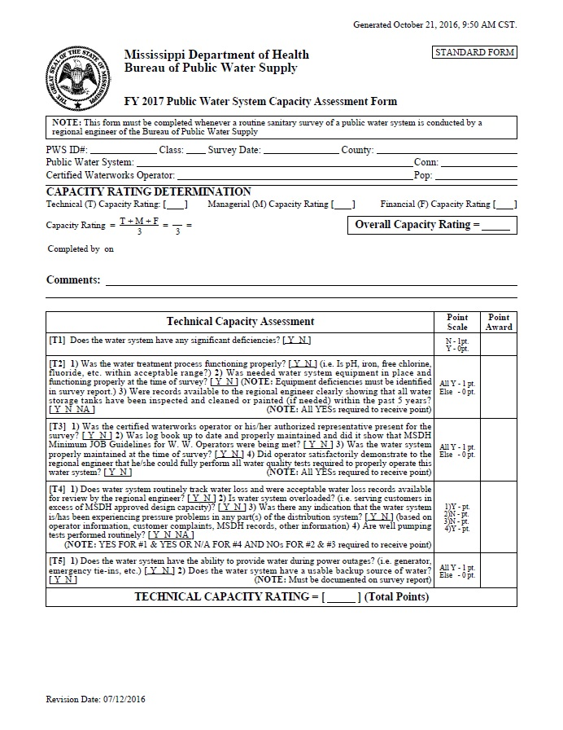
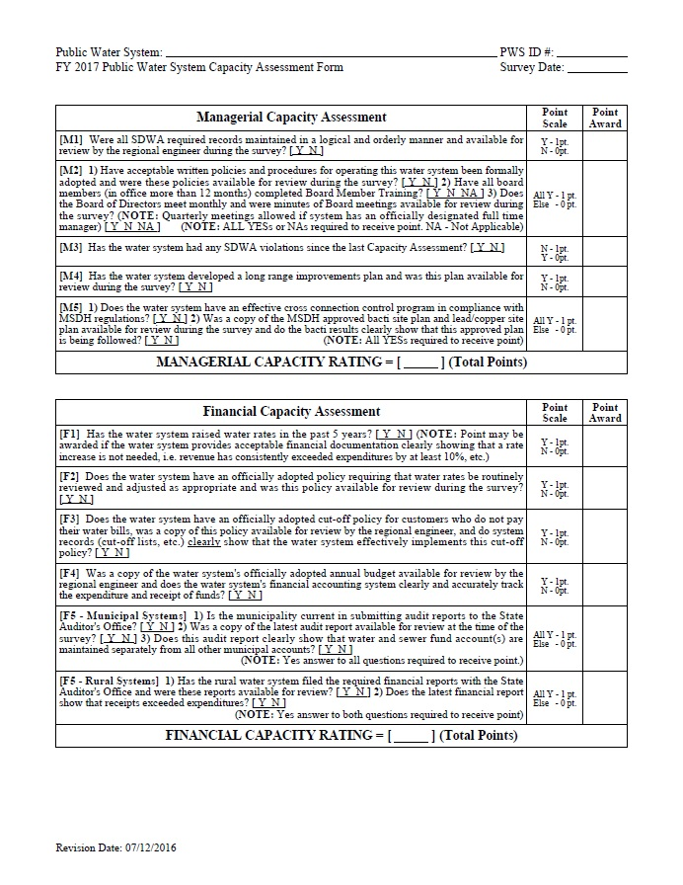
Assistance offered for Disadvantaged Communities

Slide 15
Assistance offered for Disadvantaged Communities - Peer Review Program
Funding Year | Total number of reviews
FY2015 | 21
FY2014 | 13
FY2013 | 19
FY2012 | 22
FY2011 | 20
FY2010 | 12
FY2009 | 8

Slide 16
Assistance offered for Disadvantaged Communities
Board Management Training (2% Set-Aside)
Objective: Coordination the Board Management Training (BMT) for Public Water System Officials
Mississippi state law requires board management training for all newly elected board members of private, non-profit water supplies of their duties of representing the water system.
Mississippi state law additionally requires the training for officials of municipal systems with a population of 10,000 and less
The training requirement is to complete the 8 hour training within two years of being elected to the board.

Slide 17
Assistance offered for Disadvantaged Communities - Board Management Training
Funding Year | # of Sessions | # of Officials Trained
FY2015 | 15 | 330
FY2014 | 13 | 356
FY2013 | 16 | 303
FY2012 | 19 | 275
FY2011 | 19 | 269
FY2010 | 22 | 404
FY2009 | 14 | 241
FY2008 | 23 | 421

Slide 18
Assistance offered for Disadvantaged Communities
Hands-On Operator Training Program (2% Set-aside)
Objective: To train existing certified operators for small systems through “hands-on” instruction of equipment and real water supply examples

Slide 19
Assistance offered for Disadvantaged Communities - Hands-On Operator Training
Funding Year | # of Sessions | # of Operators | # Water Sys
FY2015 | 15 | 337 | 178
FY2014 | 17 | 354 | 179
FY2013 | 20 | 398 | 197
FY2012 | 19 | 485 | 256
FY2011 | 14 | 201 | 109
FY2010 | 15 | 277 | 141
FY2009 | 8 | 132 | 138
FY2008 | 13 | 207 | 161

Slide 20
Assistance offered for Disadvantaged Communities
Well Decommissioning Program (15% Set-aside)
Objective: To provide funding to properly decommission and seal abandoned inactive wells.
Two separate contracts
Administration
Well decommissioning work
Wells that pose the highest potential risk to existing active supplies are given priority
To date a total of 134 wells have been properly decommissioned for 85 different water systems through the program.

Slide 21
Perspective of the impacts of the programs and assistance
Subsidization
Has greatly benefited those that are eligible in reducing the long term impact.
The shear number of disadvantaged systems are great due to the number of small rural systems still in existence.
Still is a struggle to get the more disadvantaged programs to participate due to additional administration requirements and limited resources.

Slide 22
Perspective of the impacts of the programs and assistance
Peer Review Program
Since it’s inception back in 2002 incremental improvements in systems TMF have been seen.
Overall TMF Capacity has seen increases to where most systems are now scoring high in their TMF capacity.
Regional regulatory staff now sees the shift in recommending systems for reviews that have incurred major turnover in their senior personnel to help maintain capacity.

Slide 23
Perspective of the impacts of the programs and assistance
Board Management Training
Having a state law does help insure that water officials are aware of the duties and responsibilities.
The training that is offered is hugely beneficial in making sure that systems are well managed not only for today but also for the future.

Slide 24
Perspective of the impacts of the programs and assistance
Hands on Operator Training Program
Has helped keep existing operators trained in tackling more issues on their own which in turn has helped some communities save from having to pay for additional outside assistance.
Mississippi has many operators that operate multiple systems so keeping their education on maintaining the systems allowing them to actually tackle real world problems with real world fixes are tremendous in maintaining a sustainable water supply.

Slide 25
Additional Information
Stay in touch
Linked In: www.linkedin.com/in/hgongjrpe18005
Email: Harry.Gong@msdh.ms.gov
hgongjr@gmail.com
Phone: 601-576-7518 or (cell) 601-573-0002
Address: Mississippi State Department of Health
Bureau of Public Water Supply
570 E Woodrow Wilson, U232
Jackson, MS 39216

Slide 26
Final Comments?

