Slide 1
Streamlining
Florida’s
State Revolving Fund

Slide 2
Overview
Streamlining Events for SRF:
  Disbursement Process
  Focus Group Feedback
  Upcoming Event Planned

Slide 3
Disbursement Process Improvement Event
Disbursement Process Streamlining:
  Rapid Process Improvement
    Planning
    The “Event”
    Implementation
  Goals –
    Make process paperless where possible
    reduce paper used

Slide 4
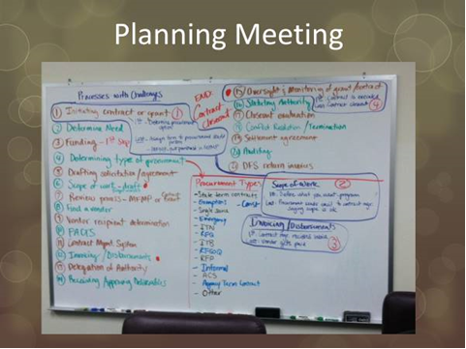

Slide 5
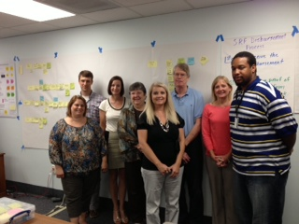
Our Team

Slide 6
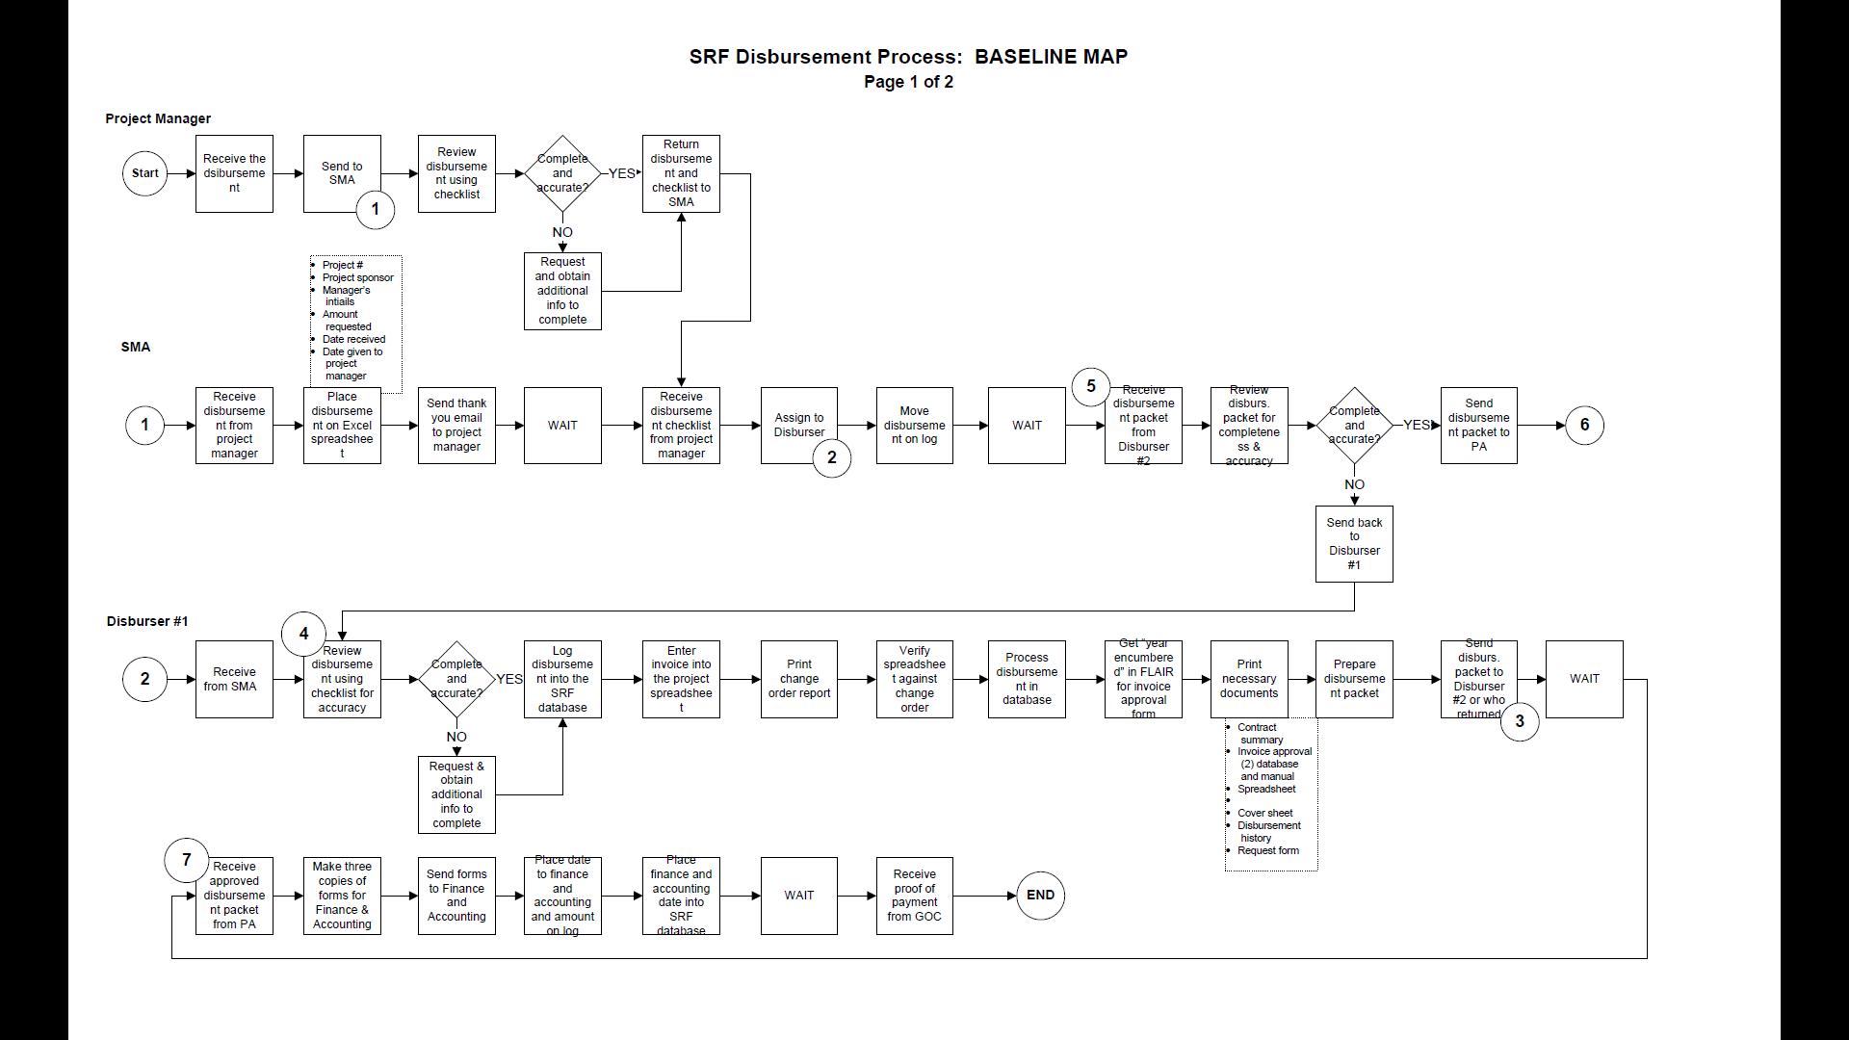
Process Map – Baseline

Slide 7
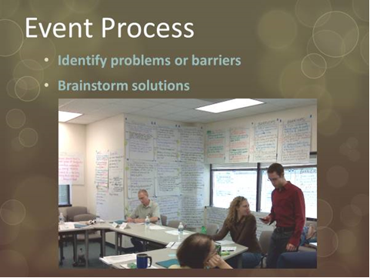

Slide 8
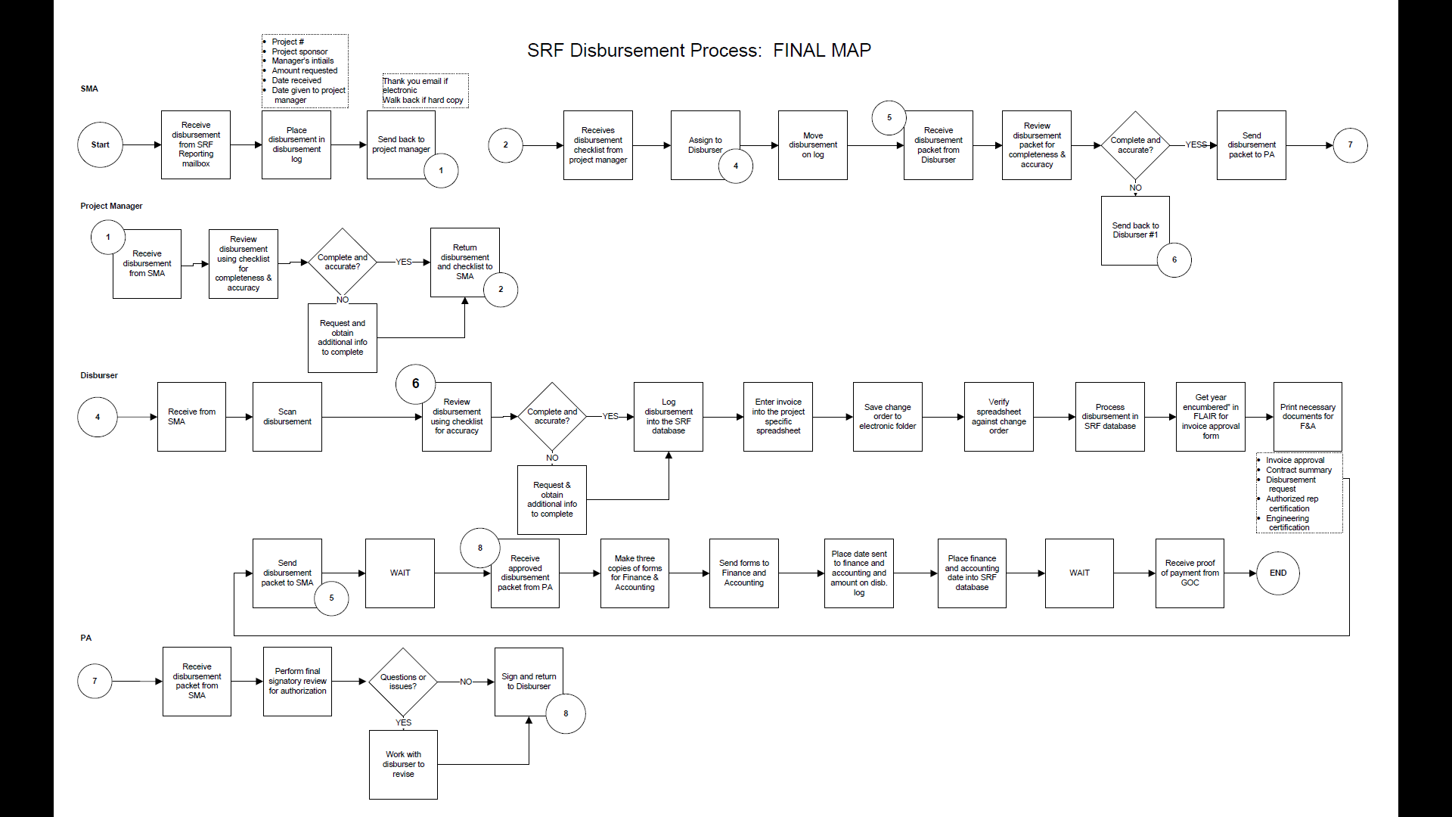
Process Map - Final
Current as of 6/28/16

Slide 9
Implementation Plan
Met with Finance & Accounting on electronic submittal process
Revised internal checklists to eliminate duplication
Met with project managers to enlist their assistance with identifying ineligible items
Combined two certification forms borrowers submit
Encourage email submittals through an electronic mailbox that is monitored daily

Slide 10
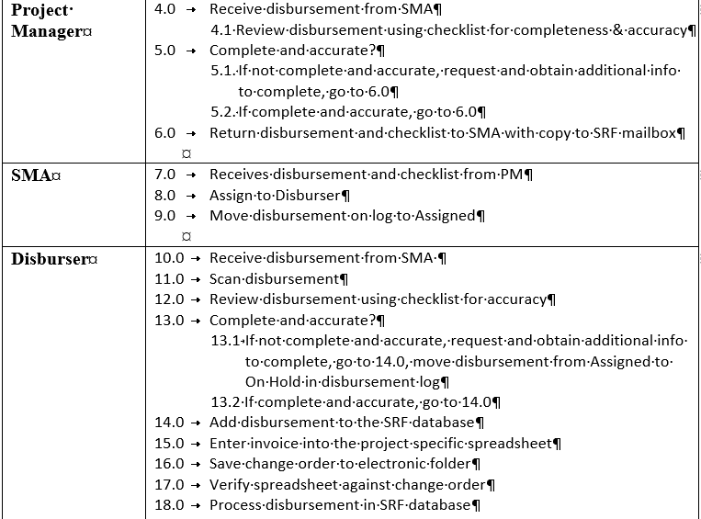
Play Book

Slide 11
Process Improvement Results
Reduced duplicative efforts and handoffs by 20% and overall steps by 16%
Estimated saving 8,700 pages or 15 reams of paper per year (based on 229 disbursements @ 38 pages each)
Fully paperless process - LiveCycle

Slide 12
CWSRF Focus Group
FDEP & EPA conducted a focus group of municipal representatives & service providers in the Indian River Lagoon region on July 28, 2017
A component of the nationwide marketing & outreach effort led by EPA
Nineteen participants – municipalities & consulting engineers

Slide 13
Focus Group Goals
Understand borrowers’ and consultants’ attitudes and opinions about the CWSRF program
Gain an understanding of how infrastructure financing decisions are made
Determine barriers to CWSRF financing
Recommend improvements to the CWSRF processes and outreach efforts in the region

Slide 14
Focus Group Feedback
AIS and Davis-Bacon requirements are cumbersome
Meeting CWSRF requirements increases workload and costs significantly
The service fee is unpopular and misunderstood
The program is confusing and difficult to navigate
The website is not user friendly and the necessary information is hard to find

Slide 15
Recommendations
Provide additional training to borrowers and contractors
Consider purchasing software for administering Davis-Bacon
Improve website – highlight advantages
Create on-line tool to calculate the current interest rate
Use website to highlight advantages of using the CWSRF
Modify how the service fee is presented to borrowers
Consider financing terms beyond 30-years

Slide 16
Future Events Planned
Lean event for Environmental Review Process
Continuous Improvement

Slide 17
Contact Information
Email: Angela.Knecht@dep.state.fl.us
Telephone: (850) 245-2934

