Slide 1
Municipal Bond Developments
Michael L. Post, General Counsel
Municipal Securities Rulemaking Board
Council of Infrastructure Financing Authorities
March 27, 2018

Slide 2
Overview of Presentation
About the MSRB
MSRB Resources
Municipal Advisors Obligations to Issuers

Slide 3
Municipal Securities Rulemaking Board (MSRB)
Created by Congress in 1975 to protect municipal securities investors, issuers and the public interest
Self-regulatory organization that writes rules, promotes transparency and provides education
Subject to SEC oversight; no enforcement authority
No federal funding; revenue primarily from fees assessed on regulated municipal securities dealers and municipal advisors

Slide 4
Long-Term Strategic Goals
Facilitate compliance with MSRB rules
Further evolve the EMMA website
Optimize the utility of municipal market data
Leverage the MSRB’s unique perspective and expertise
Promote financial sustainability to carry out mission

Slide 5
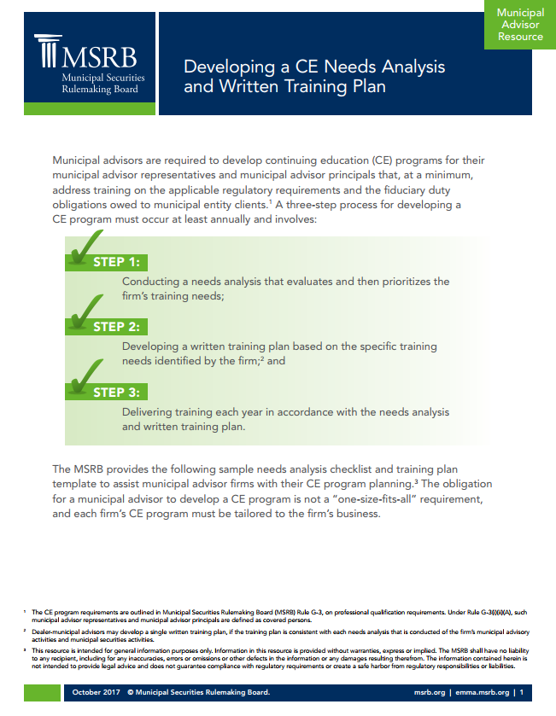
Facilitating Compliance
Responding to industry requests for additional rule guidance, clarification and compliance resources
Adding new rule-based MuniEdPro® courses
Updating consolidated Compliance Center on MSRB.org

Slide 6
Evolving EMMA
Addition of interactive tools to support understanding of market trends
Third-party yield curves and indices
New issue calendar
Economic calendar
Market-wide statistics
Improvements to site-wide navigation and presentation of information about individual securities
Informed by years-long series of focus groups and user feedback
Re-engineering and updating of data and document submission systems

Slide 7
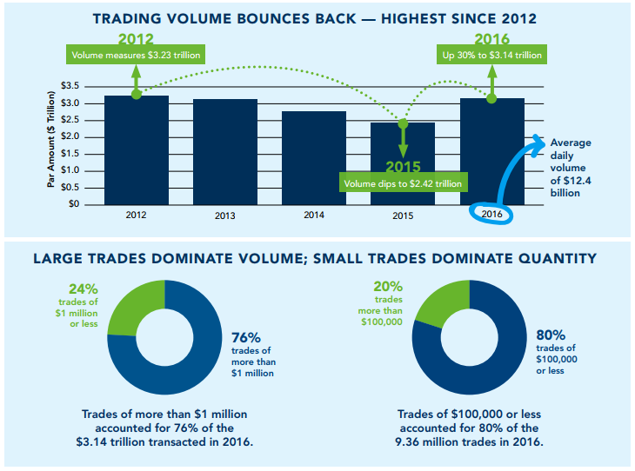
Optimizing Market Data
Conducting a comprehensive analysis of relevant market data
Disclosure documents
Trade data
Third-party data (e.g., credit ratings)
Maximizing availability, utility and quality

Slide 8
Leverage Unique Perspective
Monitoring industry practices that can have an impact on the integrity and fairness of the market
Publishing white papers, commentary and advisories
Informing policy debates

Slide 9
Financial Sustainability
Publishing public budget summary in support of public accountability and transparency
Ensuring fair and equitable distribution of fees among regulated entities
Aligning spending with strategic goals

Slide 10
MSRB Resources

Slide 11
MyEMMA Alerts
Receive real-time email alerts when new disclosure documents are posted to EMMA®
Recent enhancements:
Improved email design provides more details about the newly filed disclosure
Choose the specific types of disclosure filings to monitor, e.g., audited financial statements, bond calls

Slide 12
Financial Disclosure Email Reminders
Issuers can schedule automated emails from EMMA® to be reminded of approaching annual or quarterly financial disclosure filing deadlines
Include additional contacts to ensure all those with a role in disclosure are alerted

Slide 13
MuniEdPro® Course Catalog
Current Offerings
Find out more at MSRB.org
Standards of Conduct: Duties of Non-Solicitor Municipal Advisors
Making Recommendations: Understanding Suitability and Time-of-Trade Disclosure for Municipal Securities Transactions
Due Diligence: Primary Offering Disclosure Responsibilities
Complimentary Courses: Being an Informed Municipal Bond Issuer
Exploring Municipal Bonds: A Course for Investors
Role of the Regulator: Understanding the MSRB
The Decision to Borrow: Roles and Responsibilities of Market Participants in Fixed Rate Primary Market Offerings
Rules and Risks: Understanding MSRB Rules in Relation to Municipal Market Risks
Best Execution: MSRB Rule G-18
Gifts and Gratuities: MSRB Rule G-20
Complimentary through May 14, 2018:
Mark-Up Disclosure and Prevailing Market Price for Municipal Securities: MSRB
Rules G-15 and G-30;
CE Credit Available

Slide 14
Municipal Advisor Obligations to Issuers

Slide 15
Role of the Municipal Advisor
Has a fiduciary duty to municipal entity clients
Duty of care and duty of loyalty
Must put municipal entity client’s interests of ahead of its own
Has a duty of care to obligated person clients
May assist with:
Developing requests for proposals
Selection of underwriters
Developing the plan of finance
Analyzing financing alternatives
Advising on the method of sale
MSRB Rule G-42
Standards of Conduct
Sets forth core elements of the fiduciary duty and provides guidance on certain conduct and issues likely to occur in the course of engaging in municipal advisory activities

Slide 16
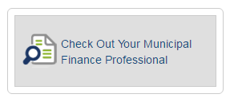
Verify Municipal Advisor Registration
All municipal advisor firms should be registered with both the SEC and the MSRB
Find a full list of MSRB-registered firms on the MSRB website
http://www.msrb.org

Slide 17
Look for Series 50 Credential
MSRB requires all municipal advisors to take and pass the baseline test of professional qualification
By fall 2017, all municipal advisor professionals should hold the MSRB’s Series 50 credential
Ask your municipal advisor whether they have taken and passed the exam

Slide 18
Municipal Advisors MUST:
Put municipal entity client’s interests ahead of their own
Disclose conflicts of interest
Provide documentation of municipal advisory relationship
Make suitable recommendations
Know their clients

Slide 19
Municipal Advisors MUST NOT
Charge excessive compensation and fees
Deliver inaccurate invoices for fees or expenses
Make false or misleading representations about their capacity or knowledge
Advise on certain transactions where the municipal advisor’s firm is acting as principal
Attempt “pay-to-play” activities
Attempt to give excessive gifts or gratuities to an employee of an issuer client

Slide 20
File a Complaint
Submit complaints to the MSRB
202-838-1330
complaints@msrb.org
Submit complaints to the SEC
U.S. Securities and Exchange Commission Office of Municipal Securities 100 F Street, NE Washington, DC 20549
Tips, Complaints and Referrals Portal
Submit complaints about FINRA-registered municipal advisors to FINRA
FINRA's Investor Complaint Center

Slide 21
Contact the MSRB
MSRB Support
202-838-1330
MSRBSupport@msrb.org
Michael L. Post
mpost@msrb.org
MSRB Email Updates
Sign up at MSRB.org
Follow Us on Twitter
@MSRB_News

