Slide 1
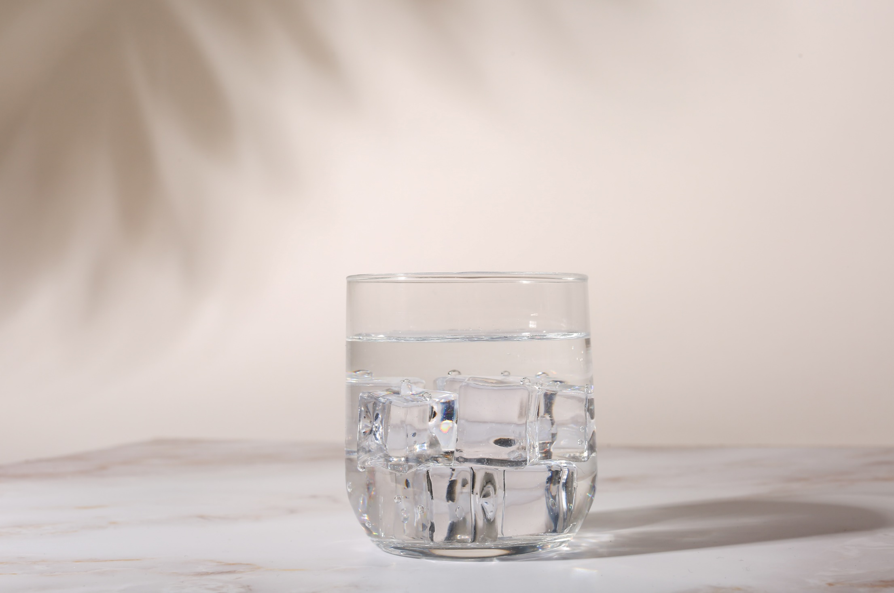
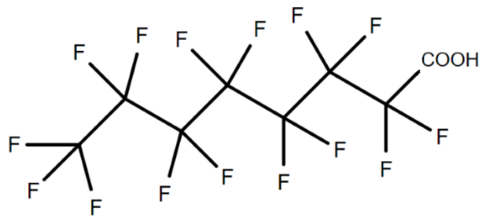
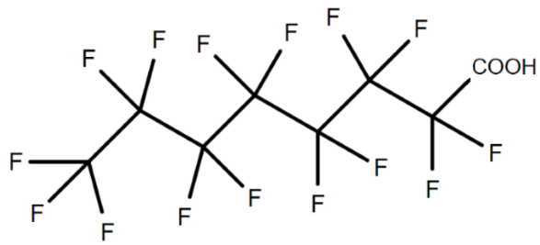
Washington State
PFAS - Policy meets funding
Office of Drinking Water
Notes:
Washington State standards for PFAS in drinking water as a title instead? Second page already says Day with DOH

Slide 2

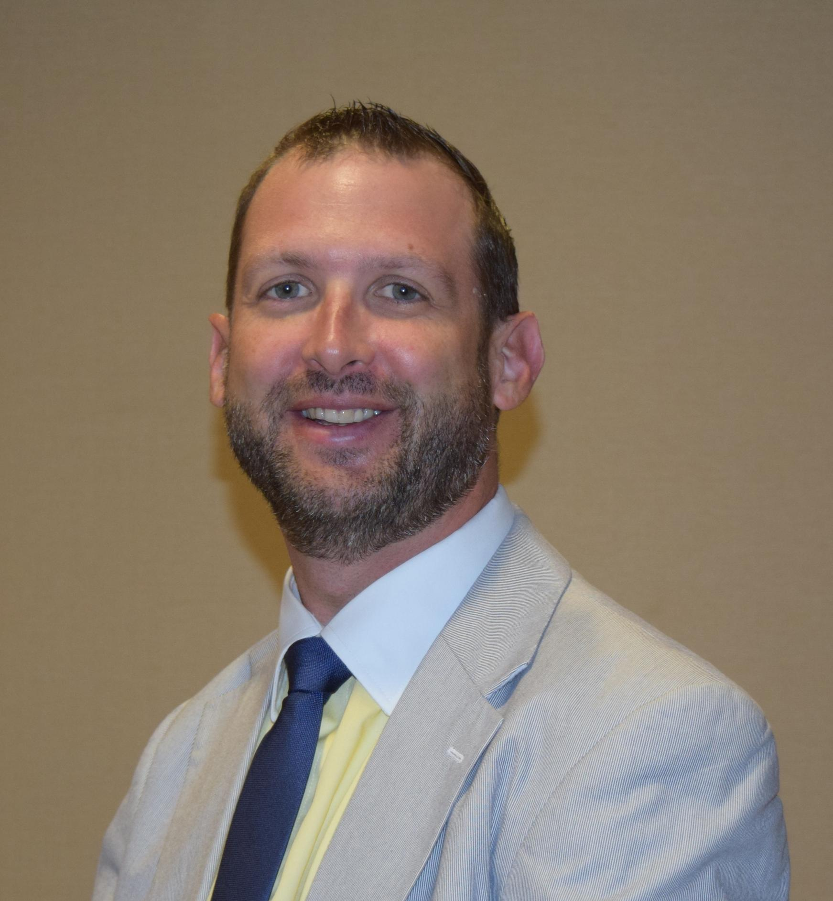
Contributors
Mike Means R.G., LHG
Chris Pettit
Capacity Development and Policy Manager
DWSRF Program Manager
Office of Drinking Water
Office of Drinking Water
Mike.Means@doh.wa.gov
Chris.Pettit@doh.wa.gov

Slide 3


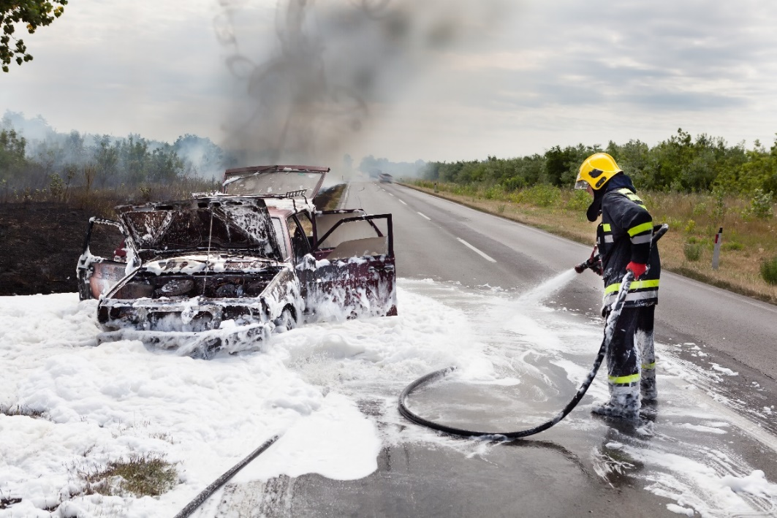
Per- and Polyfluoroalkyl Substances (PFAS) nonstick, stain and water resistant, heat stable
Notes:
Mike

Slide 4
Some PFAS are PBTs
Persistent
in the environment
Bioaccumulate
in humans
Toxic
at low levels
Notes:
Mike
PFAS are persistent - they don’t break down completely in the environment.
Some but not all are also known to bioaccumulate in humans, meaning that they build up in the human body over time.
And we know that at least some PFAS are toxic in laboratory animals at low levels. Many are yet to be studied.
Human health risks
Increased serum cholesterol
Altered liver enzymes
Reduced immune response to vaccines
Lower birth weight
Blood pressure problems during pregnancy
Increase risk of thyroid disease
Increased risk of cancer (kidney and testicular)

Slide 5
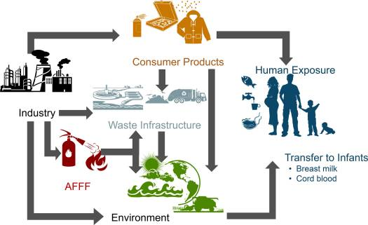
WA State Action to Address PFAS
Cosmetics (HB 1047)
Ban on PFAS in food contact paper RCW 70A.222.070
Education - How to reduce PFAS exposure
Safer Products for WA RCW 70A.350
Aftermarket stain and water proofing treatments
Leather and textile furnishings (indoor)
Carpets and rugs
Ban on PFAS in firefighting foam RCW 70.75A
Dept of ECY safe foam disposal program
Drinking water standards
Fish consumption advisories
Source: Sunderland EM et al. (2019) A review of the pathways of human exposure to poly- and perfluoroalkyl substances (PFASs) and present understanding of health effects. https://www.ncbi.nlm.nih.gov/pmc/articles/PMC6380916/
Notes:
I want to share our state philosophy at where we intervene to address PFAS.
This slide shows a simplified pathway that PFAS get into people.
Our preference and focus is to work as upstream as possible at sources. This is how to stem the flow of PFAS into the state.
Akin to turnoff the faucet while we bail the bathtub.
Drinking water standards, our fish advisories are targeting intervention points that intercept contamination that has already been released into the state.

Slide 6

SALs set to be Health Protective
A level in water expected to be without appreciable health effects over a lifetime of exposure, including in sensitive groups.
Based on best available science at the time.
Notes:
Mike
A State Action Level (or SAL) is a level in drinking water expected to have no appreciable adverse impact to health over a lifetime of exposure.
This includes sensitive populations and life stages. And is based on the best available science at the time it was set.
It is a health –protective value
Taking action at these levels is consistent with the mission of providing safe and reliable drinking water.
Important caveat is that they were set with the best available at the science at the time – science is evolving rapidly on PFAS.
As mentioned earlier, some PFAS bioaccumulate in the human body.
We took that into account when setting these values. The exposure model helps us predict the level in people that would eventually occur after many years drinking the water. As such they define a safe level for long-term exposure.

Slide 7
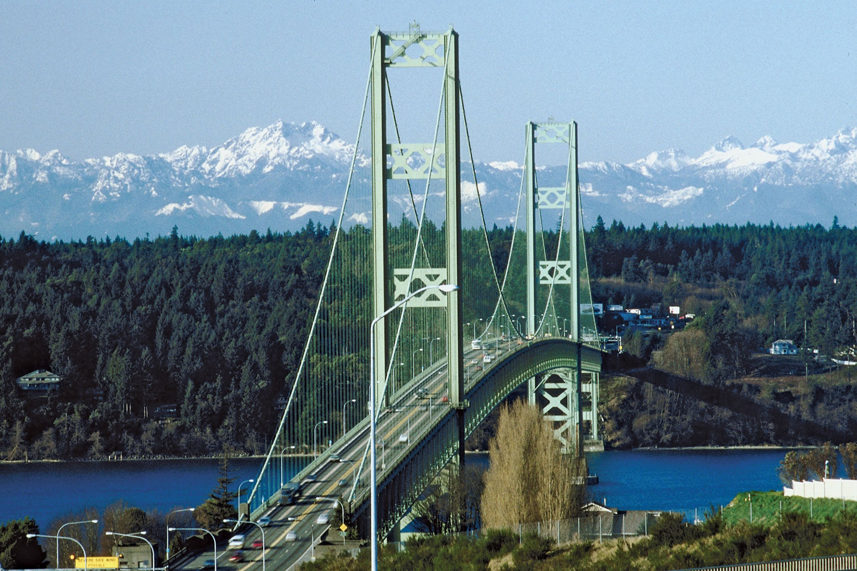
A SAL is a Bridge to an MCL
SALs require testing, public notification and guide public health response to results.
Testing helps define scope of problem and necessary funding and resources.
Testing data is needed to develop state cost-benefit analyses for Maximum Contaminant Levels (MCL).
Notes:
Mike
SAL is a bridge to an MCL.
Provides required actions and public health guidance when responding to results.
Will help us understanding the scope of the problem and what state resources are needed to address PFAS.
Collects data needed to support an MCL, if the feds don’t adopt one.

Slide 8

2021 State Action Levels (SALs)
Features
Sets action levels for 5 PFAS.
Requires PFAS testing by most Group A public water systems (PWS).
Requires notification to customers.
Requires follow-up monitoring.
Effective date: Jan 1, 2022.
Mitigation of water is not required but systems are encouraged to follow public health advice and funding and technical assistance is available.
Drinking Water Contaminant | SAL (parts per trillion)
PFOA | 10
PFOS | 15
PFNA | 9
PFHxS | 65
PFBS | 345
Notes:
Mike

Slide 9
SAL Implementation
and WTn PFAs dashboard
Notes:
Sophia

Slide 11

Public Notice Requirements
Water Systems that exceed a SAL
Inform customers about the health effects of the contaminant
What, if anything, are they doing to address the issue
What consumers can do to reduce their exposure
Include any PFAS detections in their annual consumer confidence report
Community water systems with a detection

Slide 12
Implementation of the PFAS SALs
Voluntary free testing programs
Initial PFAS testing - Jan. ‘23 – Dec. ‘25
SALs apply to Group A Public Water Systems (PWS)
Started 2021
New program offered 2024
Derrick Dennis is the primary contact
EPA methods 533 or 537.1 version 2.0
UCMR 5 samples may count
Pub. 331-700
Community
NTNC
TNC, if near a detection
Notes:
We do accredit for 537.1 version 1, but after Jun 25, 2024, results using version 1 may not meet federal requirements per 141.901(a)(2)(ii) and (b)(2)(ii).

Slide 13
Summary of PFAS Water Testing to Date
~ 61% of public water systems have tested for PFAS (1,482/2,422 systems)
~ 80% of systems tested report no PFAS
~ 2% of water system that tested have PFAS > SAL
~ 9% of water systems have at least 1 sample for a source above an MCL
Notes:
61% of PWSs and 67% of sources now tested
19% of PWSs and 18% of sources that have tested have a detection
2% of PWSs and 2% of sources that have tested have detections > SAL
127 systems have 1 or more sources with at least 1 sample >MCL. Not all of these would exceed the RAA.

Slide 14
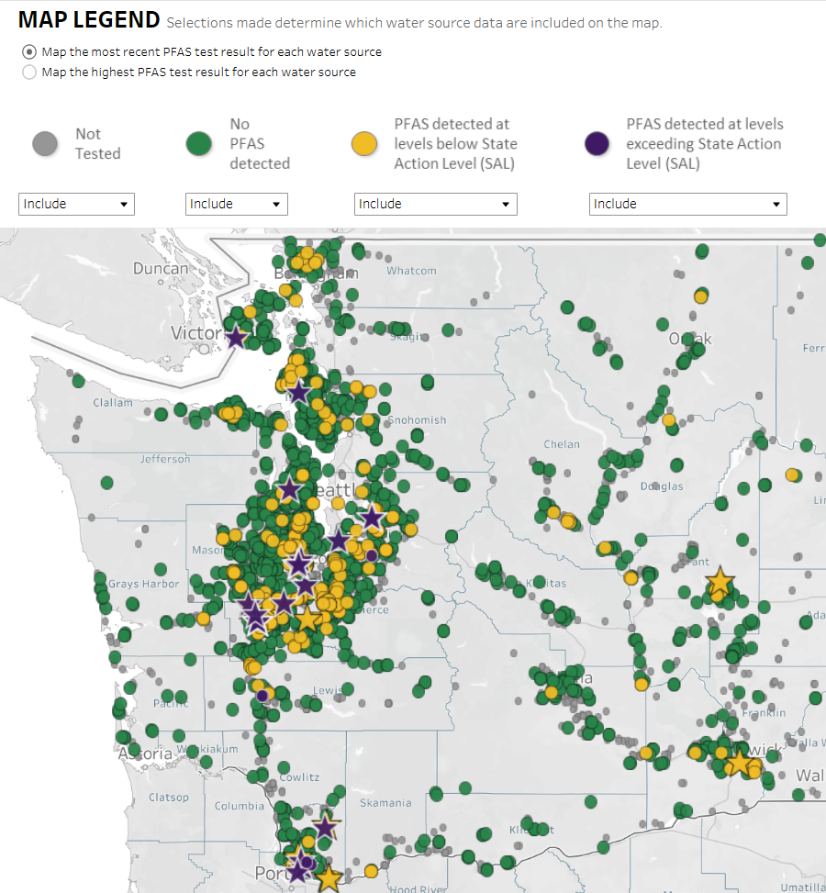
PFAS
Dashboard -
Drinking Water Data
Only includes samples for Group A PWSs complying with new rule.
Doesn’t include historical water testing.
Doesn’t include military testing.
Doesn’t include private well testing.
https://doh.wa.gov/data-and-statistical-reports/washington-tracking-network-wtn/pfas
Notes:
Change picture transparency on the right hand side only? HOW? – use old slide to fix

Slide 15
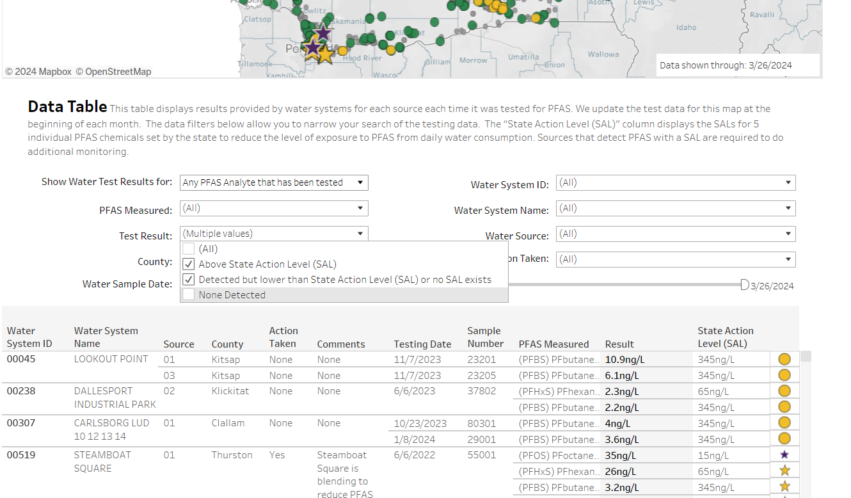
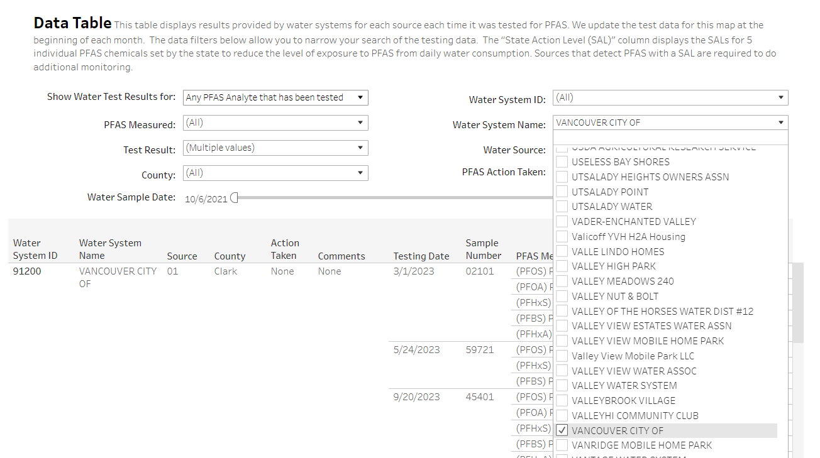
PFAS WQ results data is easily accessible and transparent in the data table section of the PFAS Dashboard

Slide 16
April 26, 2024
EPA publishes PFAS rule

Slide 17
New MCLs and Other Relevant Numbers
PFAS | MCL (as RAA) | Practical Quantitation Limit (PQL) | Trigger
 | Health-based standard | Defines detect for RAA calc. | Defines detect for mon
PFOA | 4.0 | 4.0 | 2.0
PFOS | 4.0 | 4.0 | 2.0
PFHxS | 10 | 3.0 | 5
PFNA | 10 | 4.0 | 5
HFPO-DA (GenX) | 10 | 5.0 | 5
PFBS | HBWC = 2,000 | 3.0 | -
Haz. Index (sum of ratios for PFHxS, PFNA, GenX, and PFBS | 1.0 | - | 0.5
All units are in nanograms per liter or parts per trillion
Notes:
Significant figures matter in most cases (not sure why they matter with triggers since monitoring it based on “LT” trigger and not LT or EQ

Slide 18
Monitoring under EPA rule
Action | Ground Water and <10K population | Surface Water or >10K population
Initial | 2 samples 5-7 months apart | 4 quarterly samples, with all samples 2 to 4 months apart
 | We must receive results by April 26, 2027 Legacy samples after Jan. 1, 2019, can count towards meeting initial
Compliance | Starts April 26, 2027 Same for all systems and source types Based upon results over the last 3 years IF results less than trigger (1/2 MCL) – 1 time option to reduce directly to triennial Quarterly for detections equal to or greater than a trigger 3 years of annual after first compliance period after detects, when below triggers If 3 annual sets all below triggers, can reduce to triennial
Notes:
Detected changed in 141.151 for CCR reporting per .901.
Only requires testing of 6 PFAS
141.902(b) timing must meet rule requirements
No PFAS data before 1/1/19 accepted
Systems with less samples than needed for federal rule will need additional samples

Slide 19
EPA PFAS Rule Dates
EPA promulgated the rule on April 26, 2024
June 26, 2024
April 26, 2027
April 26, 2029
Effective Date of Rule, with exceptions.
Initial monitoring must be received.
Compliance monitoring begins.
First CCR notices required.
MCLs are effective.
PN required for violations.
Water systems must mitigate for PFAS by this date.
Notes:
Mike

Slide 20
State Rule (SALs) to EPA Rule (MCLs)
Transition
Now to April 26, 2029
Notes:
Mike

Slide 21
June 2024 SBOH Decisions
Adopted an emergency rule changing language for the MCLs to replace the SALs after the effective date, instead of after the adoption date.
Start an exception rulemaking to adopt the federal PFAS rule.
Start formal rulemaking to consider adopting the MCL values as our SALs until the federal MCLs go into effect in 2029.
Notes:
Mike

Slide 22
State SALs & EPA’s Proposed MCLs for Drinking Water
For PFAS in Drinking Water (ng/L or parts per trillion)
PFAS contaminant | WA SALs 2021 | EPA MCLs 2024
PFOA | 10 | 4.0
PFOS | 15 | 4.0
PFHxS | 65 | 10
PFNA | 9 | 10
GenX | - | 10
PFBS | 345 | 2000* (not an MCL)
Hazard Index | - | 1
* PFBS has a “health-based water concentration” established for use in calculating the hazard index MCL.
The hazard index MCL is unitless.

Slide 23
SAL/MCL Comparison of PN and Other Actions
Action | State SAL Rule | EPA MCL Rule
Annual CCR (or 2X per year) | Any detection requires CCR notification currently. | Any detection equal to or above the trigger value, starting April 2027.
Tier 2 notification | Required for any confirmed SAL exceedance. | Required for MCL running annual average violations after April 26, 2029.
Treatment or other mitigation | Not required but recommended. Funding and technical assistance options available. | Required for MCL exceedance before April 26, 2029. Funding and technical assistance options available.
Notes:
Detected changed in 141.151 for CCR reporting per .902(a)(5) compared to WAC
Early transition to the SRF team that presents after us.
Would love to recommend PWSs not use method 537.1 version 1 now since CFR says only version 2.0 allowed for federal purposes after June 25, 2024.

Slide 24
SAL/MCL - Sampling Requirements
Now to 4/25/2027
Action | State SAL Rule | EPA MCL Rule
 | 1 sample every 3 years Follow-up/increased monitoring based on results or % of SAL Can reduce if < 80% of SAL Can reduce faster if <20% of SAL | 2 samples 5-7 months apart for small GW 4 quarterly samples for SW/GWI sources and all large PWS sources (10k pop)
How we blend both rules | We will include increased monitoring from the WAC with initial monitoring from the EPA rule. We will schedule WQMS months to meet EPA’s initial monitoring requirements based on the existing data. You should follow the months on your WQMS closely for PFAS. For small GW systems with 1 sample, a second sample will be scheduled 6 months from the month of the original sample. For larger systems or SW sources, samples will be scheduled in any missing quarters 2 to 4 months apart, if possible.
Notes:
Detected changed in 141.151 for CCR reporting per .901.
Only requires testing of 6 PFAS
141.902(b) timing must meet rule requirements
No PFAS data before 1/1/19 accepted
Systems with less samples than needed for federal rule will need additional samples

Slide 25
SRF Funding Programs
Planning and Engineering
Construction and Lead Service Lines
Emerging Contaminants (BIL and EC-SDC)
Consolidation Feasibility
Water System Rehabilitation and Consolidation
Emergency
Source Water Protection

Slide 26
Funding Specifics
Maximum award is $15 million per jurisdiction.
Disadvantaged community (DAC) permanent rule effective September 1, 2024.
Updated DAC criteria – Affordability meets social and environmental indicators
Plan approvals mandatory
PFAS must exceed the new EPA maximum contaminant levels (MCL). Sample must be confirmed.

Slide 27
Funding Opportunities For Emerging Contaminants
Drinking Water State Revolving Fund (DWSRF) | Washington State Department of Health
- Capitalization Grant and Bipartisan Infrastructure Law Supplemental Funding
1) Planning and Design
2) Construction
- WIIN Grant for Small and Disadvantaged Communities
1) Sampling
2) Planning and Design
3) Short Term Mitigation
4) Long Term Remediation
- TECHNICAL ASSISTANCE IS AVAILABLE

Slide 28
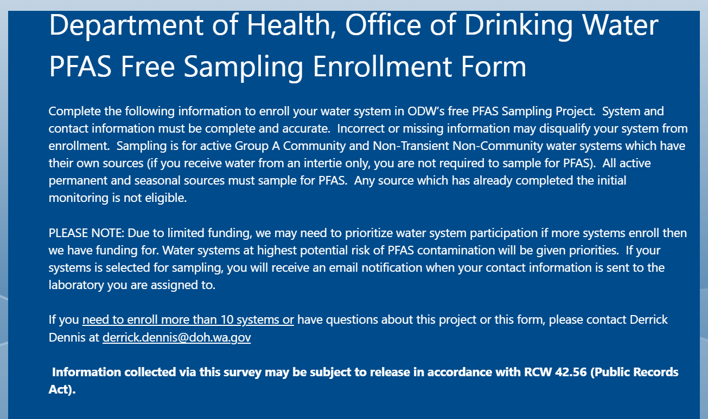
Soup-to-Nuts PFAS TA and Funding Process
Sampling Exceedances
  Consultation between ODW staff and SRF staff
Technical Assistance (ODW/SRF)
  Regional Staff
  Request assistance through the Technical Assistance Request Form (arcgis.com)
Topic Specific Technical Assistance
  Planning and Engineering (General and EC)
  Procurement Assistance (in process)
Collaborative Statewide TA (SYNC)

Slide 29
Dedicated Emerging Contaminants Funding
EPA WIIN Grant
  Targets Small and Disadvantaged Communities
  Flexibility with Planning Requirements
Emerging Contaminants
  PFAS (MCL and SAL)
  Manganese
  HABs (Nitrates?)
Water Sampling and Testing
Short Term Mitigation (tied to a long term remediation project)
Planning updates and project design (Grants and TA)
Long Term Remediation

Slide 30
Washington State PFAS Programs
Department of Ecology - PFAS - Washington State Department of Ecology
Department of Commerce - Public Works Board – Washington State Department of Commerce
Department of Health
  PFAS | Washington State Department of Health
  Drinking Water State Revolving Fund (DWSRF) | Washington State Department of Health
    Emerging Contaminants (BIL and EC-SDC)
SYNC!!

Slide 31
DWSRF Staff Contacts
  Program Manager Chris.Pettit@doh.wa.gov or 564-233-1408
  Scope of Work, Funding Cycles, and Technical Questions Jocelyne.Gray@doh.wa.gov or 564-669-4893
  WALT Application and General Questions DWSRF@doh.wa.gov or Jason.Cammarano@doh.wa.gov
  Cultural, Historical, and Environmental Review Scott.Kugel@doh.wa.gov or 360-480-7617
  Technical Assistance Coordination watersystemhelp@doh.wa.gov
  Emerging Contaminants
  Samantha.Delmer@doh.wa.gov

Slide 32
Questions?

Slide 33

To request this document in another format, call 1-800-525-0127. Deaf or hard of
hearing customers, please call 711 (Washington Relay) or email civil.rights@doh.wa.gov.

