Slide 1
Iowa SRF
Customer Service Focus
CIFA 2017
Patti Cale-Finnegan
Department of Natural Resources

Slide 2
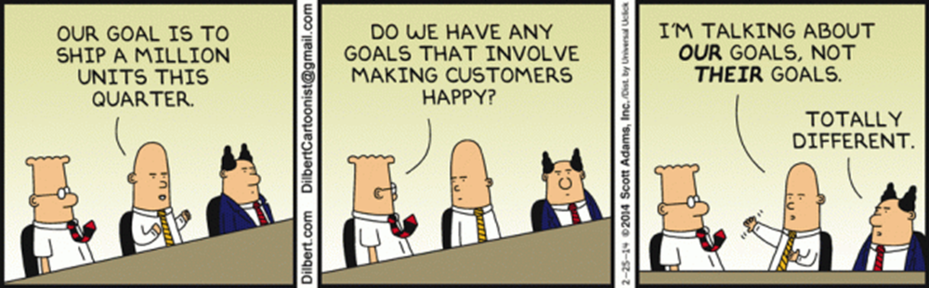
Iowa SRF Customer Service
Environmental review
Planning and design loans
Sponsored projects

Slide 3
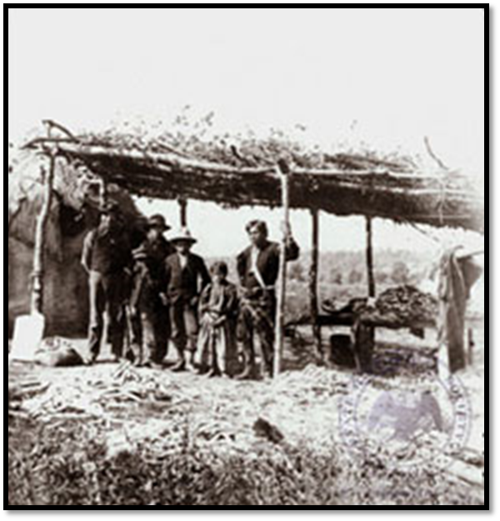
Environmental Review
Why we do it:
  It was perceived as a barrier to using the program
  We can streamline the process with expert staff

Slide 4
Environmental Review
How we do it:
  Each water or wastewater infrastructure project is assigned to an environmental review specialist
  ER specialist manages NEPA and Sec. 106 consultation
  If archaeology or architectural history survey is needed, we use our master contracts

Slide 5
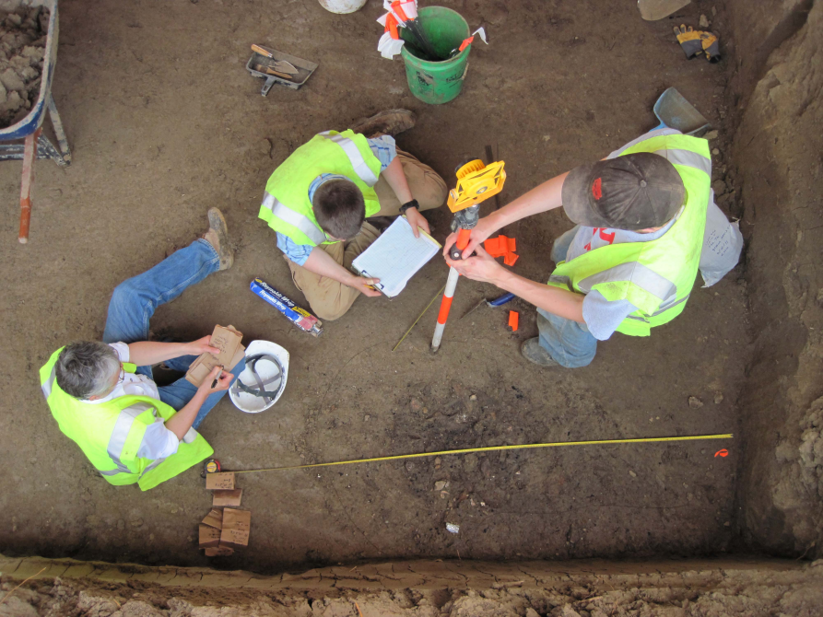
Environmental Review
Example project:
  Des Moines, IA
  Tribal concerns prompted a Programmatic Agreement
  During construction, 7,000 year-old village and human remains were found

Slide 6
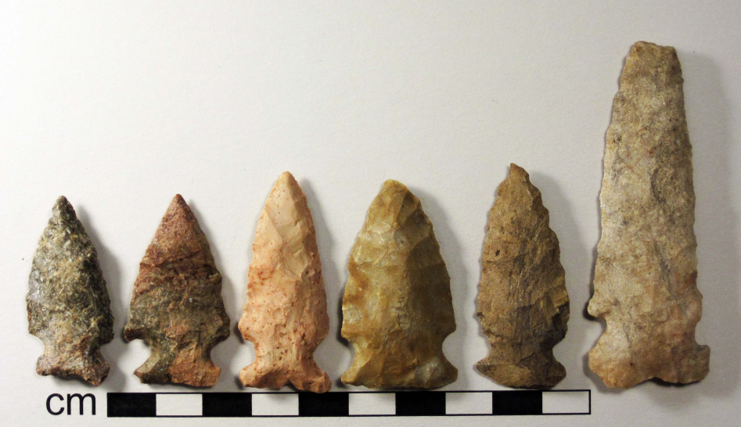
Environmental Review
Example project:
  Extensive data recovery
  Dispute over future restrictions on site went up to Advisory Council on Historic Preservation for resolution
  Without SRF ER specialists’ expertise, the issues could have dragged on for years

Slide 7

Planning and Design Loans
Why we do it:
  Many communities don’t have reserves to pay for upfront engineering costs
  Helps get project ready for permanent construction financing, applying for grants
  Timing of SRF construction loan

Slide 8
Planning and Design Loans
How we do it:
  0% interest, no fees for up to 3 years
  Rolls into SRF construction loan
  Or if other funding method used, paid off with permanent financing

Slide 9
Planning and Design Loans
Example projects:
  Walnut, IA, population 779, borrowed $170,000 for an engineering report on a new well
  Having the PER allowed disadvantaged community to apply for grant and loan from Community Development Block Grant and USDA Rural Development

Slide 10
Planning and Design Loans
Example projects:
  Clarence, IA, pop. 974, borrowed $120,000 to cover costs of televising sewers and preparing sewer rehab facility plan
  Having an approved FP made them more competitive for CDBG
  Received $300,000 grant and borrowed $1.3 million from CWSRF, rolling in P&D

Slide 11
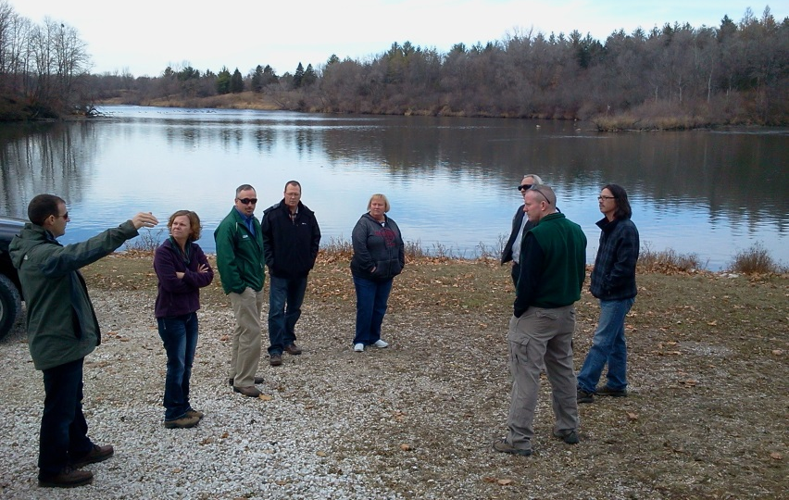
Sponsored Projects
Why we do it:
  Incentivize nonpoint source water quality practices
  Promote watershed-based planning and partnerships
  Develop expertise in design community

Slide 12
Sponsored Projects
How we do it:
  Pre-application conference call
  Technical assistance from urban conservationist
  Partnership with watershed organizations
  Training for communities, consultants, contractors

Slide 13
Sponsored Projects
Example projects:
  Sioux City, IA, located in highly erosive Loess Hills along the Missouri River
  Brought in multiple agencies to advise
  Settled on three practices: stream stabilization, prairie and oak savanna restoration, and storm water infiltration

Slide 14
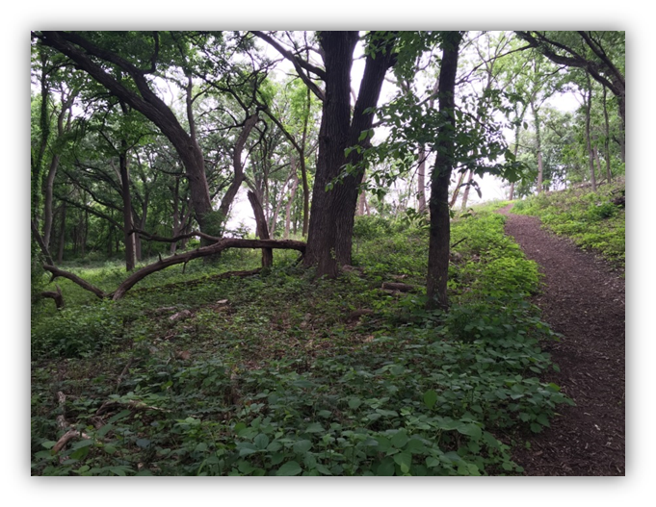
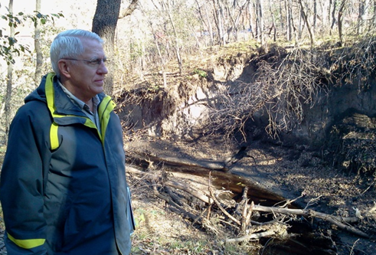
Sponsored Projects
Example projects:
  Communication with neighbors crucial
  Worked with local and national mall officials to site practices
  Contracted with AmeriCorps

Slide 15
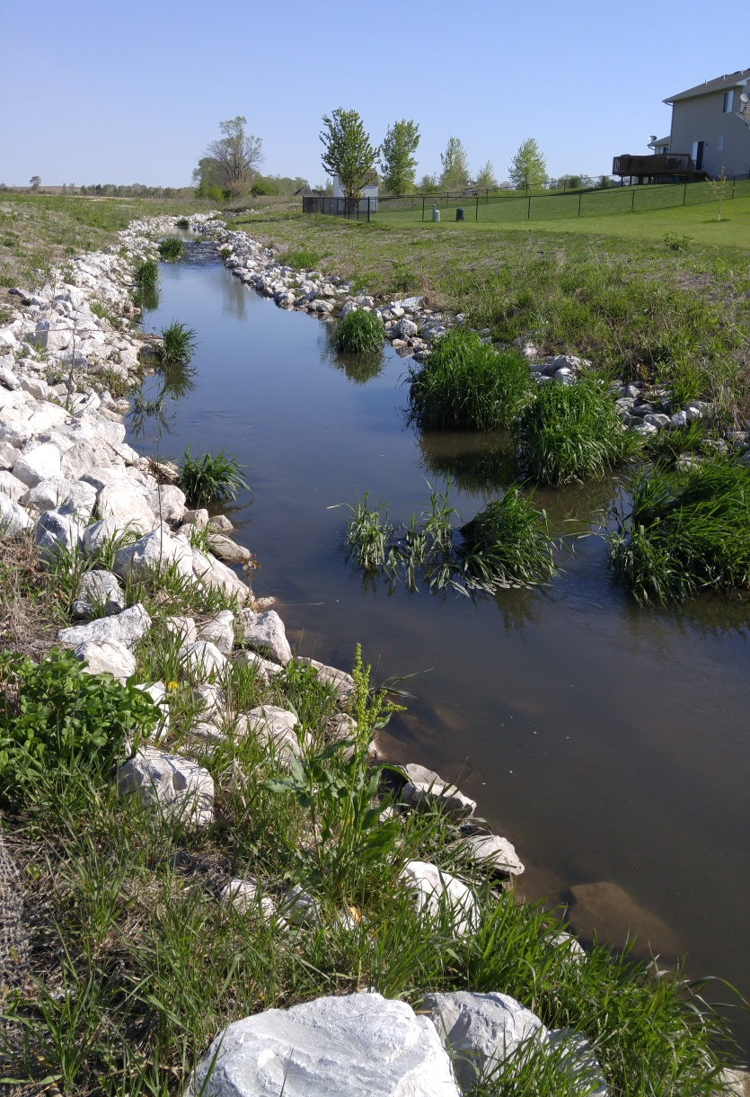
Sponsored Projects
Example projects:
  Granger, IA, pop. 1244
  Planned a stream stabilization and storm water wetland project
  Had multiple funding sources

Slide 16
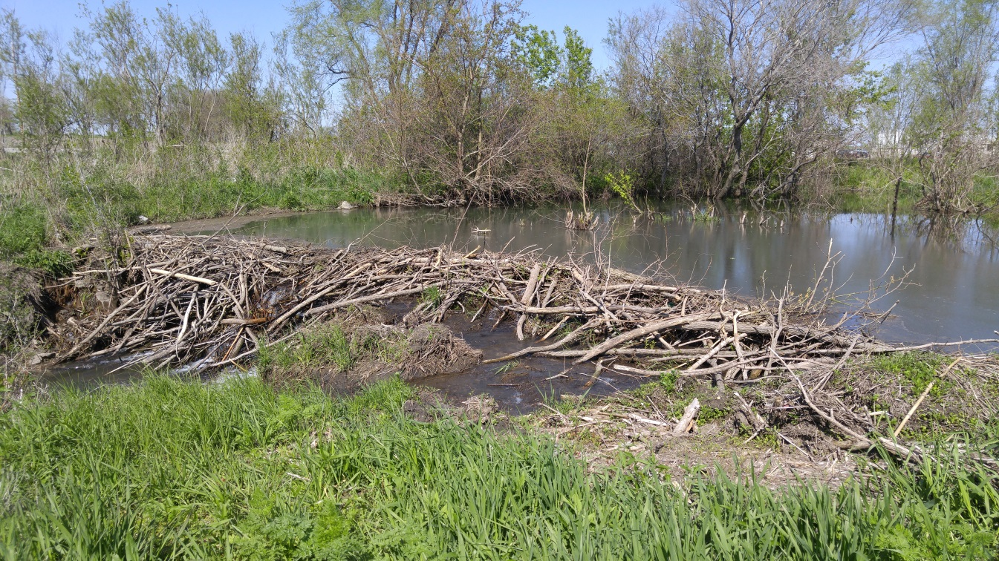
Sponsored Projects
Example projects:
  Problems with design, construction, site characteristics, etc. required constant hand-holding and intervention

Slide 17
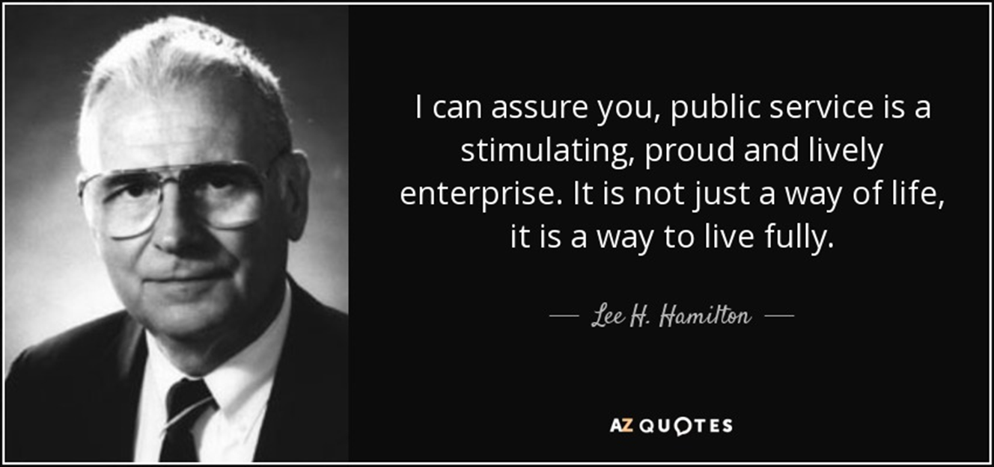

Slide 18
Questions?
IowaSRF.com

