Slide 1
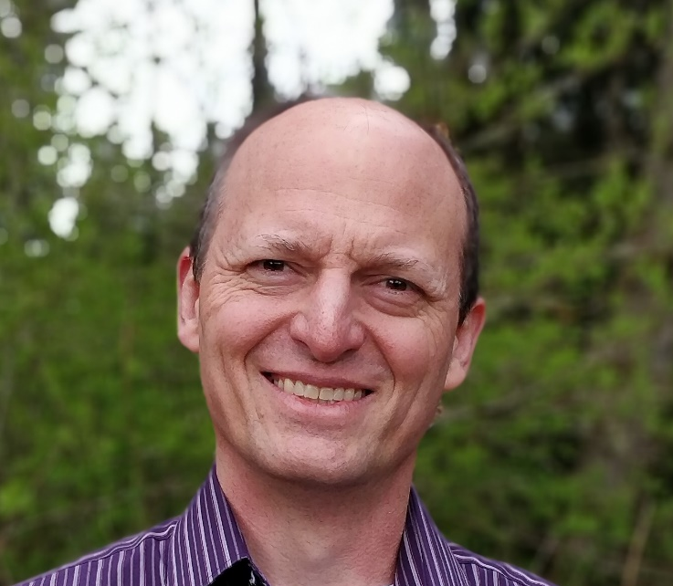
Small Community Cost Effectiveness
David Dunn P.E.

Slide 2
Cost Effective Solutions
Washington State has always “funded cost effective solutions”.
The 2014 WRRDA included a requirement for borrowers to certify that they studied cost effectiveness of alternatives and considered life cycle costs.

Slide 3
Is the project the cost effective alternative?

Slide 4
Is the project the cost effective alternative?
a

Slide 5
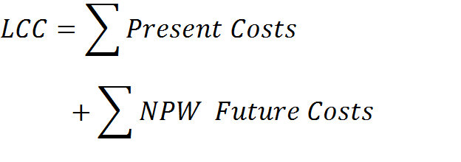
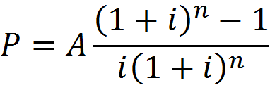
Life Cycle Cost Analysis
LCC= Life Cycle Cost
NPW = Net Present Worth
P=Present Value
A=Annual Cost
i= discount rate
n=number of years

Slide 6
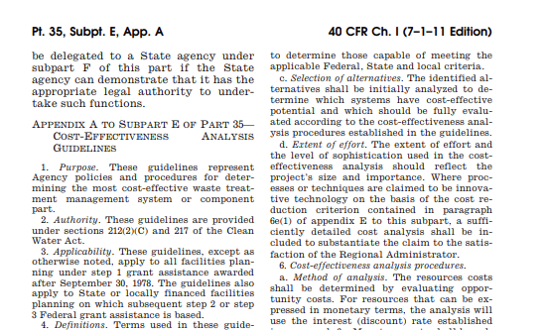

Slide 7
Local Control
Infrastructure decisions are made locally.
Trust the local process.
Allow borrowers to certify that they evaluated project cost effectiveness.

Slide 8
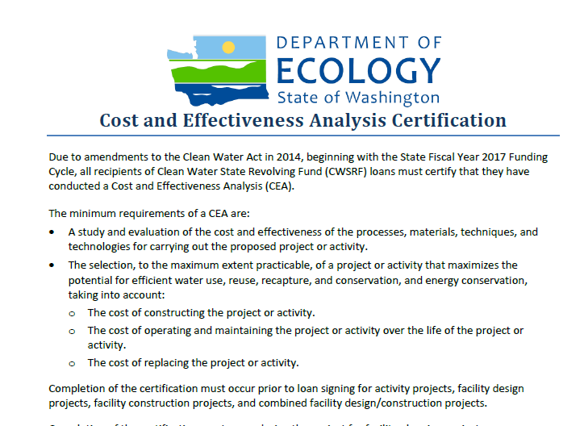

Slide 9
Three Revolving Funds
Clean Water State Revolving Fund
Drinking Water State Revolving Fund
Public Works Trust Fund

Slide 10
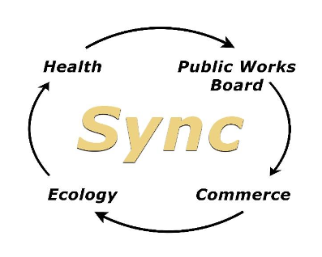
Clean Water State Revolving Fund
Drinking Water State Revolving Fund
Public Works Trust Fund

Slide 11
https://deptofcommerce.app.box.com/v/SyncValuePlanningGuide

Slide 12
Value Planning:
The right project,
At the right time,
Using the right technology,
Designing it to be the right size, and
Embracing the right amount of complexity for your community.
Notes:
I’m not saying there isn’t some art to go along with the science here, but there are some consistent characteristics of VP

Slide 13
Notes:
I/m not a graphic designer. Still working.
Not steps, certainly not linear. More moving parts

Slide 14
Focus on the Process
consider a reasonable number of alternatives,
objectively analyze the feasible alternatives, and
choose an alternative that meets the borrower’s specific needs.

Slide 15
What is a Reasonable Number of Alternatives?
Stakeholder involvement
An inclusive problem/opportunity statement
Alternatives appropriate to the problem statement

Slide 16
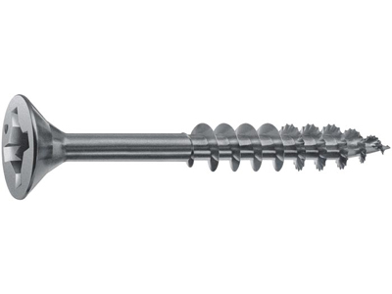
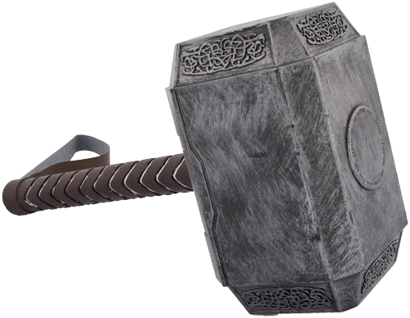
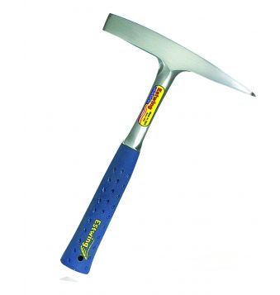
Brainstorming When You’re Stuck In a Rut
The problem:

Slide 17
Stakeholder involvement informs the problem/opportunity statement

Slide 18
Who is a “Stakeholder”?
Who uses your system?
Who can bring a different perspective?
Households
Businesses
Bulk Customers
Recreation or Tourism
Financial staff
Administrators
Elected officials (and Candidates)
Front Line Staff
Operators
Neighbors
Regulators
Other utilities
Environmental Groups
Tribes
Engineers
Notes:
Most stakeholders don’t realize that they are stake holders; if you want input, you have to go get it.
Having a wide range of stakeholders makes your project stronger.
BJJ life sparing. They are not your enemy, they are training partners.

Slide 19
The problem statement determines the range of alternatives

Slide 20
Upgrade the treatment plant at town A.
No Action
Technology X vs. Technology Y vs. Technology Z

Slide 21
Town A’s wastewater treatment plant is failing; most systems are operating beyond their useful life. Upgrade the treatment plant at town A.
No Action
Technology X vs. Technology Y
Alternative project phasing.
Consider replacing one system at a time.
Alternative project sizing.

Slide 22
Town A’s wastewater treatment plant is failing; most systems are operating beyond their useful life. Provide sanitation for the residents of Town A.
No Action
Regional options.
Abandon existing plant and build new. Consider alternate locations for new plant.
Upgrade the existing plant.
Lagoon Treatment.
Decentralized options.

Slide 23
Town B’s UV system is old technology, no longer supported by the manufacturer. The system is on the edge of complete failure. Town cannot obtain bulbs or replacement parts for the system. Replace the UV system at Town B’s treatment plant.
No Action
Use existing UV channel to install new equipment.
Build a new channel for UV equipment.
In-vessel options.
Asset Management Program

Slide 24
Town B’s UV system is old technology, no longer supported by the manufacturer. The system is on the edge of complete failure. Town cannot obtain bulbs or replacement parts for the system. Provide adequate disinfection at Town B’s treatment plant.
No Action
Various UV alternatives (high pressure, in-vessel, horizontal or vertical)
Chlorine options (onsite generation, liquid hypochlorite)
Ozone.
Evaluate need for temporary (emergency) disinfection while project is implemented.

Slide 25
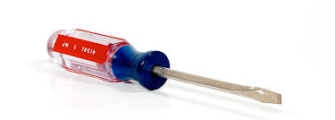
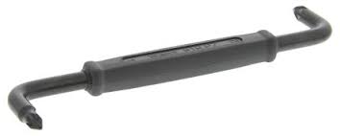
Brainstorming in a Small Box
The problem:
+
The alternatives:
Notes:
In all fairness to my colleagues in consulting, there are usually not totally off base

Slide 26
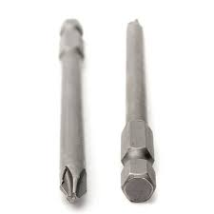
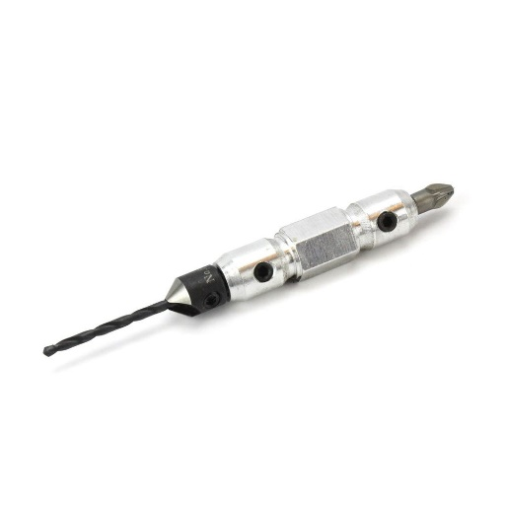
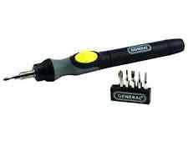
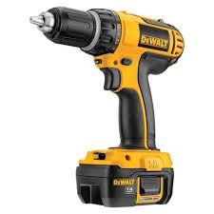
Brainstorming in a Bigger Box
The problem:
+
The alternatives:
+

Slide 27
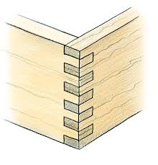
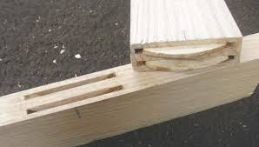
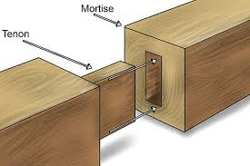
Brainstorming Outside the Box
The problem:
+
The alternatives:
Notes:
Now the brainstorm is questioning the assumptions behind the outcomes statement you developed.
Maybe these guys are your best friend, helping you do what you needed to do to begin with, maybe they are taking the crazy town to crazy train.

Slide 28
Notes:
When you ask for a screwdriver and you get this, you are probably WAY outside the box.

Slide 29
Focus on the Process
consider a reasonable number of alternatives,
objectively analyze the feasible alternatives, and
choose an alternative that meets the borrower’s specific needs.

Slide 30
Objective? Feasible?
Explain alternatives not analyzed.
Calculate life cycle costs.
Consider other factors.
Select an alternative.

Slide 31
Hidden assumptions in Life Cycle Costs
Only as good as the set of options considered.
Only as accurate as construction cost estimates.
AND the O&M estimates.
AND the replacement cost estimates.
Difficult to compare partial options or options with different levels of benefit.
Cost isn’t everything.

Slide 32
Other Factors to Consider
Risk
Regulatory requirements
Level of benefit
Operational ease / flexibility.
Other project benefits
Other non-cost factors

Slide 33
Cost Effectiveness Guidance for Small Communities
Stakeholder engagement.
Develop an inclusive problem statement.
Generate alternatives.
Consider both Life Cycle Costs and Other Factors.
Choose a cost effective alternative.
Certify.

Slide 34
David Dunn
Washington State Department of Ecology
David.Dunn@ecy.wa.gov
360/407-6503 (Desk)
360/515-8601 (mobile)

