Slide 1
The Iowa CWSRF
A Before and After Story
Patti Cale-Finnegan, Iowa Department
of Natural Resources

Slide 2
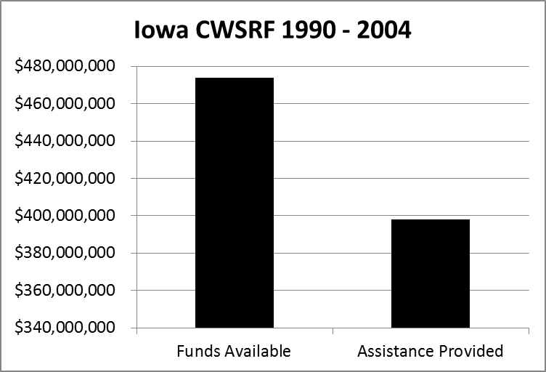
BEFORE: We had ULOs before
ULOs were invented
Notes:
Until 2002, we only offered loans for water and wastewater infrastructure.

Slide 3

BEFORE:
Low-interest loans for wastewater infrastructure only
Averaged $25 million per year in loans 1990-2004
Notes:
Until 2002, we only offered loans for water and wastewater infrastructure.

Slide 4

BEFORE:
Iowa Finance Authority
Bond issues
Iowa Department of Natural Resources
Program planning and prioritization
Project planning and permitting
Environmental review
Federal compliance
Financial management
Loan processing and disbursement

Slide 5

BEFORE:
Financial Management
Over-leveraged without corresponding demand
Did not use first-in, first-out – reserved cap grant funds for specific projects

Slide 6

BEFORE:
Project Management
No clearly laid out process for obtaining construction permits or meeting SRF requirements
Holdovers from construction grants
Poor relationships with environmental clearance agencies

Slide 7

BEFORE:
Marketing and Promotion
No outreach to potential borrowers
No understanding of our audiences and what their perceptions and attitudes were
SRF project managers were engineers with a focus on technical issues, not on marketing

Slide 8
Wake-Up Call 2003-2004
Iowa Water Quality Summit – developed a plan to restore Iowa’s water quality
Iowa Policy Project – published “Effectively Using the Clean Water State Revolving Fund to Improve Iowa Water Quality”
  CWSRF surplus of $125 million made it difficult to gain support for other water quality funding
  Iowa’s focus on wastewater ignored other watershed needs
EPA criticized Iowa CWSRF for underutilizing funds

Slide 9
Starting to Respond
DNR management started to tackle the underutilization of the CWSRF
DNR Wastewater Engineering Section -- held a Kaizen event to streamline permitting and CWSRF process
DNR and IFA initiated an MOA to define roles with the goal of IFA taking over financial tasks
  Financial experts should manage the program’s finances
  IFA dedicated resources to SRF – esp. Lori Beary

Slide 10

Starting to Respond
September 2004 -- DNR created the SRF Coordinator position
  Brought a different skill set in program management, communications and outreach, working with municipalities and financial professionals
  Fresh set of eyes
  Work with Lori and IFA
  No baggage!

Slide 11
Marketing Research - 2005
Iowa Association of Municipal Utilities Survey
  Those utilities that had used SRF were generally satisfied
  Those that hadn’t cited the following reasons:
    Reputation for costly delays
    Project deemed too small
    Interest rate savings deemed insufficient
    Advice of consulting engineer or financial consultant

Slide 12
Improvements 2005 - 2007
Increased collaboration and cooperation between DNR and IFA led to the following improvements:
  Planning and design loans created
  The CWSRF project approval process time cut from 28 months to 4.5 months
  Applications for the CWSRF accepted on a continuous basis, rather than once per year, making funds available when projects are ready

Slide 13
Improvements 2005 - 2007
More improvements:
  Held a Kaizen event to better understand how environmental review was perceived as barrier to using program
    Created environmental review services and hired ER specialist
  Three new nonpoint source programs created to provide low-interest loans to farmers, landowners, livestock producers, communities, watershed organizations, and others
  Dynamic financial management – obtained funds when needed rather than building up surplus

Slide 14
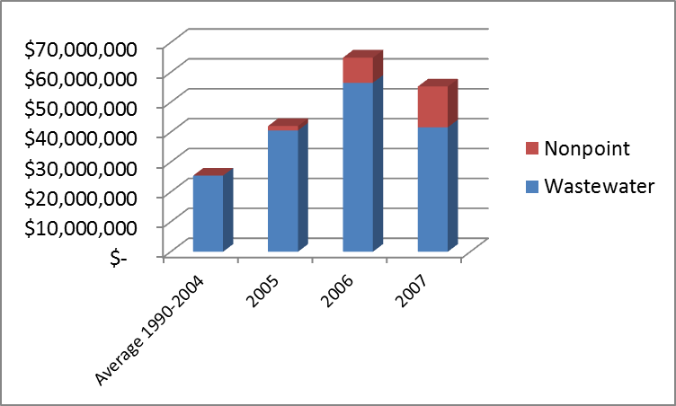
Pace Started to Pick Up

Slide 15
Marketing Research - 2007
U.S. EPA provided help
  Engaged Lisa Bechini, Northbridge, and hired Mary-Jane Atwater, Atwater Communications
  Worked with Iowa staff to identify the research problem and design a research plan
  Conducted a focus group and telephone survey

Slide 16
Marketing Research - 2007
Key Findings:
  Respondents had inaccurate perceptions of the program – weren’t aware of the improvements or new features
  Didn’t understand benefits of SRF financing
  They liked IFA but were negative toward DNR
    “IFA = Hope; DNR = No Hope”
  Preferred methods of communication – conferences and workshops, direct mail, listserves

Slide 17
Marketing Research - 2007
Recommendations:
  Provide a single point of contact
  Consolidate DNR and IFA marketing for an SRF brand identity
  Provide case studies of successful projects
  Refine SRF marketing messages – e.g. “below-market interest rate”
  Develop outreach to engineering consultants and financial advisors

Slide 18
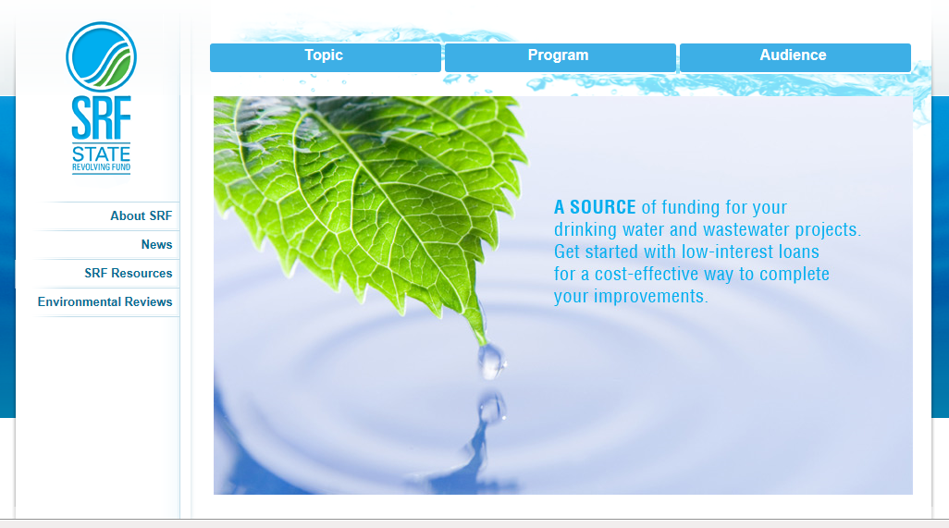
More Program Improvements
Developed SRF logo and tag line: “Investing in Iowa’s Water”
Produced a new IowaSRF.com website

Slide 19
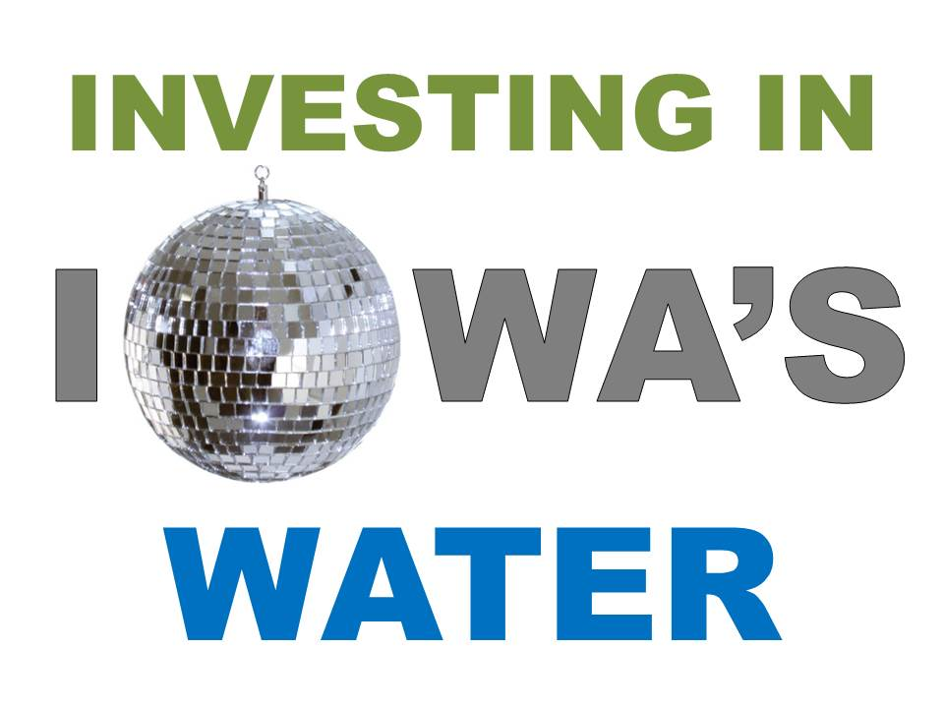
More Program Improvements
Presented at conferences and workshops, e.g. Iowa League of Cities
Implemented “Advanced SRF” training for consultants
Offered extended term financing

Slide 20
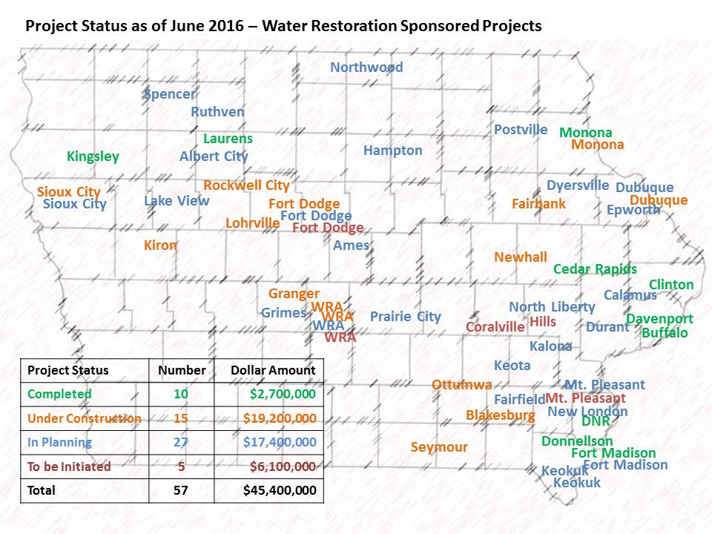
More Program Improvements
Developed Water Resource Restoration Sponsored Projects

Slide 21


AFTER
Wastewater Infrastructure
Onsite Septic Systems
Planning and Design
Lake and Wetland Restoration
Soil, Sediment, and Nutrient Management
Brownfield Cleanup
Habitat Protection
Energy and Water Efficiency
Sponsored Projects
Urban Stormwater
Landfill Closure
Notes:
With changes in state legislation and federal requirements, program development and listening to our customers, the programs have expanded into many different areas, including loans for nonpoint source water quality.

Slide 22
State Revolving Fund Organizational Structure -- Iowa
Terry Branstad, Iowa Governor
Bill Northey, Iowa Secretary
of Agriculture
Chuck Gipp,
Dep’t of Natural
Resources Director
David Jamison, Iowa Finance
Authority Director
Iowa Department of Agriculture and Land Stewardship
Tony Toigo, Local Water
Protection, Livestock
Water Quality Facilities Amy Bouska, Derek Namanny, Wayne Petersen, Joel Schwarzkopf, Jennifer Welch, Urban Conservation and Sponsored Projects
Bruce Trautman
Deputy Director
Lori Beary,
IFA SRF Coordinator
William Ehm
Environmental Services
Division Administrator
Tracy Scebold,
SRF Finance Officer
Alyson Fleming, Program
Specialist
Jane Larson, Linked
Deposit Administrator
Jennifer Nelson, Chief Budget and Grants
Jon Tack, Chief
Water Quality Bureau
Shirley Christoffersen, Grant Manager
Patti Cale-Finnegan,
DNR SRF Coordinator/Team Leader, General Nonpoint Source Program, Sponsored Projects
Erik Wiklund,
Supv., NPDES
Satya Chennupati, Supv. Wastewater Engineering
Corey McCoid, Supv., Water Supply Operations
Mark Moeller, Supv., Water Supply Engineering
Dan Olson
On-Site Wastewater Program
Jim Oppelt, CWSRF Team Leader
Nichelle Anderson, Tim Bauer, Larry Bryant, Marty Jacobs,
Terry Kirschenman,
Laura Knispel, Emy Liu, Melissa Schlickbernd, Mark Valmore CWSRF Project Managers
Gina Andre, Admin.
Mario Fenu, Jean Mayne, Tiffany Wilson Lillard, Michael Sullivan,
Lee Wagner,
Environmental Review/Sponsored Projects
Jennifer Bunton, DWSRF Team Leader
Michael Anderson, Taroon Bidar,
Lanie Boas, Bob Campbell, Daryl Enfield, Gabe Lee,
AJ Montefusco, Tara Naber, Skipp Slattenow, Sara Smith
DWSRF Project Managers
SRF financial functions
Clean Water SRF
Drinking Water SRF
Clean Water and Drinking Water SRF
Jeanne Johnson
Administrative
Assistant

Slide 23
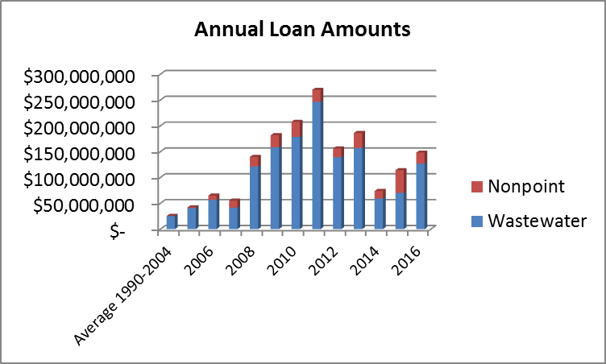
AFTER:

Slide 24
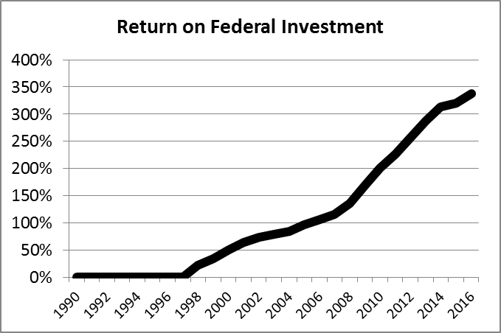
AFTER:

Slide 25
Questions?
Patti Cale-Finnegan
Iowa Department of Natural Resources
515-725-0498
Patti.cale-finnegan@dnr.iowa.gov

