Slide 1
California’s Process for SRF Co-Funding
Co-Funding 101
Michael Downey, P.E.
Assistant Deputy Director
Division of Financial Assistance
November 2024

Slide 2
Agenda
SRF vs WIFIA Loan Features
Requirements of Non-SRF Sources
How it’s Working
Sources of Co-Funding
WIFIA Co-Funded Projects
CA’s Application Review Process
2

Slide 3
Sources of Co-Funding
Federal
  Water Infrastructure Finance and Innovation Act (WIFIA)
  US Bureau of Reclamation
    WaterSmart Program
    Large-Scale Water Recycling Program
  U.S. Department of Agriculture (USDA)
  Community Grant / Congressionally Directed Spending
State Internal
  Bond Funds (Propositions)
  General Fund Appropriations
  State External
  Department of Water Resources
  California Office of Emergency Services Grants
3
Notes:
DWR - Integrated Regional Water Management (IRWM) Program

Slide 4
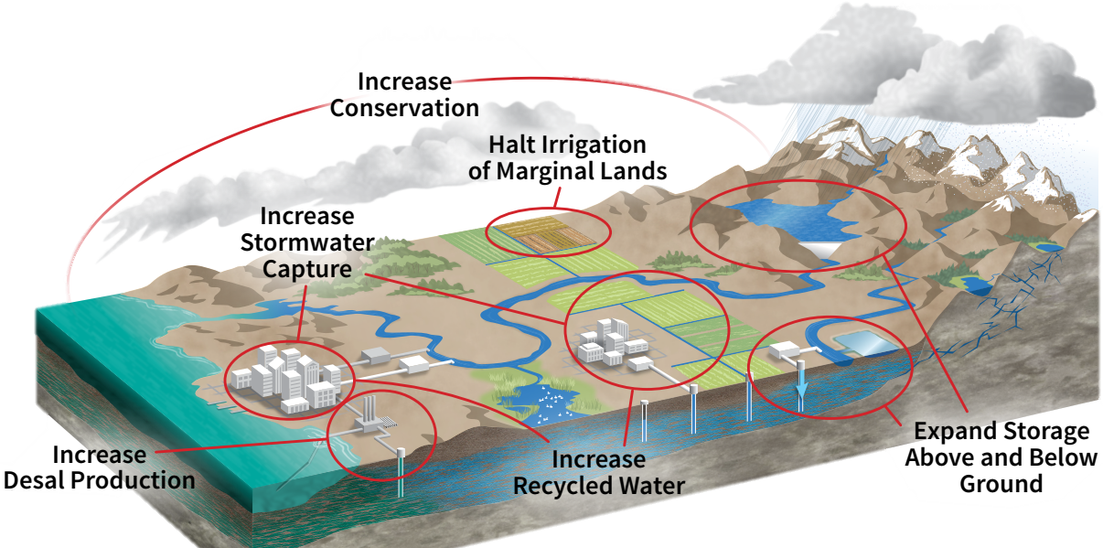
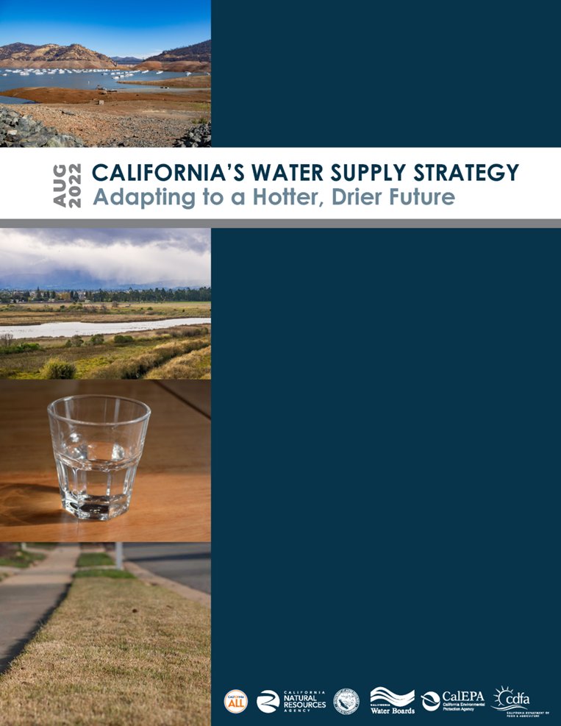
California’s Water
Supply Strategy
4

Slide 5




California’s Water Supply Strategy
 | 2030 | 2040
Increase Recycled Water | 800,000 AF | 1.8 MAF
Increase Desalination Production | 28,000 AF | 84,000 AF
Increase Stormwater Capture | 250,000 AF | 500,000 AF
Increase Conservation | 500,000 AF | 500,000 AF
SUBTOTAL FOR RECYLED, DESAL, STORMWATER, AND CONSERVATION | 1.6 MAF | 2.9 MAF
Currently CA is delivering approximately 717,000 AFY of RW - serving 1,780,000 households
5

Slide 6
WIFIA / SRF Co-Funded Projects
Agreements Executed Since 2020
$6.5 billion combined total
19 Co-Funded Projects
State Water Board funding:
  CWSRF Loan
  DWSRF Loan
  WRFP Loans and Grants
SRF investment doubled with WIFIA partnership
6

Slide 7







CWSRF Loan Features
      Based on $600 M annual CWSRF Loan capacity
      Maximum loan term
      Can pay for any project cost
      Interest rate will be half the GO Bond rate (currently 1.80%)
Applicant must satisfy a 1.2 debt-coverage ratio
CEQA Plus Federal Requirements, Davis-Bacon, DBE, American Iron and Steel, BABA and all federal cross-cutter provisions apply.
Projects are scored annually and must be placed on Fundable List to qualify
Cannot take a subordinate position
30 YEARS
7

Slide 8
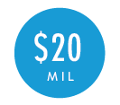
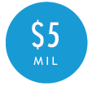
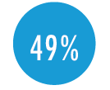


WIFIA Loan Program Features
      Minimum project size for large communities
      Minimum project size for small communities (population of 25,000 or less)
      Maximum portion of eligible project costs that WIFIA can fund
      Maximum final maturity date from substantial completion
5 YEARS
Maximum time that repayment may be deferred after substantial completion of the project
Interest rate will be equal to or greater than the U.S. Treasury rate of a similar maturity
Broad eligibility allows for wide variety of borrowers and projects, plus special program for SRF borrowers (SWIFIA)
NEPA, Davis-Bacon, American Iron and Steel, Build America, Buy America, and all federal cross-cutter provisions apply
8

Slide 9
Additional Requirements / Objectives of Non-SRF Sources
Federal
  WIFIA – total Federal assistance may not exceed 80% of eligible cost
  USBR – 75% non-Federal Cost Share Requirement – Does not consider SRF/WIFIA loans “Federal”
State Funds
  Encumbrance/Liquidation Deadlines
  Challenging Competitive Selection criteria (Prop 1)
    Cost-effectiveness
    Energy efficiency and GHG
    Geographic Allocation
  Other specific objectives: % for Small DAC, Septic to sewer callouts
9
Notes:
Generally SRF funds are easier to assign to projects and don’t come with a lot of extra requirements. Here are some examples of co-funding source requirements that may be challenging

Slide 10
Application Review Process
Submit Application
Application Completeness Review
Placed on Fundable List
Priority Score
Execute Funding Agreement¹
Eligibility Review
(Technical, Environmental, Financial,
Legal)
Final Budget Approval
(after Bid Opening)
Construction Disbursement
&
Inspection
Coordinate with co-funding partners
Coordinate with co-funding partners
      ^{1.} Disburse soft costs (Planning, Design, Admin, etc.)
Coordinate with co-funding partners
10

Slide 11
How it’s Working - Pre-Agreement
Request a list of all funding sources with project application
Coordinate with applicant/co-funding partners
  Determine funding amounts
  Who will be environmental lead
  Discuss Federal provisions and potential waivers
Hold recurring meetings with WIFIA staff to discuss current and future projects
Discuss parity/subordinate lien provision requirements
11

Slide 12


How it’s Working – Disbursements
Recipient responsible for keeping track of sources of funding
Splitting each bid item by % funding
Recipient responsible for ensuring there’s no “double-dipping”
Recipient responsible for determining which funding sources to request first
Assign funding to specific bid items
Staff include lump-sum amount of other funding sources in the construction disbursement form

Slide 13
How it’s Working - Compliance
Coordinate with recipient/co-funding partners on site inspections
Staff coordinate with recipient/co-funding partners on ensuring projects are complying with federal provisions
Future points of coordination:
  Annual surveillance of pledged loans
  Audit coordination
13

Slide 14
Questions?
14

