Slide 2

Outline
Why Desalination
Project Background
Challenges
Project Status

Slide 3

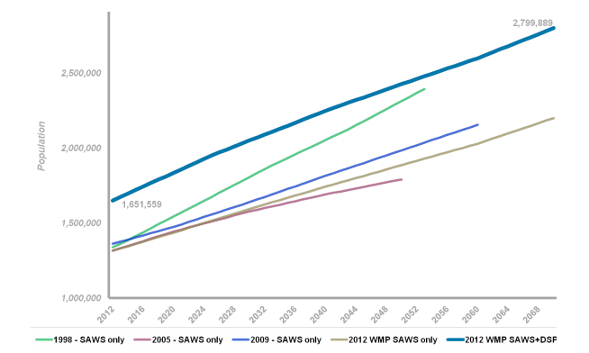
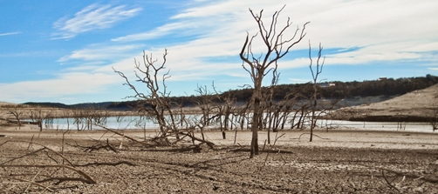
Water Challenges

Slide 4
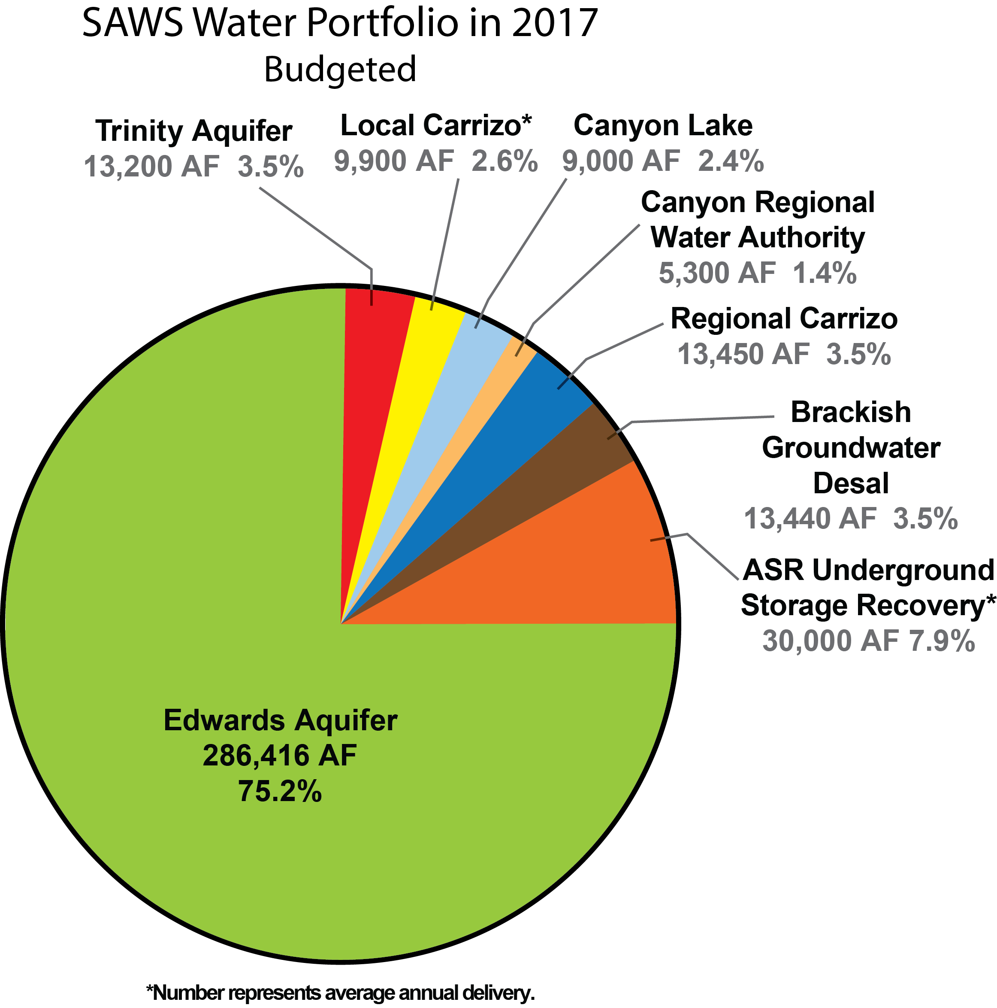
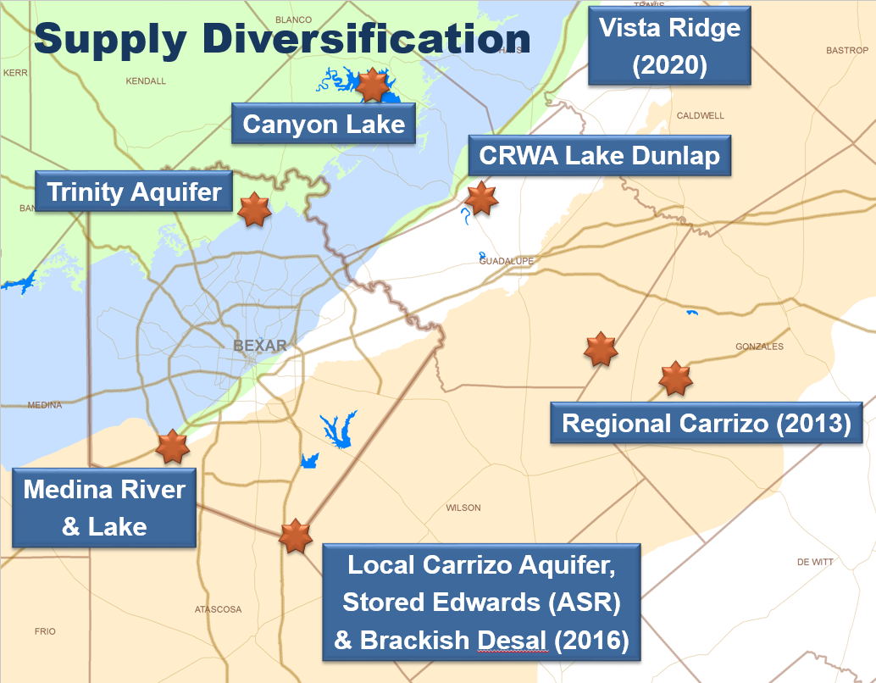
SAWS Water Portfolio
2017 Water Portfolio
Notes:
233,929 AF delivered to SAWS customers

Slide 5
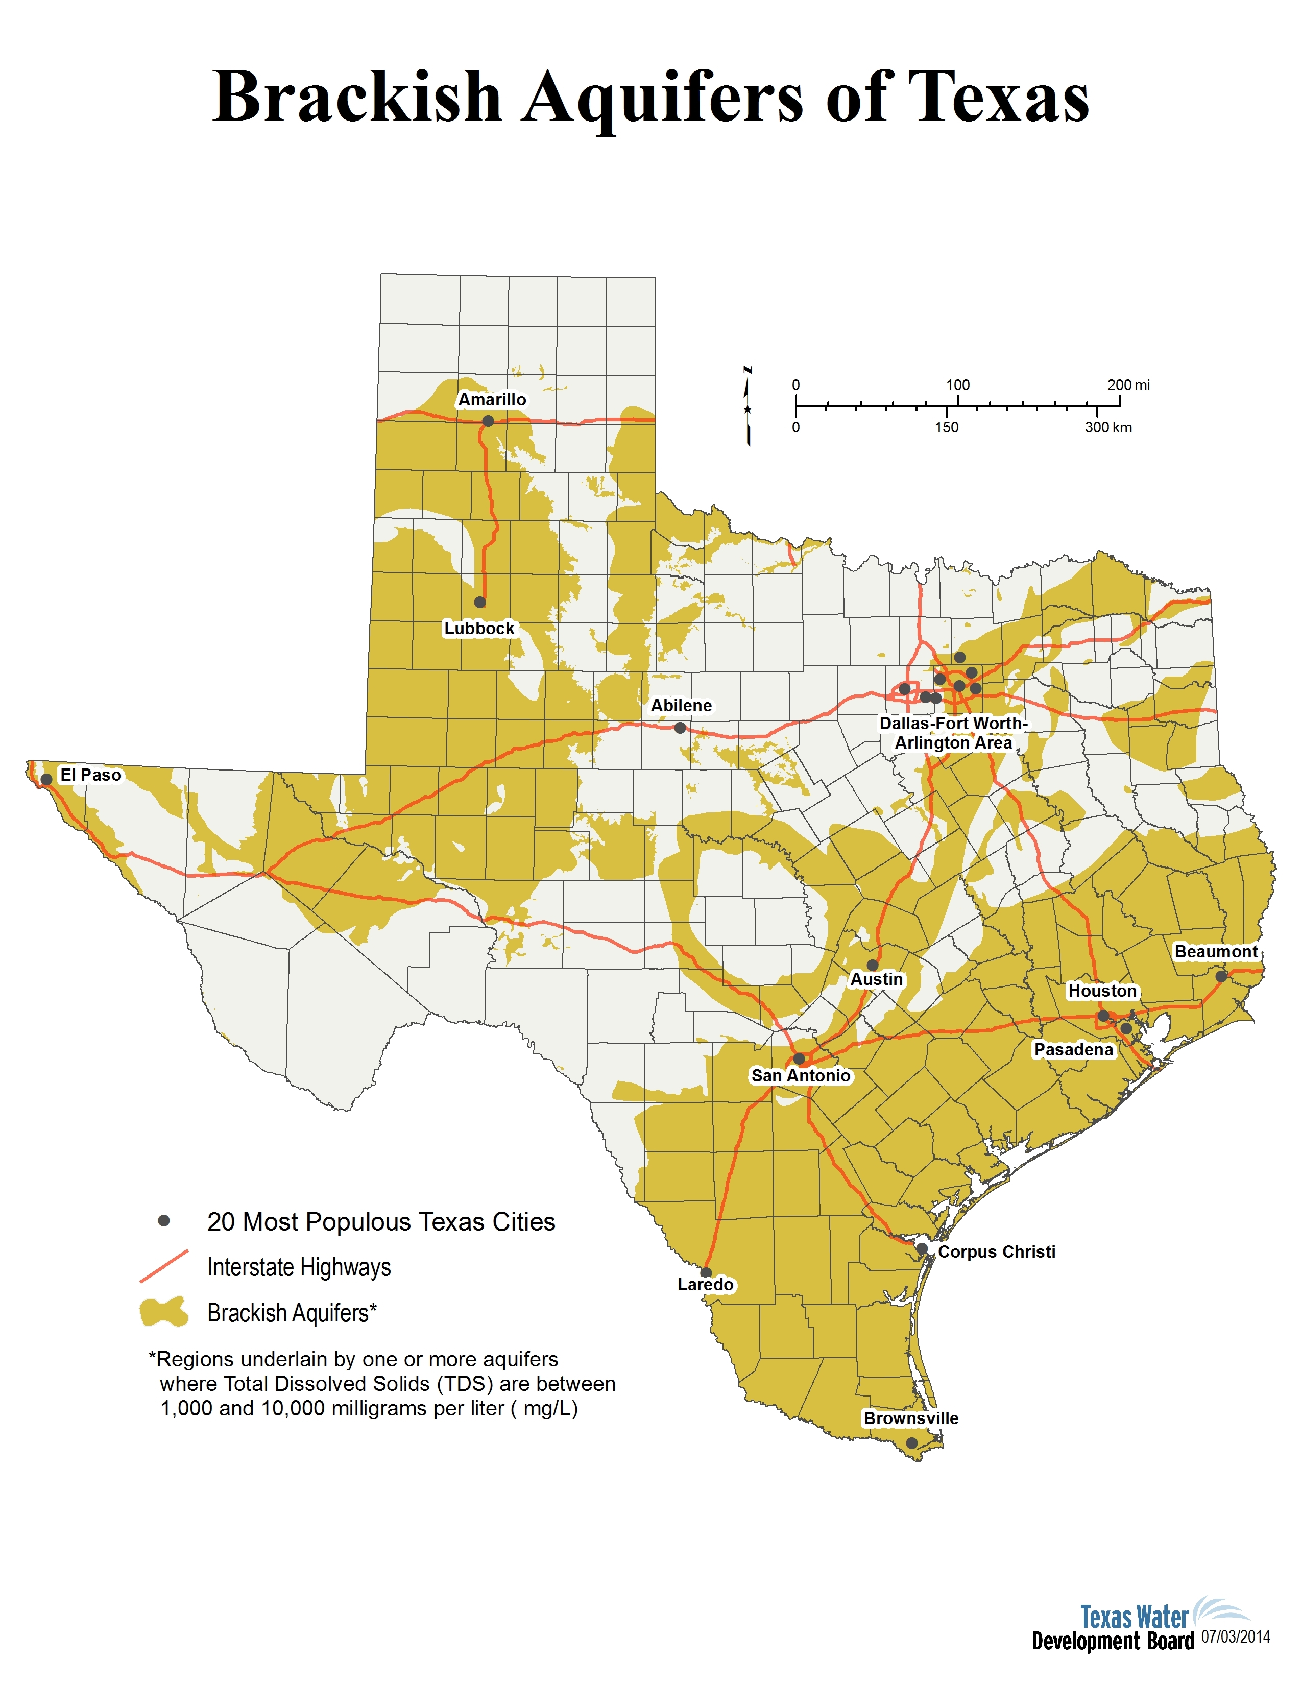
Why Brackish Inland Desalination
Outlined in SAWS 2005 Water Management Plan
Diversification
Untapped resource
Large volumes of available brackish water
    Estimated over 2.7 billion acre-feet
Resource close to San Antonio

Slide 6
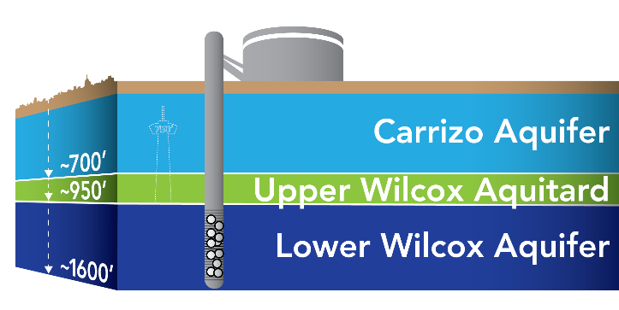
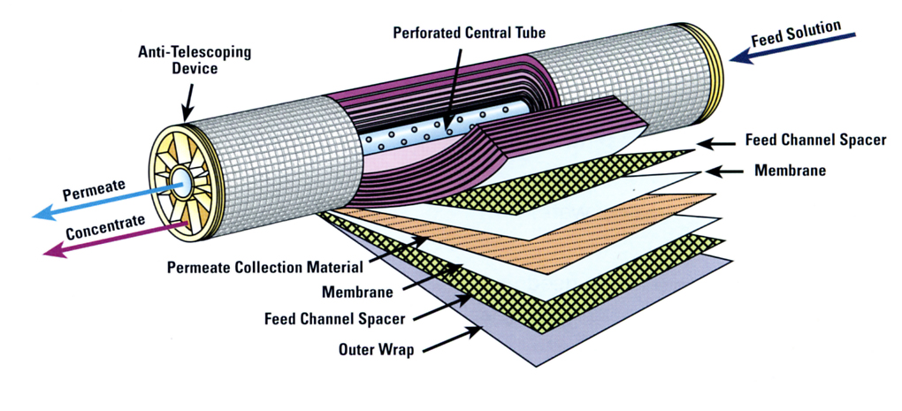
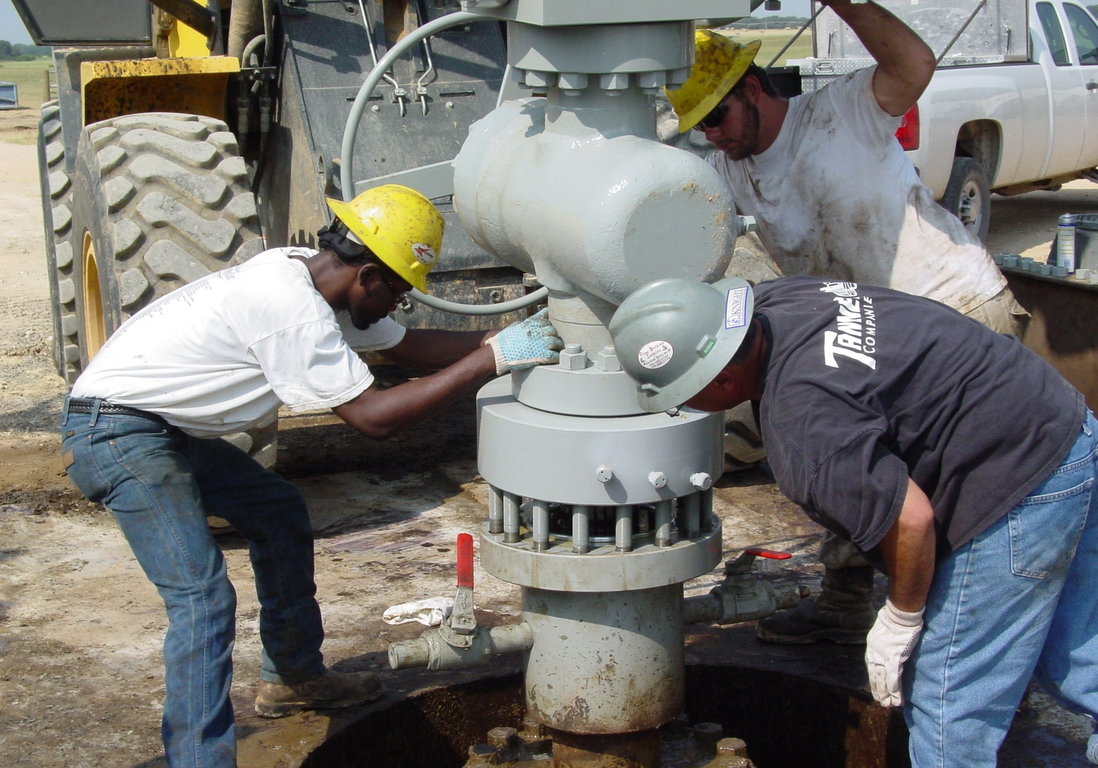
Desalination Program
General Information
Phase I (2016) – 12 MGD – 13,440 Acre-feet / year
  (~50,000 Households)
Source Water
  Lower Wilcox Formation
  12 Production wells - ~1,500’ avg. depth
Treatment Process
  Reverse Osmosis
Concentrate Disposal
  2 Injection wells –~5,000’ avg. depth

Slide 7
Program Timeline
Feasibility – Design - Construction
Feasibility
2006
Design
2012
Construction
2014

Slide 8
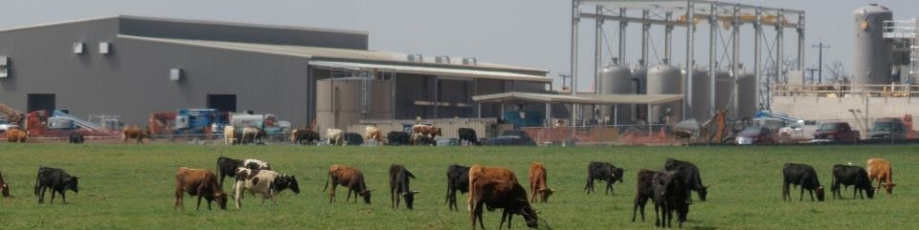
Cost / Schedule
Phase I
Project Cost: $192.7 million, $1,177 $/AF
  Annual Estimated Debt Service (~3% over 30 years): $9.9M
  Annual Estimated O&M: $5.9M
Schedule Completion: Late 2016

Slide 9
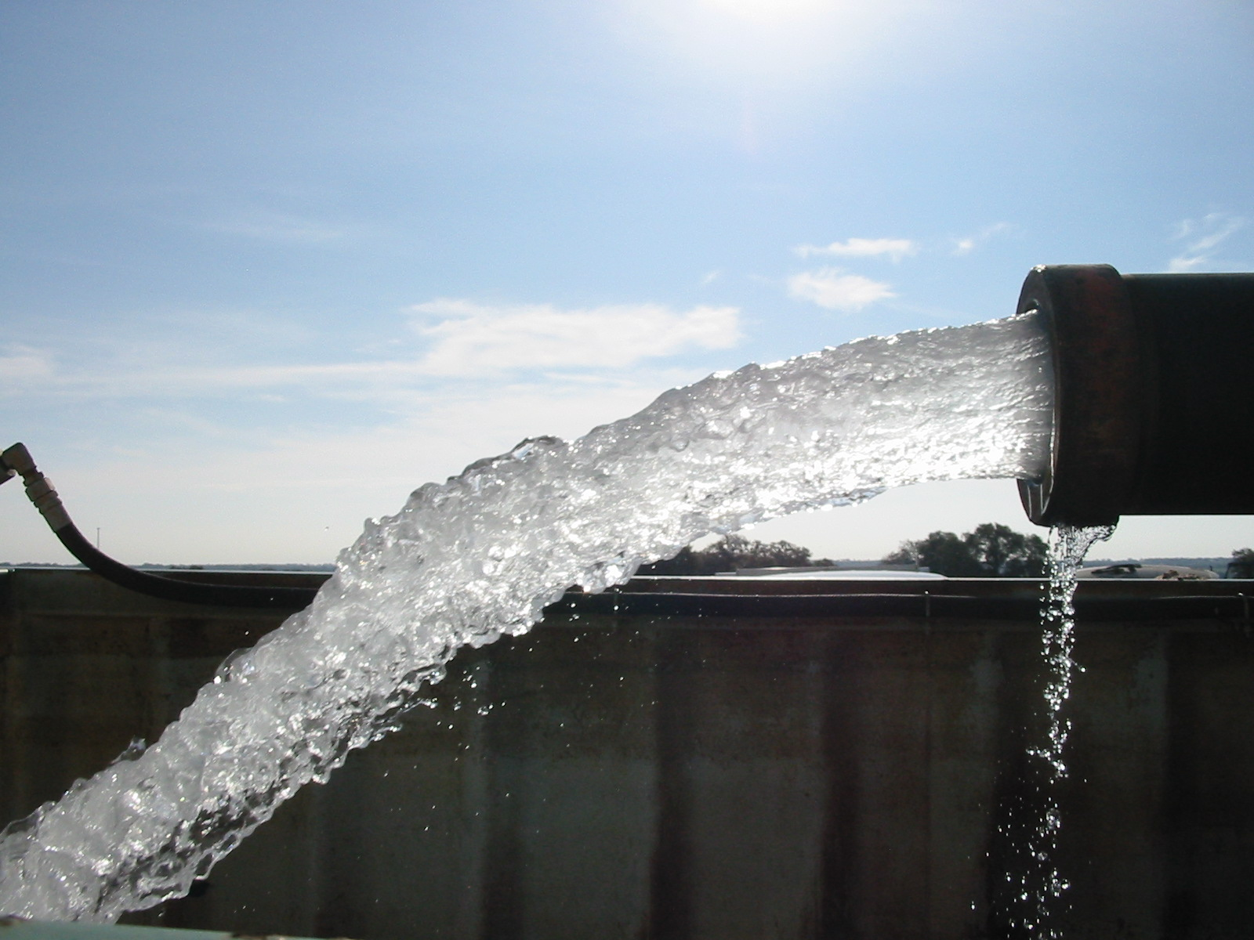
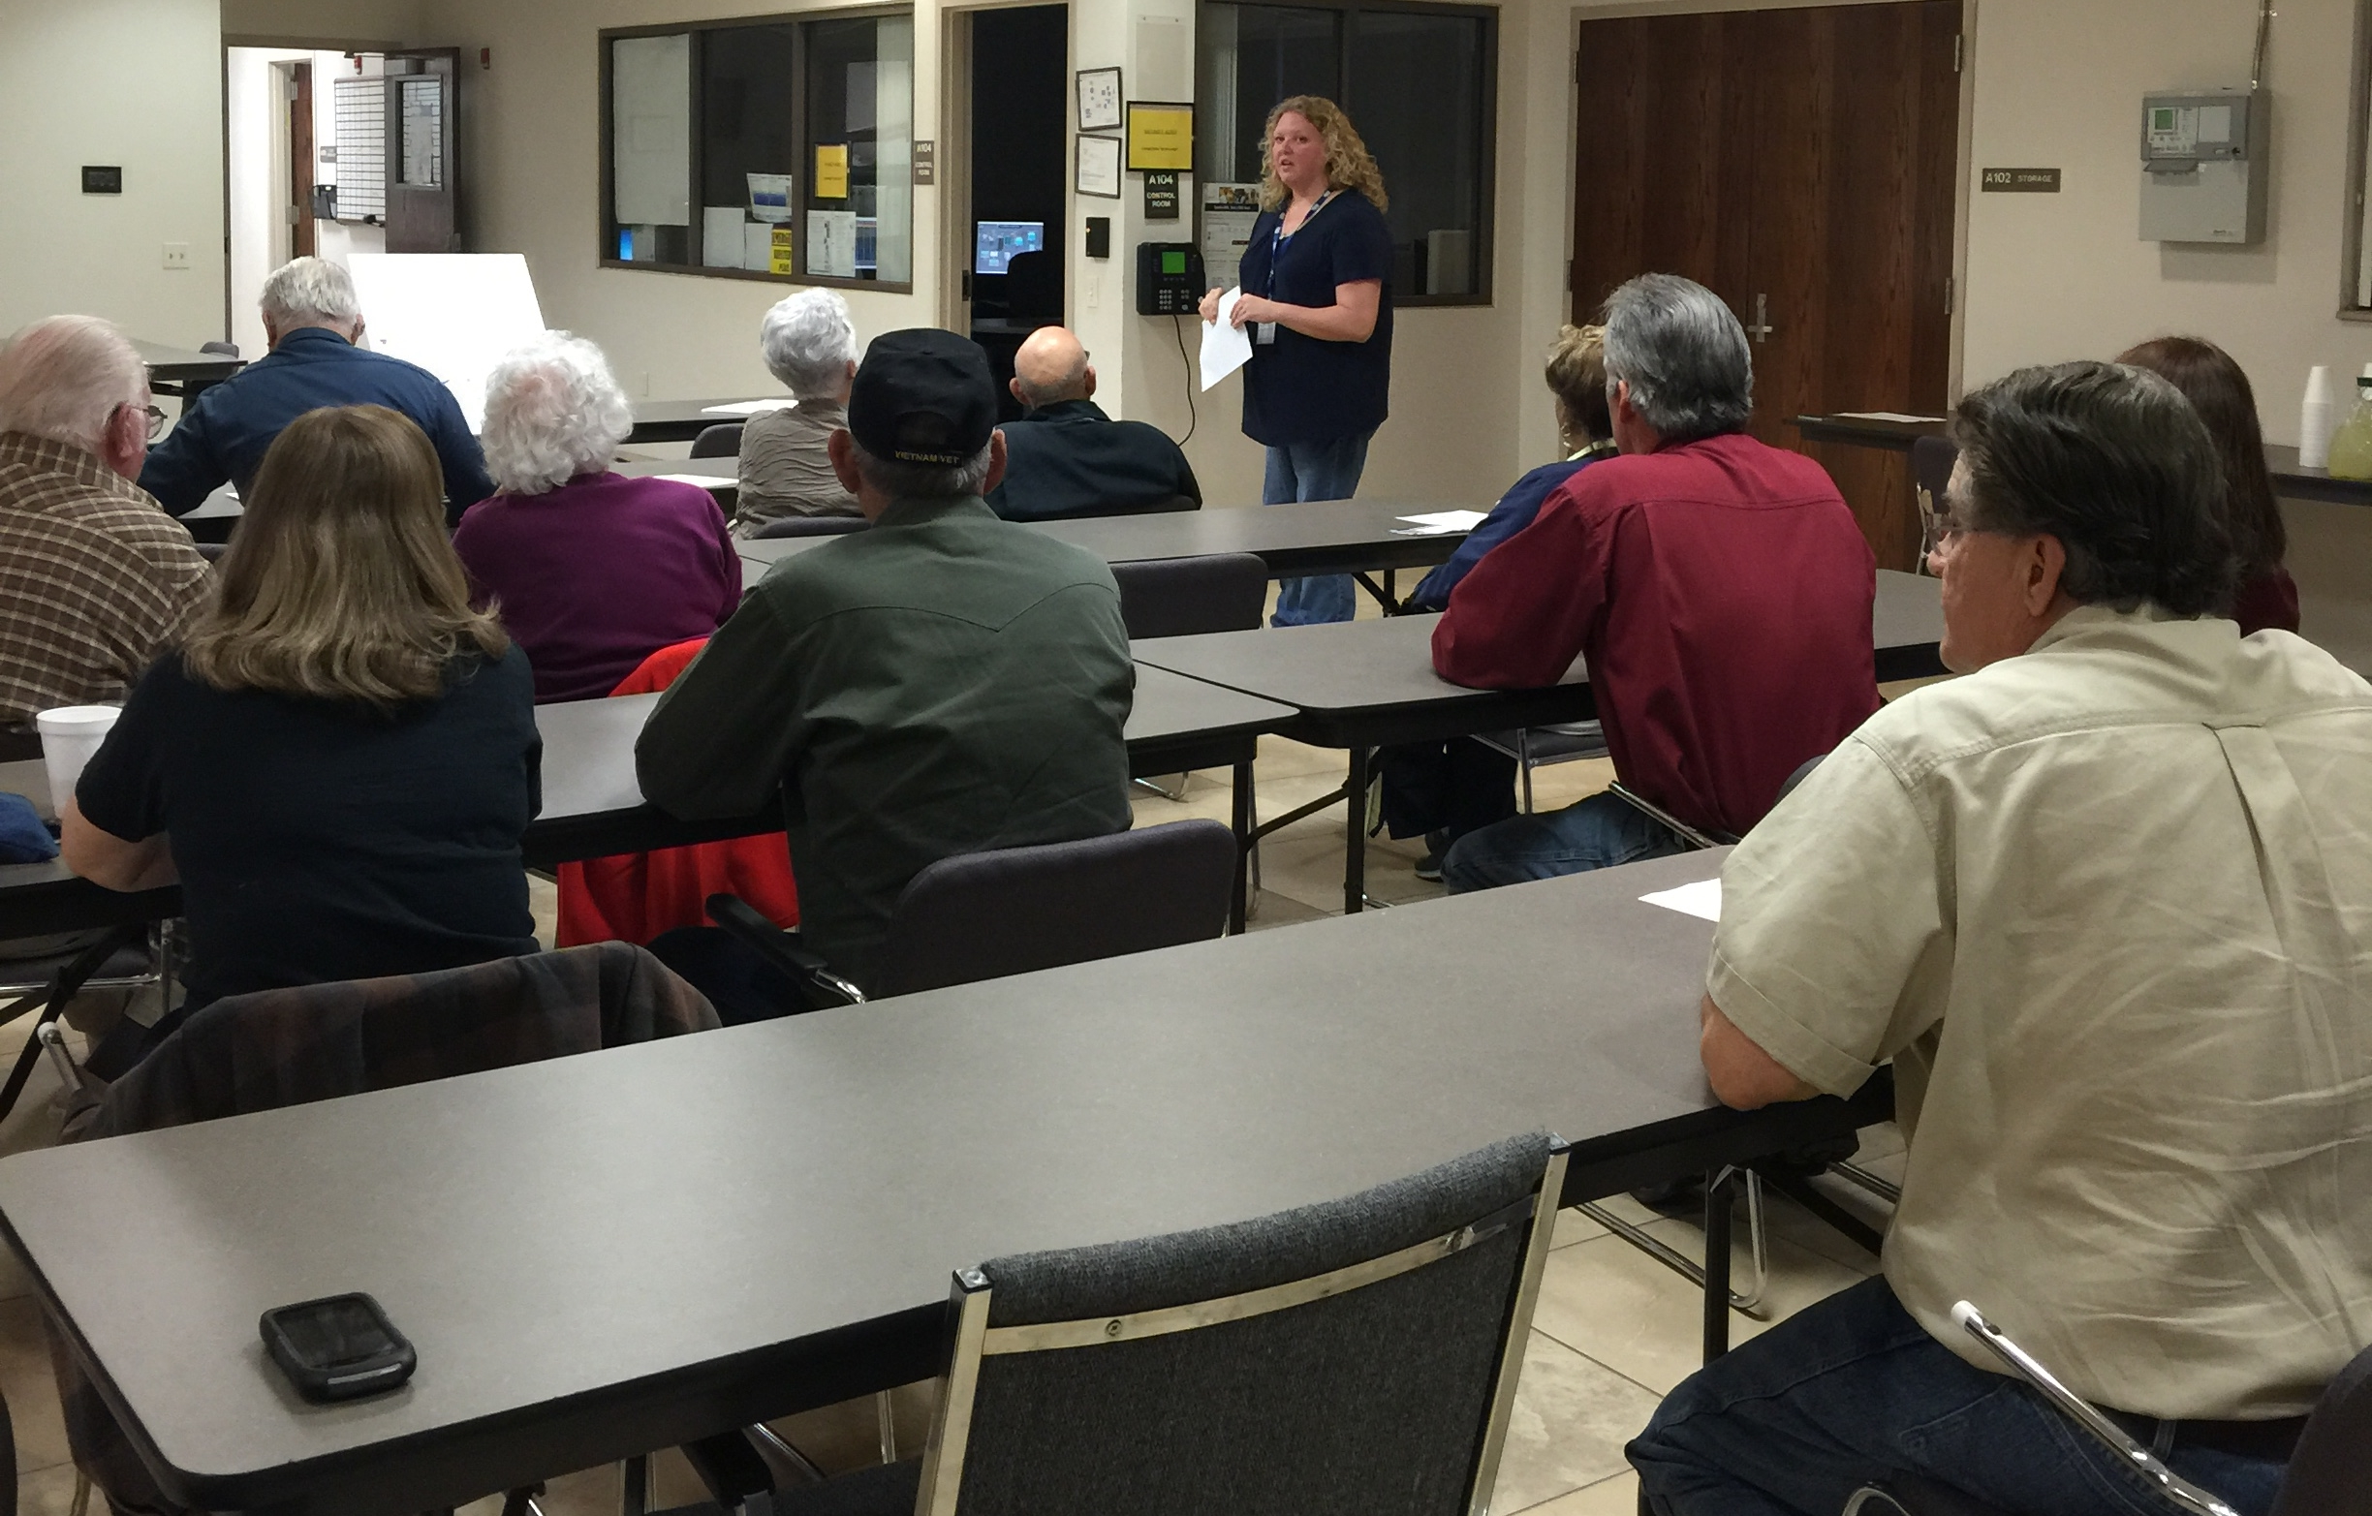
Challenges
State and Local Groundwater Regulation
Public Perception
Stakeholder Buy in
Funding/Value Engineering
Real Estate
Concentrate Disposal
Design Challenges
Construction Challenges
Operational Challenges

Slide 10
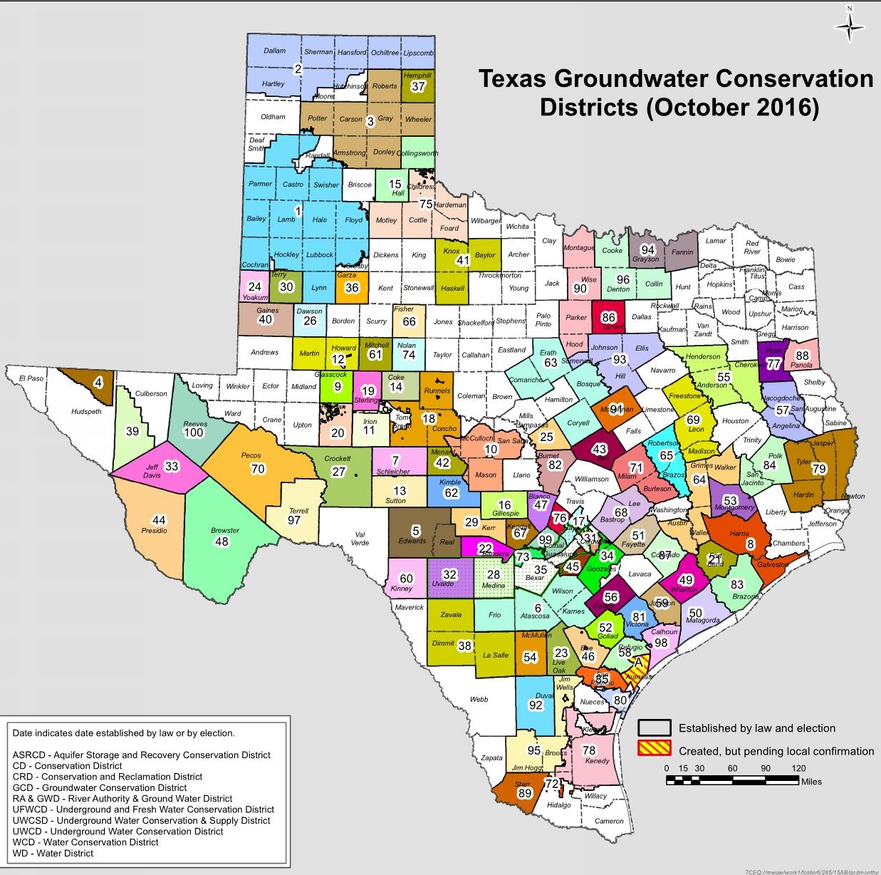
Regulatory
Challenges
State and Local Groundwater Regulation
  16 Groundwater Management Areas
  100 Groundwater Districts
Challenges:
  Desired Future Conditions (DFCs)
  Groundwater Permits
http://www.tceq.state.tx.us/assets/public/permitting/watersupply/groundwater/maps/gcdmap.pdf
Notes:
Desired Future Conditions approved through by GMA 13
Region L Plan – required projects need to be part of Region L plan to get state funding.
Ensured the full volume of our projects are submitted within the model – 2016 Region L plan – New = 48’ drawdown and
Currently 5622 MAG for brackish – Projects need to be in Region L to get state funding –

Slide 11
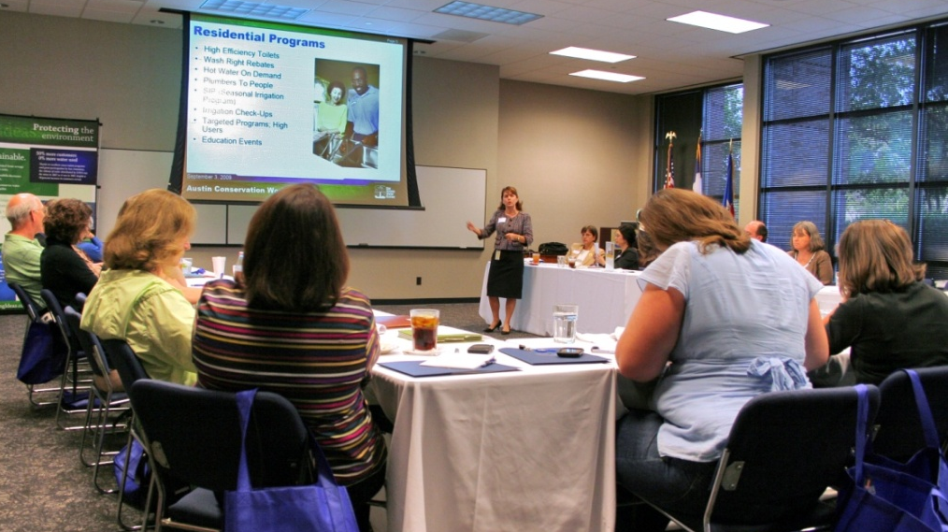
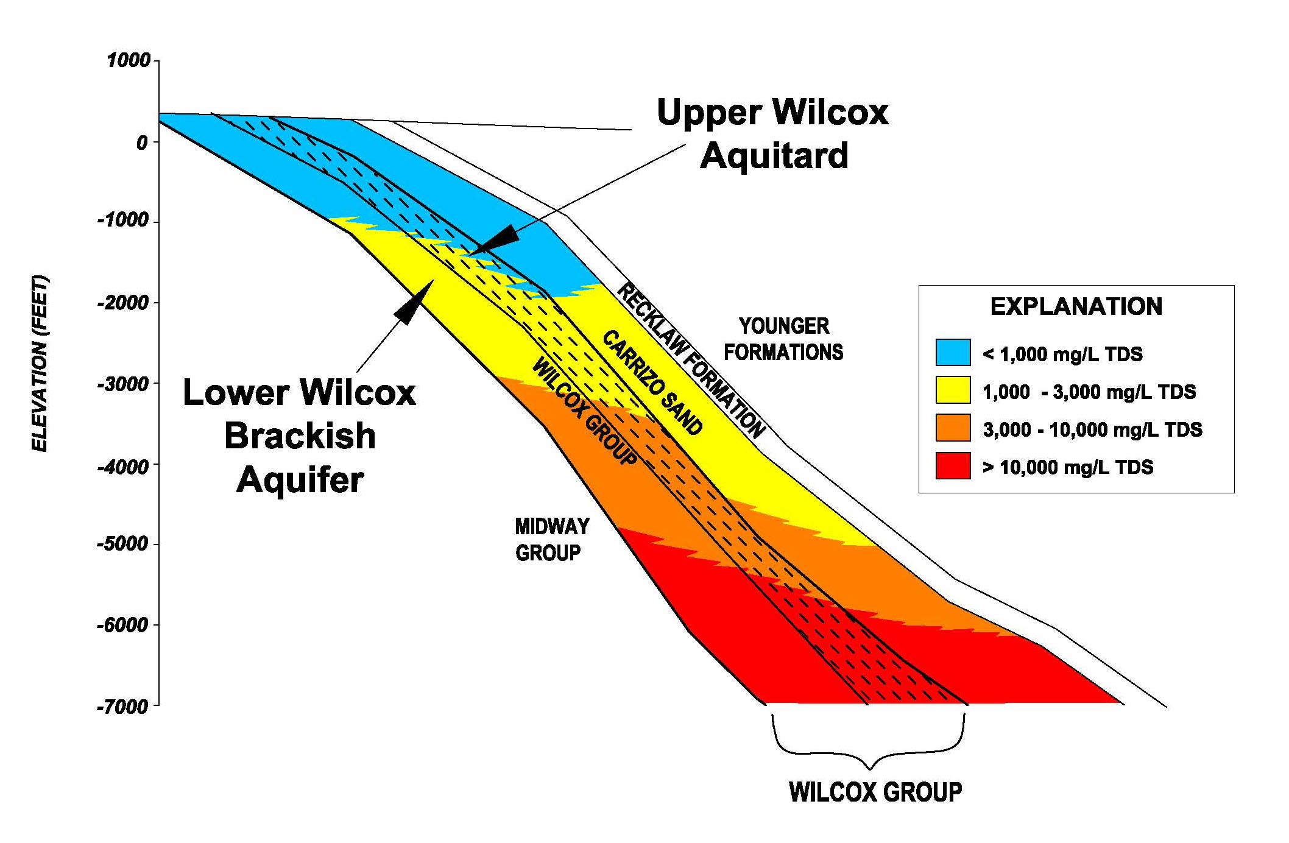
Public Perception
Challenges
Project Opposition
  Residents of neighboring counties
  Atascosa Water Watch
Response to Opposition
  Science Committee
  Phase I in Bexar County
  Constructing monitoring wells
  Continue providing information to political leadership in Bexar County and surrounding Counties

Slide 12
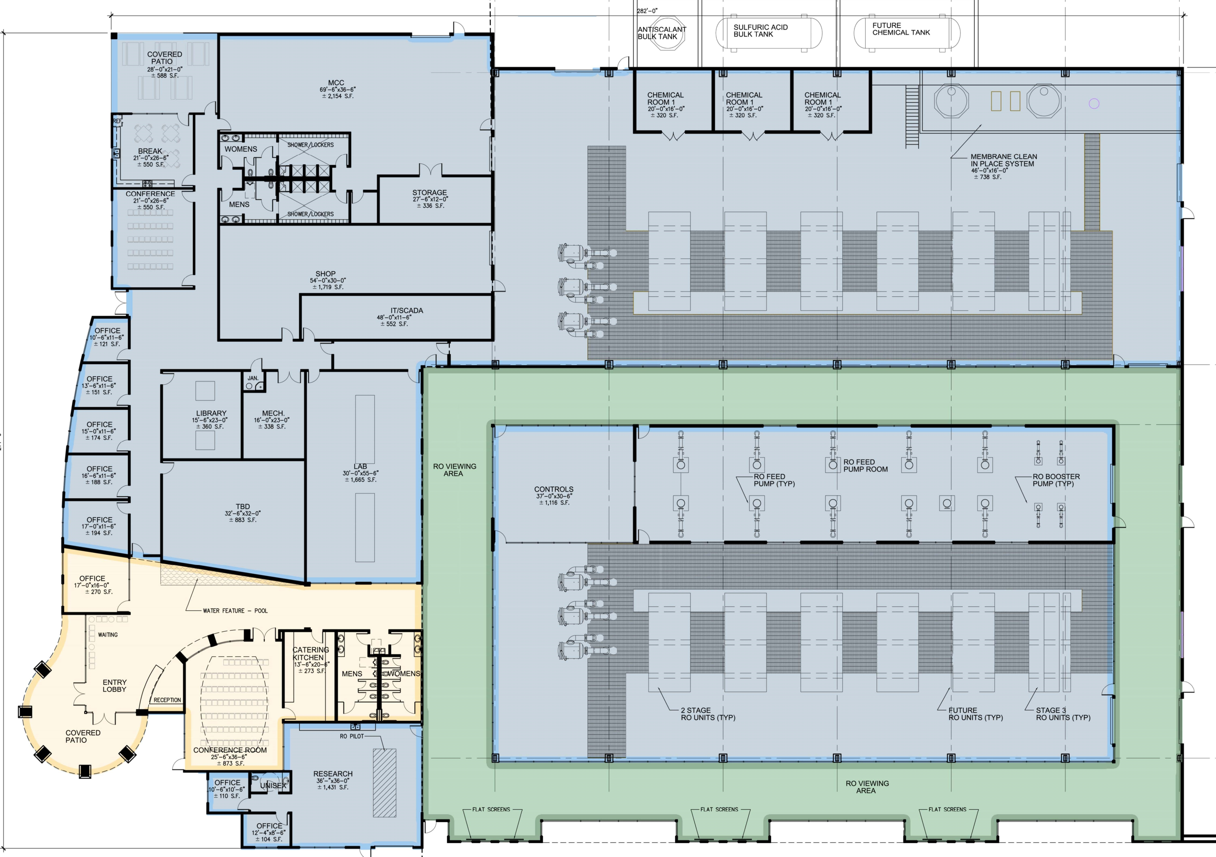
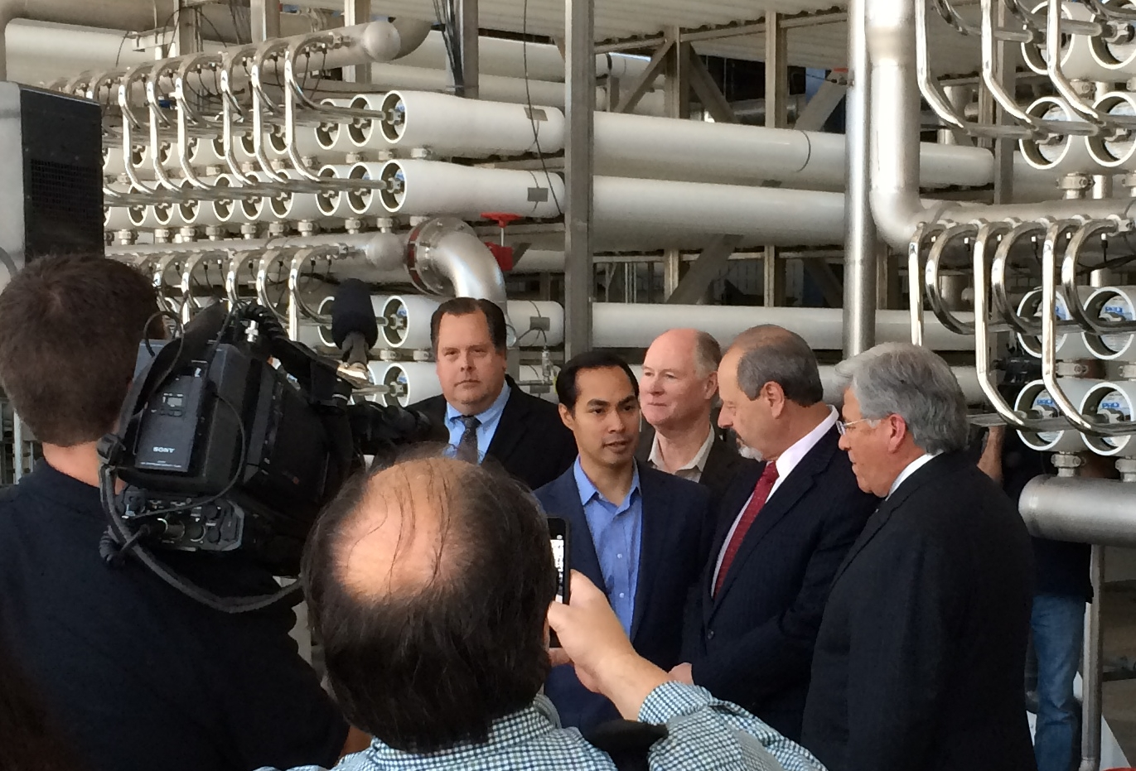
Stakeholder Buy in
Challenges
Large project many different stakeholders across SAWS
Partnering sessions with SAWS upper management
Desal plant visits across the United States
Outreach to San Antonio elected officials and SAWS Board of Trustees
  Addressed Project concerns
Construction Manager, Program Manager, and SAWS Workshops

Slide 13
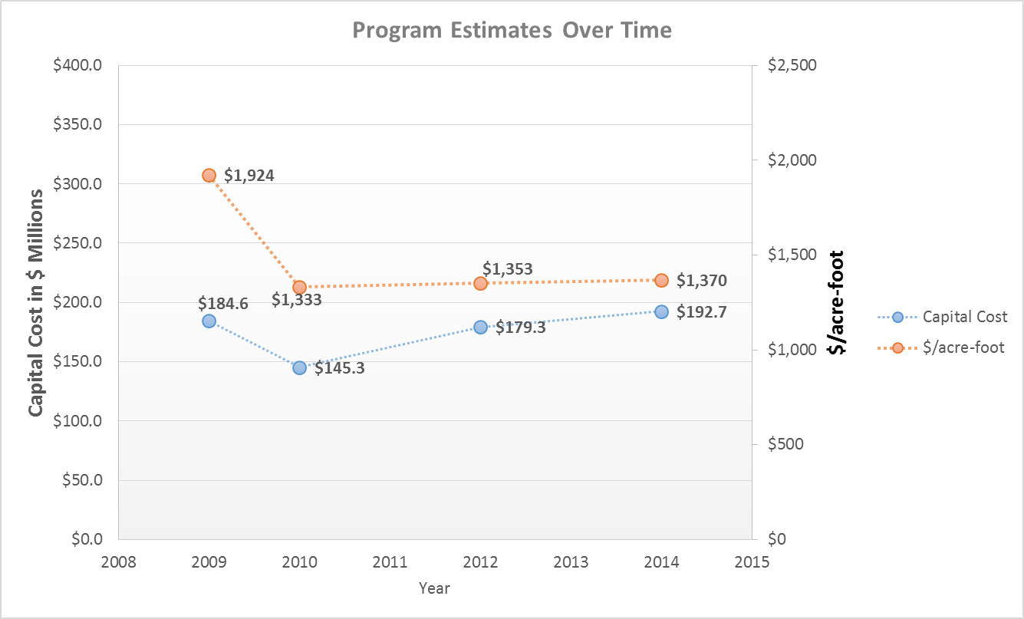
Budgeting
Developing Cost Estimates
Economy
Increase Plant Capacity
Scope/Vision Change
New Information
Estimates vs. Actual Bids
*For comparison purposes all estimates assume 5% annual debt service
*2009/2010 Estimate 10 MGD / 2012 Estimate 10.9 MGD / 2014 Estimate 12 MGD

Slide 14
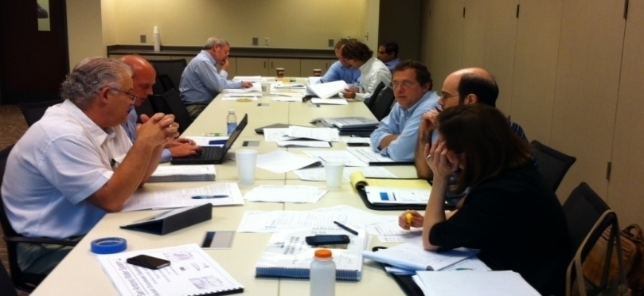
Funding
Funding Sources for the Program
Interest Rate | $/acre-foot | $/1,000 gallons
5% | $1,370 | $4.20
4% | $1,266 | $3.89
3% | $1,177 | $3.60
*Without and interest rate reduction SAWS would need to lower the capital cost by $40M to achieve $1,177 / acre-foot
Rate approval through SAWS board of Trustees and City Council
Texas Water Development Board (TWDB) Low Interest Loans
Construction estimates greater than budget estimates
  Value Engineering
  $17.7M reduction
Notes:
Outreach occurred with SAWS board of Trustees and City Council members addressing concern on the project
Consent decree came in 2013 and there was an expected sewer infrastructure increase in cost to $1.1B
WIF Funding ($109.5M) – Fill out application and provide backup information including contracts, deeds, feasibility studies, drawings

Slide 15
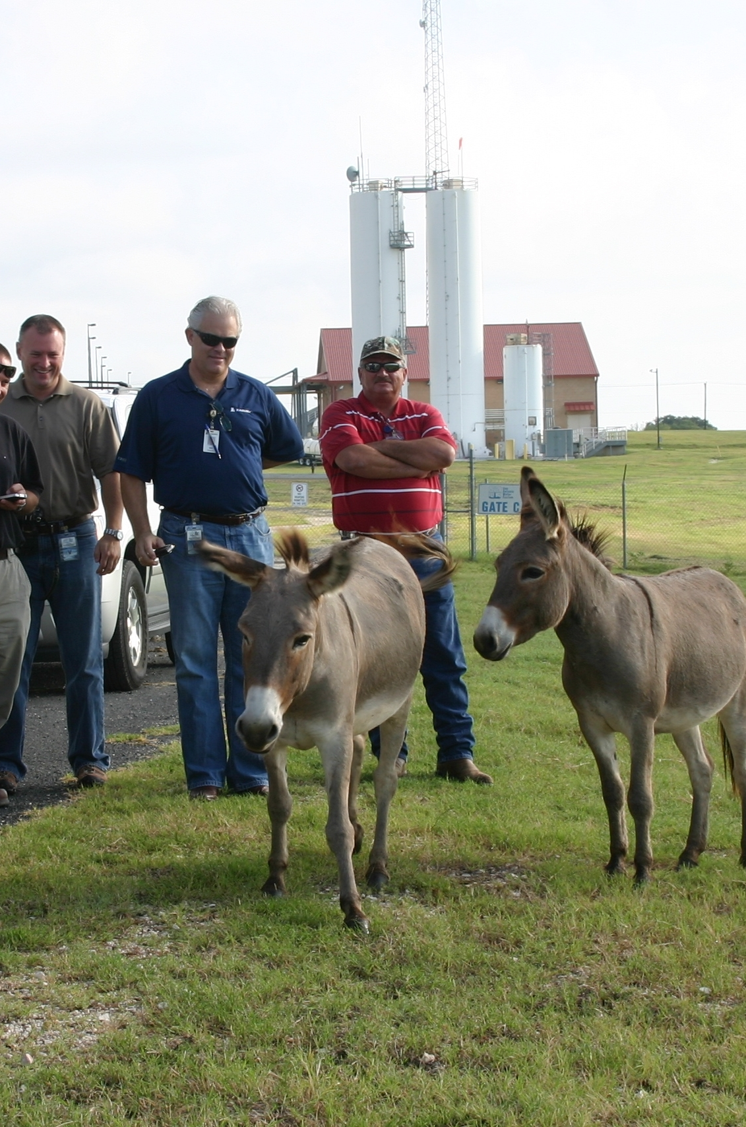
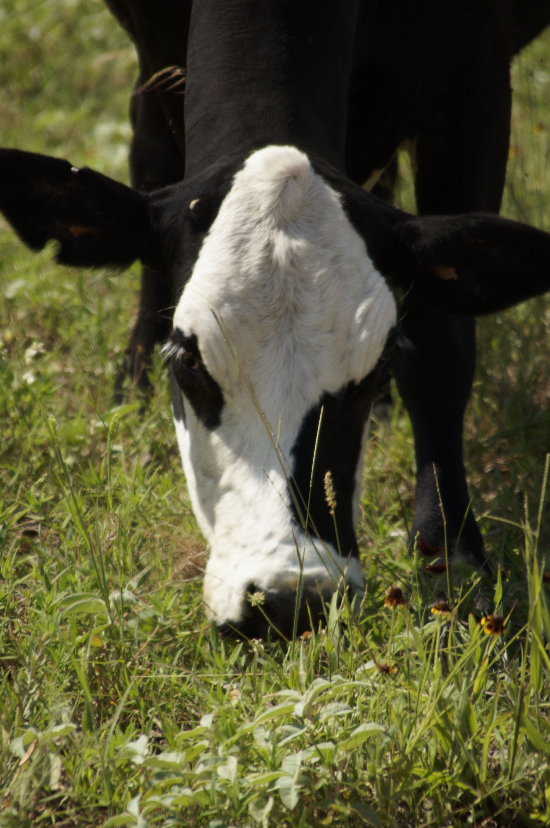
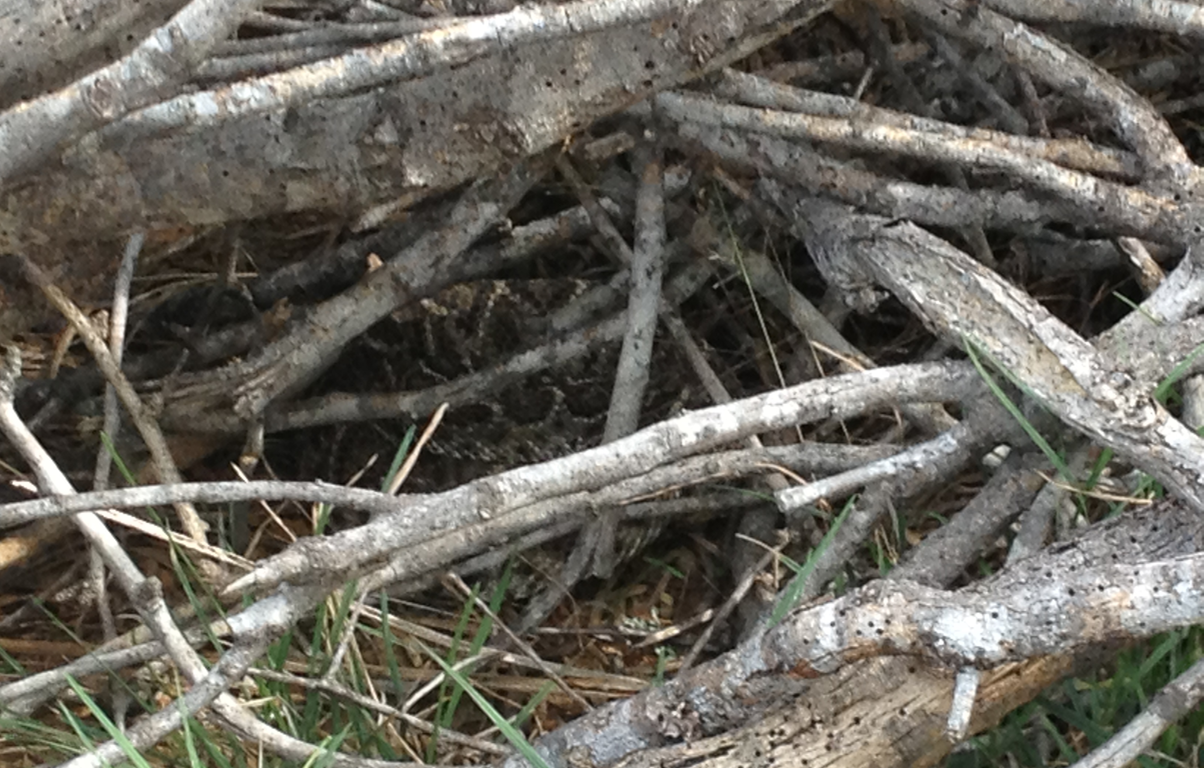
Real Estate
Challenges
Purchasing land needed for well field
  3,200 acres already owned
  Additional 2,800 acres purchased – Takes time
Land is leased back for agriculture and grazing
  Livestock
Working with neighbors
  Public Meeting
Notes:
Purchasing land in rural Texas can be challenging. Incomplete deeds, surveys, mineral rights.
Neighbors story of the drill rig and the wedding
Story of Larry and his concern seeing us out there
Story of window being shot out

Slide 16
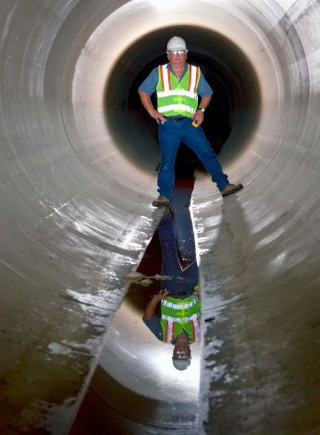
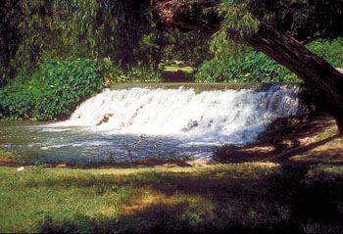
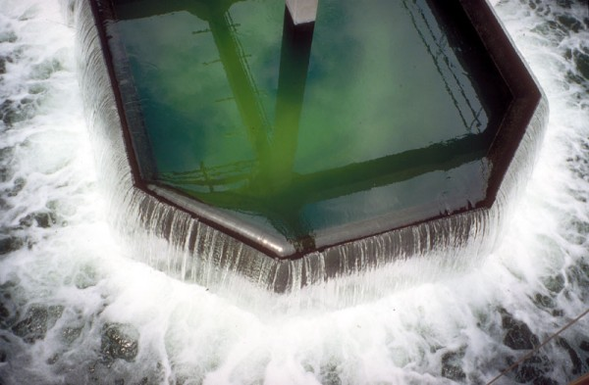
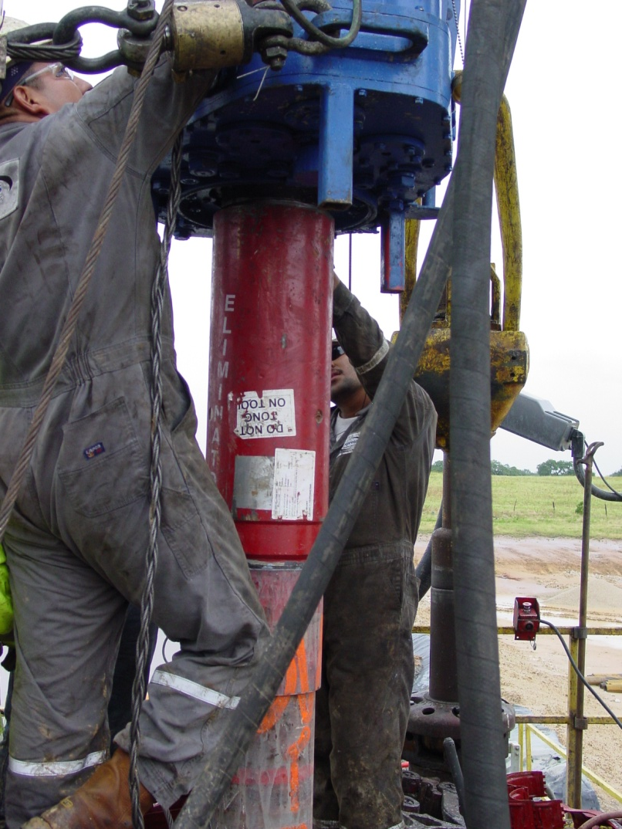
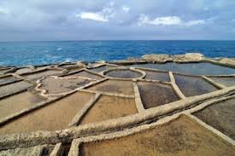
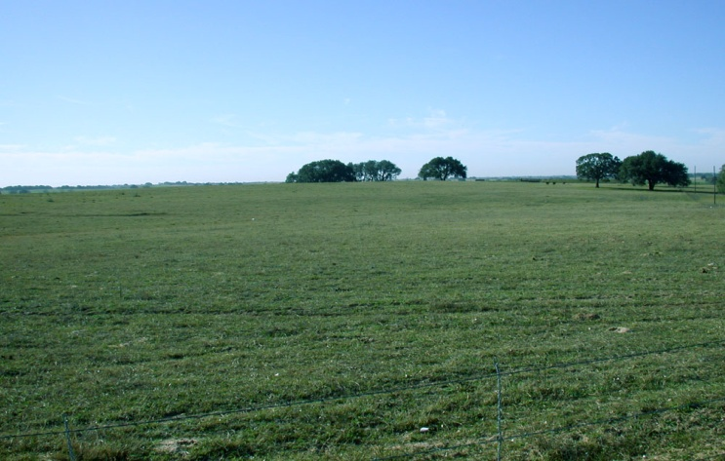
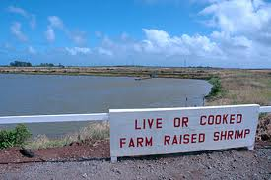
Concentrate Disposal
Options Considered

Slide 17
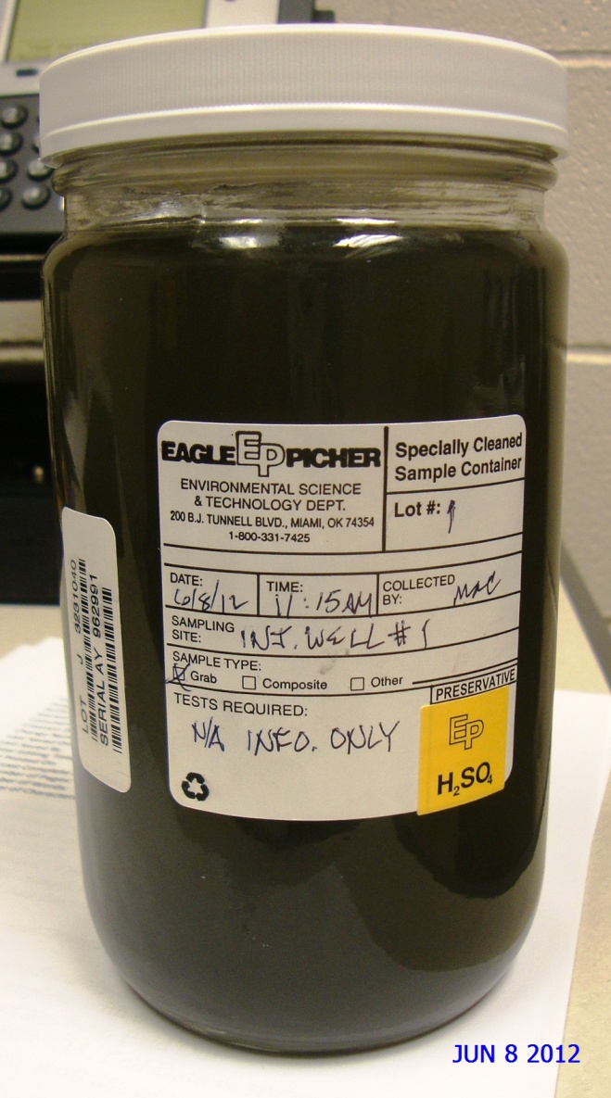
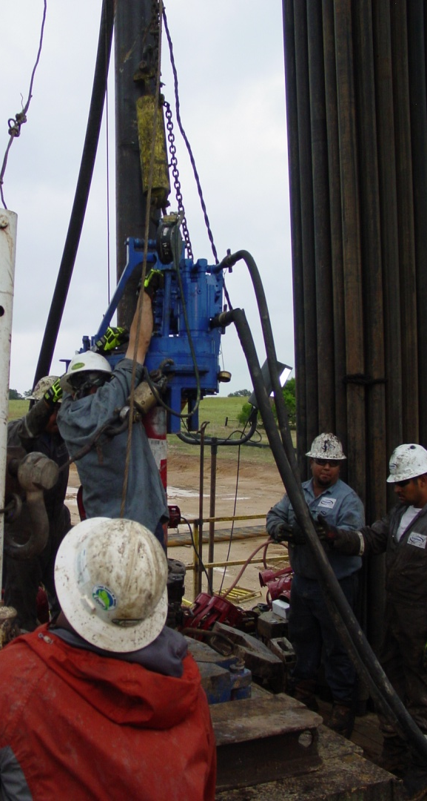
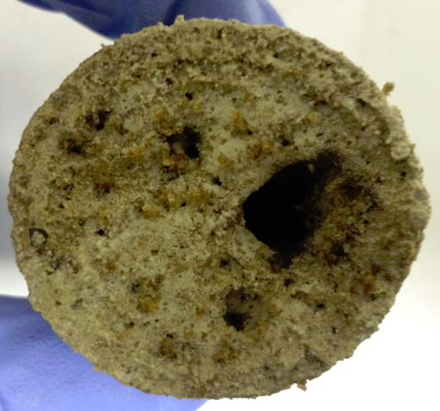
Class I injection well
Challenges
Concentrate Water Quality
Water quality of receiving formation
Injection capacity
Regulatory
  Texas Commission on Environmental Quality (TCEQ) General Permit

Slide 18
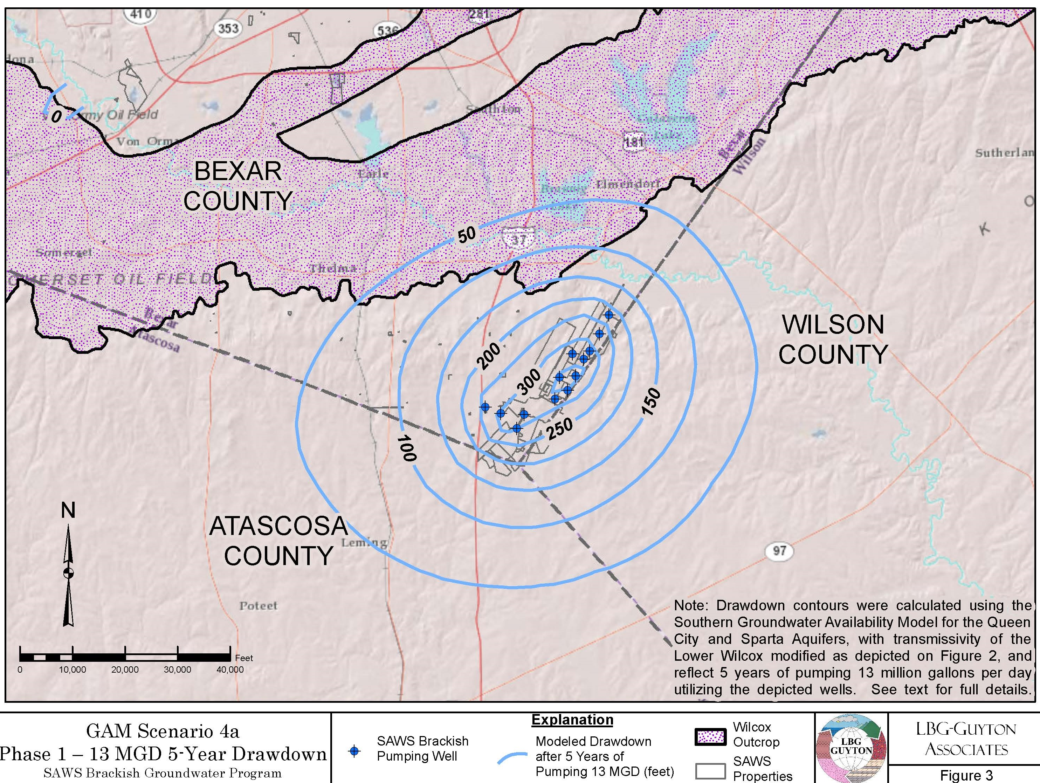
Design
Challenges
Prevent Membrane fouling
  Open System vs. Closed System
  Pre-treatment
Finish water quality standards
Short design timeline
Production well drawdown

Slide 19
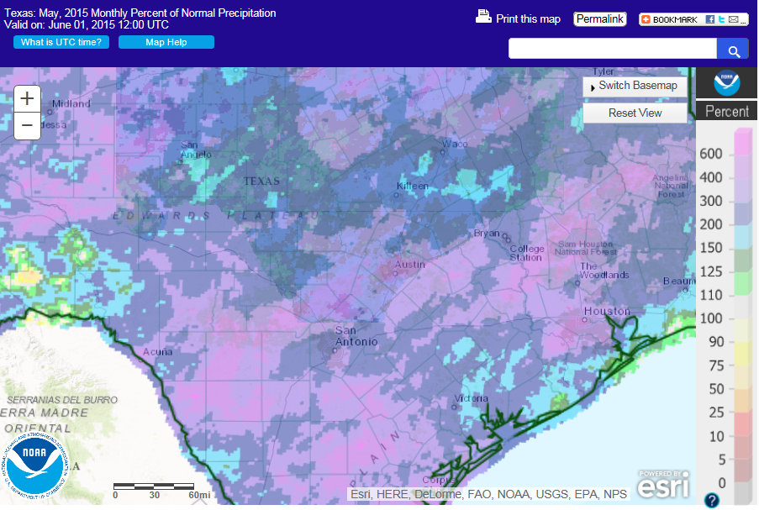
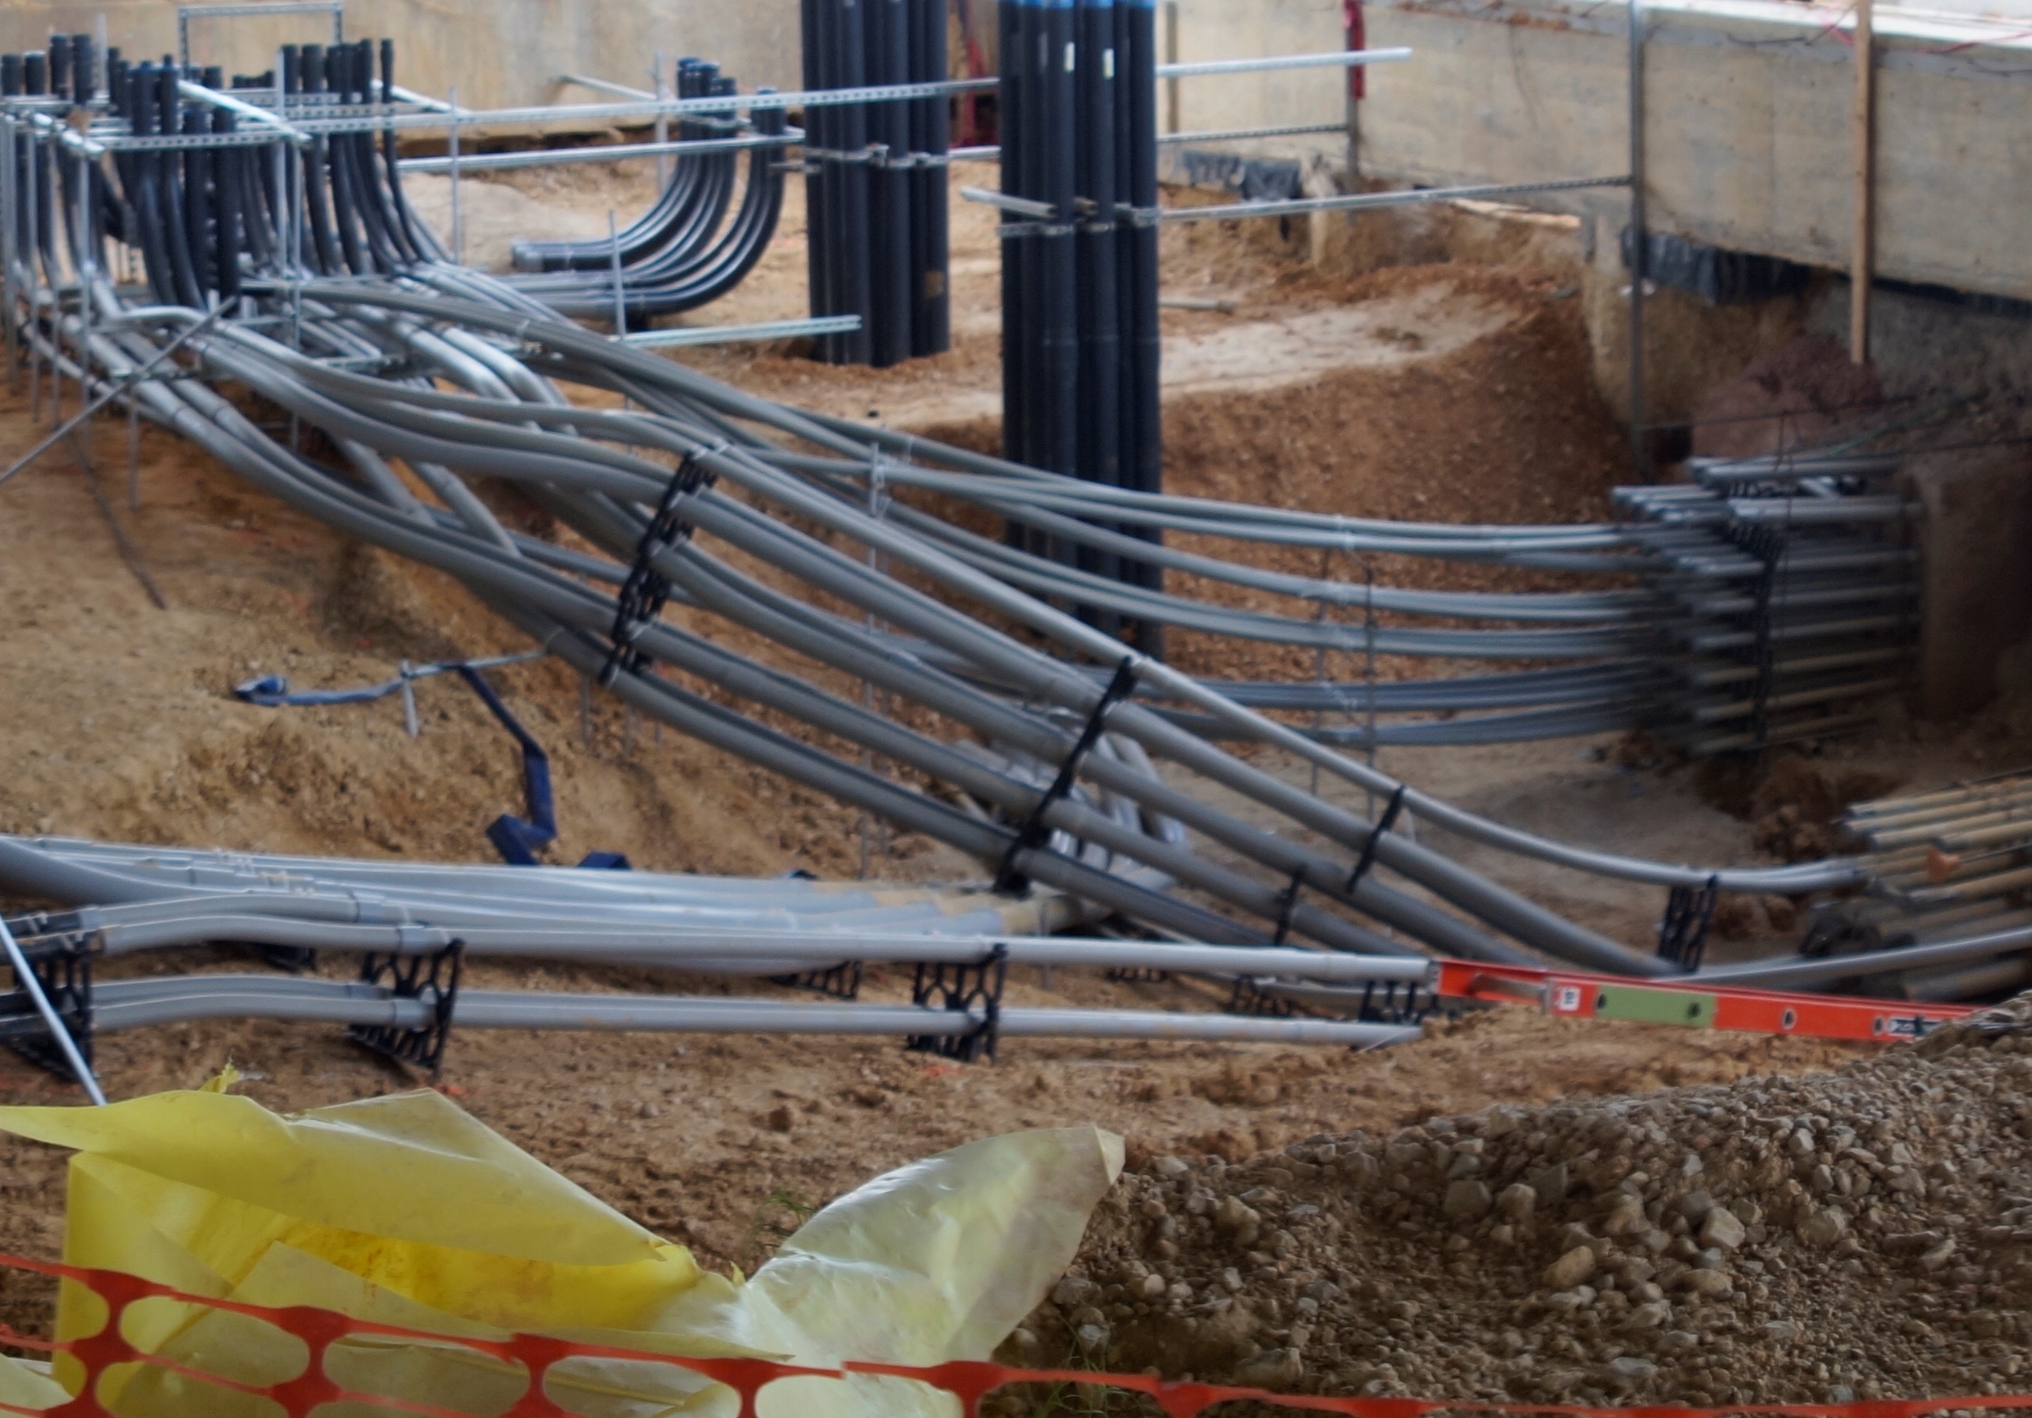
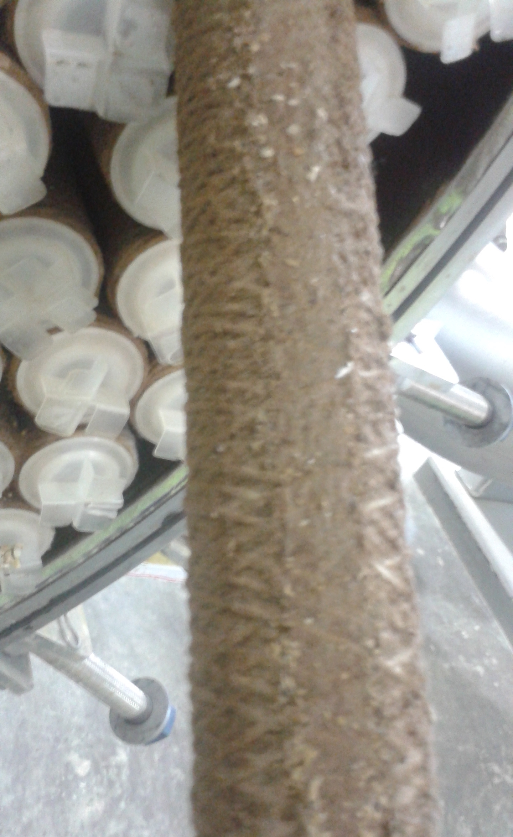
Construction/Testing Challenges
Challenges
$
Budget
  Managing a budget without owner contingency
Schedule
  Record Rainfall
Complicated Construction
Water Quality
  Raw Water
  Finished Water

Slide 20
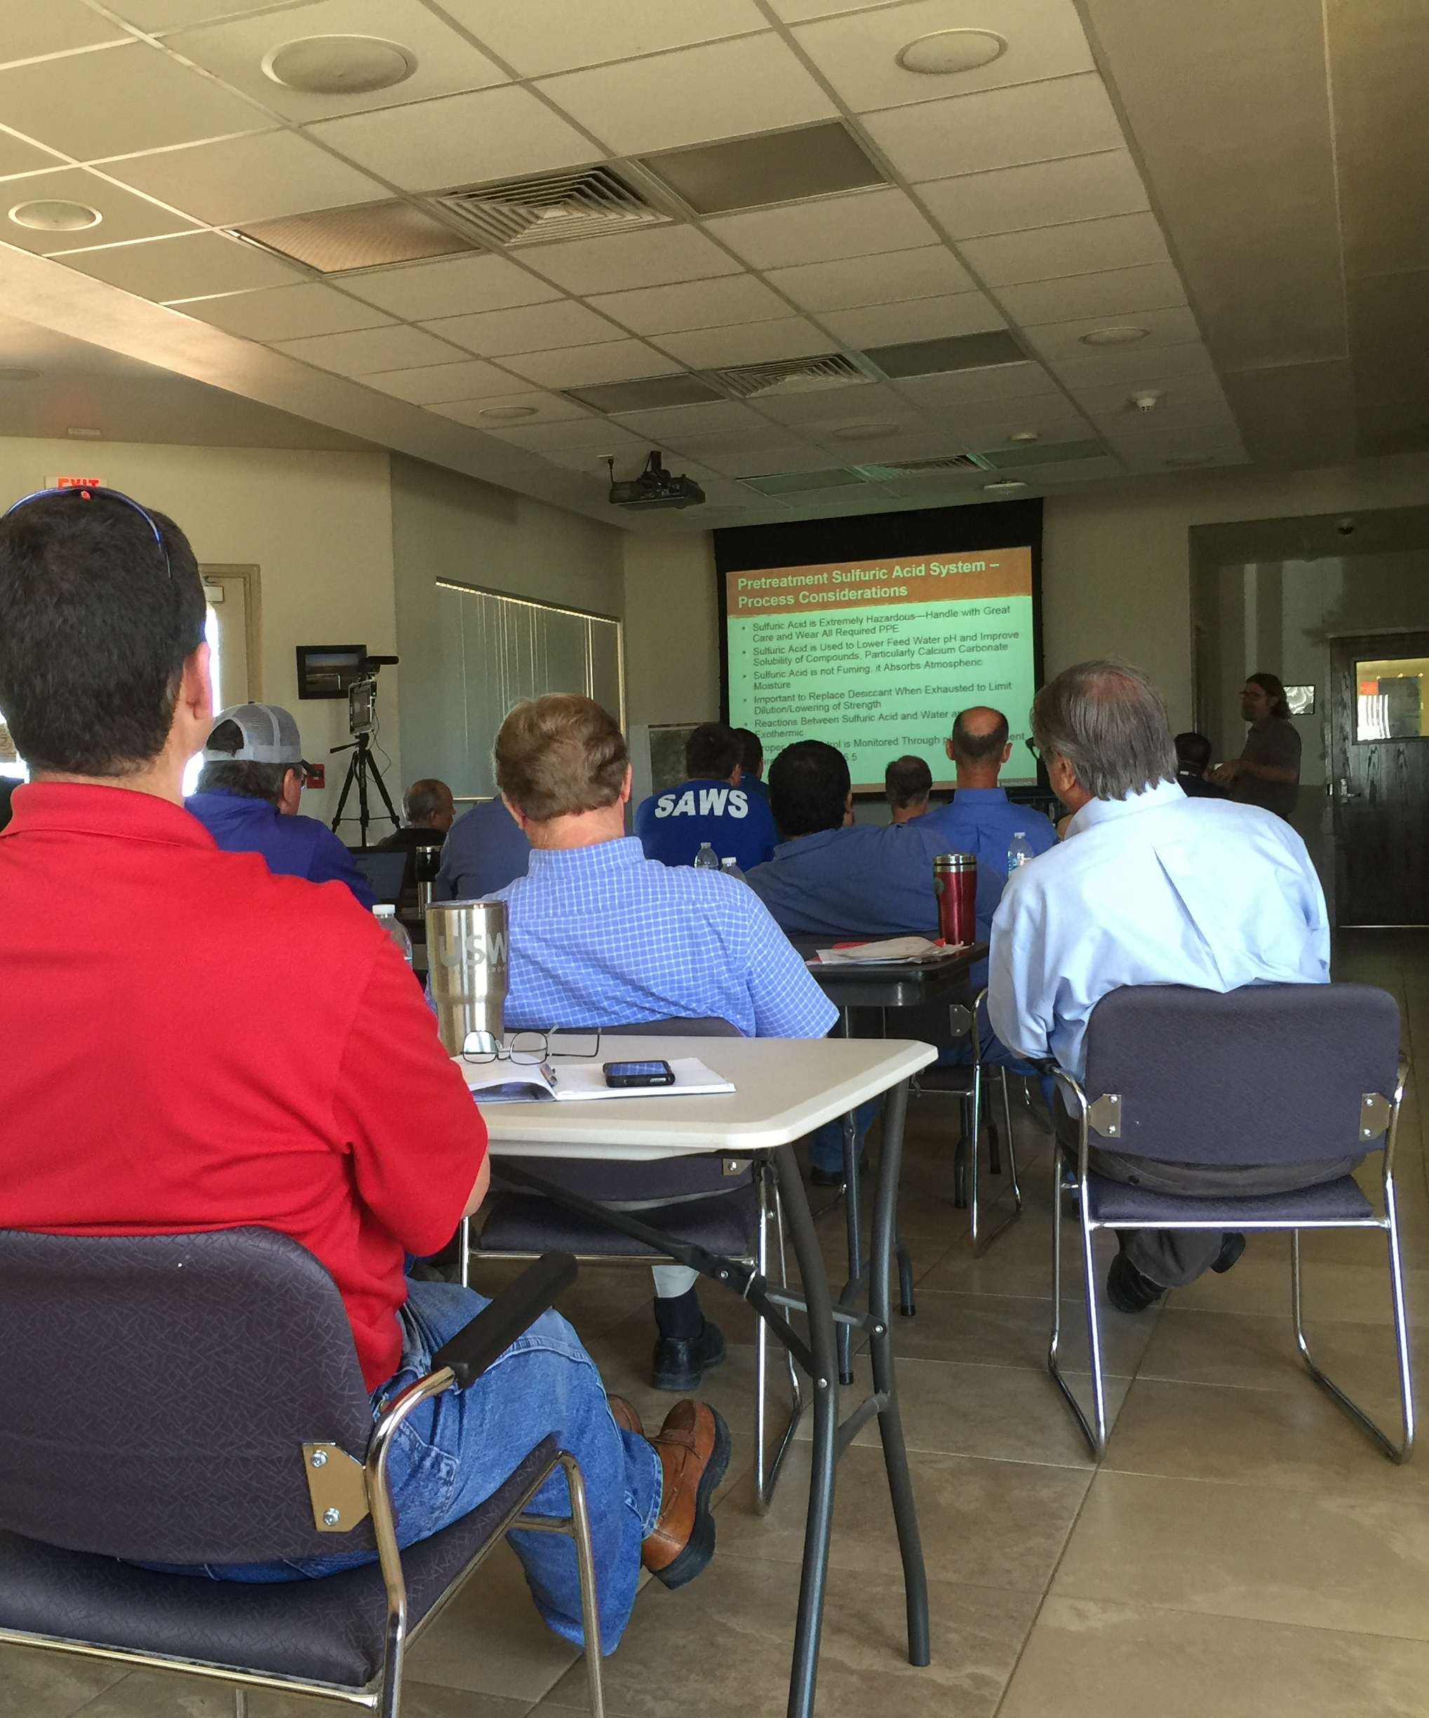
Operational
Challenges
Learning curve new water treatment plant
  Bring in operators early
  Recorded Training
  1 month Reliability Demonstration Testing
  3 months commissioning phase

Slide 21
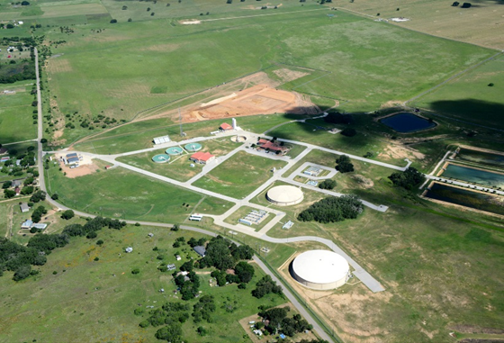
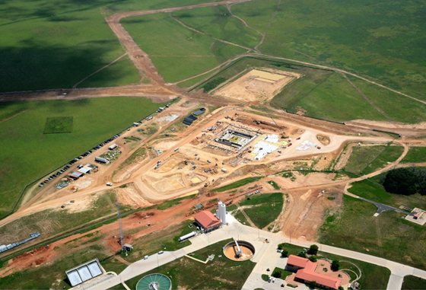
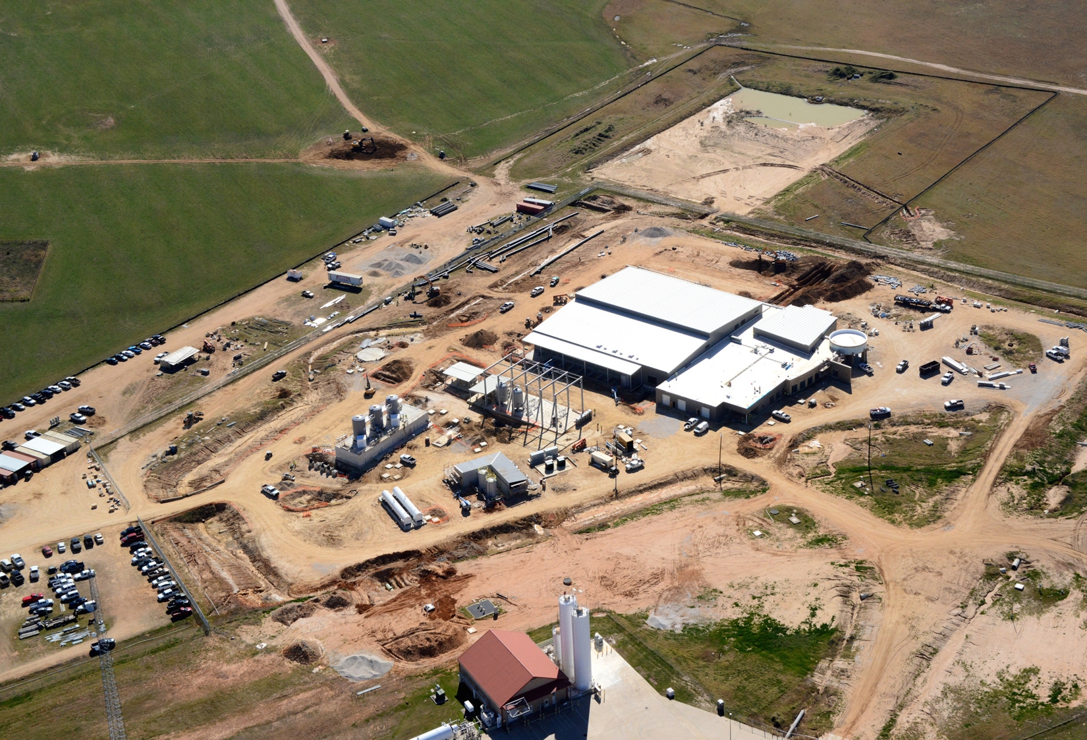
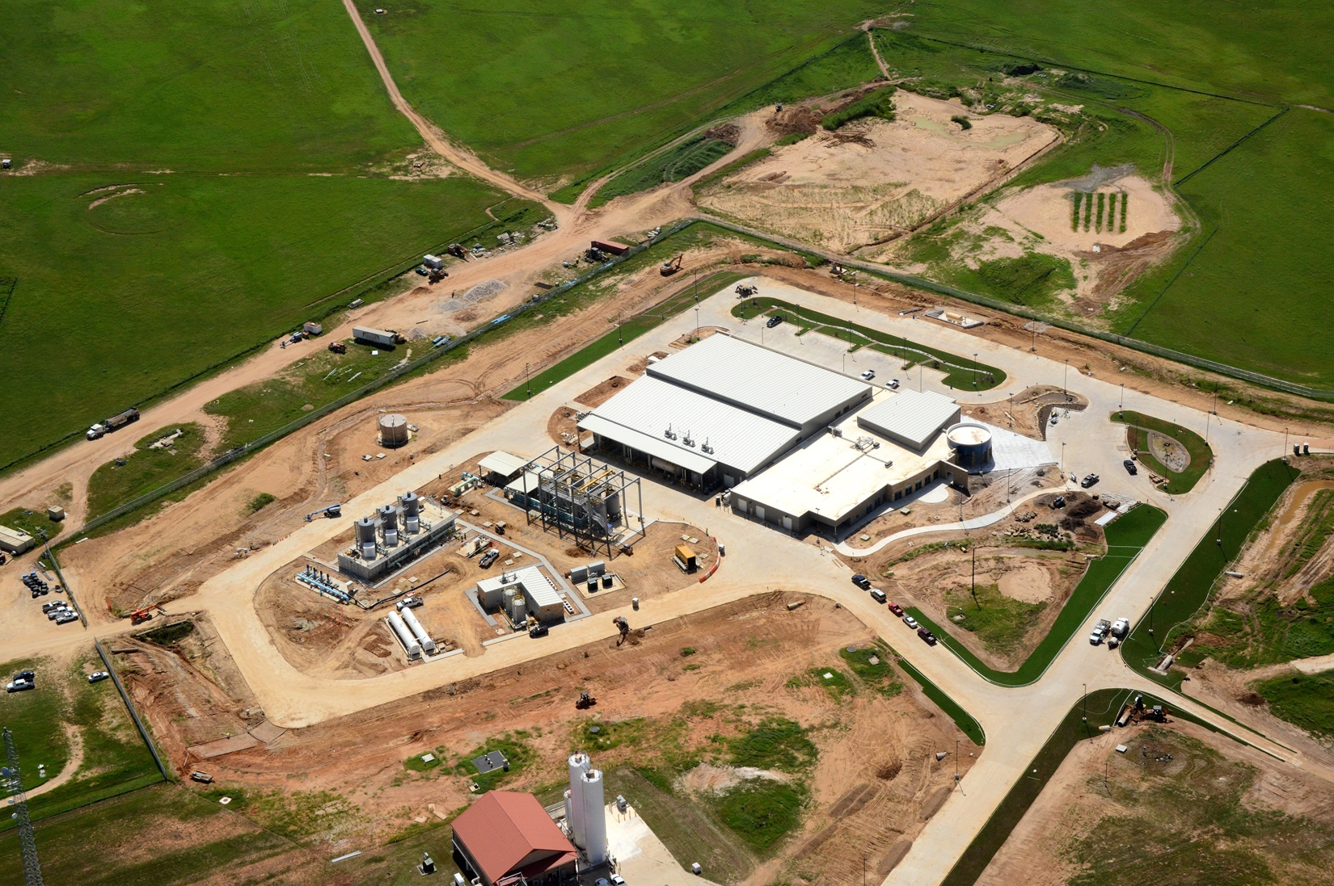
Construction 2014 to Present
Building Success
June 2014
April 2015
February 2016
September 2016

Slide 22
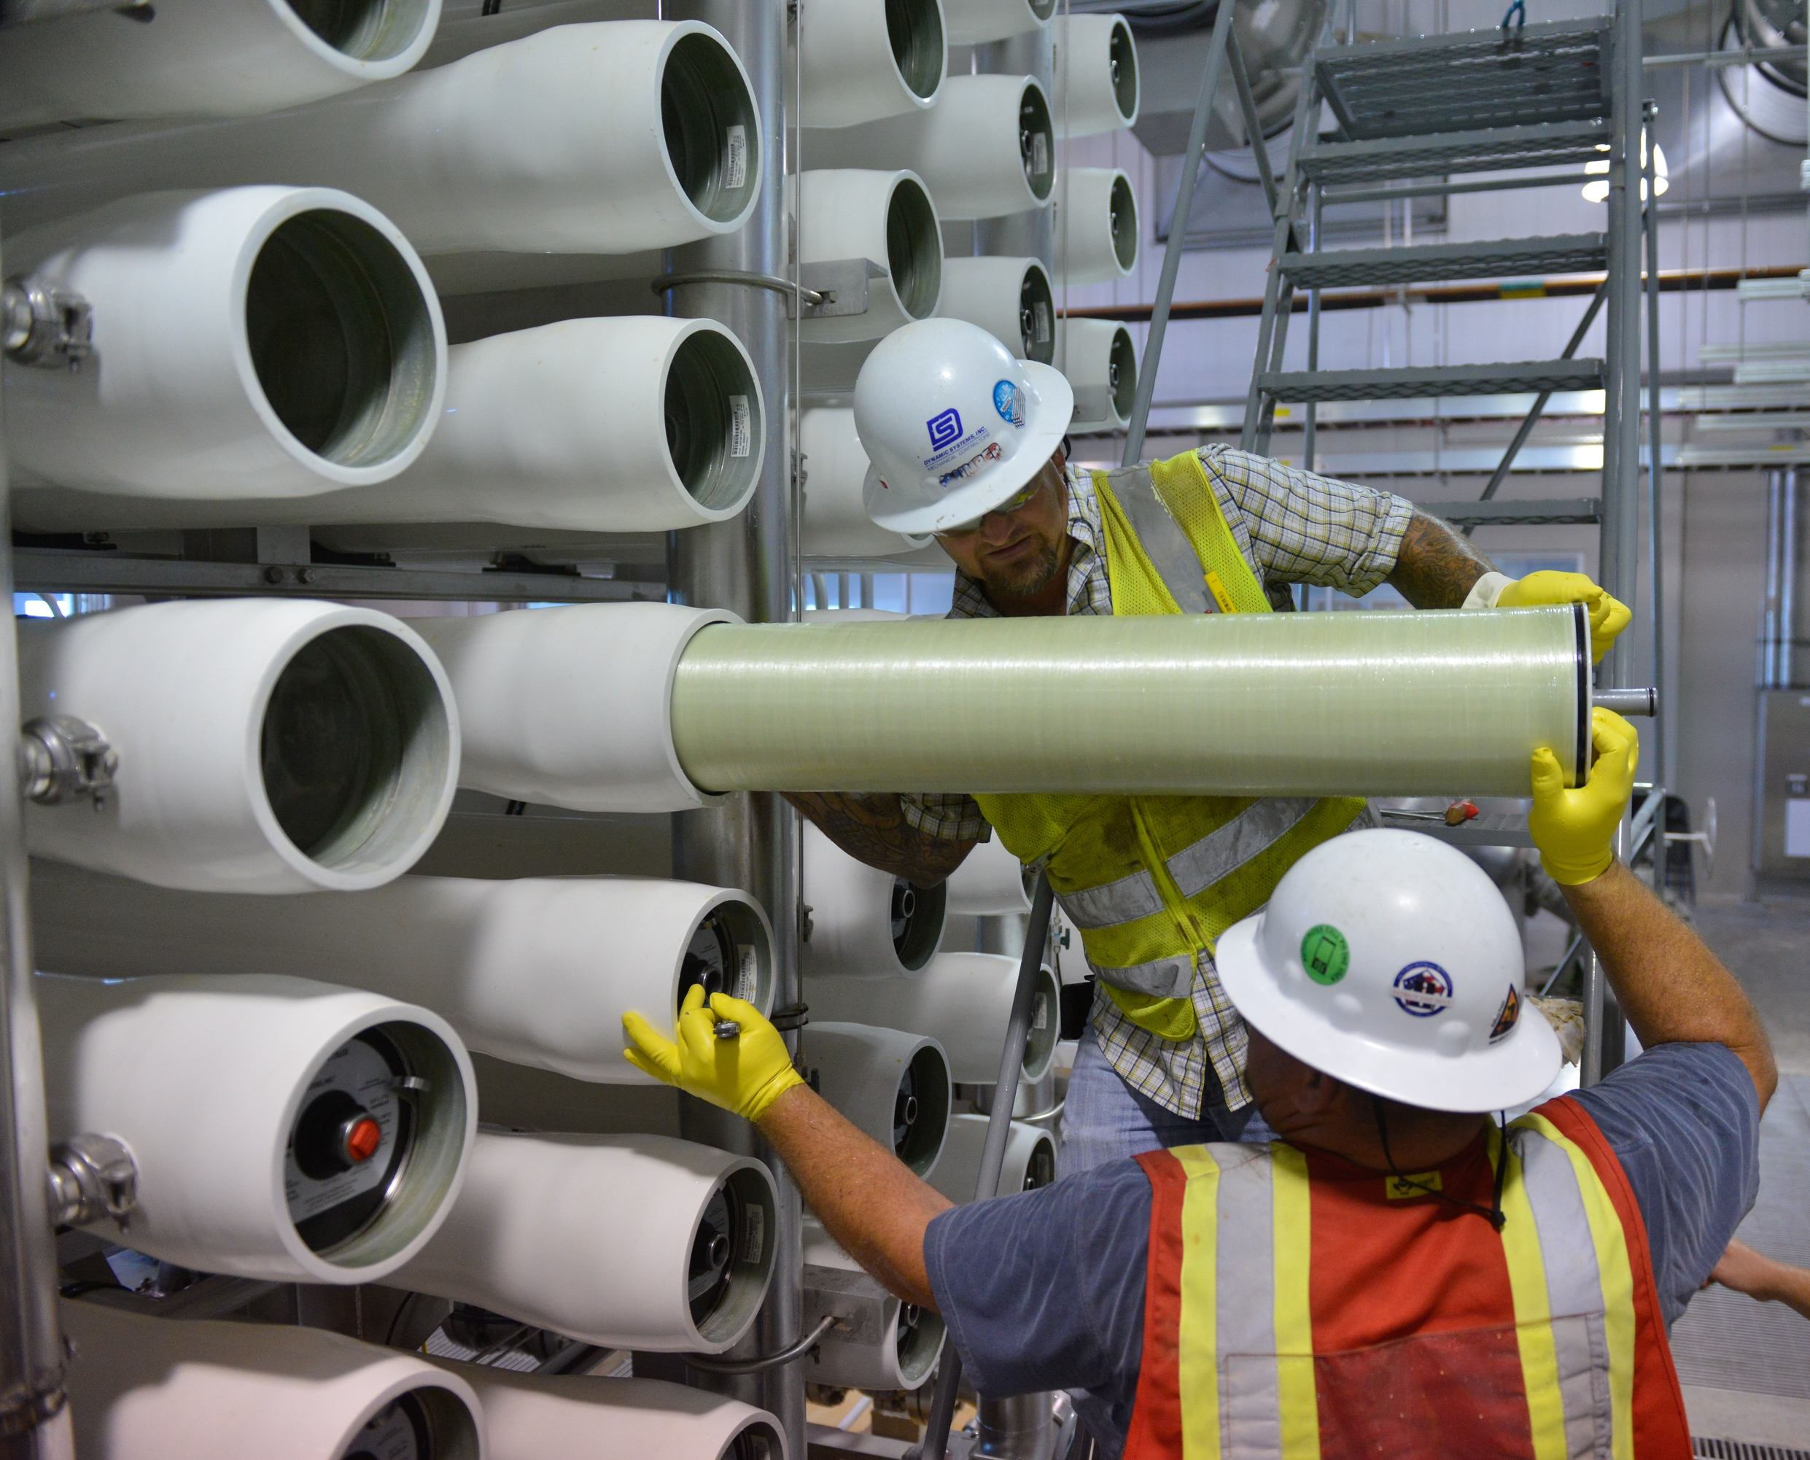
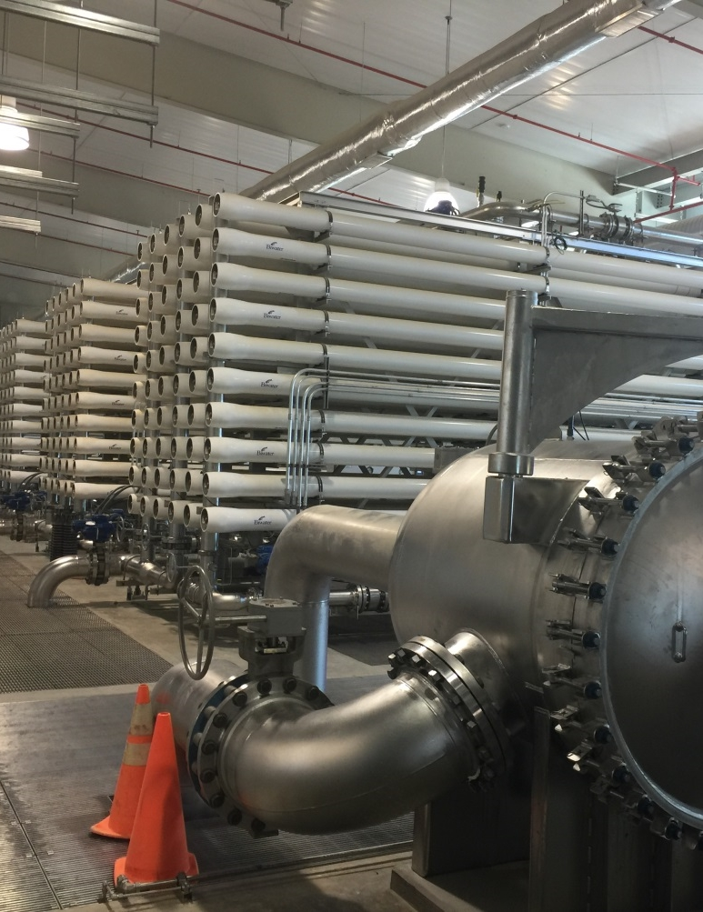
Loading RO Membranes

Slide 23
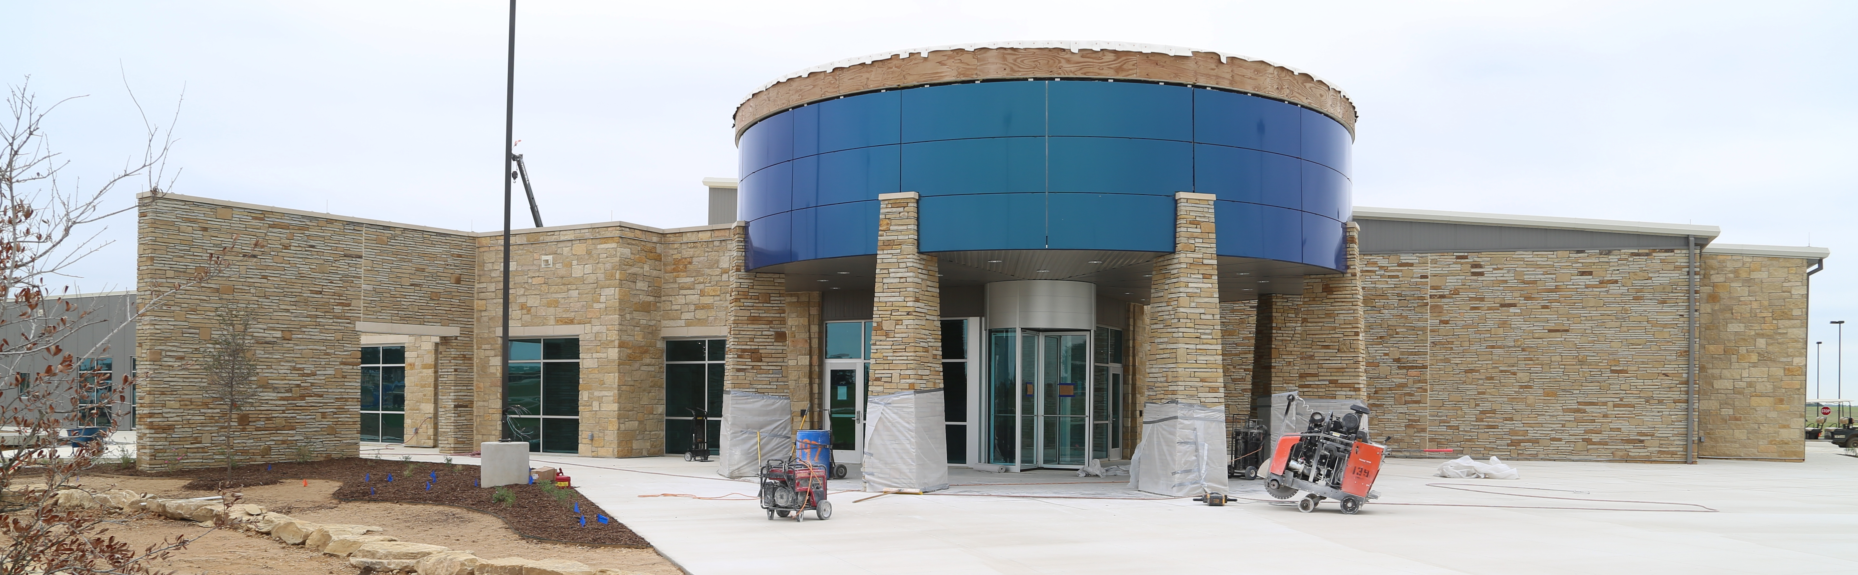
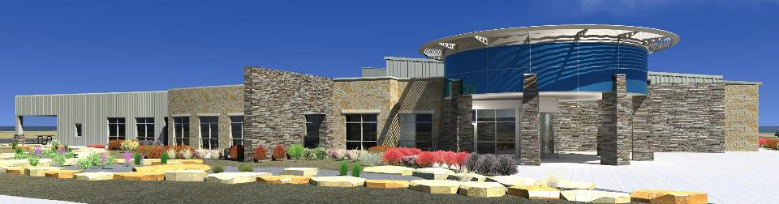
Administration Building

Slide 24
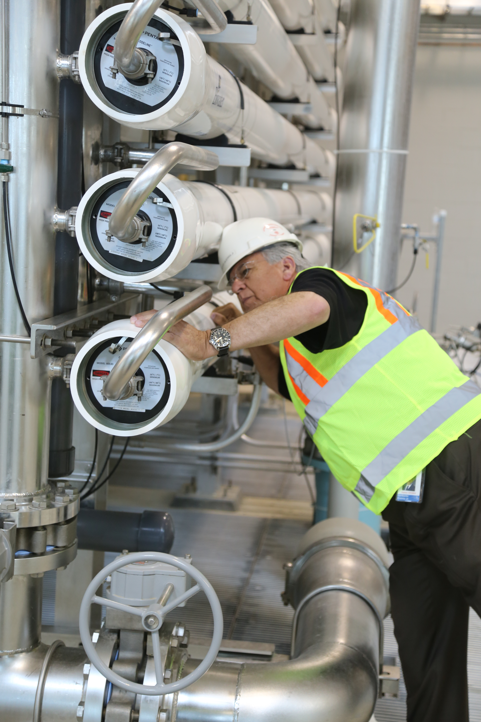
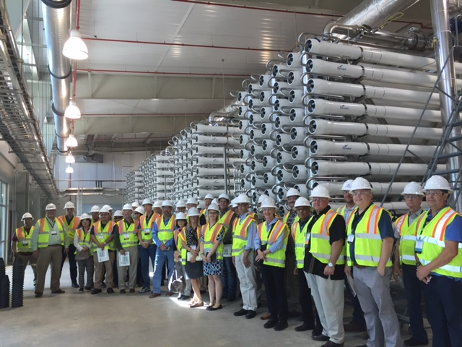
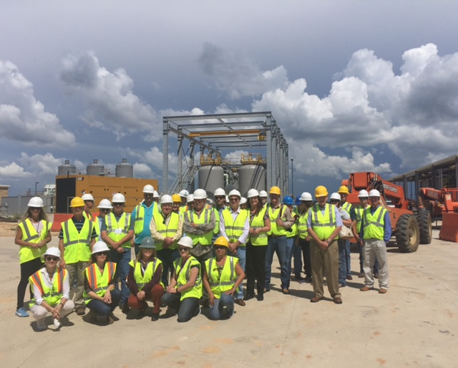
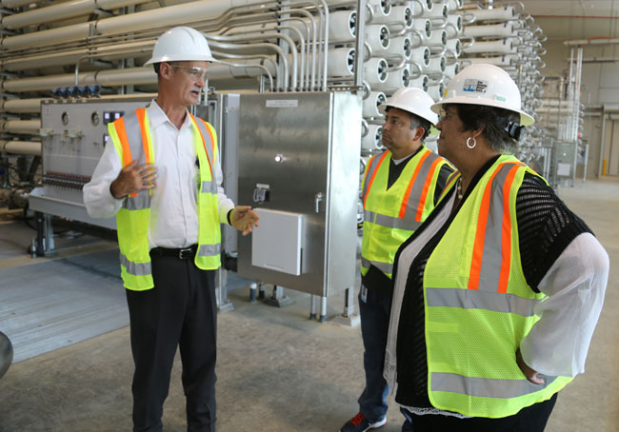
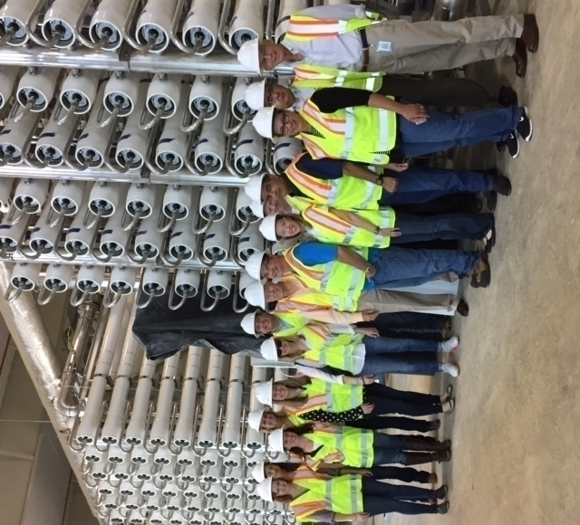
Showcase Facility
Hard Hat Tours
Notes:
From left to Right: 1. Chairman 2. Texas Desalination Conference Tour 3. Texas Groundwater Association
4. Pat Jasso and Ernesto Arrellano 5. Texas Senate Committee on Agriculture and Water

Slide 25
Questions?

