Slide 1


Multi-Funder Regionalization Projects:
Oklahoma
Greg Carr Charles de Coune
DWSRF Manager Lending Manager
DEQ OWRB
gregory.carr@deq.ok.gov charles.decoune@owrb.ok.gov
405-702-8104 405-530-8825

Slide 2
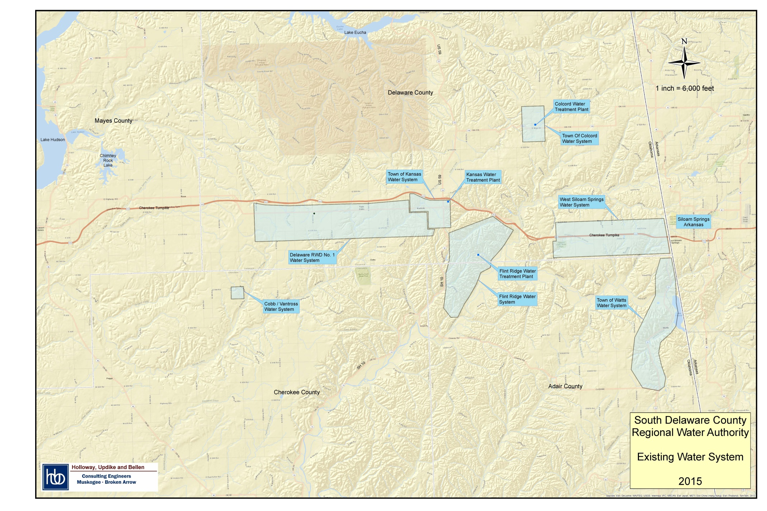

Slide 3
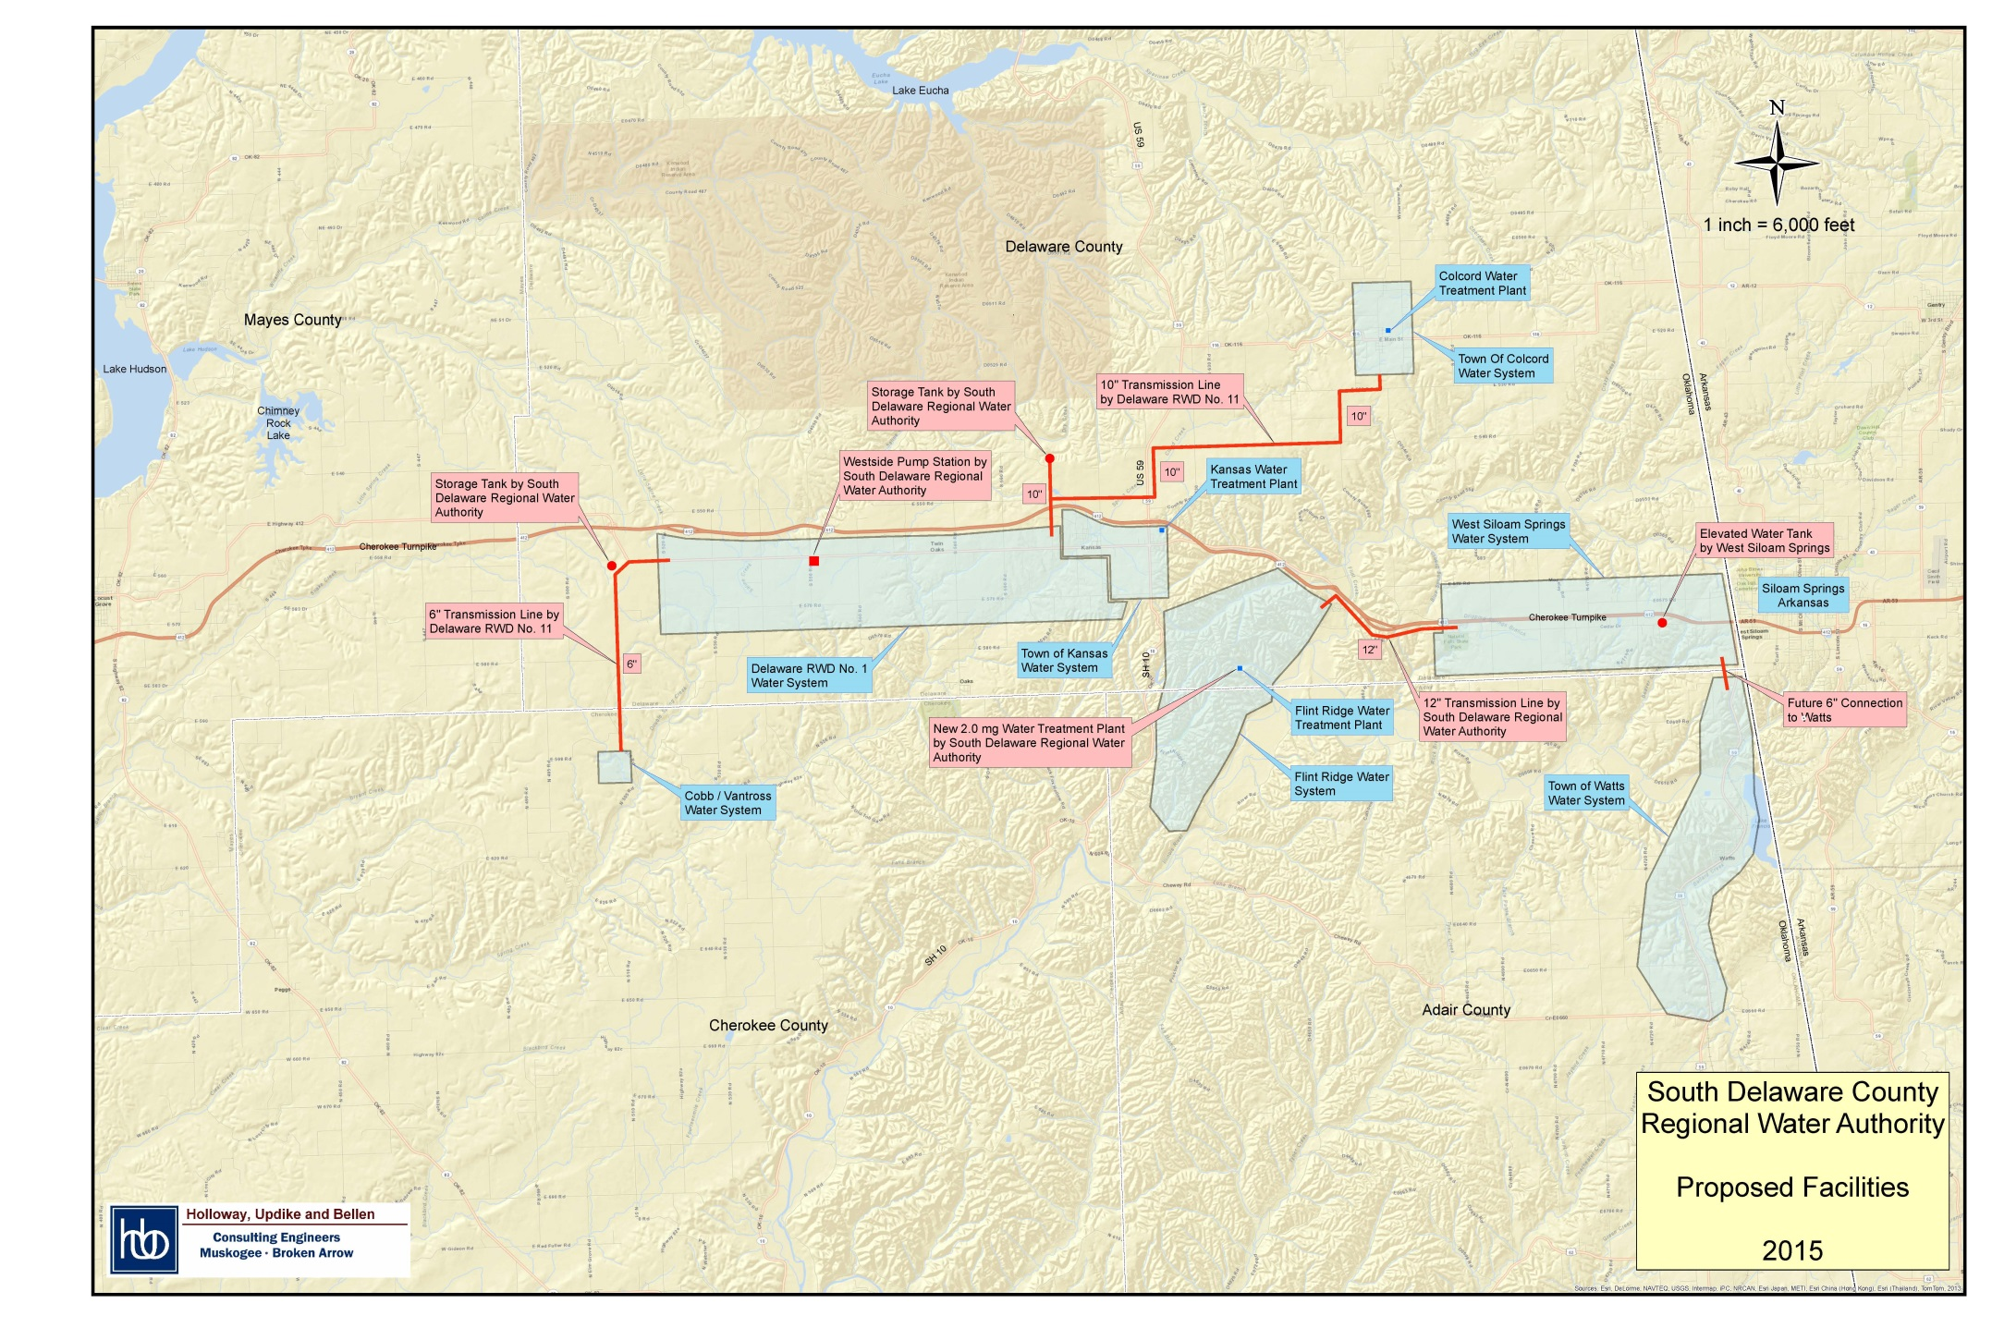

Slide 4
Development Milestones
South Delaware County Regional Water Authority
Steering Committee
Seed Money (Cherokee Nation)
Feasibility Study
More Seed Money (Cherokee Nation)
Form Authority (Bond Counsel)
Engineering Report
More Seed Money (Cherokee Nation)
Plans, Specifications, EID
Funding (DWSRF/IHS/USDA)
Bidding/Contracting
Construction

Slide 5
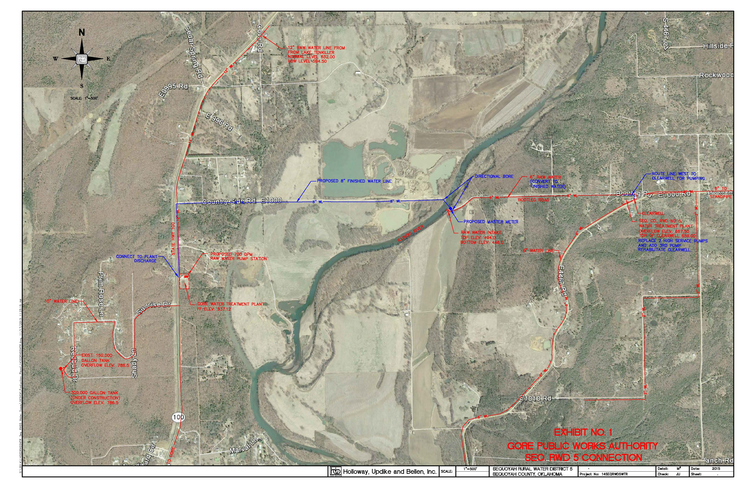
Gore PWA/ Sequoyah County RWD No. 5

