Slide 1
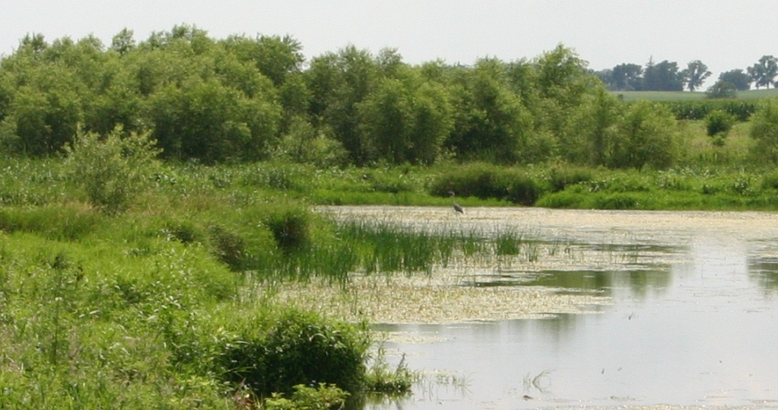
INVESTING IN
IOWA’S WATER
Loans for Habitat Restoration and Water Quality
Patti Cale-Finnegan, Iowa Department
of Natural Resources

Slide 2
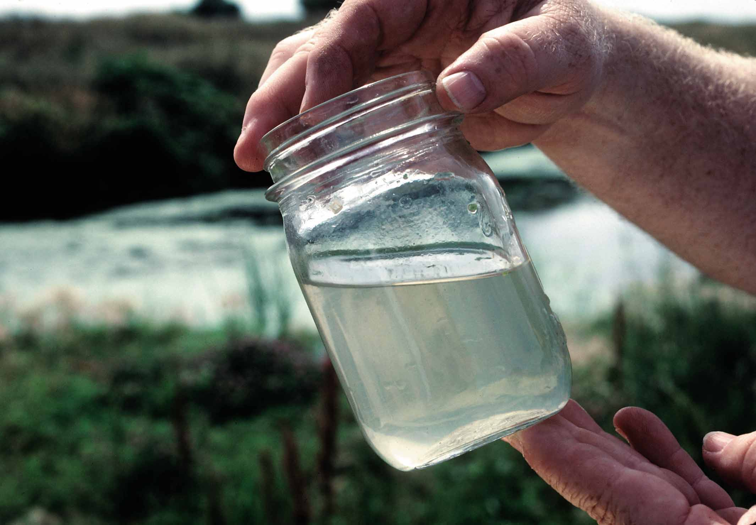
Background
Iowa Department of Natural Resources
  Program planning and prioritization
  Project planning and permitting
  Environmental review
  Federal compliance
Iowa Finance Authority
  Financial management
  Bond issues
  Loan processing
  Loan disbursements

Slide 3
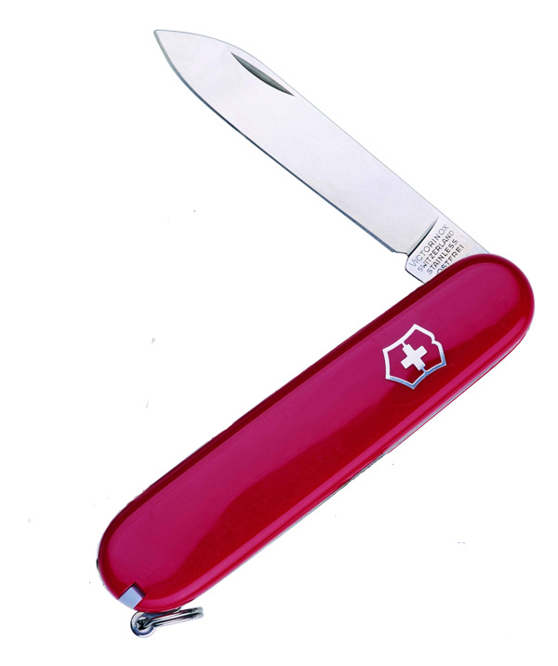
1989 - 2002
LOW-INTEREST LOANS FOR
Water and wastewater infrastructure only
Notes:
Until 2002, we only offered loans for water and wastewater infrastructure.

Slide 4

2003 - Present
Water and Wastewater
Onsite Septic Systems
Planning and Design
Lake and Wetland Restoration
Soil, Sediment, and Nutrient Management
Brownfield Cleanup
Source Water Protection
Energy and Water Efficiency
Sponsored Projects
Urban Stormwater
Landfill Closure
Notes:
With changes in state legislation and federal requirements, program development and listening to our customers, the programs have expanded into many different areas, including loans for nonpoint source water quality.

Slide 5
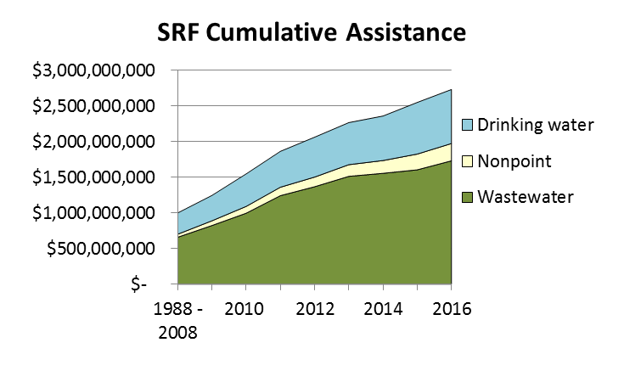

Slide 6
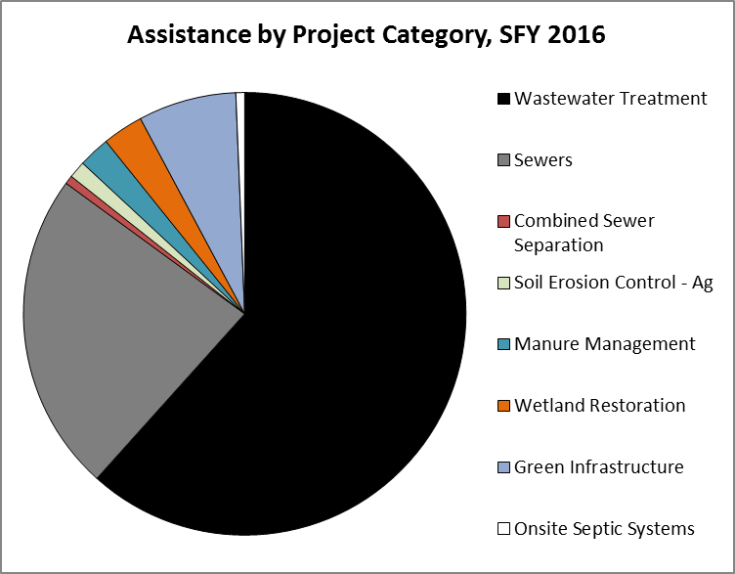

Slide 7
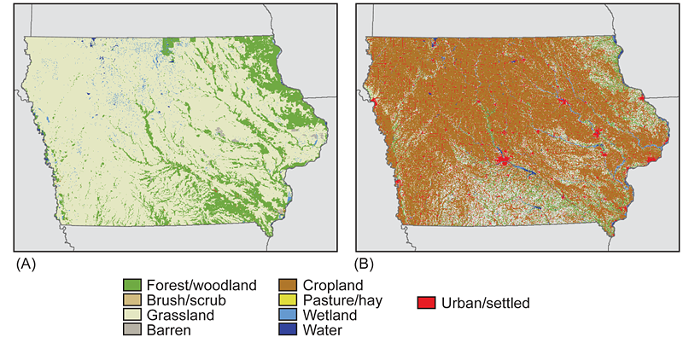
Iowa’s Landscape Transformed
“Nowhere have landscape and habitat changes been more dramatic than in Iowa.”
--U.S. Geological Service

Slide 8
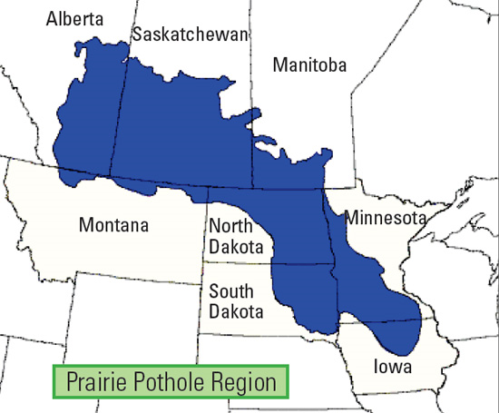
Prairie Pothole Region

Slide 9
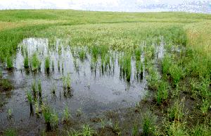
Prairie Pothole Region
Originally 100,000 acres of prairie potholes across the Great Plains
Natural shallow lakes and large marshes
Provided ecosystem services – wildlife habitat, water quality
In Iowa, 90% of potholes have been drained for agricultural production

Slide 10
Prairie Pothole Joint Venture
In Iowa, DNR and Fish and Wildlife Service have identified 100 priority areas for wetland restoration
Must be located in historic high density wetland landscape with high potential for restoration of ecological functions

Slide 11
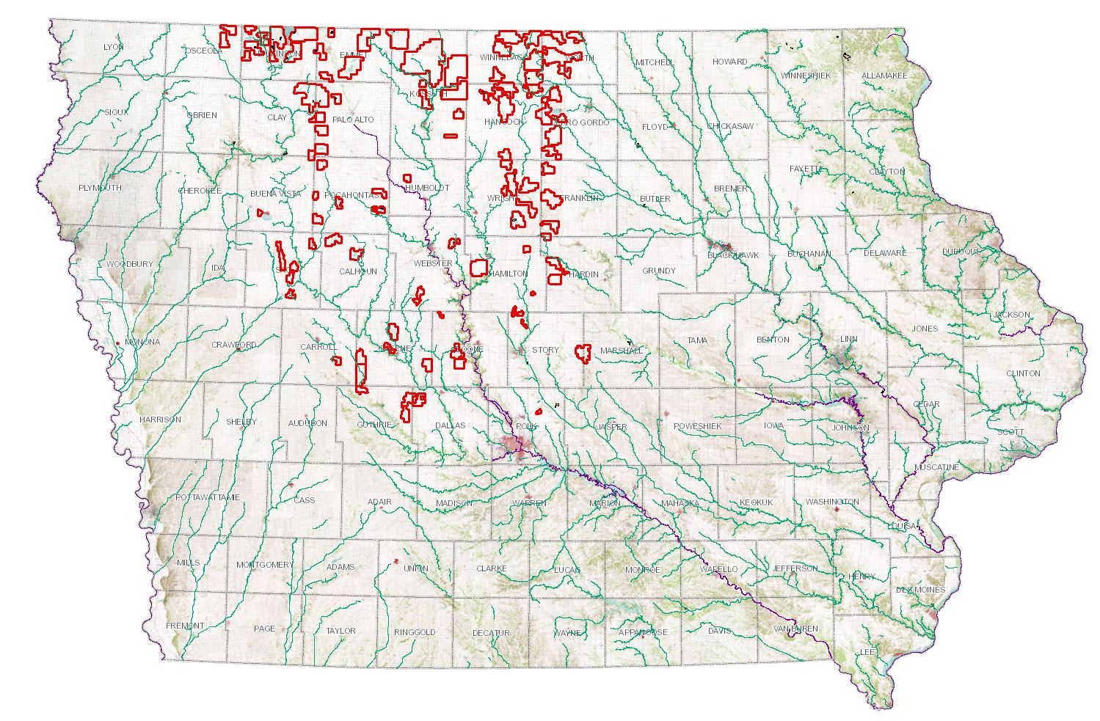
Prairie Pothole Joint Venture

Slide 12
SRF Provides a Financing Tool
Land acquisition of priority parcels is unpredictable
Local, state, and federal partners may not have funding when land comes on the market
Iowa Natural Heritage Foundation purchases land using SRF loan through participating lender, often at 0%
INHF holds land for 3-5 years while public agency assembles funding

Slide 13
Rolling Line of Credit for PPJV
CWSRF sets aside funds annually for upcoming loans at 0% interest
In 2008, a $10 million rolling line of credit good for 10 years was approved for PPJV loans
As loans are repaid, more dollars available for additional loans
Provides certainty and flexibility

Slide 14
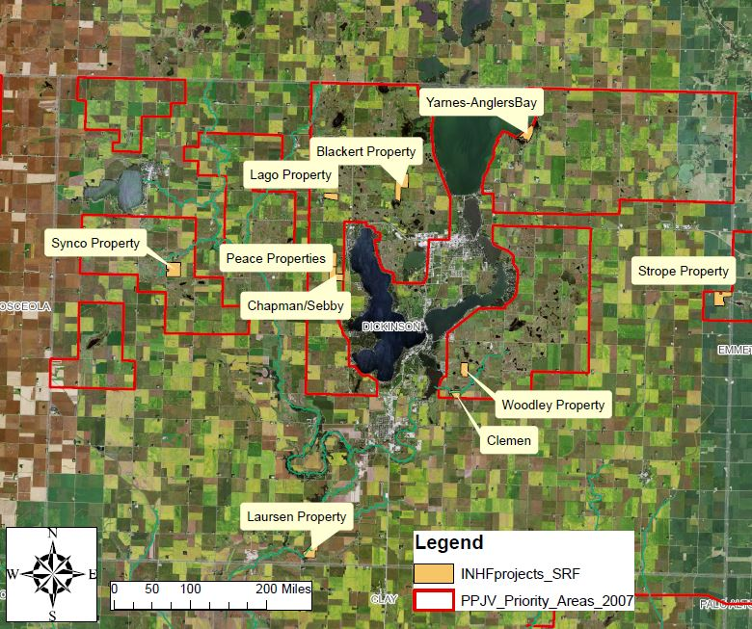
PPJV – Dickinson County

Slide 15
West Okoboji Lake
One of Iowa’s Great Lakes – natural glacial lakes
  High Quality Resource Water
  Drinking water source
“The primary threats to the region’s water quality are from agricultural nutrients, soil erosion, human and livestock waste, storm water contaminants, urban development and loss of natural wetlands.”

Slide 16
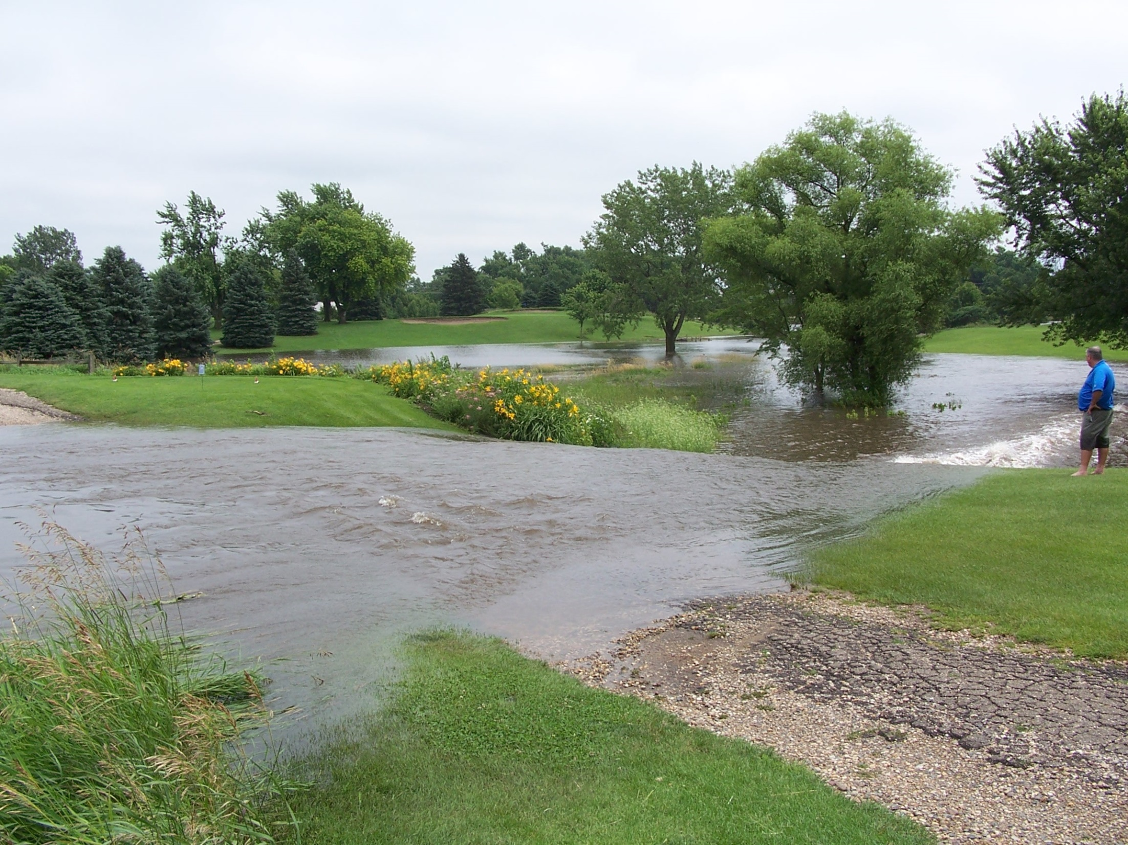

Slide 17
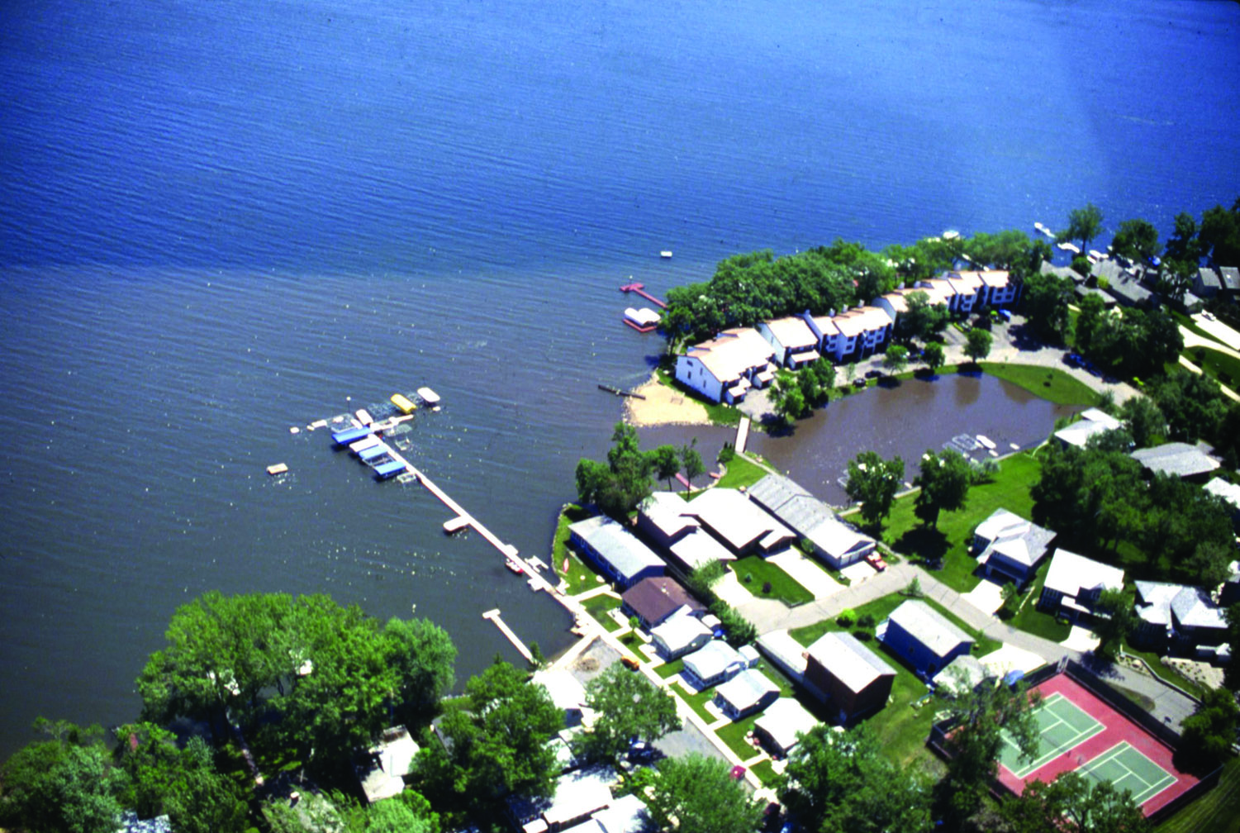

Slide 18
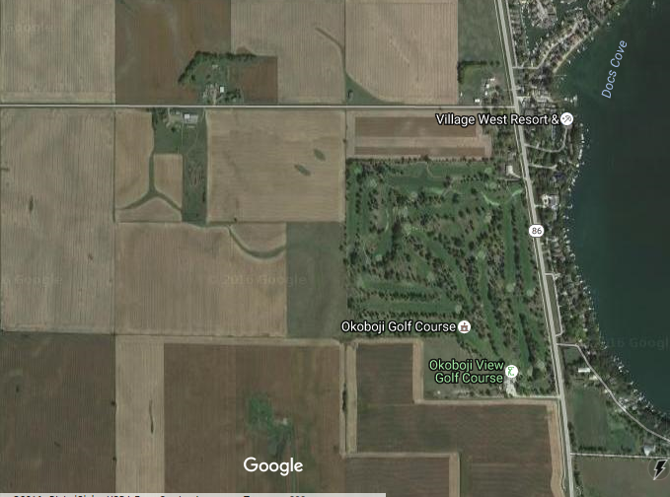
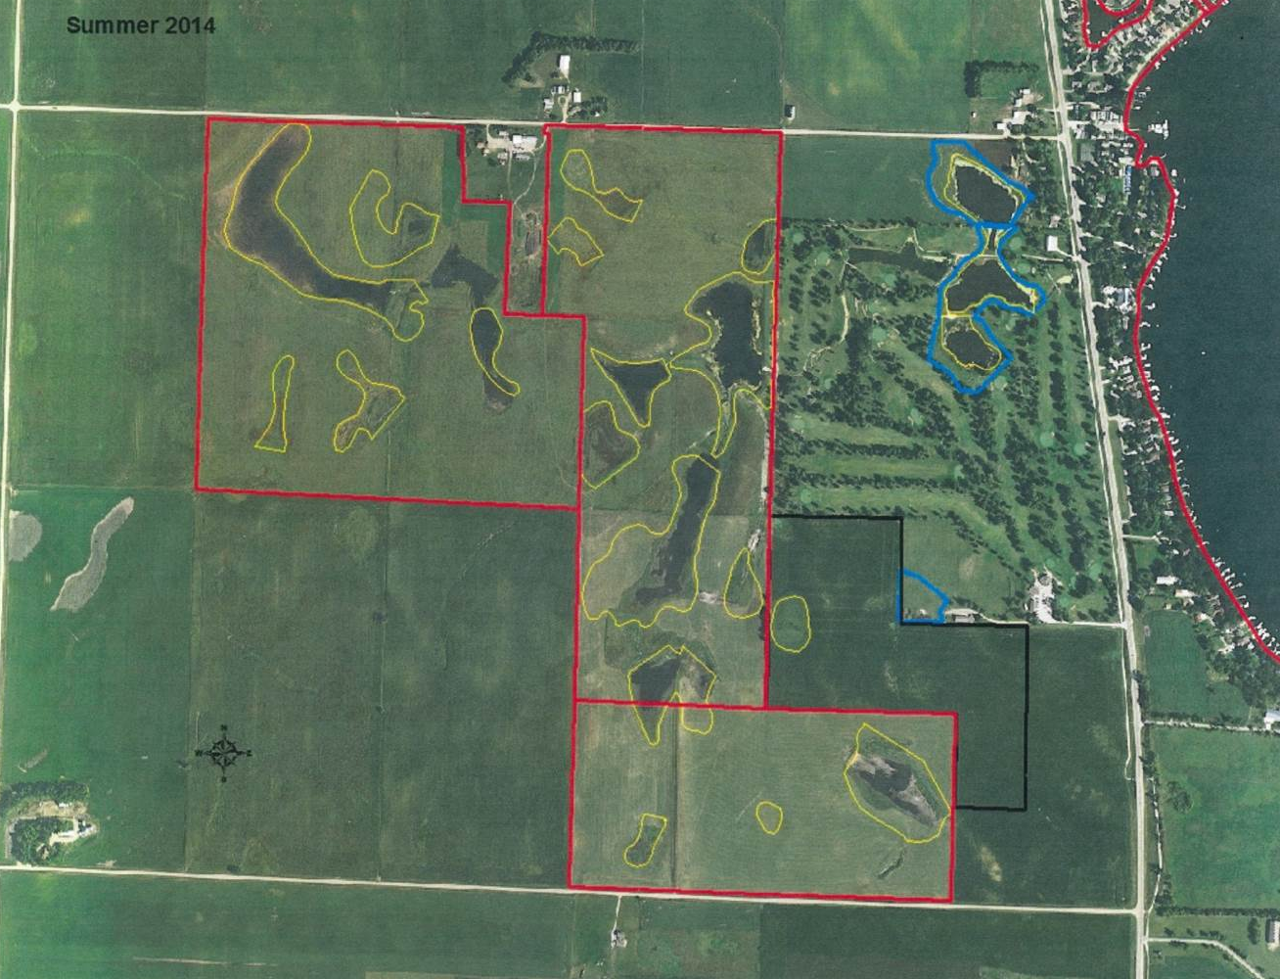
West Okoboji Lake
Before acquisition and restoration
After acquisition and restoration

Slide 19
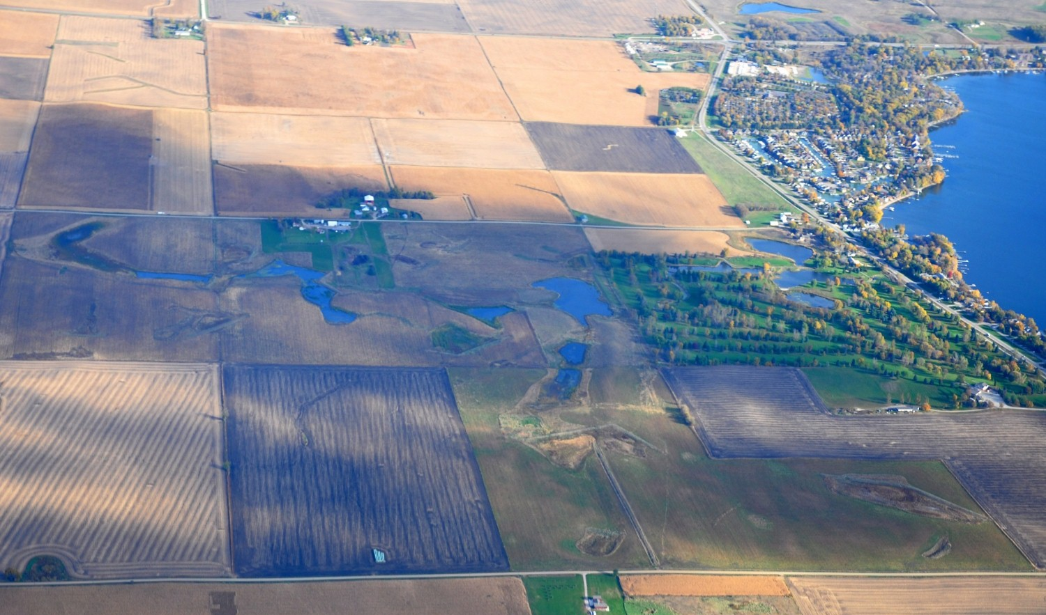
West Okoboji Lake
Two parcels of land were purchased in 2010 for a total of $1,860,000. Loans have already been repaid and the land transferred to DNR ownership for permanent protection. Total cost for land, easements, and restoration = $3,000,000.

Slide 20
West Okoboji Lake
Funding Sources for loan repayment and restoration:
  U.S. Fish and Wildlife Service - federal
    Waterfowl Production Areas (WPA)
    North American Wetlands Conservation Act (NAWCA)
  EPA 319 Program - federal
  Iowa Lake Restoration Program – state
  Dickinson County SWCD – state
  Iowa State Duck Stamp - state
  Dickinson County Water Quality Commission – local
  Iowa Natural Heritage Foundation – private nonprofit (donations)
  LaVonne Foot Estate - private

Slide 21
PPJV – Winnebago County

Slide 22
Hogsback Marsh
PPJV priority area
Part of wetland area forming headwaters of the Winnebago River

Slide 23
Hogsback Marsh
Langesen Property – 612 acres purchased for $1,958,400
Wetlands on the property were drained in the 1930s, but soils are mostly hydric or sandy
Corn suitability rating is 44 (on scale of 1-100 – 60 is minimum for good harvest)
Land along river floods regularly

Slide 24
Hogsback Marsh
Plans for restoration include:
  Disabling subsurface tile
  Seeding with native prairie plants (550 acres)
  Conservation of 50 prairie pothole wetlands (86 acres)

Slide 25
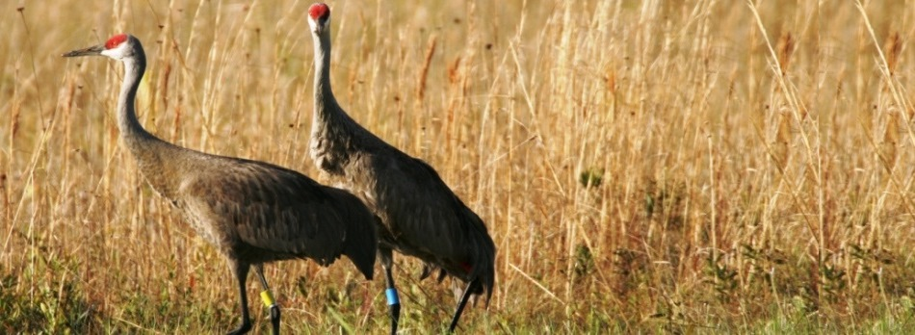
Environmental Benefits
Restoration of flood plain
Taking unsuitable land out of row crop production reduces nutrients and sediment
Wetlands capture and filter runoff
Creation or protection of wildlife habitat – from birds to butterflies

Slide 26
Other Land Conservation
SRF regularly sets aside $10 million per year for the General Nonpoint Source program
Primary user is the Iowa Natural Heritage Foundation
In addition to PPJV effort
Major purchases along the Upper Iowa River – Driftless Region
  “In the Midwest, where a 200-foot-tall bump is considered a mountain, you get used to pancake-flat land and sluggish prairie streams. Yet tucked away in an isolated corner of northeast Iowa is a cliff-lined gorge that the glaciers forgot to flatten: the Upper Iowa River valley.” – Canoe and Kayak Magazine

Slide 27
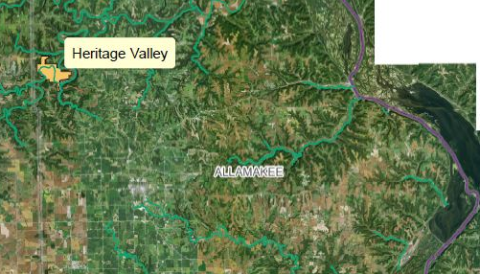
Heritage Valley – Allamakee Co.
1200 acre purchase for $4 million
Iowa Natural Heritage Foundation raised funds privately
Removal of invasive species and restoration of native prairie and woodlands
Protection from inappropriate row crop use and development

Slide 28
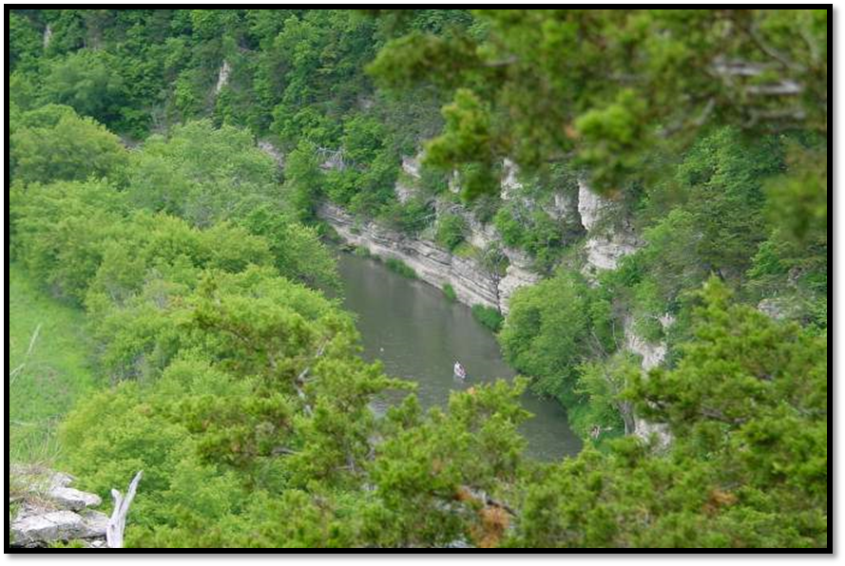
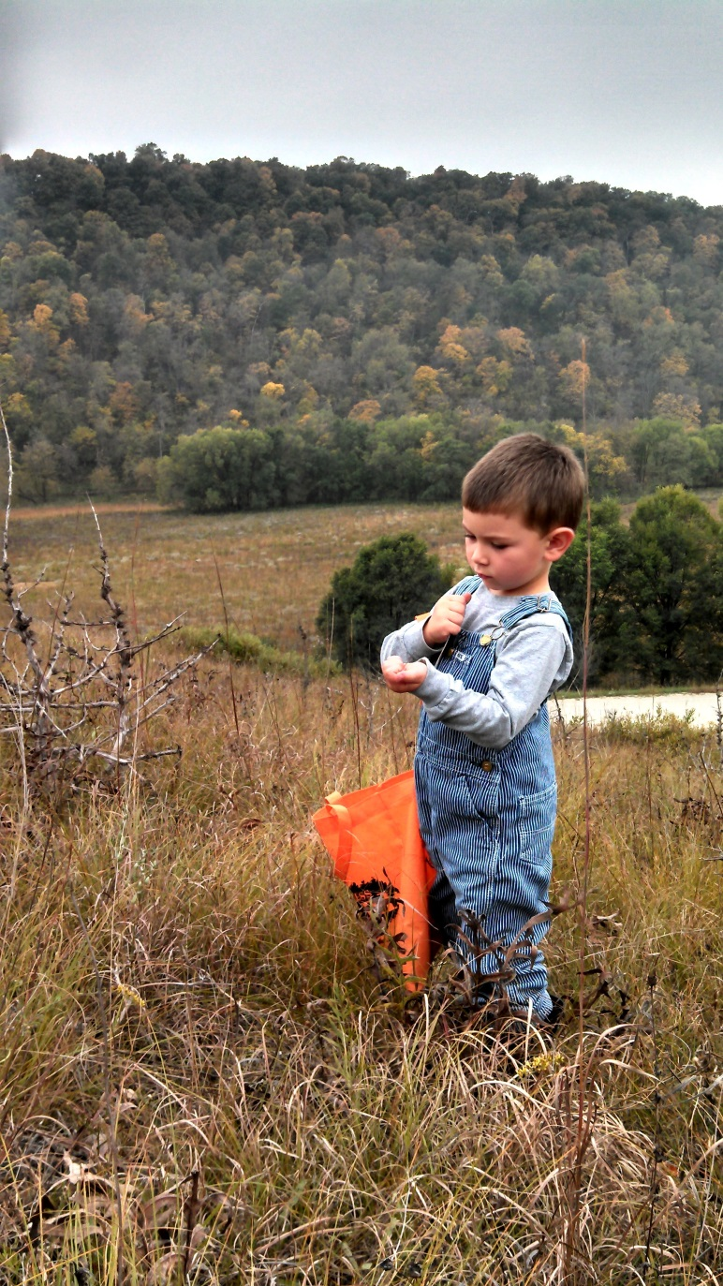
Heritage Valley – Allamakee Co.

Slide 29
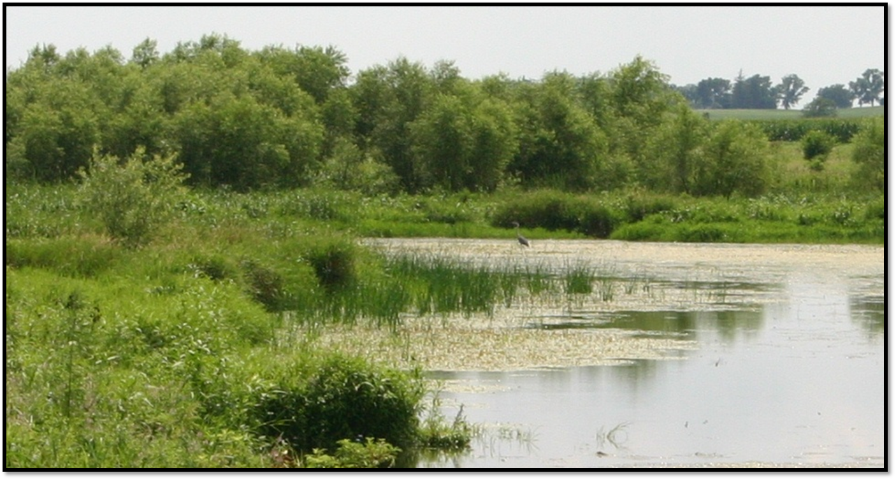
Questions?
Patti Cale-Finnegan
Iowa Department of Natural Resources
515-725-0498
Patti.cale-finnegan@dnr.iowa.gov

