Slide 1



Cyber-Informed Engineering Primer
Monday, November 18, 2024

Slide 2

The Evolution of Engineering
At First:
Analog Only
Now:
Digital designs, monitor, connect,
and control analog elements

Slide 3
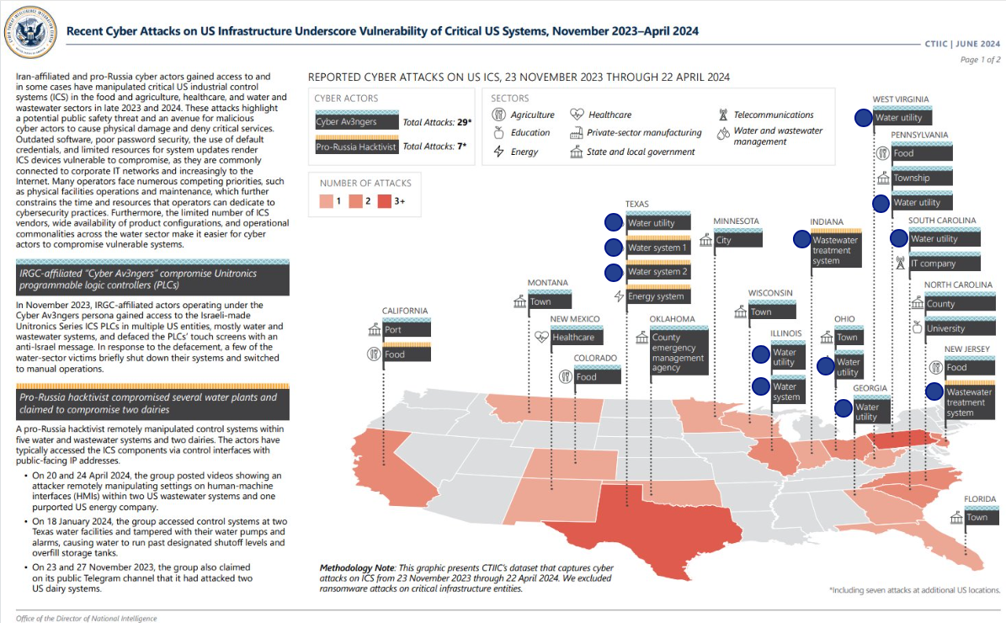

Slide 4
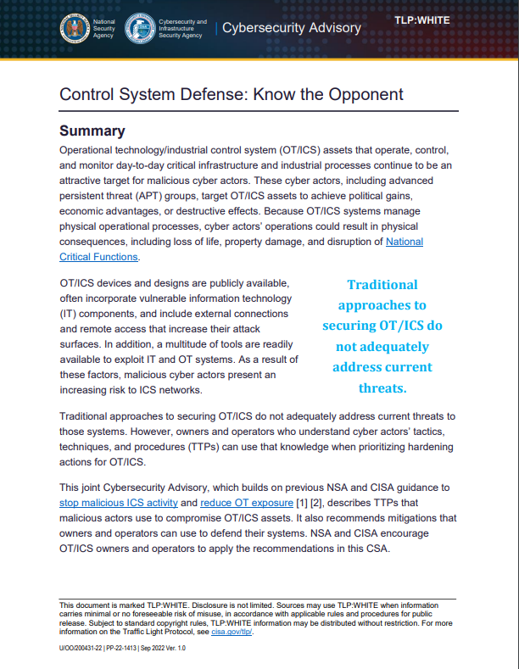
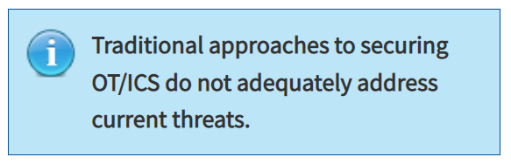
CISA Alert AA22-265A: Control System Defense: Know the Opponent (Sept. 22, 2022)

Slide 5


CIE Background
CIE uses design decisions and engineering controls to eliminate or mitigate avenues for cyber-enabled attack
CIE offers a framework to “engineer out” cyber risk throughout the design and operations lifecycle
Focused on engineers and operators
Infuses cybersecurity into existing industry cultures for Functionality, Safety, and Reliability

Slide 6
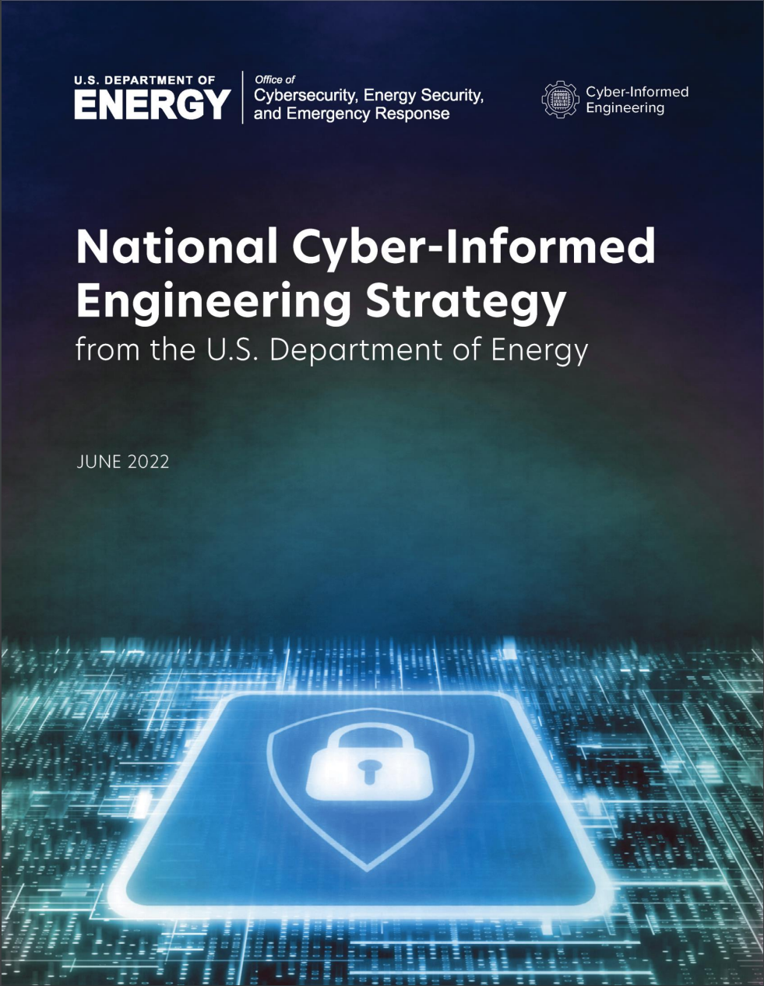
Cyber-Informed Engineering (CIE)
What does CIE look like
when fully implemented?
“Engineers incorporate cybersecurity practices into their body of knowledge, including engineering minimum requirements and specifications, for physical […] infrastructure systems that incorporate digital controls.”

Slide 7
Three Key Questions to a Utility
Are your systems engineered to be operated without automation (e.g. SCADA)?
Are your staff trained to operate your systems without automation?
Are your systems engineered with cyber-physical protections (e.g. time-delay relays)?

Slide 8
THANK YOU

Slide 9
Start with a Question:
Dear Engineer,
How bad of a day/week/month could we have if a malicious cyber-actor owns our control system?
Regards,
The Asset Owner

Slide 10
“Not every cyber problem requires a cyber solution.”
– Amy Thomas,
American Public Power Association

Slide 11
Where to Start?
Implementing within the City’s Existing Engineering and Operations Activities

Slide 12
Start with a Question:
Dear Engineer,
How bad of a day/week/month could we have if a malicious cyber-actor owns our control system?
Regards,
The Asset Owner

Slide 13
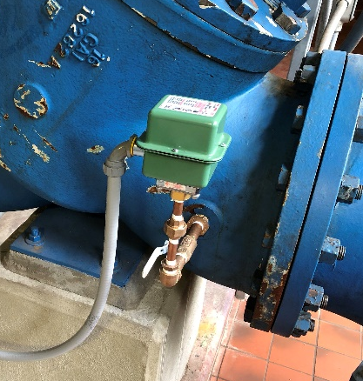

Designing to “Assume Breach”
Cyber-Physical Protections
Water main overpressure concerns
Pressure switch downstream of each pump, wired to pump controller
Notes:
https://res.cloudinary.com/teepublic/image/private/s--wrtcbKXV--/t_Resized%20Artwork/c_fit,g_north_west,h_954,w_954/co_eae0c7,e_outline:48/co_eae0c7,e_outline:inner_fill:48/co_ffffff,e_outline:48/co_ffffff,e_outline:inner_fill:48/co_bbbbbb,e_outline:3:1000/c_mpad,g_center,h_1260,w_1260/b_rgb:eeeeee/c_limit,f_auto,h_630,q_90,w_630/v1551115230/production/designs/4283149_1.jpg

Slide 14
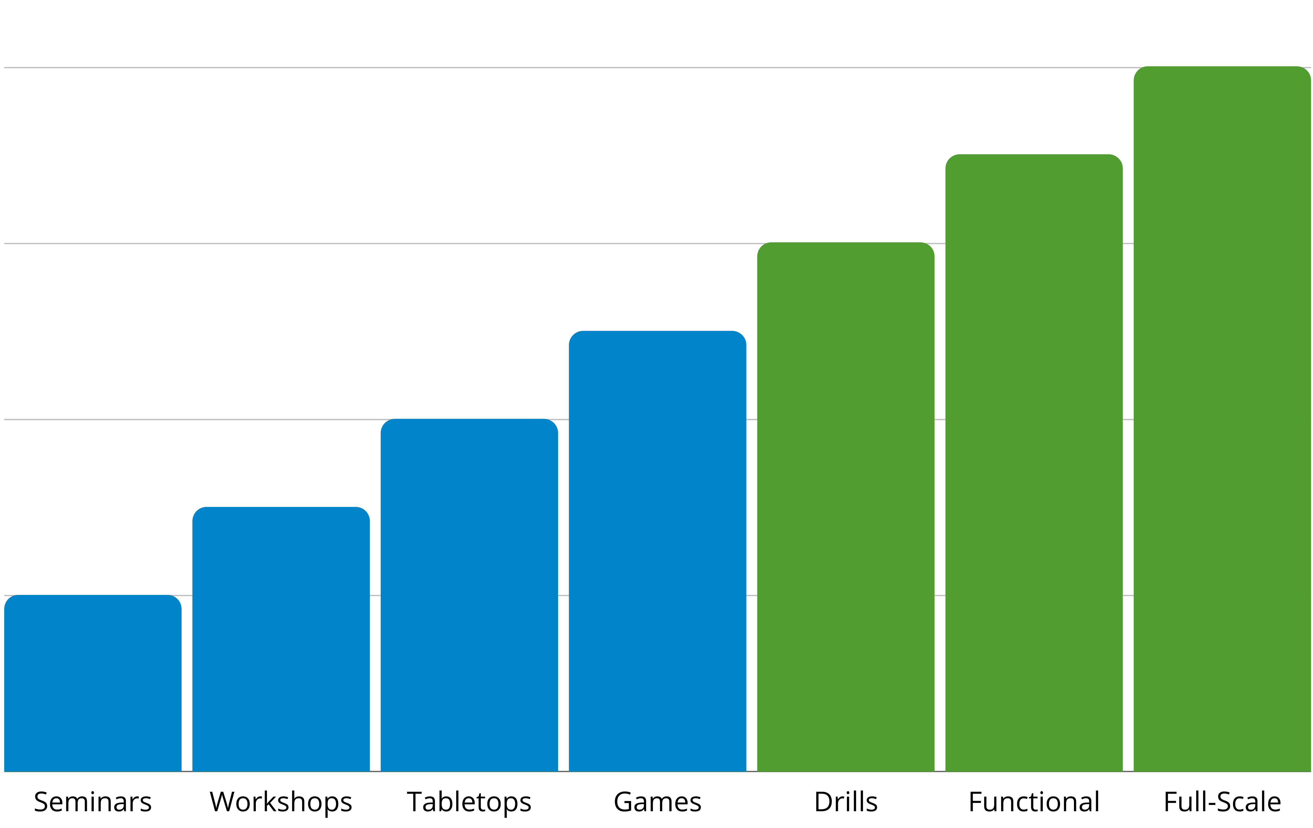
A Day without SCADA®
Crawl Walk Run
Evaluate the extent to which the utility can meet its mission without automation.
Capabilities under evaluation:
  System engineering
  Personnel
  Regulatory compliance
Capabilities
Complexity
Discussion-Based
Operations-Based

Slide 15
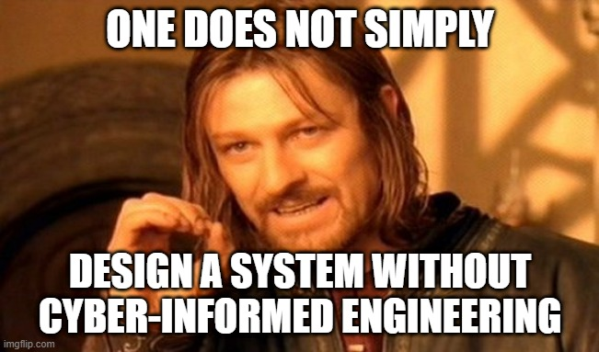
Redefining Expectations

Slide 16
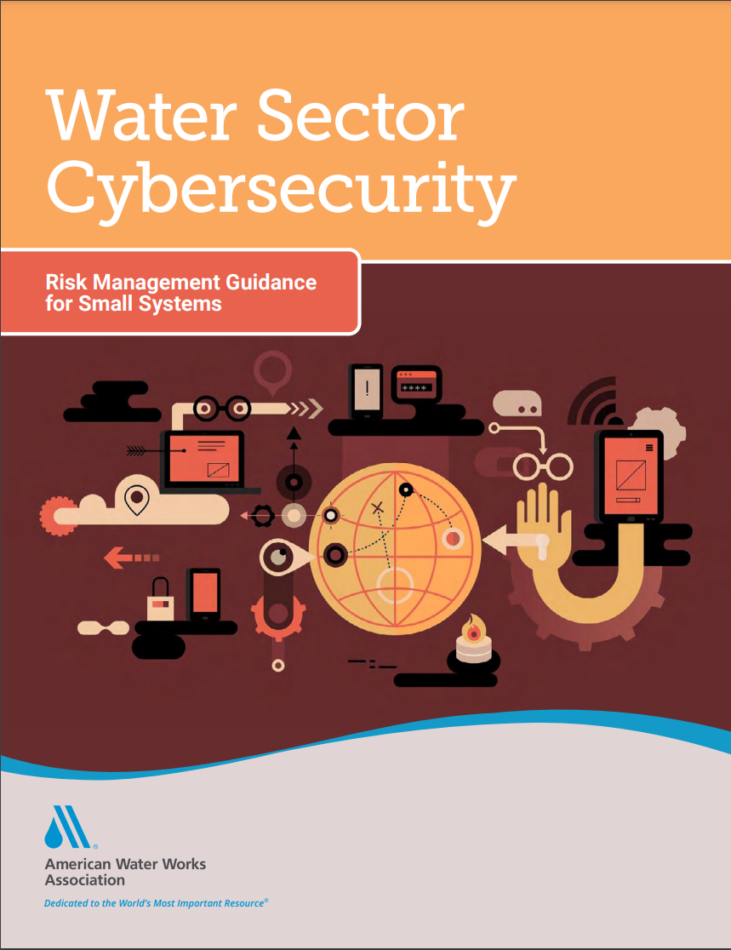
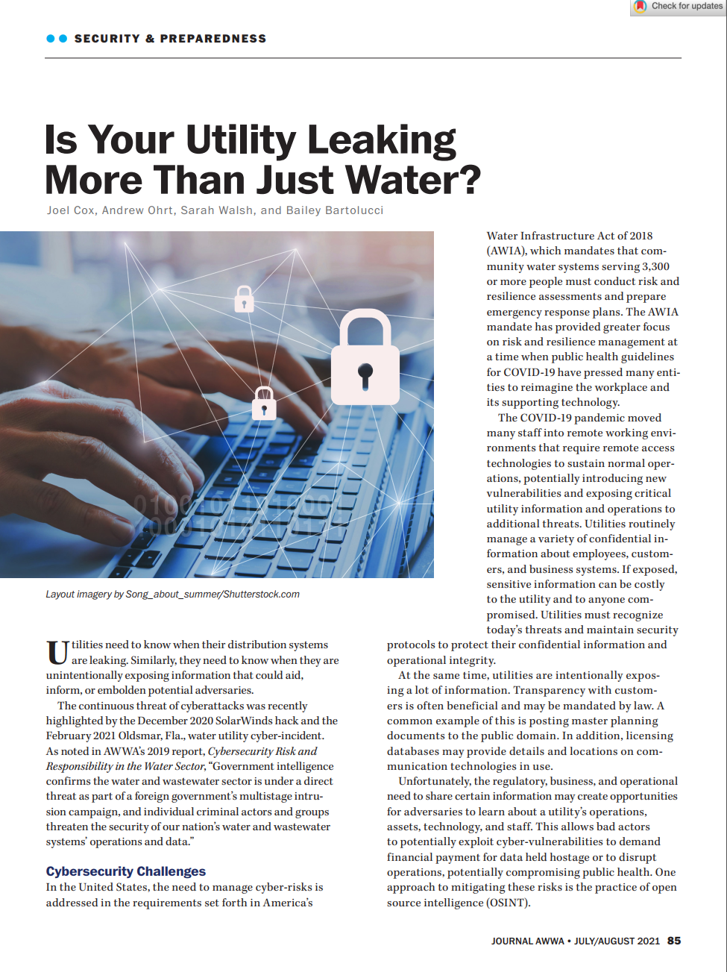
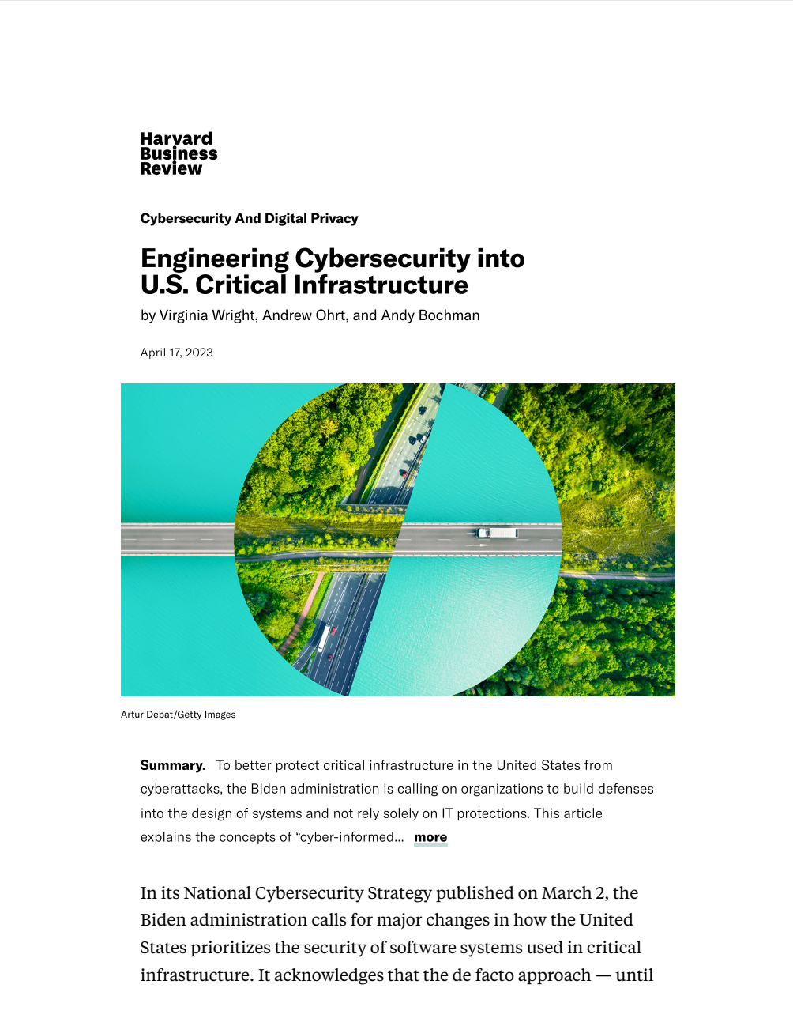
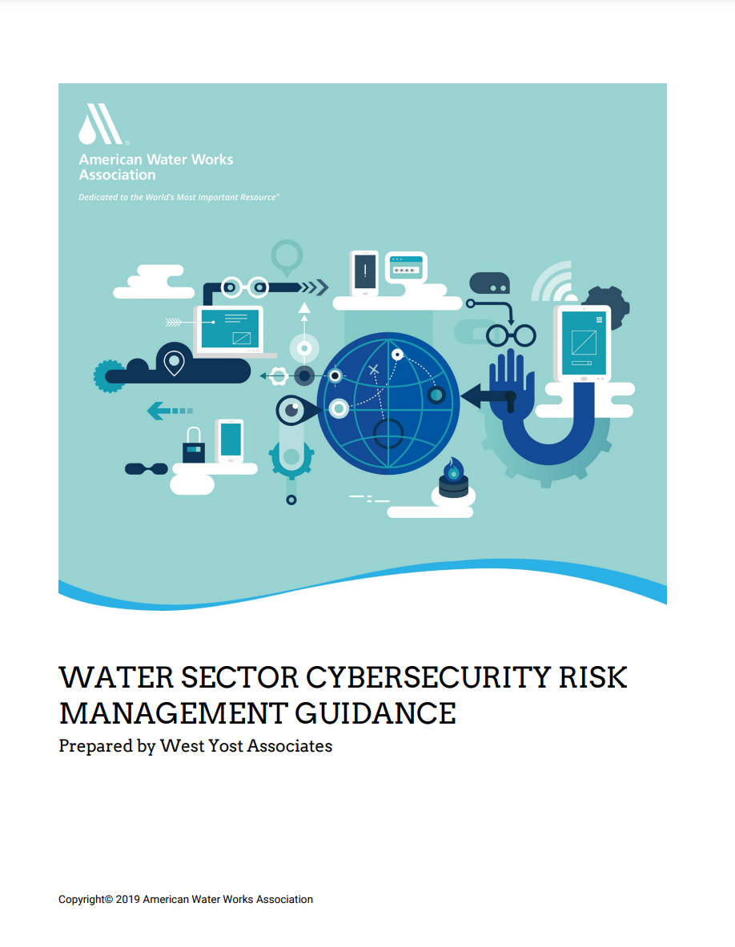
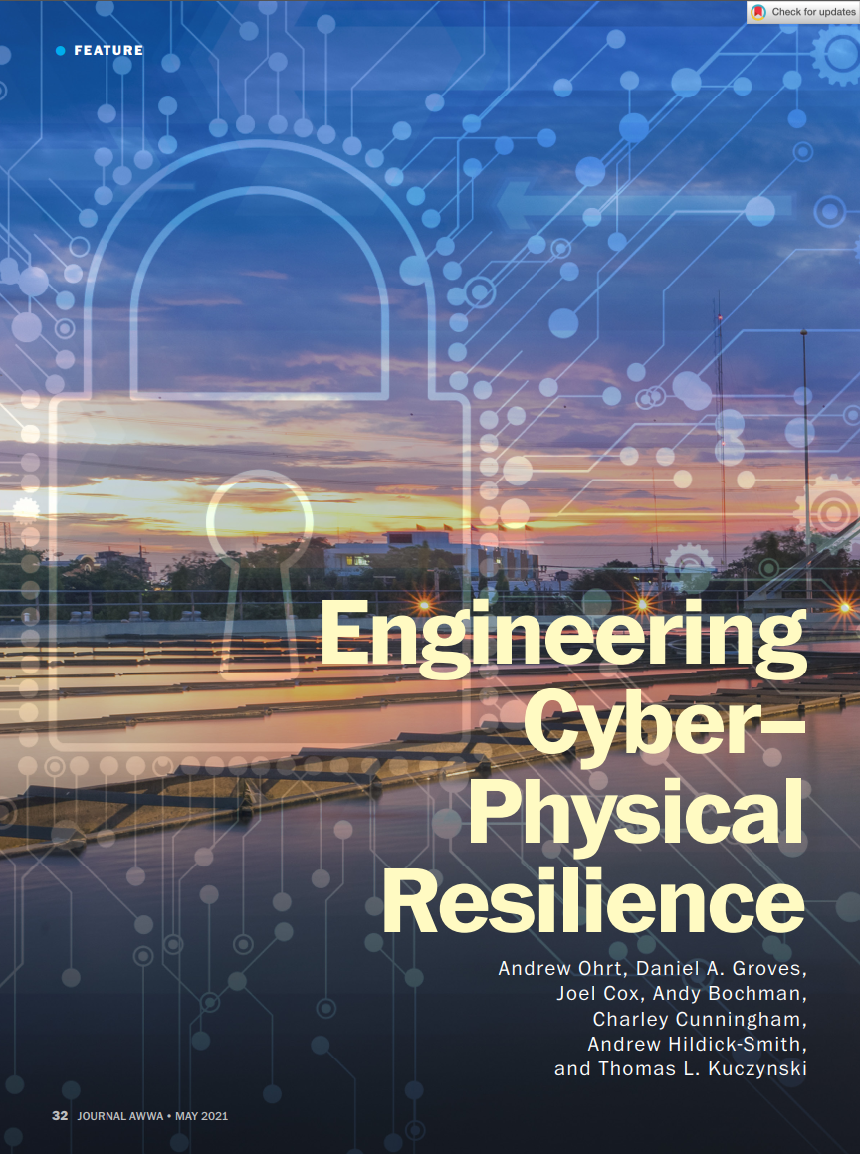
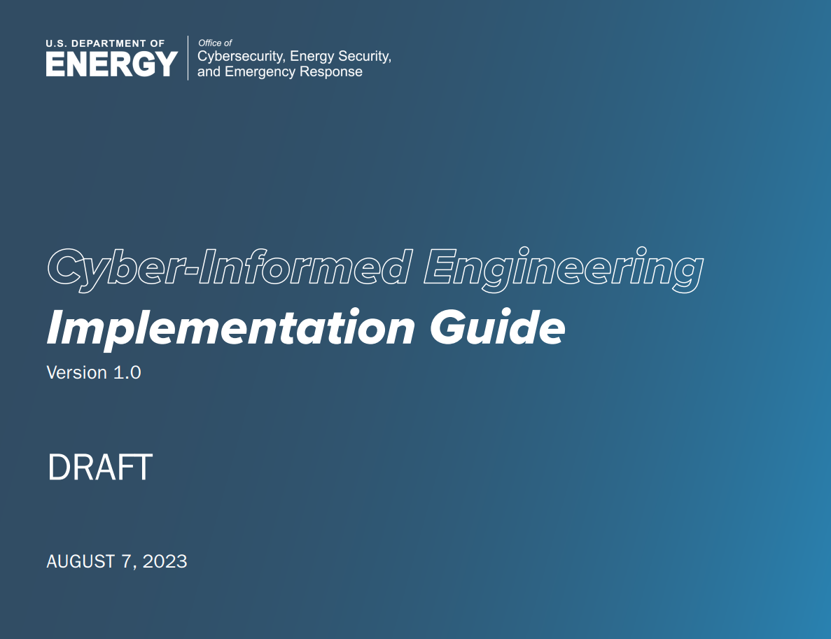
West Yost’s Water Sector Leadership

Slide 17
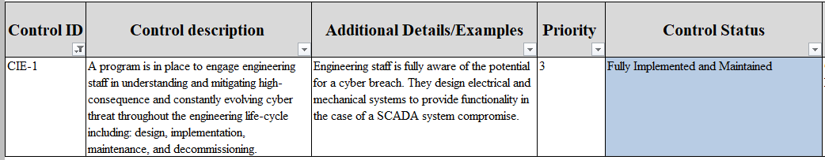
First Sector-Specific Guidance to Include CIE

