Slide 1


Consolidations in California
Evolving Solutions to Achieve the Human Right to Water
Kristyn Abhold
Assistant Deputy Director, Office of Sustainable Water Solutions
Division of Financial Assistance
CALIFORNIA WATER BOARDS SAFER PROGRAM

Slide 2
CA’s Drinking Water Problem: Fragmented Infrastructure
CALIFORNIA WATER BOARDS SAFER PROGRAM

Slide 3
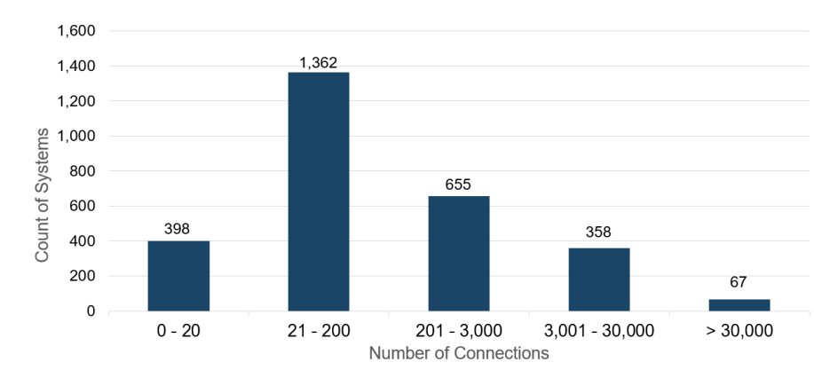
CA’s Drinking Water Problem: Small Water Systems
CALIFORNIA WATER BOARDS SAFER PROGRAM

Slide 4
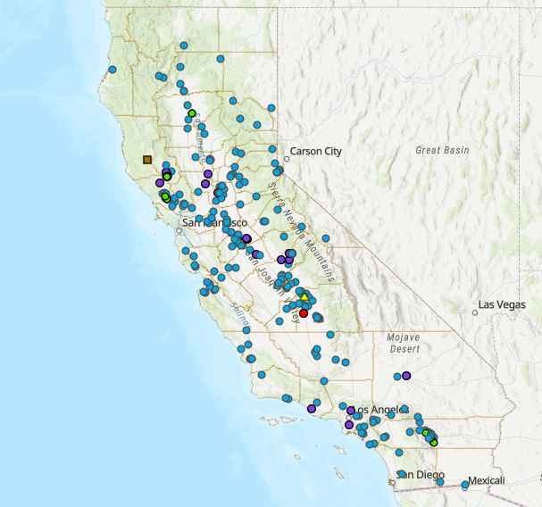


Consolidation Accomplishments (2019 – 2024)
134
consolidations completed, serving 127,056 customers.
260
Consolidations in process, serving 120,335 customers.
CALIFORNIA WATER BOARDS SAFER PROGRAM
Notes:
California Water Partnerships: https://gispublic.waterboards.ca.gov/portal/apps/webappviewer/index.html?id=fabf64fbe50343219a5d34765eb7daad

Slide 5




Toolkit to Advance Consolidations
In 2019, to advance the goals of the Human Right to Water, California passed Senate Bill 200, which enabled the State Water Board to establish the Safe and Affordable Funding for Equity and Resilience (SAFER) Program.
Safe and Affordable Drinking Water Fund
Data Collection
& Analysis
Regulatory Authorities
Administrators
Technical Assistance & Capacity Building
CALIFORNIA WATER BOARDS SAFER PROGRAM

Slide 6



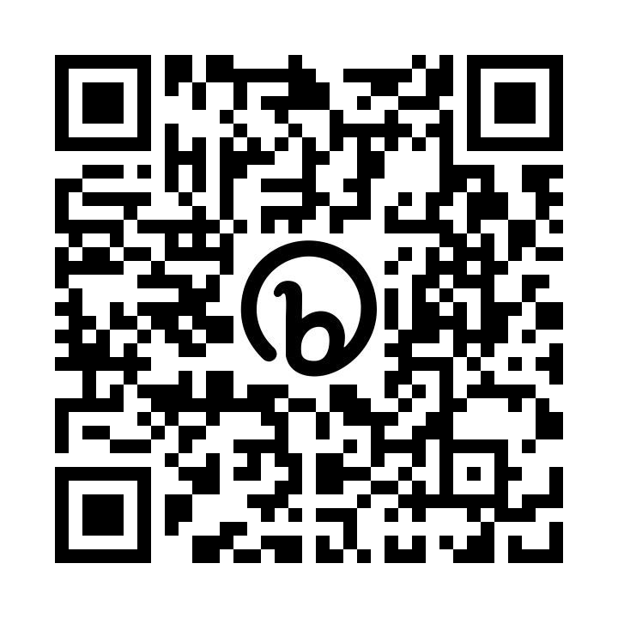
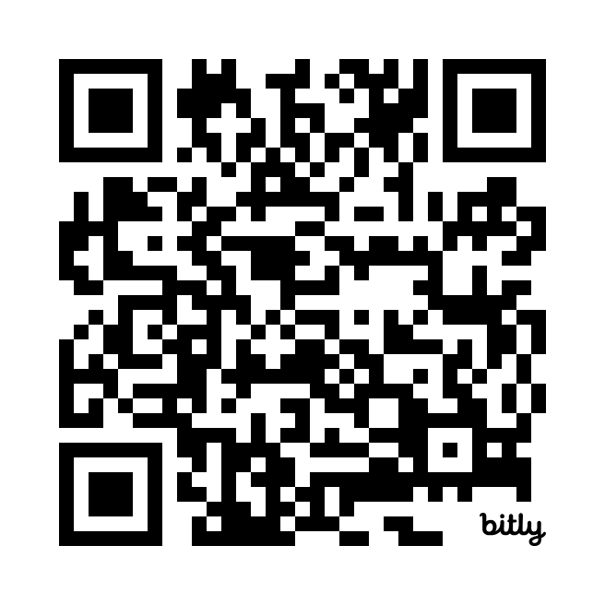
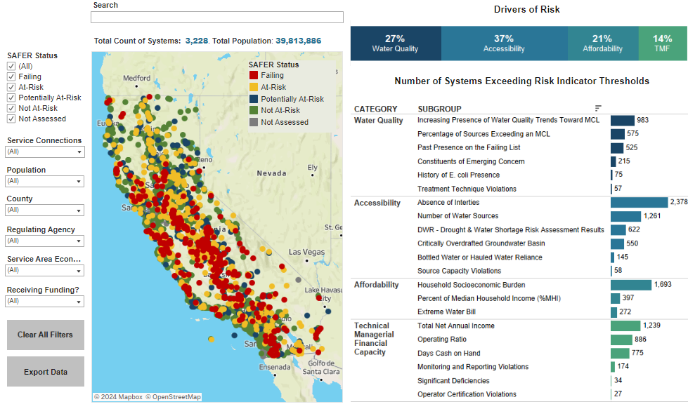
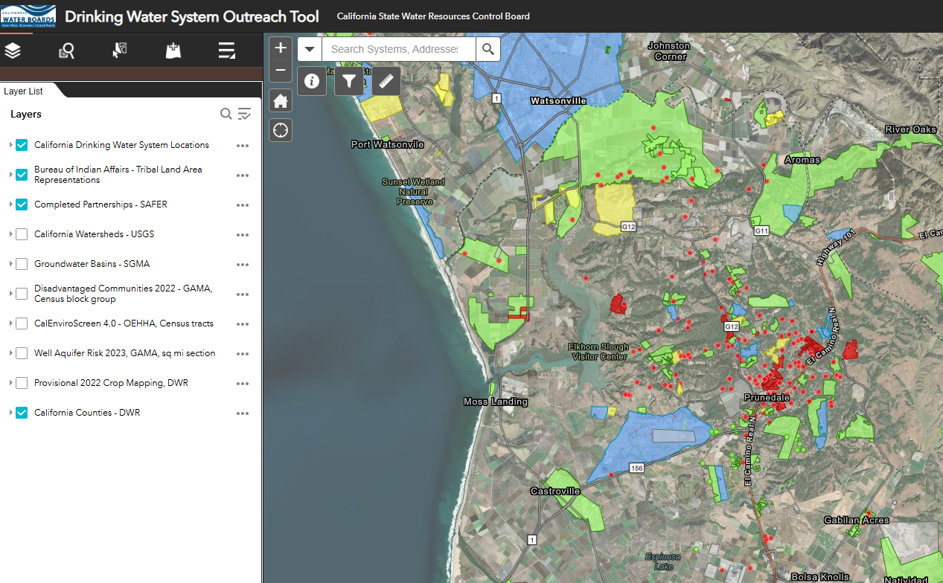


Data & Analysis
Explore where physical consolidation may be feasible.
Identify Failing and At-Risk water systems = priority communities.
SAFER Dashboard
SAFER Water System Outreach Map
CALIFORNIA WATER BOARDS SAFER PROGRAM
Notes:
SAFER Water System Outreach Map: https://gispublic.waterboards.ca.gov/portal/apps/webappviewer/index.html?id=70d27423735e45d6b037b7fbaea9a6a6
California Water Partnerships: https://gispublic.waterboards.ca.gov/portal/apps/webappviewer/index.html?id=fabf64fbe50343219a5d34765eb7daad

Slide 7


Community Outreach & Planning
Technical assistance:
  conduct community outreach.
  explore options and convey benefits of consolidation.
  conducts rate studies to assess affordability.
  helps manage the funding application and construction project.
CALIFORNIA WATER BOARDS SAFER PROGRAM

Slide 8

Regulatory Authorities & Tools
Mandatory consolidation authority for disadvantaged Failing & At-Risk drinking water systems.
Administrator authority
  Can appoint not for profit and for-profit entities.
  Limited and full-scope authorities.
Application for new water system permit must assess the feasibility of connecting to adjacent existing systems.
CALIFORNIA WATER BOARDS SAFER PROGRAM
Notes:
Learn more here: https://www.waterboards.ca.gov/drinking_water/certlic/drinkingwater/documents/needs/2024/2024-legislation-safer-capdev.pdf
Senate Bill 1263 requires any proposed new public water system to develop and submit a preliminary technical report (PTR) which analyses opportunity for consolidation of the proposed water system into an existing water system. Division of Drinking Water may deny a new permit application if consolidation is feasible

Slide 9

Funding Sources (2019 – 2023)
Funding Sources | Total SAFER Spending | Consolidation Spending
Drinking Water SRF (Federal) | $1,619 M | $73 M
Safe and Affordable Drinking Water Fund (State) | $107 M | $50.9
General Fund (State) | $247.1 M | $150 M
Drinking Water Bonds (State) | $164 M | $56.6 M
Emerging Contaminant Fund (State) | $8.8 M | $--
TOTAL: | $2,145.9 M | $330.5 M
Learn more in the Fund Expenditure Plan
CALIFORNIA WATER BOARDS SAFER PROGRAM
Notes:
Expedited Drinking Water Grant Program: https://www.waterboards.ca.gov/drinking_water/services/funding/expedited-grant-funding.html

Slide 10
Funding Programs Grant & Principal Forgiveness
Drinking Water SRF
  Planning and Construction
Safe and Affordable Drinking Water Fund (SADWF)
  Direct O&M Assistance
  Interim / Emergency Assistance
  Planning & Technical Assistance
  Construction
Expedited Drinking Water Grant Program (EDWG)
Urgent Drinking Water Needs (UDWN) Program
Advance payment options for construction agreements (25%; DAC only)
$842 M Projected Funding Available FY 2024-25
CALIFORNIA WATER BOARDS SAFER PROGRAM
Notes:
Expedited Drinking Water Grant Program: https://www.waterboards.ca.gov/drinking_water/services/funding/expedited-grant-funding.html

Slide 11
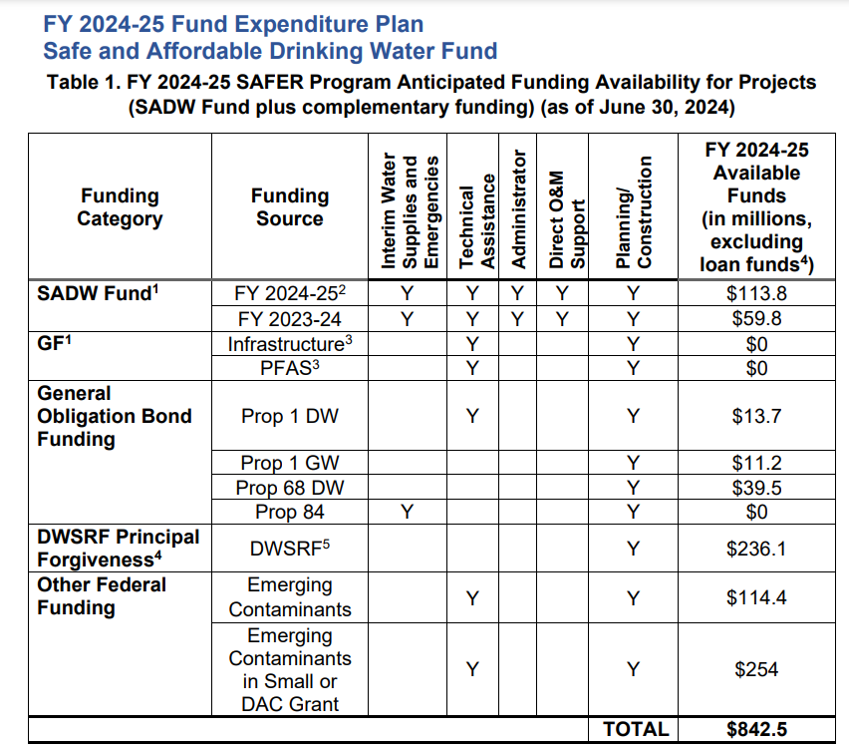
Funding Programs (FY 2024-25)
SAFER Program Anticipated Funding Availability
CALIFORNIA WATER BOARDS SAFER PROGRAM

Slide 12
What’s Working
Building partnerships to develop and advance projects.
Reducing barriers to funding and trying to develop strategies to expedite the process.
Creating a framework of support:
  Interim assistance, technical assistance, Administrators, O&M assistance can all help move a project forward.
Transparency and community engagement helps build trust.
Mandatory consolidation helps move projects forward that may otherwise never happen and can spur voluntary consolidation projects.
Administrators can also help move projects forward where existing governance structure is non-functional or not corporative.
CALIFORNIA WATER BOARDS SAFER PROGRAM

Slide 13
Challenges
When to use voluntary approach vs. mandatory.
Time needed upfront for planning and community engagement.
Systems often lack capacity to navigate and manage a project.
Liability concerns for construction and O&M on private property.
Affordability concerns:
  Rates increases for customers of Subsumed water system.
  Private utilities face limitations in receiving systems if it may impact their current customer rate-base.
Consolidation project timelines are long.
Challenges with agreements involving private entities / CPUC regulated.
CALIFORNIA WATER BOARDS SAFER PROGRAM

Slide 14
Challenges Cont.
Administrators:
  Expensive when compared to traditional technical assistance ($26k per connection for 2 years).
  Finding Administrators willing to take-on a Failing system can be challenging. Had to amend legislation to address liability concerns.
Funding application can be difficult for Receiving systems to navigate.
TMF requirements can delay projects for years.
Receiving systems asking for “full” fixes before agreeing to consolidation.
Failing systems vs. low hanging fruit.
Increasing costs.
CALIFORNIA WATER BOARDS SAFER PROGRAM

Slide 15
Opportunities
Increase authority and specificity around sustainability and TMF requirements. TMF regs are coming soon in CA!
Truncate initial alternatives analysis where consolidation is the preferred solution.
Managerial consolidation as a precursor to physical consolidation.
Managerial consolidation where there is little/no opportunity for physical consolidation.
Limited-Scope Administrators for project implementation.
Develop a consolidation funding agreement template.
Expand UDWN program for smaller consolidations.
Finetune roles and responsibilities.
CALIFORNIA WATER BOARDS SAFER PROGRAM

Slide 16
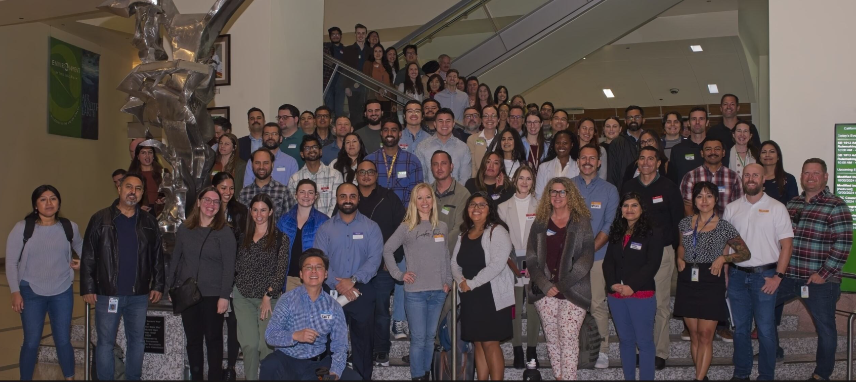

SAFER Team
CALIFORNIA WATER BOARDS SAFER PROGRAM

