Slide 1
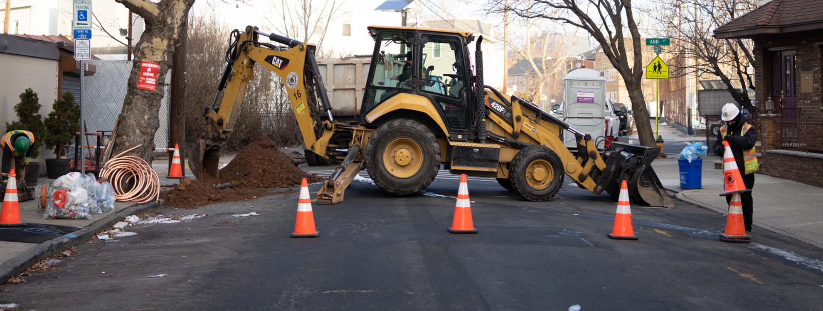

Inventories into Action
Patricia (Trish) Ingelido
New Jersey Department of Environmental Protection

Slide 2
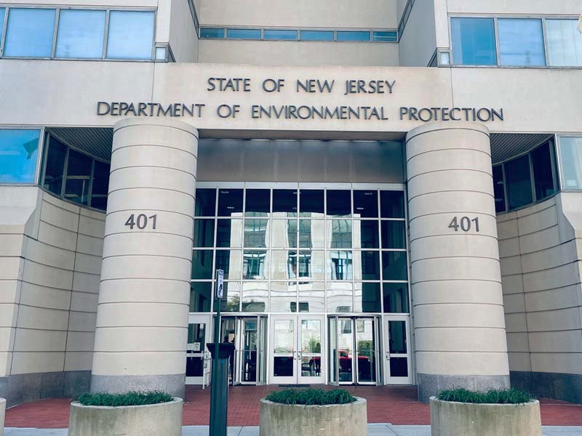
Lead Service Line Inventories in NJ
Beginning in 2018 NJDEP requested all CWS submit an inventory of Lead Service Lines with updates in 2020
July 2021, New Jersey’s Lead Service Line Replacement Law, P.L. 2021, C. 183, requires
  CWS to replace all lead service lines in their distribution systems by 2031.
  develop inventories , submit to DEP, make
  available to the public
  notify property owners, tenants, and non-paying consumers served by lead service lines.
  provides funding pathways for LSLR projects

Slide 3
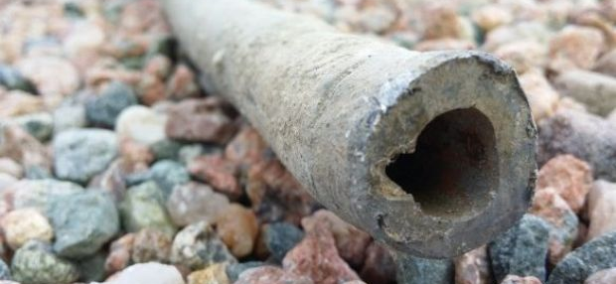
Service Line Inventories:
A Dynamic Statistics
Early estimates (2018-2020) were summary data by category
In 2022 the first address level inventories submitted by water systems

Slide 4

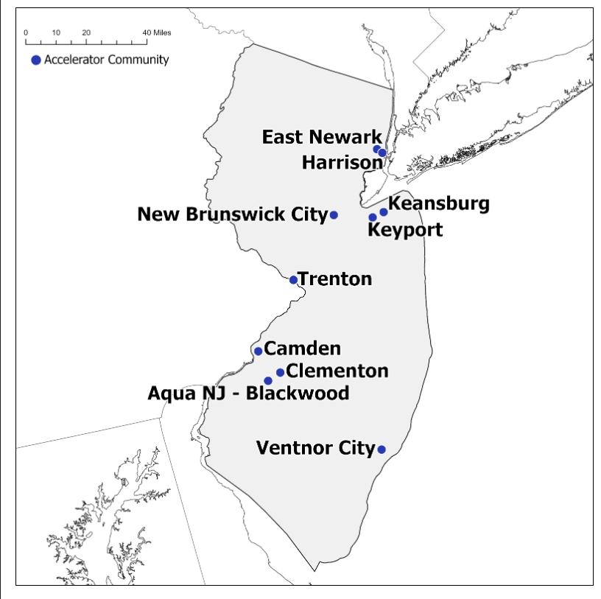
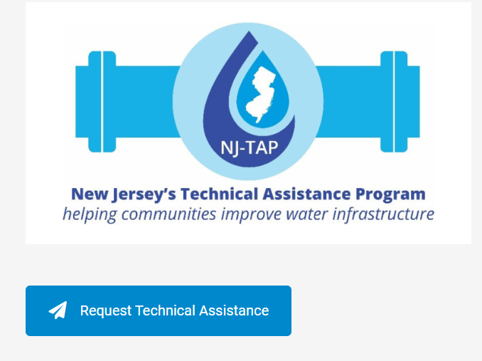
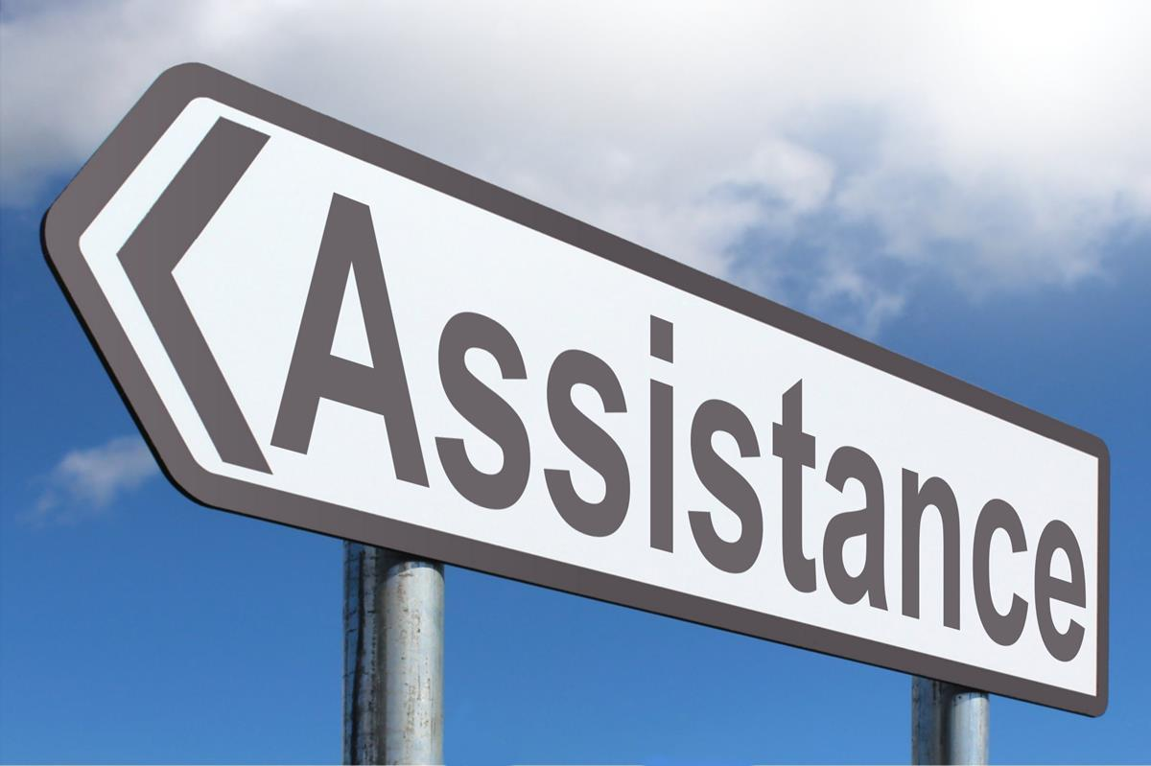
NJ Technical Assistance Programs
Prioritized Communities who:
- meet the disadvantaged community criteria,
- have not participated in SRF in previous 5 years,
- For LSL TA those that have large number of lead or unknowm service lines
NJTAP
Options include:
  Program Navigation
  Financial and Needs Assessments
  Community Engagement
  Engineering Services
EPA Accelerator Program and GLO Program
10 communities in NJ participating
Additional NJ communities in 2025 through GLO
Inventory development and addressing unknowns continues to be one of the greatest needs

Slide 5

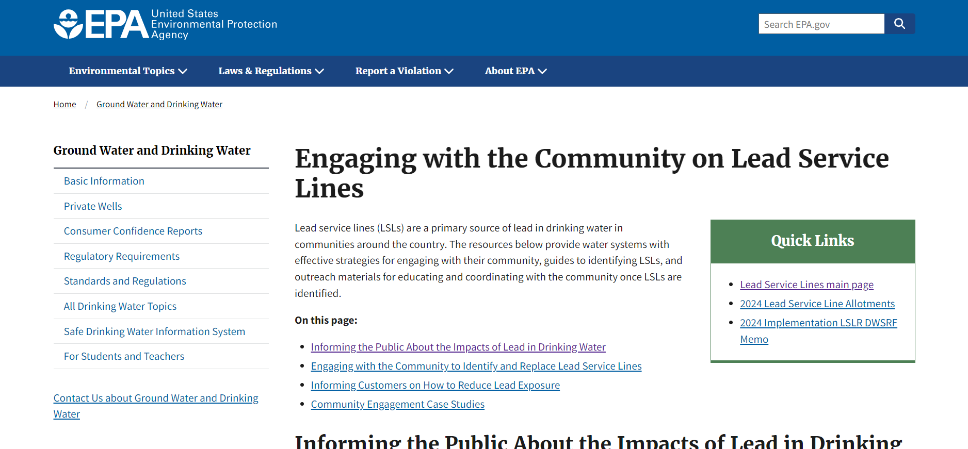
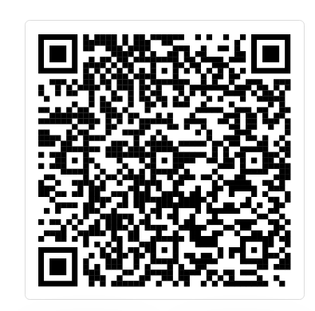
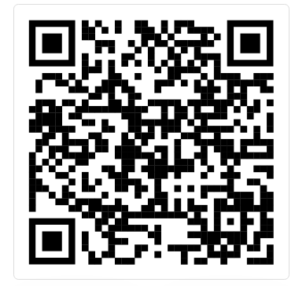
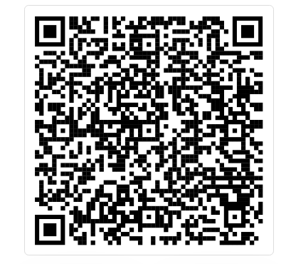
Importance of Community Engagement
Access to funding is not the only hurdle, participation from community is necessary for a successful , public notification is a critical first step but additional outreach strategies are needed at all levels.

Slide 6
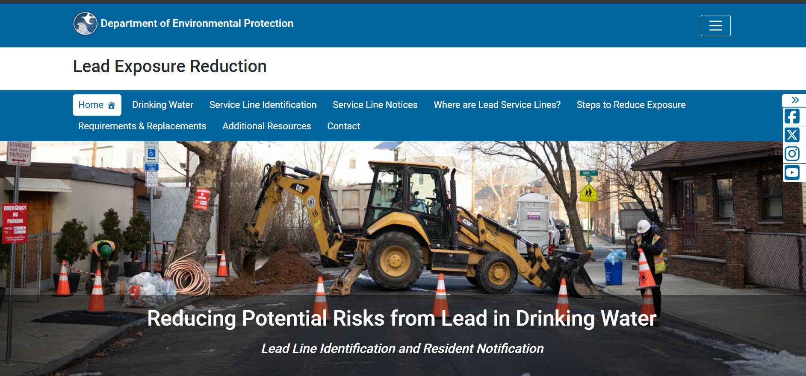
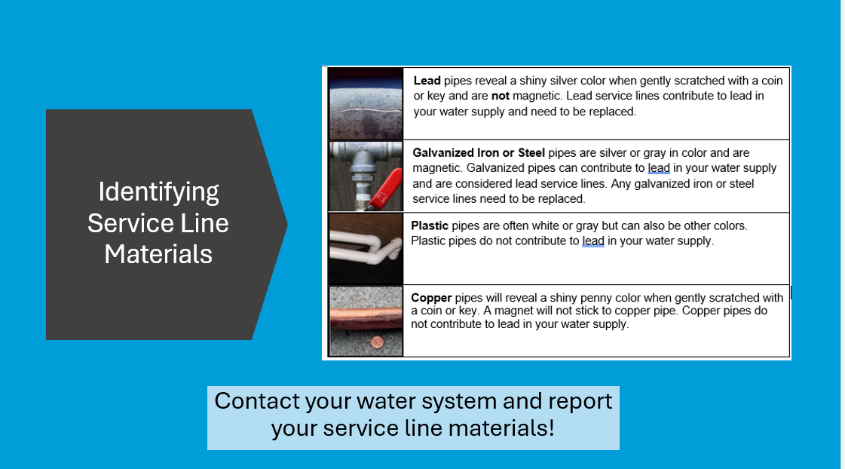
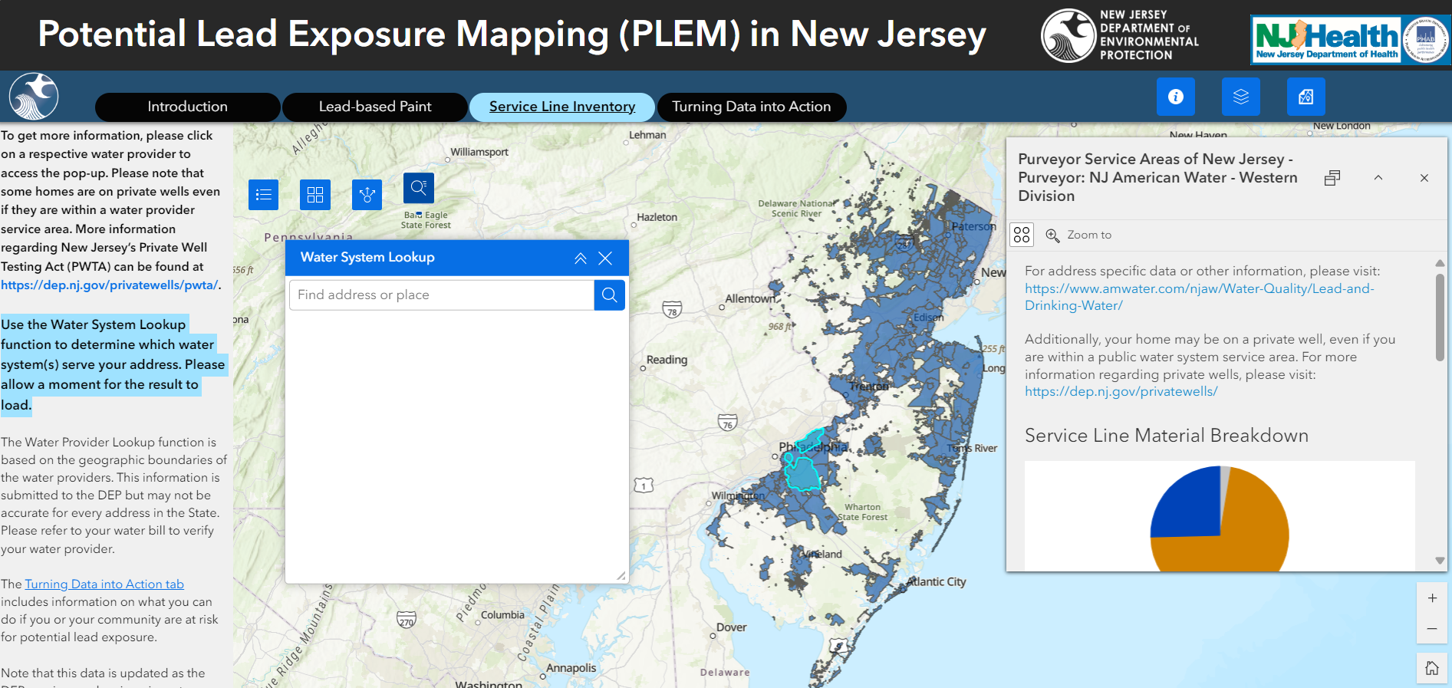
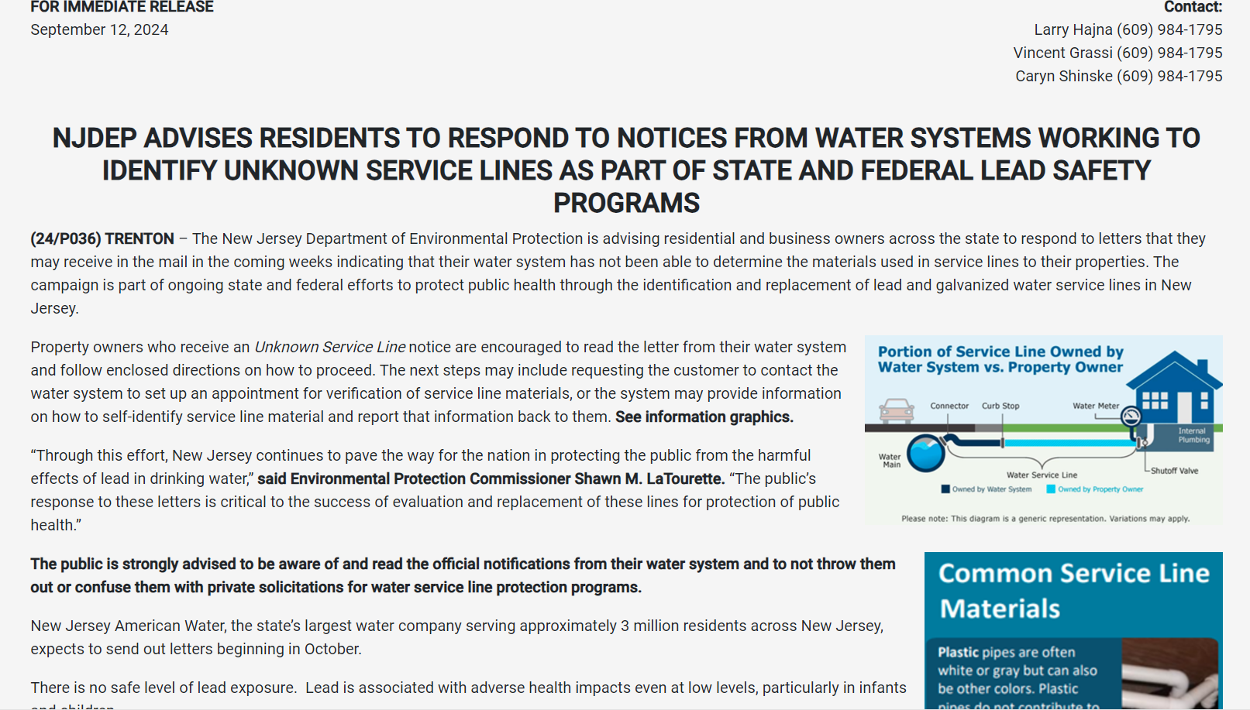
Community Engagement

Slide 7

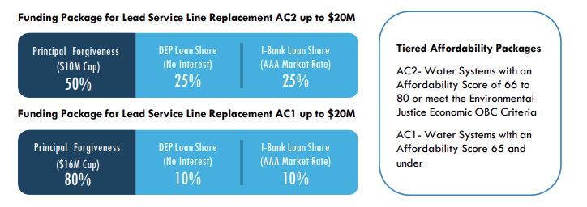
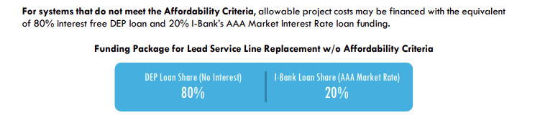
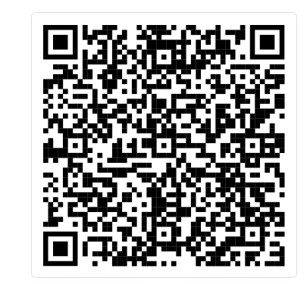
Funding for LSL Replacement

Slide 8
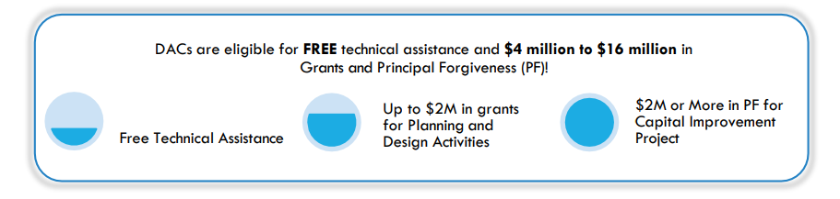
Connecting Technical Assistance and Funding
Disadvantaged Communities participating in the TA programs are eligible for planning and design grants
NJWB intends to use up to $60 million in SFY22 to SFY25 water infrastructure state appropriation funds for guaranteed PF and funds for capital improvement project sponsored by applicants participating in the Technical Assistance program
This will ensure that funding will be available for DACs’ projects upon completion of the planning and design process

Slide 9






Patricia.Ingelido @dep.nj.gov
www.nj.gov/dep/watersupply
@newjerseydep
@nj.dep

Slide 10
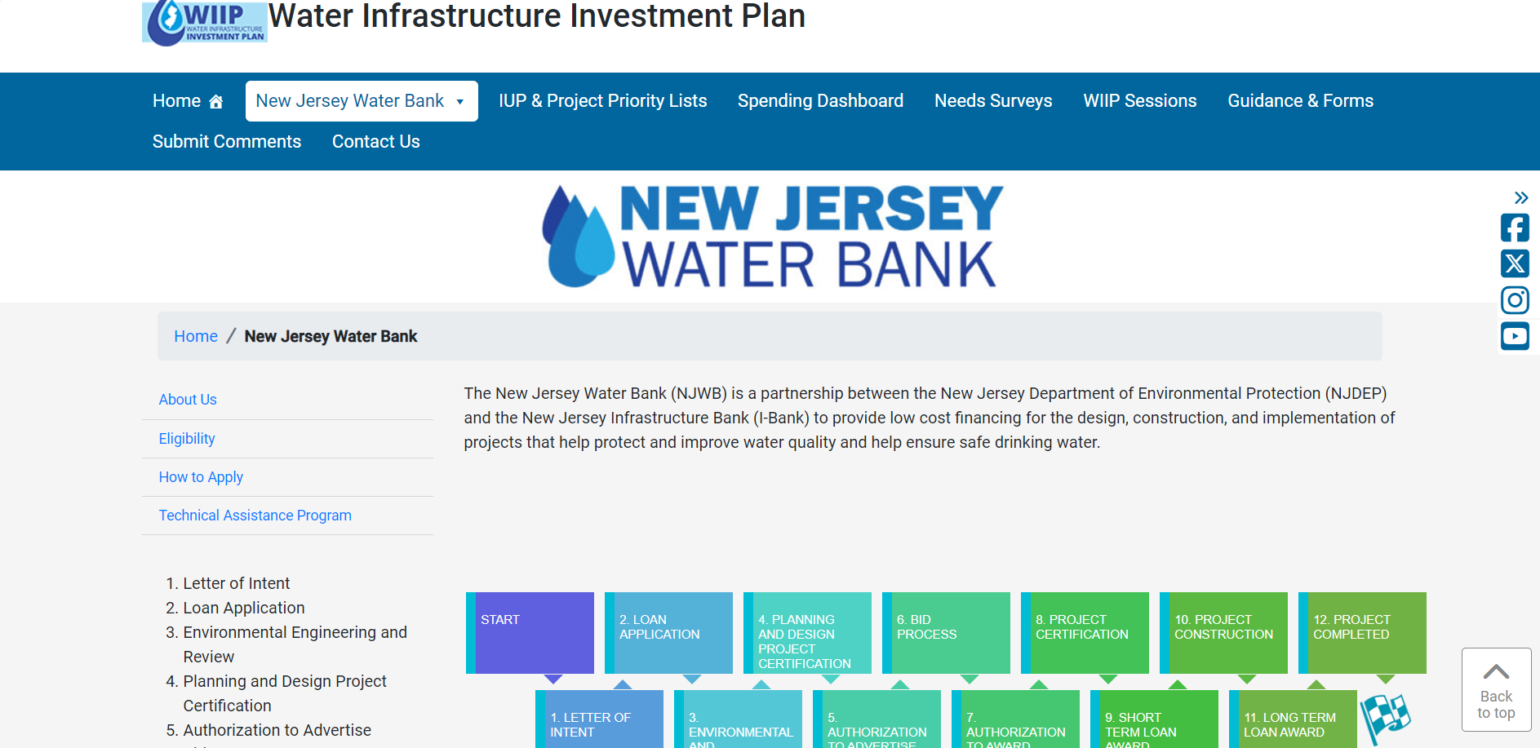
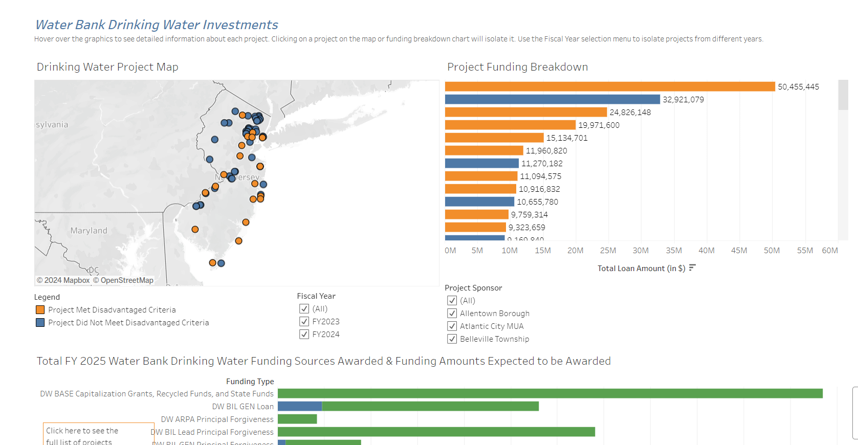
NJDEP| Water Infrastructure Investment Plan | Home
NJDEP| Water Infrastructure Investment Plan | Spending Dashboard

