Slide 1
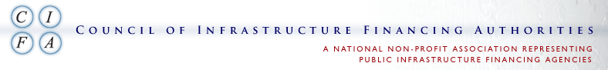

Green for Green: ARRA Funding for
Hornsby Bend Biosolids Management Plant
2016 SRF National Workshop
October 30 - November 1, 2016
Chris Chen, P.E., Assistant Director
Rajendra P. Bhattarai, P.E., BCEE, Division Manager
Austin Water, City of Austin, Texas
Austin, Texas
October 31, 2016

Slide 2






Acknowledgments
U.S. Environmental Protection Agency
Texas Water Development Board
City of Austin
CH2M
Matous Construction
Chasco Constructors

Slide 3
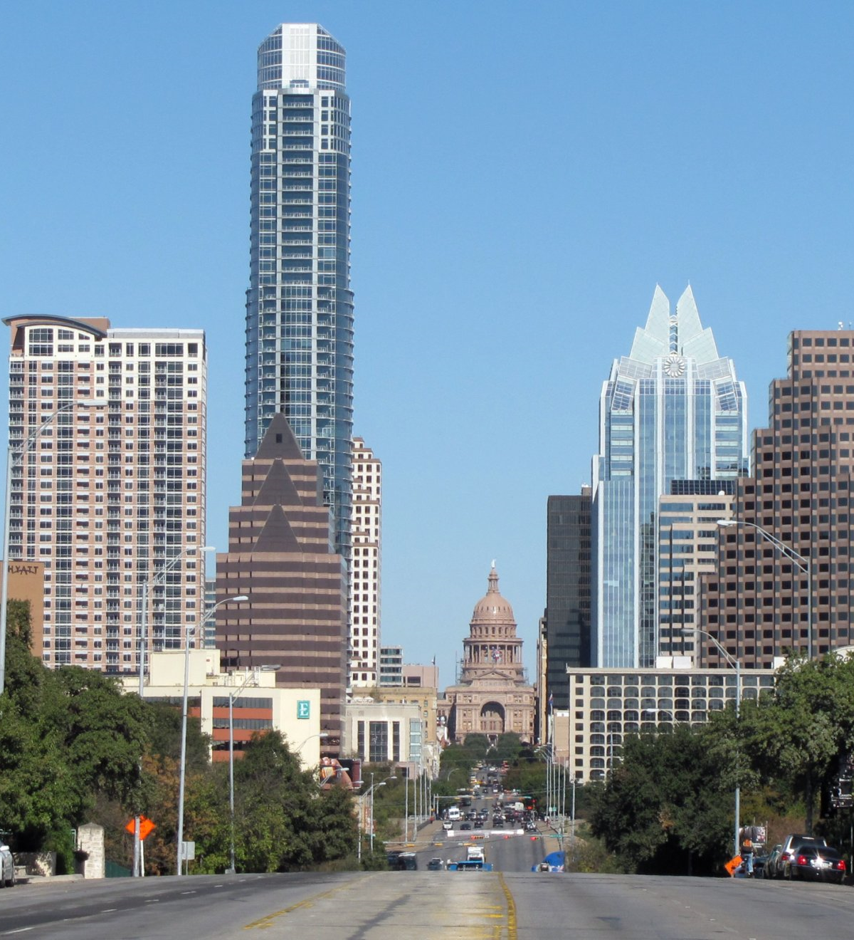
Presentation Outline
Austin, Texas
Austin Water
Hornsby Bend
ARRA Funding and Improvements
Results
Future of Hornsby Bend
Questions

Slide 4
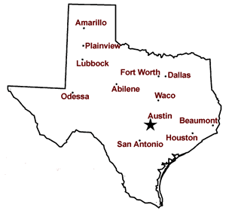
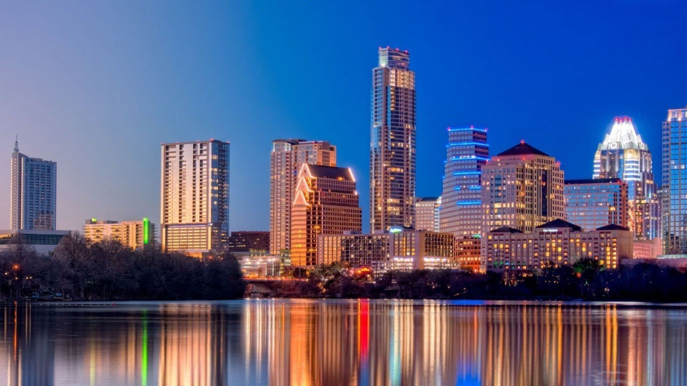
Austin, Texas
Oklahoma
New
Mexico
Capital of Texas
11th Largest city in the U.S.
Metro Area Population: 2.01 million
20% Population growth between 2010 and 2014
~540 sq. miles
Louisiana
Mexico
Gulf
of
Mexico
One of the most desirable cities to live in the U.S.
~ 110 new people move in daily

Slide 5



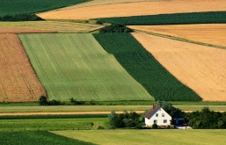

The Path of Austin’s Water
Drinking
Water
Plant
Wildlands
Lake Austin
Hornsby Bend BiosolidsPlant
Wastewater
Treatment Plant
Reclaimed
Water
Downstream Colorado River

Slide 6
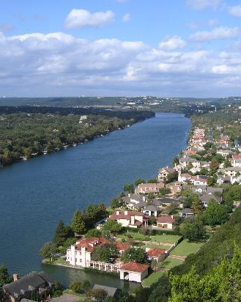
Austin Water
Population Served: 1 million
Service Area: 548 Square Miles
Employees: 1,170
Water Source: Colorado River
Annual O&M: ~$520 Million
5-year CIP: ~$900 million

Slide 7
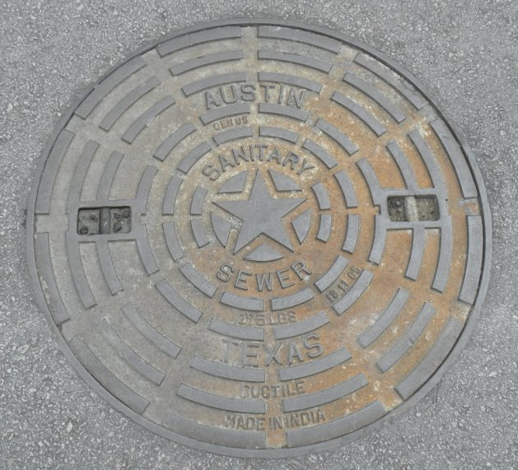
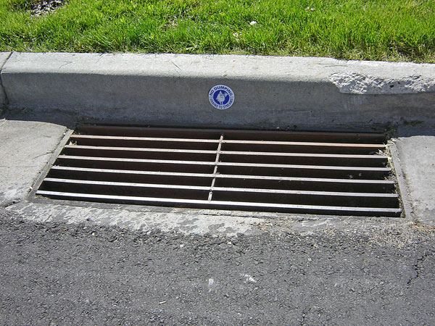
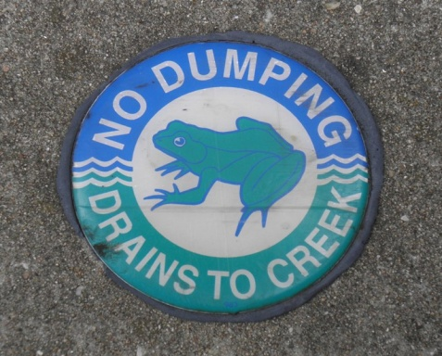
Austin’s Wastewater System
Separate System
Collection System: ~2,800 miles
Private Laterals: ~2,800 miles
50,000 manholes
137 wastewater lift stations

Slide 8
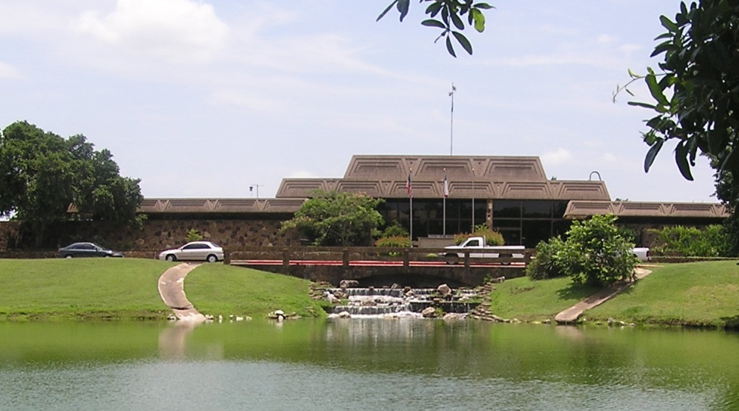
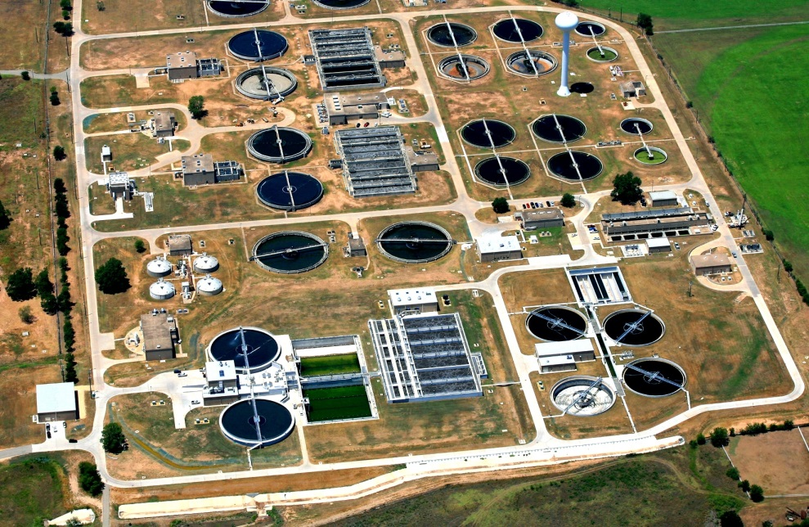
Austin’s Wastewater System (continued)
12 major odor control units on collection systems
Service Connections: ~200,000
2 large wastewater treatment plants
1 biosolids management plant (Hornsby Bend)
8 small wastewater treatment plants
Systemwide Wastewater Flow: ~100 MGD
Walnut Creek WWTP
South Austin Regional WWTP

Slide 9
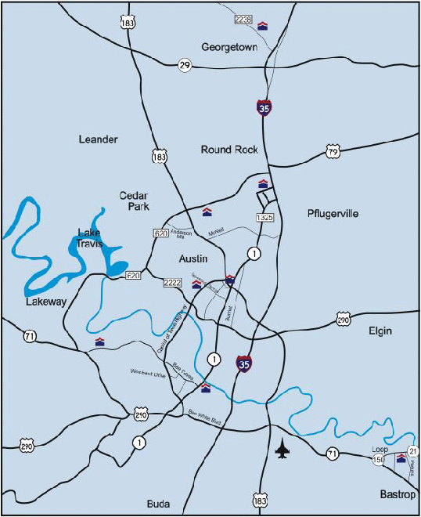
Austin’s Small Wastewater
Plants
2
Balcones
Brushy Creek
Dessau
Harris Branch
Wild Horse Ranch
Thoroughbred Farms
Lost Creek
River Place
1
3
8
4
7
5
6

Slide 10
Walnut Creek Wastewater
Plant
(1977)
Hornsby Bend Biosolids
Plant
(1956)
South Austin
Regional
Wastewater
Plant
(1986)

Slide 11
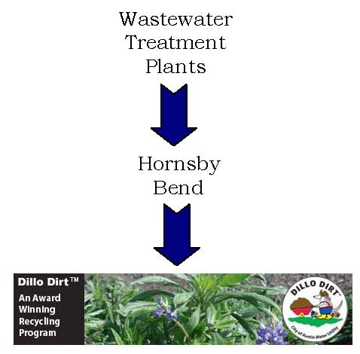
Hornsby Bend
Biosolids Management Plant
Urban Waste Recycling
Conservation
Research
Restoration
Energy Production
More than 40 local, state, regional
and National awards

Slide 12
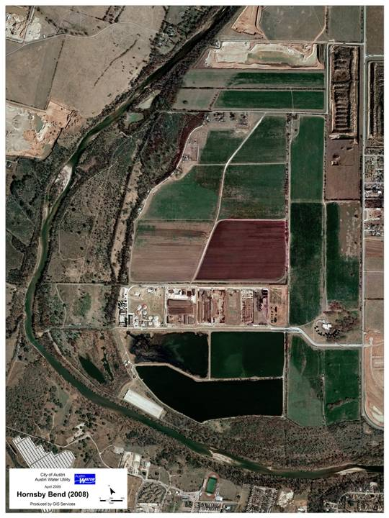
Hornsby Bend Biosolids Management Plant
1200 acres
3.5 miles of
Colorado River
Treefolks and
Austin Youth River Watch
EcoHouse Offices
FM 973
Public Safety Training Houses
Riparian Research Area
Biosolids Research Fields
Biosolids Management
Admin Building and Center for Environment Research
Treatment and Compost area
Main Entrance
Treatment Ponds
Aquatic
Greenhouse
Riparian Research Area

Slide 13
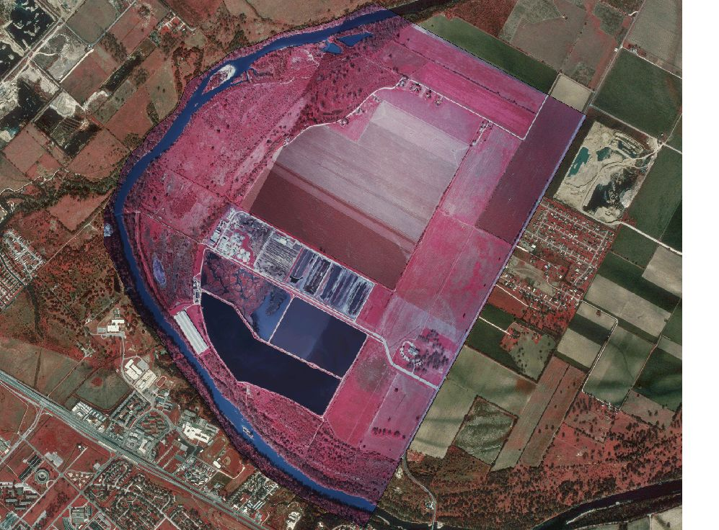
Platt Lane to North Entrance
River Trail
North Entrance
Ecohouse Offices
for Treefolks and Austin Youth River Watch
Riparian Research Area
Public Safety Training Houses
Biosolids Research Fields
FM 973
Digesters
Restricted area
Compost Pad
Pond 3
Restricted area
Storage basins
Sidestream
Treatment
Plant
Pond 1 W
Restricted area
/
N
Administration offices
and CER
Aquatic Greenhouse
Pond 1 E
/
Pond 2
Hornsby Bend site
Birding Shelter
Public Entrance
to Ponds
SH 71
River Trail South Entrance
Riparian Research Area
FM 973
Austin Airport

Slide 14
HORNSBY BEND BIOSOLIDS MANAGEMENT PLANT
Combined Heat and Power
BENEFICIAL USE THROUGH
AGRICULTURAL LAND APPLICATION
WALNUT
CREEK
WWTP
CHP
CH₄
SLUDGE
CLASS B
BIOSOLIDS
EQUALIZATION
BELT
THICKENERS
MIXING/
BLENDING
ANAEROBIC
DIGESTERS
DEWATERING
SOUTH
AUSTIN
REGIONAL
WWTP
SLUDGE
SLUDGE
SIDESTREAM
SIDESTREAM
SIDESTREAM
TREATMENT
PLANT
BULKING AGENTS:
WOOD CHIPS/
YARD TRIMMINGS
COMPOSTING
EFFLUENT
CLASS A COMPOST
“DILLO DIRT”
PONDS
ON-SITE IRRIGATION
BENEFICIAL USE THROUGH
DISTRIBUTION AND MARKETING

Slide 15
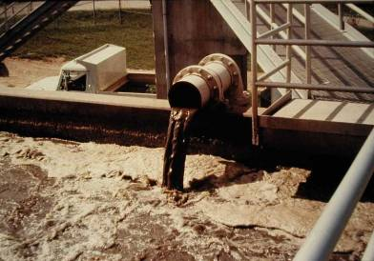
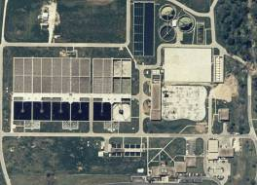
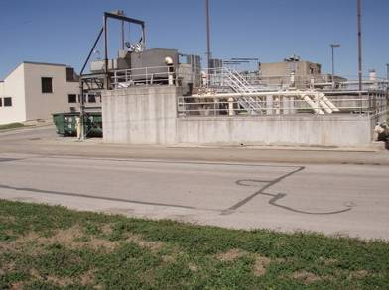
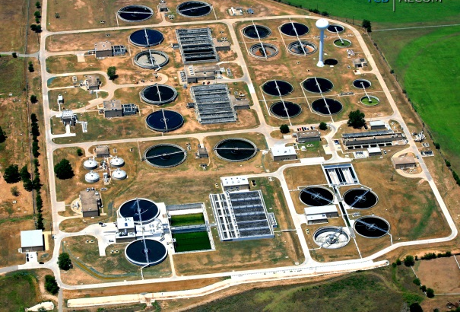
All of Austin’s Biosolids – 1.5 million gallons per day
98.5% water
Wastewater: 100 MGD
Biosolids: 95 dry tons/day
Walnut Creek Wastewater Treatment Plant
South Austin Regional Wastewater Treatment Plant

Slide 16
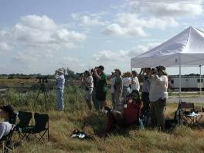
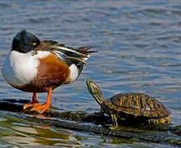
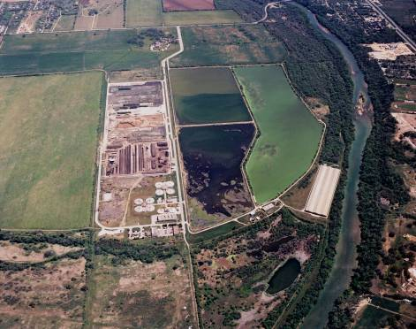
Water - Treatment Ponds 185 acres
Water moves by gravity
Pond Ecosystem treats water
All water recycled – no discharge to the river
Water used to irrigate hay fields onsite
Most popular birding site in Austin Area
320 bird species
1E
2
1W
4
3

Slide 17
Anaerobic Digestion Simplified
Digester Feed
Organic Acids
Methane
Hydrolysis and Acidification
Leftover
Biosolids
Methanogenesis
Leftover
Biosolids
Energy Recovery
Beneficial Reuse

Slide 18
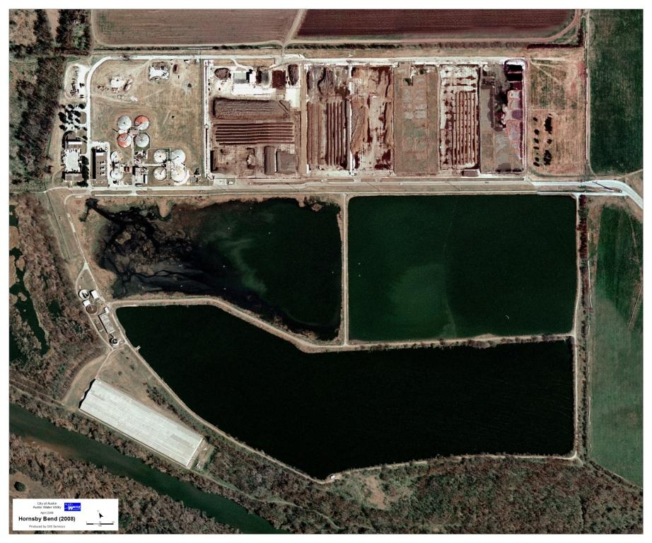
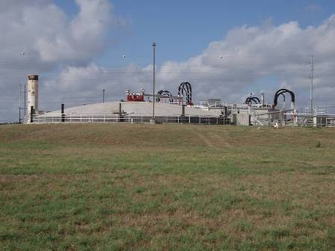
Solids –
Anaerobic Digesters
Mesophilic digestion – 98º F
Approximately 60 days detention time
50% solids reduction
95% pathogen reduction = Class B
By-product: Methane

Slide 19
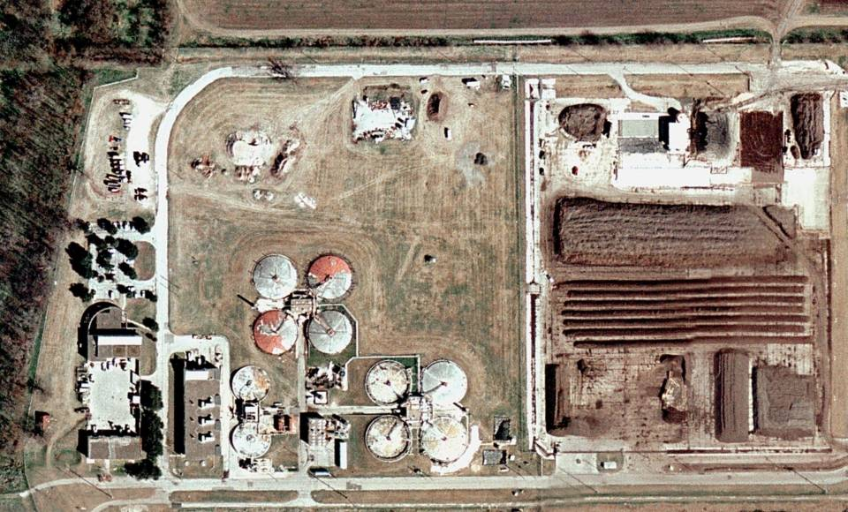
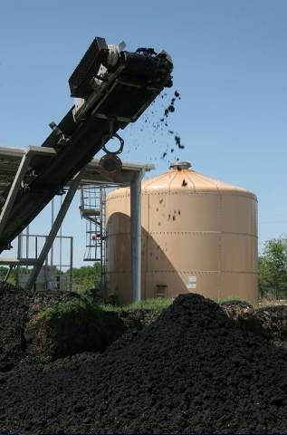
Dewatering

Slide 20

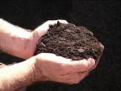

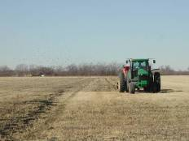
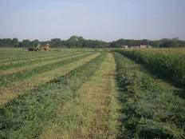
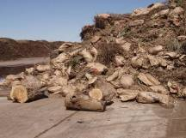
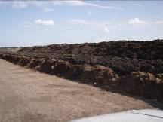
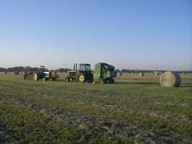
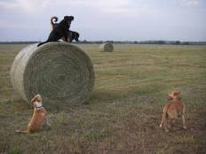
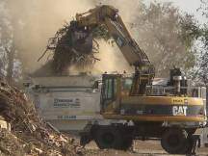
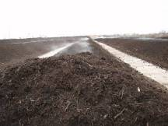
Biosolids Recycling
Second Method
Composting
Yard Trimmings and Biosolids
⅓
Biosolids
⅔
Biosolids Recycling
First Method
Beneficial Reuse through Land Application
⅓ on onsite farm – 550 acres
⅓ on offsite farm

Slide 21
Biosolids Recycling Method 1
Land Application
Class B
Biosolids
550 acres of hay fields

Slide 22
Biosolids Recycling
Method 2 Composting
Class A Biosolids

Slide 23
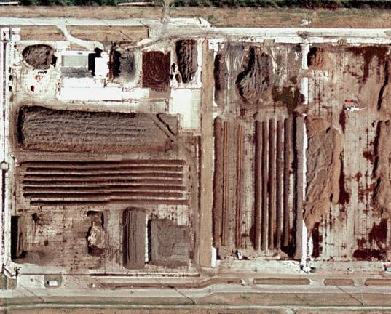
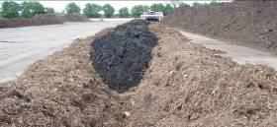
Composting
Yard Trimmings
Processing
Method 2
Composting
3 parts yard trimmings [carbon]
1 part biosolids [nitrogen/phosphorus]
Compost Pad
All of Austin’s of yard trimmings:
150,000 yd³
~12% of Austin’s solid waste stream
~40% of Austin’s recycling stream
~7,000 tons/year of Class A Compost – “Dillo Dirt”

Slide 24

American Recovery and Reinvestment Act of 2009
Effective Feb. 17, 2009
$4 billion for Clean Water State Revolving Fund
Wastewater treatment infrastructure improvements
Shovel-ready Projects
Funding for “green” projects

Slide 25
HORNSBY BEND BIOSOLIDS MANAGEMENT PLANT
Combined Heat and Power
BENEFICIAL USE THROUGH
AGRICULTURAL LAND APPLICATION
WALNUT
CREEK
WWTP
CHP
CH₄
SLUDGE
CLASS B
BIOSOLIDS
EQUALIZATION
BELT
THICKENERS
MIXING/
BLENDING
ANAEROBIC
DIGESTERS
DEWATERING
SOUTH
AUSTIN
REGIONAL
WWTP
SLUDGE
SLUDGE
SIDESTREAM
SIDESTREAM
SIDESTREAM
TREATMENT
PLANT
BULKING AGENTS:
WOOD CHIPS/
YARD TRIMMINGS
COMPOSTING
EFFLUENT
CLASS A COMPOST
“DILLO DIRT”
PONDS
ON-SITE IRRIGATION
BENEFICIAL USE THROUGH
DISTRIBUTION AND MARKETING

Slide 26

Clean Water Federal Stimulus Award
Hornsby Bend ranked #1 in Texas among “green” projects
$31.8 million zero-interest Federal Stimulus Loan
$30.7 million in interest savings
80% of the funds for the “Green Reserve” projects through the Texas Clean Water State Revolving Fund
Hornsby Bend
# 1

Slide 27
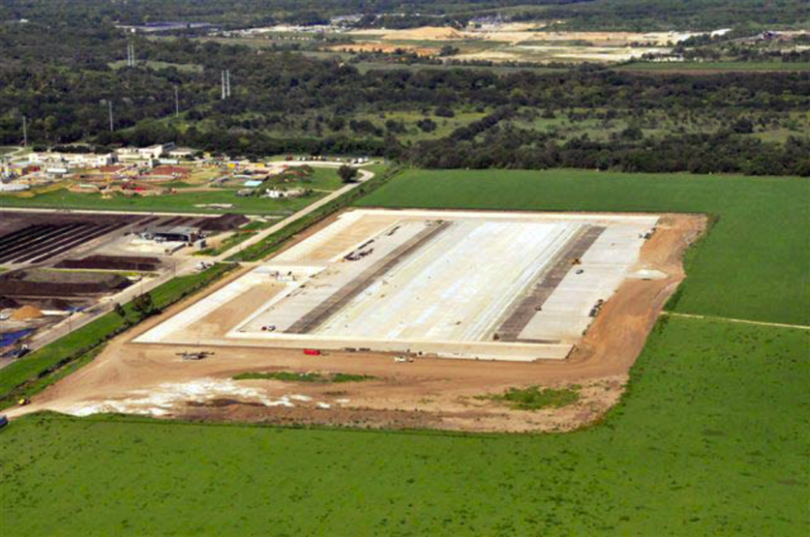
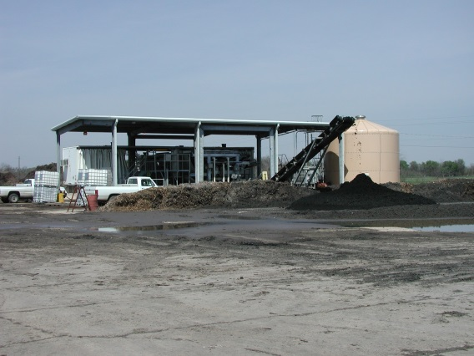
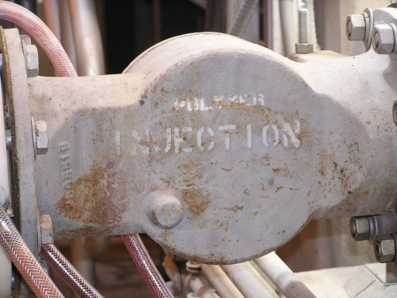
Two Contracts with Stimulus Funds
$6.95 million for Compost Pad expansion
  Addition of 15-acre compost pad
  Double composting capacity to use 10,000 dry tons of biosolids per year
$27.95 million for digester upgrades and plant-wide efficiency improvements
  Sludge dewatering improvements – increase capacity, reduce operation cost
  Digester upgrades – improve process efficiency, increase gas production and capture, reduce use of petroleum-based polymers

Slide 28
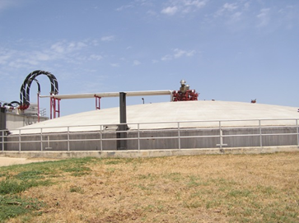
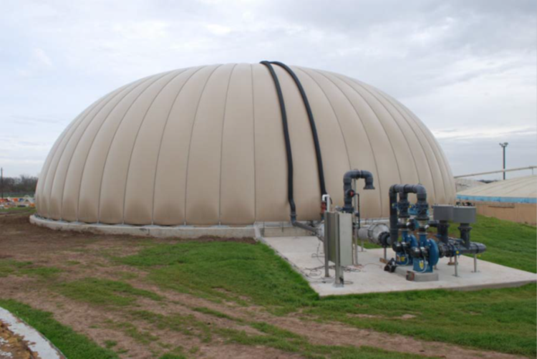
Digester Improvements
Changed from floating covers to more efficient fixed covers
Flexible membrane cover for more efficient gas storage
New 20 HP linear motion mixers in lieu of 100 HP nozzle mix systems

Slide 29
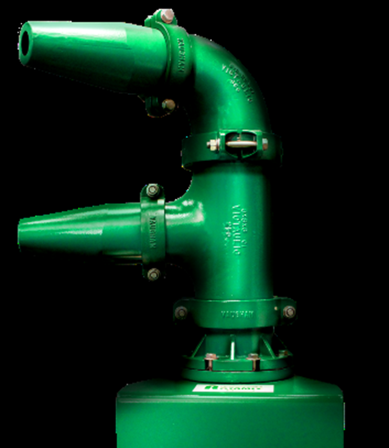
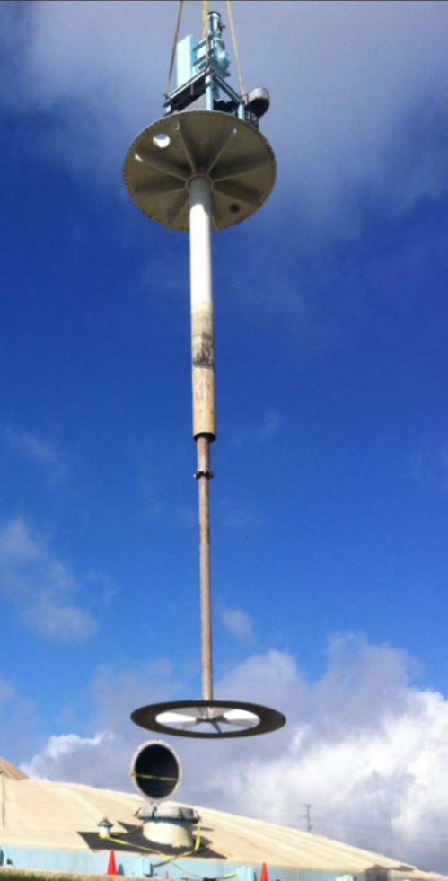
Digester Mixer Replacement
Before
  Nozzle Mixers
  Inadequate Mixing
  High power use
  After
  Linear Motion Mixers
  Better mixing
  80% reduction in power use
Nozzle Mixer
Linear Motion Mixer

Slide 30
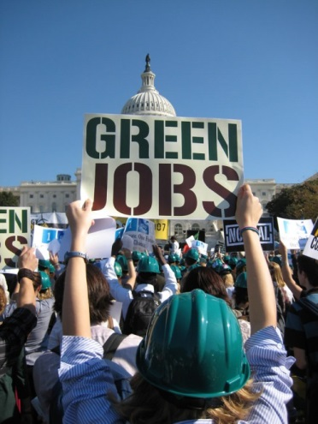
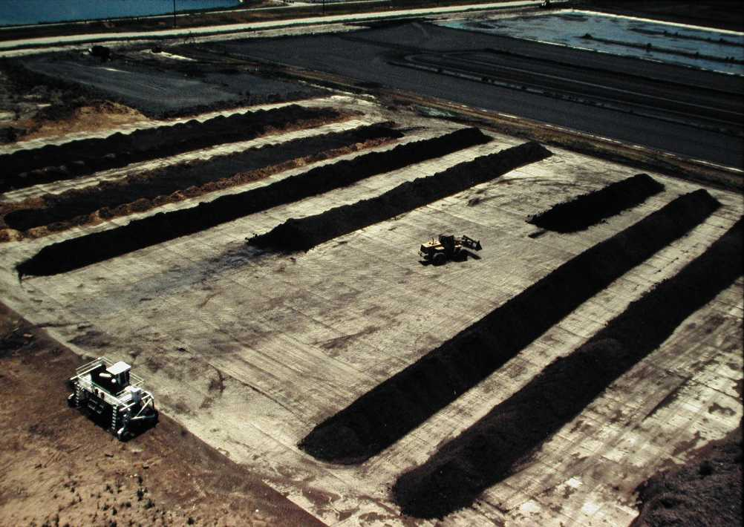
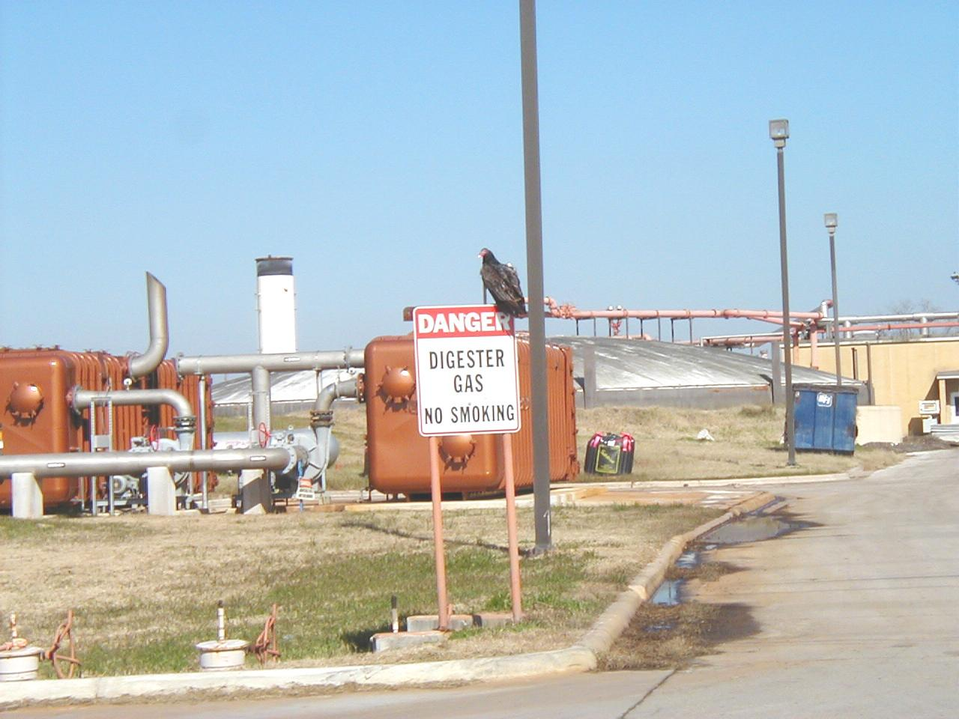
Benefits of Stimulus Fund Projects
560 local jobs over 3 years
Increase digester gas production
Compost capacity doubled to produce exceptional quality Class A compost
Reduce diesel fuel use by 30,000 gallons/year
41% reduction in petroleum-based polymers
Extra 16,000 yd³/year of yard and tree trimmings used in composting by 2012
300 tons of fly ash in concrete for compost pad

Slide 31
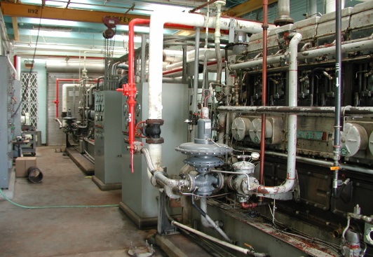
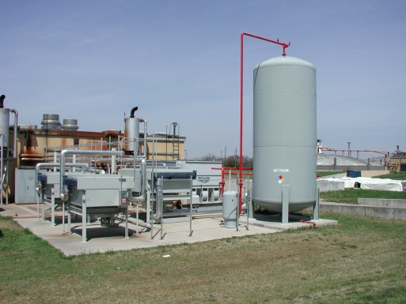
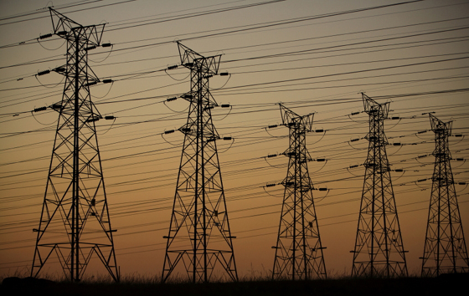
Benefits of Stimulus Fund Projects
(continued…)
6,500 tons of CO₂ equivalent GHG reduction by 2012
55% increase in energy production by 2012
1.75 MW electricity from a related biogas generator project – $1.2 million grant from U.S. Dept. of Energy through Austin Energy
Waste heat from generators for heating digesters and other uses
Generate enough electricity for Hornsby Bend

Slide 32

Combined Heat and Power from Methane
875 KW electricity from a biogas generator
Waste heat from generators for heating digesters and other uses
Hornsby Bend energy neutral
Excess electricity goes to the grid

Slide 33

Clean Water
State Revolving Fund
2010 PISCES Award
Performance & Innovation in the SRF
Creating Environmental Success
Awarded to
The City of Austin
Texas
For Innovative and Effective Use
of the SRF Financing Mechanisms

Slide 34


Future Upgrades at Hornsby Bend
Increase biogas production by anaerobically digesting:
    Fats, oils and grease
    Food wastes
Increase CHP capacity
Sidestream Treatment
100% Class A Biosolids
Nutrient Recovery
    Phosphorus recovery for fertilizers
Solar Energy Farm

Slide 35

Questions, Comments?
Tom Toro, The New Yorker, May 12, 2012

