Slide 1
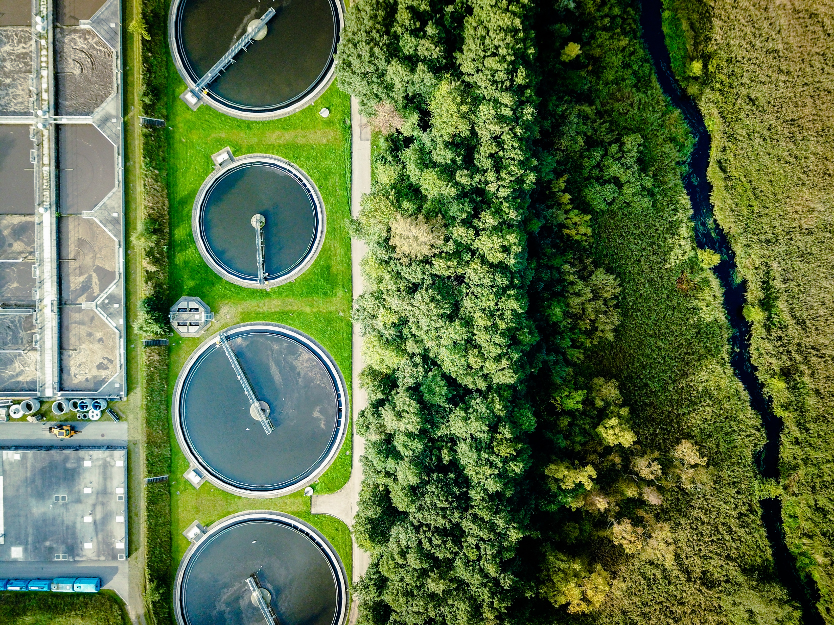
Building a Clean Water SRF
Emerging Contaminants Project Pipeline
Notes:
Kelly
Notes
16x9 orientation
Podium with 5 chairs/table with another mic
Slides to CIFA by 11/15 as ppt and PDF
Will be recorded (voice and slides)

Slide 2
Workshop Agenda
Introductions & Overview of Clean Water Tech Center
Background & Project Portfolio Summary
Building a Project Pipeline
Discussion
Notes:
Kelly

Slide 3


Introductions
Smiti Nepal, Environmental Engineer, Office of Wastewater Management, U.S. Environmental Protection Agency
Heather Strathearn, Environmental Engineer, Office of Wastewater Management, U.S. Environmental Protection Agency
Notes:
Kelly
Smiti Nepal is and Environmental Engineer at the US EPA with a focus on water reuse, nutrient removal and recovery technologies, wastewater-based surveillance, and emerging contaminants. Smiti is using her previous work experience from Maryland Department of the Environment and as a consultant to work with States on issues related to Emerging Contaminants. Smiti received her Bachelor of Science in Environmental Engineering degree and Master of Science in Systems and Ecological Engineering from the University of Florida. She also has her professional engineering license from the State of Maryland.
Heather Strathearn is an Environmental Engineer at the U.S. Environmental Protection Agency in the Office of Wastewater Management. Heather holds a B.S. in Environmental and Ecological Engineering from Purdue University and an M.S. in Environmental Engineering from Stanford University. With a passion for holistic and realistic water management, Heather currently works in the Sustainable Communities and Infrastructure Branch with a focus on emerging contaminants, nutrients, and water recycling. With this, one of her main roles is working to support the CWSRF Emerging Contaminants program.

Slide 4

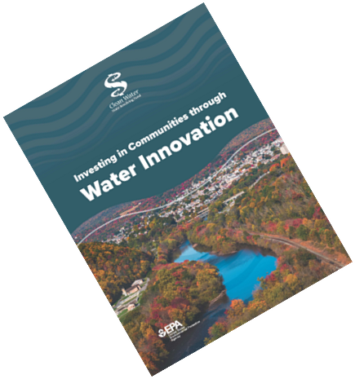
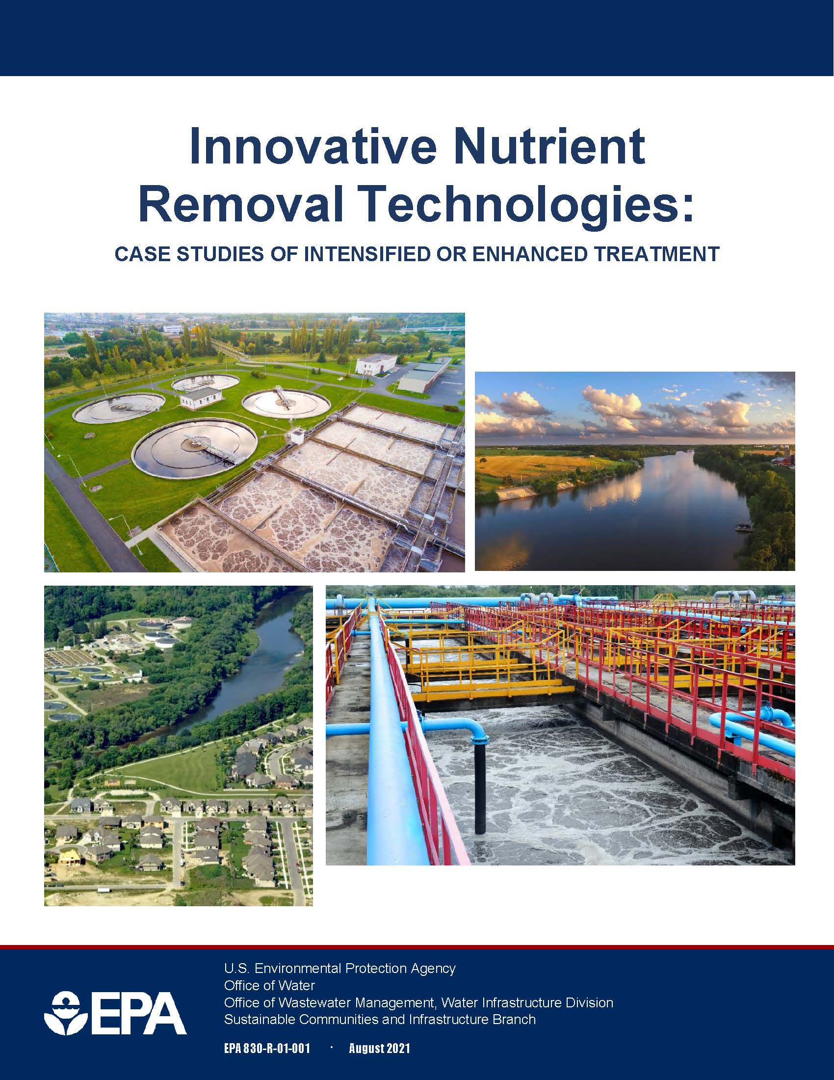

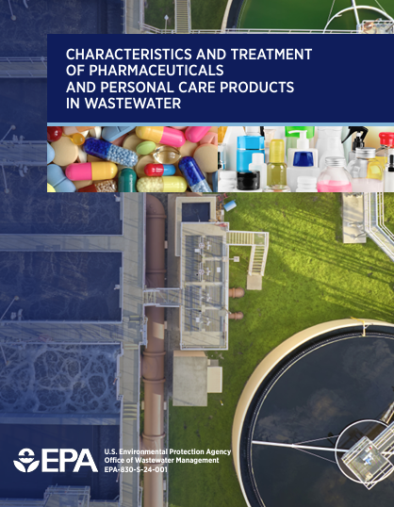
Clean Water Technology Center
Resources and services to help communities build capacity and become more sustainable by adopting innovative and alternative wastewater technologies.
Searchable Clearinghouse of Wastewater Technology (SCOWT)
Notes:
Before we get into all the new information on Emerging Contaminants, we wanted to ground you all with the understanding of the Clean Water Technology Center that Heather and Smiti are with and how it connects to all our work on infrastructure.
EPA’s Clean Water Technology Center (Tech Center) provides resources and services to help communities of all sizes build their capacity to become more sustainable by adopting innovative and alternative wastewater technologies that address local water challenges. Of course, this team focuses on emerging contaminants, but they also work on areas like:
Nutrient Reduction and Recovery,
Water Reuse,
Intelligent Water Solutions, and
Wastewater-based Surveillance (WBS).
These graphics below highlight some key resources from the last couple of years that may be of interest:
The first study analyzed the long-term performance of five facilities in the U.S. and one facility in Canada that implemented innovative technologies to enhance the removal of nutrients (nitrogen or phosphorus species). This can be a great resource to understand the variability of performance for these newer technologies.
The second report provides an overview of CWSRF investments in innovation over the last 10 years. This is useful to get a high-level overview of how the CWSRF supports different types of communities, different regions, and different types of technology.
The third report builds on that innovation overview with an explicit focus on intelligent water systems and how other communities of various sizes, locations, and demographics are developing intelligent water systems and using CWSRF money to invest in technologies today for a more efficient and resilient water system in the future.
Lastly, the newest report focuses on pharmaceuticals and personal care products and Heather will cover this is a bit.

Slide 5
Background &
Current Project Portfolio

Slide 6


What is an emerging contaminant?
Clean Water SRF EC Examples
      Per- and polyfluoroalkyl substances (PFAS)
      Antimicrobial resistant bacteria
      6PPD-quinone (from tires)
      Microplastics
      Pharmaceuticals and personal care products (PPCPs)
      Contaminants with water quality criteria recommendations published by EPA under CWA Section 304(a), except for PFAS, are not considered emerging contaminants
      Separate definition for Drinking Water SRF emerging contaminants
CWSRF EC Definition: Substance or microorganism, including manufactured or naturally occurring physical, chemical, biological, radiological, or nuclear material, which is known or anticipated in the environment, which may pose newly identified or re-emerging risks to human health, aquatic life, or the environment.
See Appendix B of EPA’s March 2022 memo for more detail: https://www.epa.gov/system/files/documents/2022-03/combined_srf-implementation-memo_final_03.2022.pdf
Notes:
We included this slide as a reference for folks to look at the full definition of emerging contaminants. I will just emphasize on the left that ECs include contaminants like PFAS, antimicrobial bacteria, 6PPD, microplastics, and pharmaceuticals and personal care products.
PFAS continues to be an emerging contaminant, but otherwise, contaminants with water quality criteria and not considered emerging contaminants.
And just to reemphasize, there is a separate definition for DWSRF

Slide 7
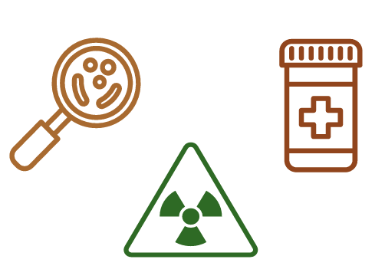
Clean Water Emerging Contaminants Funds
The Bipartisan Infrastructure Law (BIL) provides funding over five years (FFY 2022 – 2026) specifically to address ECs in wastewater, stormwater, and nonpoint source pollution.
  $1 billion in Clean Water SRF funding
    $775 million has been allotted through FFY2025.
    $225 million will be allotted in FFY2026.
  $20 million in Clean Water Indian Set-Aside (CWISA) funding for federally recognized Tribes
    $11 million has been allotted through FFY2024.
    $9 million will be allotted in FFY2025 - FFY2026.
Funding does not require a cost-share or match.
All funds are awarded as
100% forgivable loans or grants.
Notes:
As you all know, the Emerging Contaminants funds are a new appropriation from FFY 22-26 and there are 1 billion dollars on the CWSRF side.
Of this, 775 million has been alloted but there are still more funds to come and so we want to emphasize these resources and tools to help you all make the most of the remaining funds.
This holds true for CWSRF and CWISA funding and you can see that there are still funds left to be used on both sides.

Slide 8
Clean Water SRF Emerging Contaminants Fund
Project Types – FFY22 & FFY23
    Currently, there are 146 proposed projects* across the states and Puerto Rico.
    More than half of these projects are planning, design, and pilot projects.
*All data was pulled from Intended Use Plans and are subject to change.
Notes:
So, what’s the status of the funding?
States are identifying a lot of CW projects and some are seeing a large need for DW so they’ve directed CW funds to the DW side. The number of full transfers from CW to DW decreased from FY22 to FY23 and hopefully will continue that downward trend. On the other end, some states (NV, NM) have seen a large clean water need and have transferred funds from DW to CWSRF.
Here on the slide you can see the 146 proposed projects that were pulled from FFY22-23 IUPs
Of the clean water projects, the spread from the last two years hasn’t changed dramatically. Going top to bottom, many projects were at wastewater treatment facilities, however, there were a lot of projects out in the watershed as well.
We saw a lot of landfill water quality projects and nonpoint source projects.
We’ve also seen a few biosolids projects.
We’ve seen states building the laboratory capacities for emerging contaminants.
Beyond those, there have also been a handful of projects on stormwater, sourcewater protection, and decentralized.

Slide 9
Clean Water SRF Emerging Contaminants Fund
ECs Addressed – FFY22 & FFY23
Of the 146 proposed projects:
84% will address PFAS
30% will address other contaminants:
  Pharmaceuticals and Personal Care Products (PPCP)
  6 PPD-Quinone
  1,4-Dioxane
  Harmful Algal Blooms (HABs)
  Microplastics
Note: Percentage adds up to greater than 100% as some projects address more than one EC.
Notes:
Most of these projects are addressing PFAS but almost 1/3 of them are addressing other emerging contaminants like pharmaceuticals and personal care products, 1,4-dioxane, 6PPD, Harmful algal blooms, microplastics, and antimicrobial resistance.

Slide 10
Building a CWSRF EC Project Pipeline
Outreach Support
Eligibility Decision Tool
PPCP Technology Brief
Technology Effectiveness for EC Framework
Emerging Contaminants & PPL Connection Tool
EC Project Case Studies
Notes:
So now moving into the recent tools and work to help build a CWSRF EC project pipeline.
I’ll start by sharing some of our outreach work, the new eligibility decision tool, and the recent PPCP technology brief
Smiti will follow to discuss the EC framework, a new project priority list connection tool, and case studies

Slide 11
Outreach Support

Slide 12
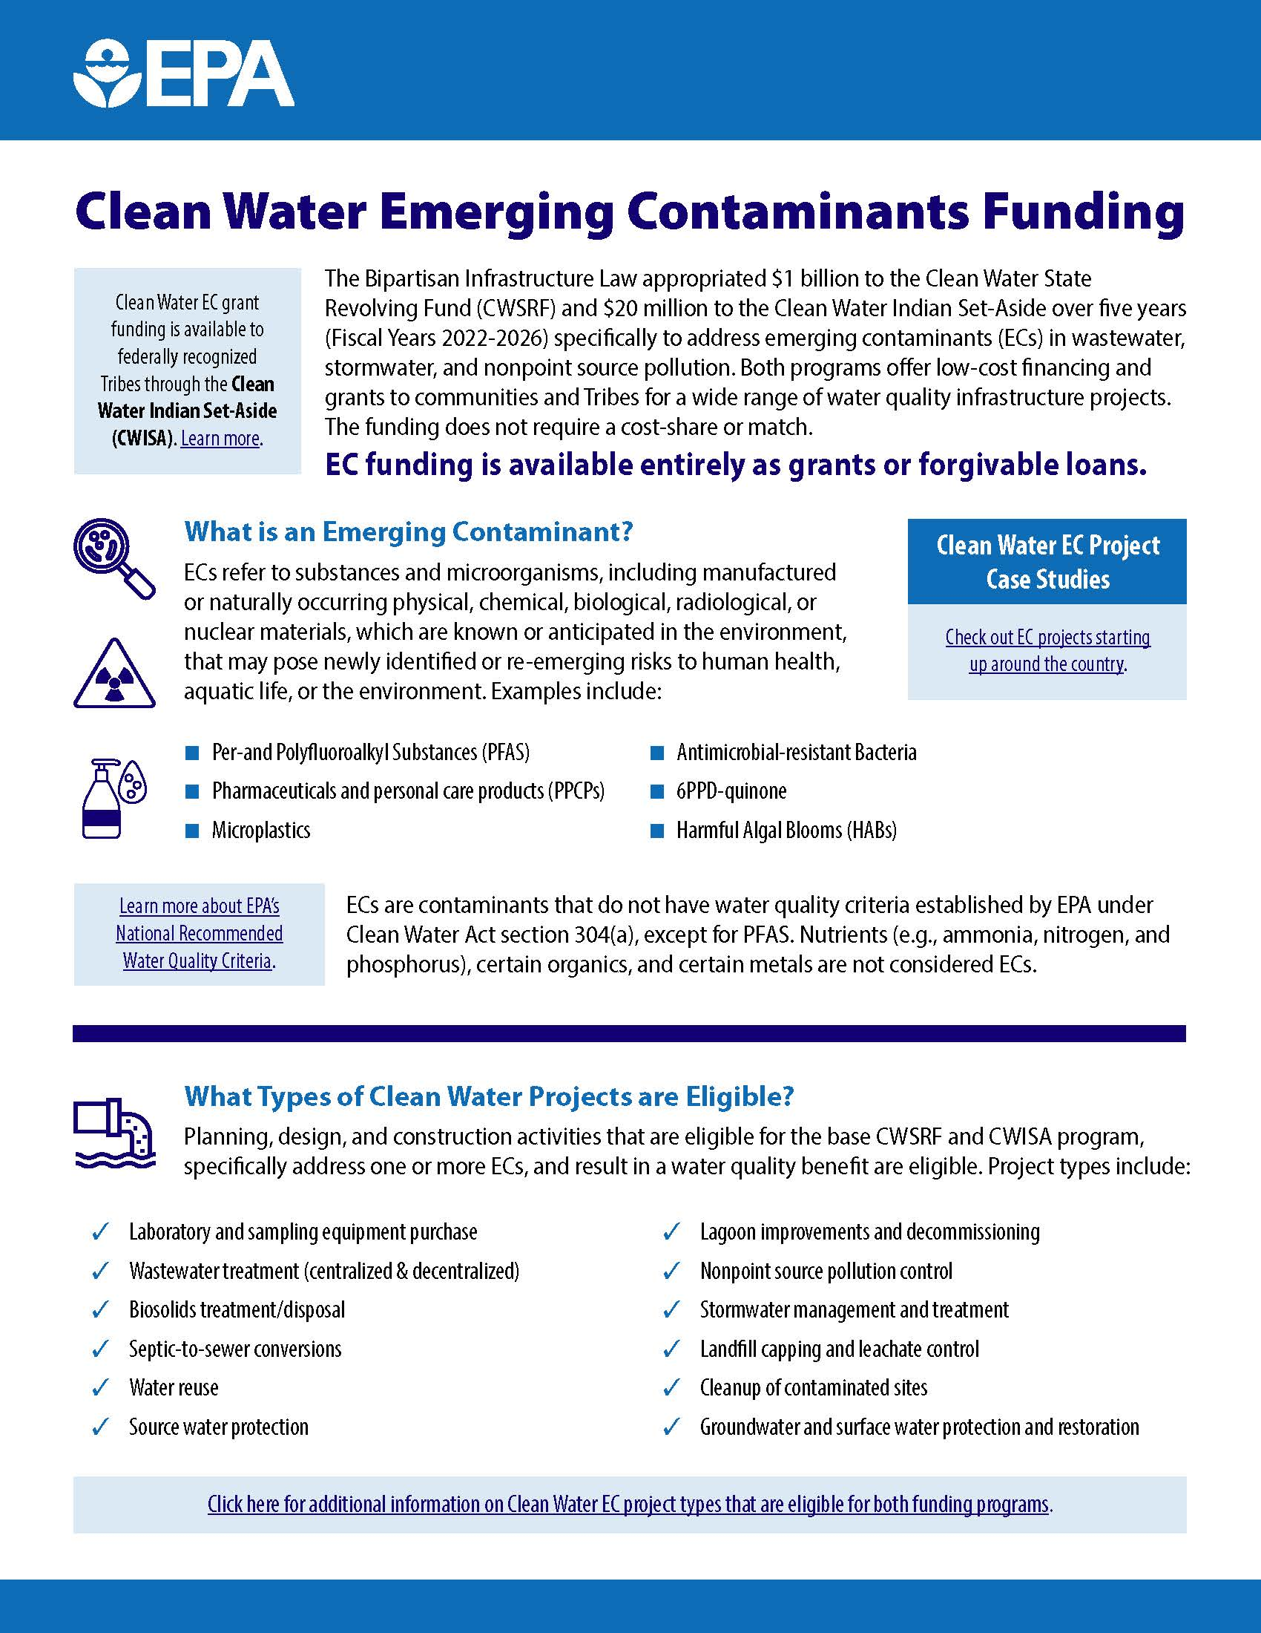
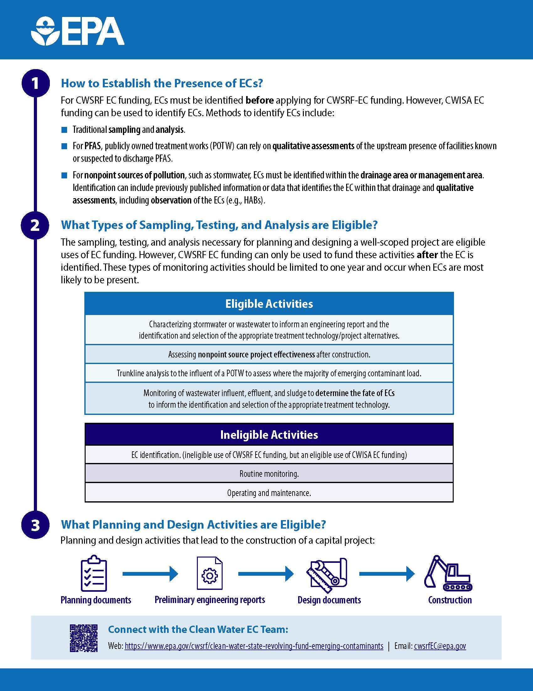
CWSRF EC Outreach Support
Fact Sheet development
State-level marketing materials
Presentations at conferences and webinars
Research on treatment technology effectiveness
Project identification
Notes:
For outreach support, we’d love your feedback on where these efforts are hitting the mark and where we can be better in supporting you all.
For factsheets, we have a general 2-pager that introduces the fund and describes eligible projects
Additionally, we are able to and have made state-specific outreach resources if that is of interest (OK)
As needs arise for presentations to get the word out about the availability of EC funds, we have presented to technical assistance providers (NRWA), state water quality groups (ACWA), and more (SWP group)
Additionally, we are here to support in research on what technologies or projects might align with EC program needs

Slide 13
Project Eligibility Decision Tool

Slide 14

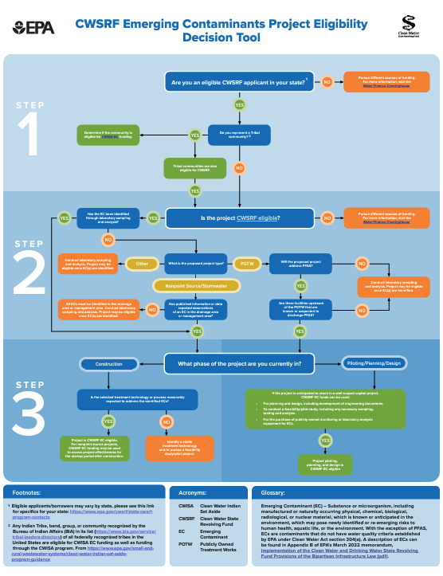
CWSRF Emerging Contaminants Project Eligibility Decision Tool
Three step process:
Eligible applicant
Eligible CWSRF project and identification of an emerging contaminant
Project phase
Notes:
Now for eligibility, I will keep this quick, but Smiti, Kelly, and I are always happy to talk through the details.
This new decision tool walks through project eligibilities to help identify whether a project may be eligible for CWSRF EC funding
First it looks at project applicant
Then it looks at the identification of the emerging contaminant
Last it looks at details for eligible project components

Slide 15
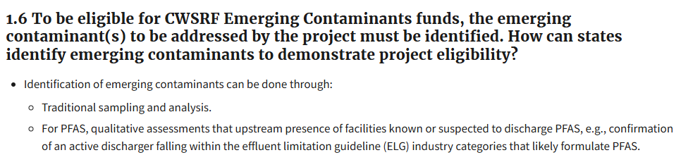
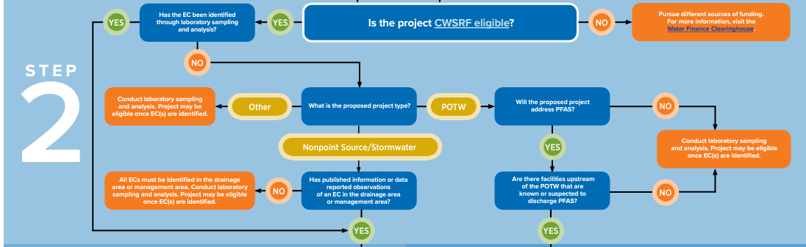
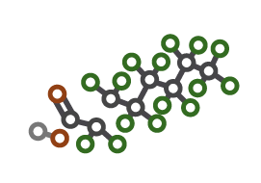
CWSRF Emerging Contaminants Project Eligibility Decision Tool
Incorporates PFAS qualitative assessments from FAQ:
Notes:
I will zoom in here to highlight that this decision tool includes our eligibility language that was new as of this January providing additional flexibility for PFAS projects.
Specifically, all CWSRF EC projects must have already identified and EC that is present. Any project can do this through traditional sampling and analysis. In addition, PFAS projects can utilize qualitative assessments that there is an upstream presence of facilities known or suspected to discharge PFAS
As an example, a POTW could confirm that there is an active industrial discharger likely to formulate PFAS
Industry categories known or suspected to discharge PFAS as identified on page 14 of the PFAS Strategic Roadmap include: organic chemicals, plastics & synthetic fibers (OCPSF); metal finishing; electroplating; electric and electronic components; landfills; pulp, paper & paperboard; leather tanning & finishing; plastics molding & forming; textile mills; paint formulating, and airports. This is not an exhaustive list and additional industries may also discharge PFAS.

Slide 16
Pharmaceuticals & Personal Care Products Technology Brief
Notes:
This report was developed to support EPA’s Searchable Clearinghouse of Wastewater Technology (SCOWT) and to encourage/inform the use of EPA infrastructure funds for emerging contaminants projects.
If you remember from above, 6% of FFY22-23 projects included a focus on PPCPs.
These projects included nonpoint source projects (ID) addressing cesspools (HI), failing septic systems (NV), and WWTP evaluations (OH, OK)
Our discussion is not exhaustive in describing the extent and effects of PPCPs, but rather we introduce this complex class of chemicals which may pose newly identified or re-emerging risks, along with technologies that can be used to treat them at wastewater treatment plants.
The content of this report was developed from a review of existing literature, including research papers and published case studies on PPCPs.

Slide 17
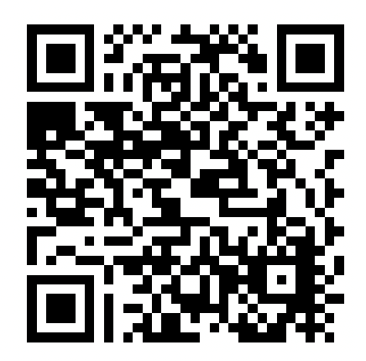
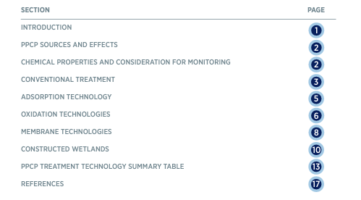
PPCP Technology Brief
Notes:
We are showing the cover page and table of contents so you all know what types of information are included in this report.
1. The document begins with an introduction to PPCPS
PPCP include all drugs, both those prescribed from a doctor and those available over the counter at a local drug store. PPCPs also include non-medicinal consumer chemicals like the ultraviolet (UV) filters in sunscreens or cosmetic products.
When detected in wastewater or the environment, PPCPs are usually present at low concentrations (parts per billion or trillion). However, even at low concentrations, PPCPs may have adverse effects on aquatic organisms, including effects on antibiotic resistance, endocrine disruption, and bioaccumulation
2. Then document provides an introduction to PPCP sources and effects. In this we link out to other key resources on source control.
3. An important step to discussing technology options is to understand the characteristics of PPCPs that make them resistant to removal in conventional WWTFs. So, the document includes an overview of chemical properties and considerations for monitoring.
4. As a baseline, for discussion, we include some information on conventional wastewater treatment. Conventional treatment is not designed to remove PPCPs but may have the co-benefit of removing select PPCPs without the addition of tertiary treatment processes.

Slide 18
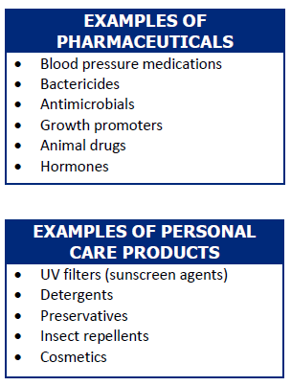
PPCP Technology Brief
Overview of technologies to remove and/or destroy PPCPs in wastewater:
  Adsorption
  Oxidation
  Membranes
  Constructed wetlands
Notes:
•There is limited research on these technologies operating at full scale where PPCPs are specifically monitored, but evidence at the pilot- and lab-bench scale indicates that these technologies are likely to achieve greater removal of PPCPs than conventional treatment alone at full scale. The technologies covered include:
First off, adsorption technologies remove dissolved organic and inorganic compounds from wastewater by adhering them to binding sites on a solid adsorption media. The most common adsorption media is activated carbon, either in a granular (GAC) or powdered (PAC) form.
Oxidation technologies utilize chemical agents to react with target pollutants and oxidize them into a different chemical that is distinct from but related to their parent compound. The oxidation processes include chlorination, photolysis (UV radiation), and ozonation.
Membrane technologies use separation processes to remove PPCPs through size exclusion, electrostatic repulsion, and adsorption.
Lastly, constructed wetlands mimic natural wetlands but are specially designed to meet treatment goals. Constructed wetlands use several removal pathways, including biodegradation, sorption, and chemical oxidation.
•We include information on the applicability of the technology, performance, advantages and disadvantages, as well as case studies. As an example, some pharmaceuticals include blood pressure medications and hormones while some personal care products include detergents and cosmetics.

Slide 19
Technology Effectiveness for Emerging Contaminants Framework

Slide 20
Technology Effectiveness for
Emerging Contaminants Framework
Purpose:
Summarize published information on the effectiveness, cost and environmental impact
of technologies to treat emerging contaminants in a web-based application.
Notes:
With the support of our sister office, ORD, we are currently undertaking a development of a framework that provides information on technology effectiveness for emerging contaminant. As we distribute EC funds, one thing that has been raised is regarding understanding of the level of treatment needed, and the need for technologies that are being used for removal. In the absence of limits, states and utilities needing to understand treatment efficacies, we are trying to build this framework by first summarizing published information on the effectiveness, cost and environmental impact of technologies to treat emerging contaminants. The final product will be a web-based application where users can input there needs.
The second pathway of informing the framework is using real data from the CWSRF investment being made. We are reaching out to utilities that have used CSWRF $ for the implementation are requesting if they would share data on effectiveness to help with the framework.
Documentation of removal rates and removal mechanisms
Real world process/treatment train data (utility, groundwater, surface water, fate and transport)
Data quality

Slide 21
Technology Effectiveness for
Emerging Contaminants Framework
General Inputs
Location
Cost parameters (e.g., interest rate, loan term, etc.)
Feedwater characteristics
  Flow rate
  Important water quality parameters
Contaminant of concern
Target removal rate
Process characteristics
General Outputs
Cost
  Capital and annual O&M
  Present value
  Net present value
Environmental Impact
  Global climate change potential
  Total energy demand
  Fossil fuel depletion potential
  Water consumption
  Water scarcity
  DALY
Notes:
1,4, Dioxane and PPCPs, including some indicators
Disability-adjusted life years (DALYs) are a measure of overall disease burden, expressed as the number of years lost due to ill-health, disability, or early death.
Takes in account of occupational hazard from an exposure. Proximal (direct) and distal (indirect) risk

Slide 22
Technology Effectiveness for
Emerging Contaminants Framework
User Defines General Inputs:
Contaminant(s) of concern
Tool Identifies:
Feasible processes based on feedwater criteria
User Defines Process Model Inputs:
Desired contaminant removal rate
Location
Feedwater characteristics (e.g., TOC, nutrients)
Tool Generates:
Flow
Approximate cost ranges of each
Approximate effectiveness of each
Capital and annual cost estimates
Life cycle impact estimates
Process-specific inputs (e.g., dosage rates, retention time, material type, etc.)
Process:
Notes:
Looking at the workflow of the framework, we can input some information on your contaminant of concern, feedwater quality, flow and others. The tool then identifies the feasible processes, range of cost for those processes, and effectiveness. There is flexibility for user to input additional information such as contaminant removal rate, or any other process specific inputs. The tool will generate outputs on cost and life cycle impacts.

Slide 23
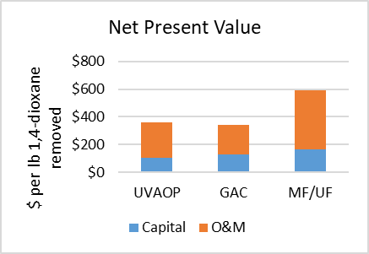
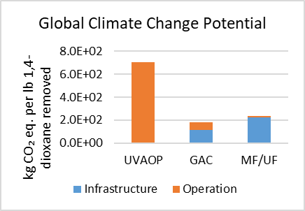
Technology Effectiveness for
Emerging Contaminants Framework
Depending on user input on the effectiveness target, the model can generate an output.
Example: Comparison of processes and metrics for cost and environmental impact results
Notes:
This is an example of what the graphs can potentially look like.
The time horizon for net present value is actually a user-defined input. We typically assume 30 years for our projects, but it is just as easy to make it a variable. The model then integrates all of the components, which can have different (also user defined if desired) lifetimes. For example, assuming a 30 year time horizon, the capital cost for a concrete basin with a 50 year assumed lifetime would only be incurred once, though the capital cost for an HVAC system with an assumed lifespan of 15 years would be incurred twice, with the second expense in year 15 being discounted according to the user-defined discount rate.
For global CCP, we use 100-year GWP values from IPCC. The latest values are based on the 6th Assessment Report (AR6) that was released in 2020.
This will be a publicly available tool. This is not meant for designing but to provide information on potential investments for removal of ECs.

Slide 24
Emerging Contaminants & PPL Connection Tool

Slide 25
Emerging Contaminants & PPL Connection Tool
Purpose: An internal EPA tool to assist state CWSRF programs to develop a pipeline of emerging contaminant projects.
Process:
Analyze ECs and PFAS discharges to POTWs.
Cross-reference the POTWs receiving ECs with a state’s CWSRF Project Priority List (PPL).
Create a targeted list of potential CWSRF EC projects.
Notes:
This tool is a bit different. This is an internal EPA tool that we are using to assist State CWSRF to develop a pipeline of EC projects if needed. In general, we are looking at ECs and PFAS being discharge to POTWs cross walking that list with POTWs receiving ECs with State’s PPL and creating a list of potential EC projects after we review if the tech is propose that would effectively remove some or all of the ECs.

Slide 26

Emerging Contaminants & PPL Connection Tool
Data Source: Toxic Release Inventory (TRI)
National database of industrial facilities and the chemicals they release to POTWs, the quantity discharged, and locations of the facilities.
The data includes emerging contaminant data, but not all chemicals listed are considered emerging contaminants.
TRI reporting is compulsory.

Slide 27

Emerging Contaminants & PPL Connection Tool
Data source: PFAS Analytic Tool
A collection of discharge monitoring data from states, Tribes, and localities that are testing for PFAS.
Not every state, Tribe, or locality contributes to this data.
Reporting is voluntary.

Slide 28
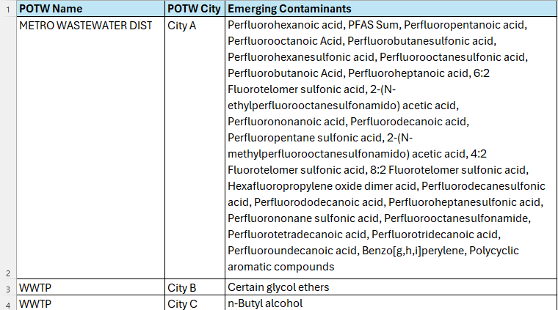
Emerging Contaminants and PPL Connection Tool
Tool identifies a broad range of chemicals
Not all listed chemicals will be ECs
POTWs can consider treating for these ECs
Notes:
The analysis of one state’s PPL resulted in 17 POTWs receiving a range of ECs.
One of the main reasons we are doing this internal leg work and making it a publicly available tool is because there needs to be additional verification by the applicant to make sure the EC is still being sent the said WWTP and that the proposed tech will effectively remove some or all. TRI’s current data is 2022, so the last piece of final verification would need to happen by the applicant or the State.

Slide 29
Case Studies

Slide 30

EC Project Case Studies
PFAS Destruction in Biosolids Technology Pilot
PFAS, PPCPs
City of Orlando, Florida
Land Application of Biosolids and Yard Waste Compost Demonstration Project
PPCPs, Microplastics, and PFAS
City of Norman, Oklahoma Water Reclamation Facility
Septic-to-Sewer Conversion
PPCPs
Southern Nevada Water Authority/Las Vegas Valley Water District
South Thornton Natural Drainage System Installation, Stormwater Pollution Prevention
6PPD, 6PPD-quinone
City of Seattle Public Utilities
Laboratory Equipment Purchase
PFAS, Lithium, 1,4-Dioxane
Montana Department of Public Health and Human Services
Soliciting Source Water Protection Planning Projects
PFAS, 1,4-Dioxane
New York State
POTW Water Pollution Control Emerging Contaminants Project
PFAS
City of Cedar Rapids, Iowa
Landfill Leachate Treatment Project
PFAS
Town of Conway, New Hampshire
Lake Thunderbird Emerging Contaminants Assessment Project
PFOS, pesticides, PPCPs, hormones
Central Oklahoma Master Conservancy District
Reclaimed Water Emerging Contaminants Project
PFAS, 1,4-Dioxane
City of Tucson, Arizona
Wastewater Treatment Plant Lagoon Decommissioning and Sludge Disposal
PFAS
City of Belding, Michigan

Slide 31

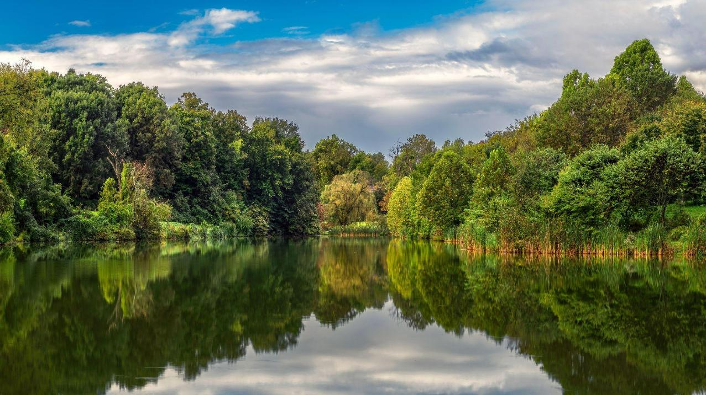

Clean and Sustainable Destruction of Organic Waste
Implementing a Demo Supercritical Water Oxidation (SCWO) system in Orlando, Florida
CIFA SRF Workshop - November 2024
©2024 374Water Inc. All Rights Reserved. This document and the information set forth herein are the property of 374Water.

Slide 32

Learning Objectives
How to apply for Clean Water SRFs for demo projects
Carrying out an SRF funded demo for sludge treatment
What is SCWO & how does it apply to biosolids management
What comes next & how to fund it
Page 32

Slide 33

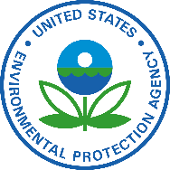
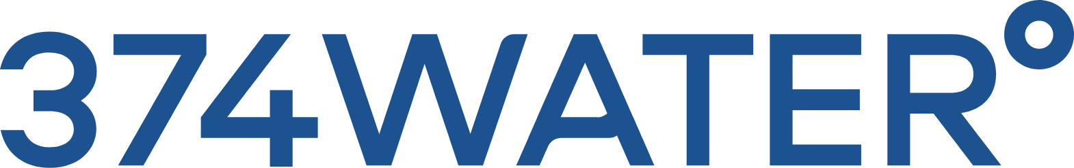

Project Collaborators
Provides SRF funding
Shares data
Distributes SRF funding
Shares
data
Hosts 374Water's technology on-site
Designs, manufactures, installs, operates technology
Page 33
Notes:
Firstly, I'd like to emphasize the collaboration between all parties involved in the project. As the name of this workshop suggests, this project was enabled by SRF funding which is ultimately provided by EPA to the Florida Department of Environmental Protection, and then distributed to various parties such as the City of Orlando's Public Works Department. The City of Orlando has been working closely with us, 374Water, to use this SRF funding for an on-site demonstration of our technology at one of the City's wastewater treatment plants. As we run this system both the City and ourselves are working with the EPA to collect and share appropriate data that inform the tools and databases that were just talked about in previous presentations.

Slide 34
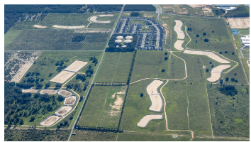
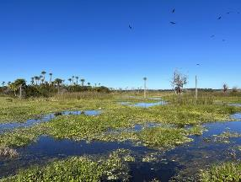
SRFs in an age of innovation
Main project enablers:
The City of Orlando: is uniquely committed to R&D and innovating, some examples:
  Water Conserv II facility: "Zero Discharge" method
  Iron Bridge Wetlands: polishes effluent, supports aquatic plants & wildlife
SRF Funding: funds ---> demo (or permanently install) new technologies ---> less risk of large expenditures on new tech
Policy: increased stringency on nutrient loading and contaminant removal support companies with innovative wastewater treatment tech
Water Conserv II infiltration Basins
Iron Bridge Wetlands
Page 34
Notes:
There are three main project drivers and first I want to especially highlight the City of Orlando and their commitment to pursuing R&D efforts and implementing innovative wastewater solutions. Two completed projects I'd like to point out are their Water Conserve Two facility which employs a zero discharge method whereby the treated effluent is used for irrigation of citrus groves & groundwater recharge. Additionally they have completed the construction of the Iron Bridge Wetlands, a large wetland designed to polish treated effluent for enhanced nutrient removal while supporting millions of aquatic plants and wildlife. A second driver is the SRF funding itself which reduces risks for utilities who may not have the budget to try, either as a demo or permanent install, technologies that are not commonly used at scale yet. And finally the third driver is policy which is becoming more and more stringent and demanding technological solutions that push past the capability of traditional wastewater treatment processes.
Irrigation basins pic source: Reclaimed Water Process - Water Conserv II
Wetlands pic source: Orlando Wetlands Park is absolutely gorgeous : r/orlando

Slide 35
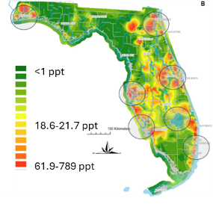
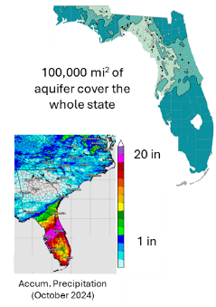
Project Motivation & Goals
Goal 1: implement an all-weather solution that reduces dependence on land application
Goal 2: eliminate PFAS from the treatment residuals needing management
Why? SB 712 restricts biosolids land application when groundwater is within 2 feet of the surface
Why? Proactive measure in response to potential PFAS in wastewater/biosolids regulations
PFAS levels in surface water around FL can be very high (>50 ppt)
Proactive measures to reduce impact of WWTP effluents & residuals is vital
Florida's Large groundwater network & wet weather ---> frequent restrictions
Predicted total surface water PFAS levels
(based on empirical data)
ACS EST Water 2024, 4, 10, 4343-4355
USGS
Page 35
Notes:
FL has an immense network of aquifers, as you can see on the picture to the left where all the shades of teal represent aquifer coverage. To the map just on the right of it you'll see a comparison of precipitation in FL to other southeast states which really highlights how "wet" the state is. The confluence of these two features creates conditions where the groundwater rises to levels close enough to the surface that the application of biosolids can lead to the spread of excess nutrients to waterbodies. Thus, FL has a Senate Bill 712 that restricts the application of biosolids when groundwater is within 2 feet of the surface. This happens frequently and results in the storage of odorous biosolids on site. This is a major driver for the City's primary goal of implementing an all-weather biosolids management solution that reduces dependence on land application. Secondly, as we touch on in the last slide regulations for contaminants such as PFAS are becoming more stringent so Orlando is being very proactive in implementing an all weather solution that also eliminates PFAS. This is especially important in the FL ecosystem where local groundwater is susceptible to PFAS contamination and is the major source of drinking water.
Florida aquifer map: Groundwater Tracing | GUE, statistics to go with it: Floridan aquifer system | U.S. Geological Survey

Slide 36
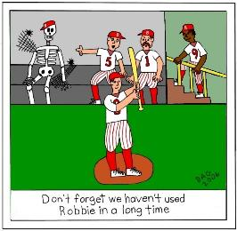
Technology Evaluation
 | Composting | Drying w/Pelletization | Incineration | SCWO
CAPEX | Low | High | High | High
OPEX | High | High | High | Medium
End-product | Class B biosolids | Class A biosolids | Ash | Minerals
Organic CEC destruction | Low | Low | Medium | High
Main challenge | 3rd party dependent | Labor intensive | Air permitting | Limited full-scale data
SCWO needs more "game time"
the City of Orlando, SRF funding, and policy drivers are enabling that!
Page 36
Notes:
The City undertook an evaluation of various options, and it became clear that SCWO has the technical capacity to meet the project goals as related to residuals management and PFAS treatment efficiency. The ultimate challenge in choosing SCWO is the lack of existing full-scale data to purchase a permanent installation. This highlights the benefit of SRF funding which enables utilities to test out SCWO as a demonstration to help gather this data and determine if the fit is appropriate to the wastewater treatment plant in question.

Slide 37
Project Funding
SRF Application Components:
Schedule
  Planning documentation, engineering design, certification of site availability, permitting*
Requested loan amount
Pilot study plan
Request for Inclusion submitted February 14, 2023, awarded on February 22, 2023
Note: aside from staff time, the demo was funded 100% by the SRF grant
Task | Cost
Schedule 1 – System Design & Site Prep | $52,000
Schedule 2 – Mob, Install, Commission, Start-up | $118,000
Schedule 3 – Operation & Maintenance | $574,000
Schedule 4 - Demobilization | $68,000
Total | $812,000
*Note that in this case permitting was not required as it was a demonstration study
Page 37
Notes:
To be written….

Slide 38
Project Implementation
SRF Grant agreement signed February 2024
Pilot agreement with 374Water signed February 2024 after receipt of grant agreement
Evaluate site & design SCWO system
(March -June)
Mobilization, Installation, Commissioning, & Startup
(July -September)
Operation & maintenance
(Nov-Feb)
Decommissioning, Disassembly, & Demobilization
(TBD, may enter into long term lease )
Page 38
Notes:
To be written…

Slide 39
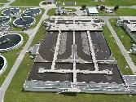
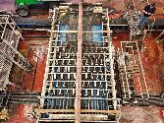
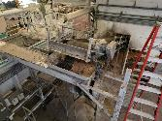
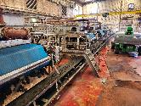
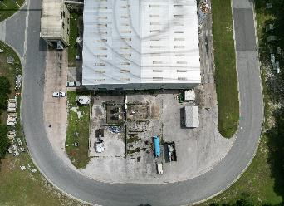
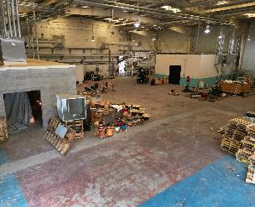
Project Implementation – Site Evaluation Stage
374Water AirSCWO Site Requirements
Iron Bridge Water Reclamation Facility
Water
  Hose or tap connection
  Discharge or storage for distilled water
  Discharge of SCWO effluent to headworks
Electricity
  400/480 3 Phase, 200 Amps max draw during start-up
Fuel storage (~50 gal)
Pre-treatment equipment*:
  Dewatering
  Maceration
  Screening
40 MGD Max / 25 MGD AADF
~56,000 wet tons sludge/ year (13.8% DS)
*Can be included in project scope if not pre-existing at site
Page 39
Notes:
374Water’s AirSCWO system has fairly typical site requirements and comes skidded in a shipping container (we will see pictures on the next slide). The site requirements are listed to the left and cover water, electrical, and startup/shutdown fuel demands. In terms of pretreating the waste prior to the AirSCWO system, traditional equipment for dewatering, maceration and screening is used. On the right are some pictures from the initial site visit to the Iron Bridge Water Reclamation facility where the AirSCWO 6 demo is located. As you can see the demo utilizes open space the plant had both within the enclosed building space and just outside it. The process follows pre-installed sludge dewatering equipment.

Slide 40
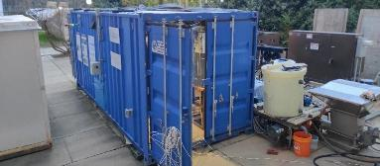
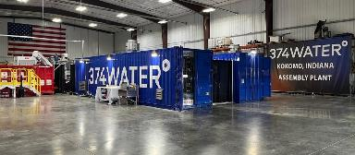
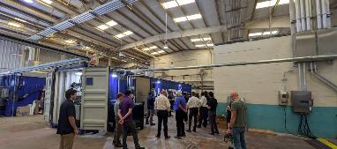
Project Implementation – System Design
2013
Duke University in Durham, NC built first air-based SCWO system
AS1 was capable of processing 1 wet ton per day
Nearly 190 different wastes processed over ~10 years
2022
First commercial scale unit built in Kokomo, IN
AS6 is capable of processing 6 wet tons of waste per day
2024
AS6 unit deployed at the City of Orlando, FL
Page 40
Notes:
374Water’s AirSCWO technology has gone through extensive R&D and testing, starting in 2013 at Duke University. The system has treated over 100 different types of wastes and has been commercially scaled to treat up to 6 wet tons per day. The AirSCWO 6 demo is now up and running in Orlando to test wastewater sludge and other various PFAS containing wastes.

Slide 41
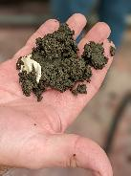
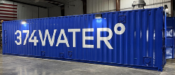
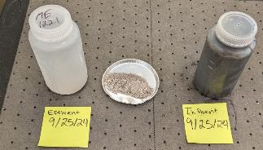
Project Implementation – System Installation
SLUDGE
PRE TREATMENT & CONDITIONING
AIRSCWO
POST TREATMENT
TREATED WASTE DISCHARGE
Maceration
Pre-Heating
Clarification
Screening
AirSCWO Reactor
Filtration
Dewatering
Heat Recovery
Disinfection
PRE TREATMENT & CONDITIONING
AIRSCWO
POST TREATMENT
Macerate & remove inorganics (>2-4mm)
Adjust %DS to make pumpable & energy rich
Page 41
Notes:
Here is a graphic visual of how the AirSCWO fits into an existing WWTP. The sludges undergo basic pretreatment, are run through the enclosed SCWO system, and on the backend there is a liquid effluent stream containing ~3-5% inorganics which can be separated and dried for easier handling. At the demo, the liquid effluent goes back to head of plant; solids to dumpster.

Slide 42
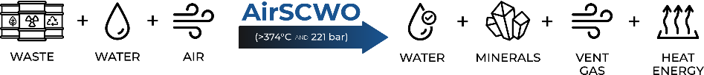

Project Implementation – Operation (AirSCWO Concept)
What happens inside the AirSCWO reactor?
The sludge, water, air mixture is heated & pressurized (>374°C and >221 bar)
The water in this mixture becomes supercritical water, a fluid that easily dissolves organics (e.g. PFAS) and gases (e.g. O₂)
Organic compounds break into their elements, carbon gets converted to CO₂ (g), nitrogen is converted to N₂ (g) , and inorganics are oxidized
Example reaction:
2 CF₃(CF₂)₆COOH + 7 O₂ + base
H₂O + 15 F₂ salt + 31 CO₂ + ~8276 kJ/mol
(PFOA)
(air)
Page 42
Notes:
Although this is a mostly non-technical talk, I do want to take a moment to provide a high-level explanation of what exactly happens in the reactor on a conceptual level. You can see from this linear graphic at the top that our inputs are waste (such as sludge), water, and compressed air. This mixture is sent through the enclosed AirSCWO system and on the back end we get an effluent stream composed of mainly water and some inorganic minerals, vent gas which is predominantly CO2 and N2, and excess heat which is used within our system to keep the reactor at temperature and thus reduce energy demand. Inside this AirSCWO system the mixture is heated and pressurized above 374degC and 221 bar, which causes the water in the mixture to become a fluid called supercritical water. Supercritical water is able to dissolve organics, such as PFAS, and gasses, such as oxygen in the air, which allows for the rapid destruction of all organics in the waste. These organics break down into their elements and all the carbon is converted to CO2. The example reaction at the bottom illustrates what happens to an organic compound that we find complex, but that the SCWO system does not. PFAS, such as PFOA in this example, are completely broken down into their elements. The carbon gets converted to CO2, the hydrogen combines with oxygen to produce water, and the fluorine combines with other components of the waste to form inert fluoride salts, such as calcium fluoride, a major component of toothpaste.

Slide 43
Project Implementation – Operation (AirSCWO Performance)
Goal 1: implement an all-weather solution that reduces dependence of land application*
Data collection on % reduction of residuals requiring handling is ongoing (at ~3 month mark it will be assessed)
Goal 2: eliminate PFAS from the treatment residuals needing management
PFAS Compound | Detected Residual PFAS (ng/L or ppt) | % Removal
PFBA | 10.2 | 99.86%
PFHxA | 5.15 | 99.89%
PFNA | 1.07 | 99.90%
PFDA | 0.8 | 99.97%
PFUnA | <1.10 | > 99.89%
PFBS | <0.19 | > 99.98%
PFPes | <0.29 | > 99.98%
PFHxS | 0.28 | 99.99%
PFOS | 0.65 | 99.99%
*while not detrimentally impacting the plant with process effluent
Page 43
Notes:
To be written….

Slide 44
Next Steps
Complete a successful pilot study
Share results with the FDEP/EPA
Orlando receives part 2 of the grant for design, construction and installation of AirSCWO 30
Enter into long term relationship with Orlando to continue operations of the AirSCWO 6 to test other PFAS contaminated materials
Build and test AirSCWO 30 at Iron Bridge
Relocate AirSCWO 30 to Orlando's Water Conserv I facility, the City's smallest of three treatment plants which processes an average of 5.5 MGD
The AirSCWO 30 should be capable of handling all sludge produced at Conserv I for the immediate future
Page 44
Notes:
To be written….

Slide 45
Takeaways & Tips
Best advice – reach out to your stat's SRF grant coordinator and see if they have any Clean Water (wastewater) emerging contaminants funding available
If so, put together a draft proposal for their consideration and present to the state for review
Find out what the approval cycle is for SRF projects and get on the list.
Bottom line: SRF Funding enables wastewater facilities that may not otherwise have the means to take on new R&D projects that can save $$, make meeting permits easier, and better protect the environment and human health
Page 45
Notes:
To be written….

Slide 46
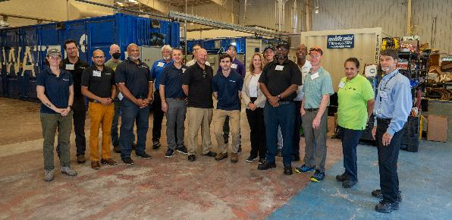
THANK YOU
Many thanks to:
US EPA, FL DEP, The City of Orlando, & all at 374Water, who each have uniquely contributed to get this demo off the ground
Visit 374Water.com or contact
Naomi Senehi, M.S. / naomi.senehi@374water.com
Sudhakar (Sunny) Viswanathan, M.S. / Sudhakar.viswanathan@374water.com
Nasdaq: SCWO
Page 18
Notes:
To be written….

Slide 47
Discussion

Slide 48
Discussion Topics
Outreach efforts to build an EC project pipeline
Using EPA’s tools and resources
How demonstration projects impact future project development
Building laboratory capacity
Notes:
Key Points
No limit for demonstration projects. Demonstration projects for the same technology/process can occur in multiple states (e.g., SCWO projects in multiple states)

Slide 49
Discussion Topic:
What kind of efforts have you pursued to build your CWSRF EC project pipeline?

Slide 50
Discussion Topic:
How could you use EPA’s resources and tools to build the EC project pipeline?

Slide 51
Discussion Topics:
For those that are funding a demonstration or pilot project, how do you envision those helping to create more projects in the future?
Notes:
Key Points
No limit for demonstration projects. Demonstration projects for the same technology/process can occur in multiple states (e.g., SCWO projects in multiple states)

Slide 52
Discussion Topics:
How are you building laboratory capacity?

Slide 53
Call for CWSRF EC Project Data
Project type
EC addressed
Technology utilized
Results: What was the fate of the EC(s)?
Notes:
For example, X state is providing X data currently.

Slide 54
Connect with Us
CWSRF Emerging Contaminants Website:
https://www.epa.gov/cwsrf/clean-water-state-revolving-fund-emerging-contaminants
EPA’s Emerging Contaminants Team: cwsrfEC@epa.gov

Slide 55
Appendix slides from here on out if needed during discussion

Slide 56
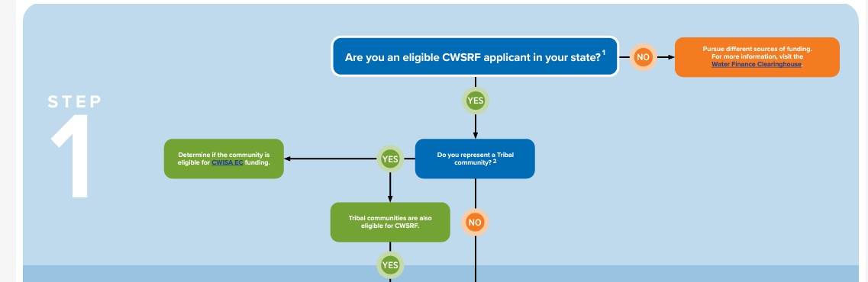

Slide 57
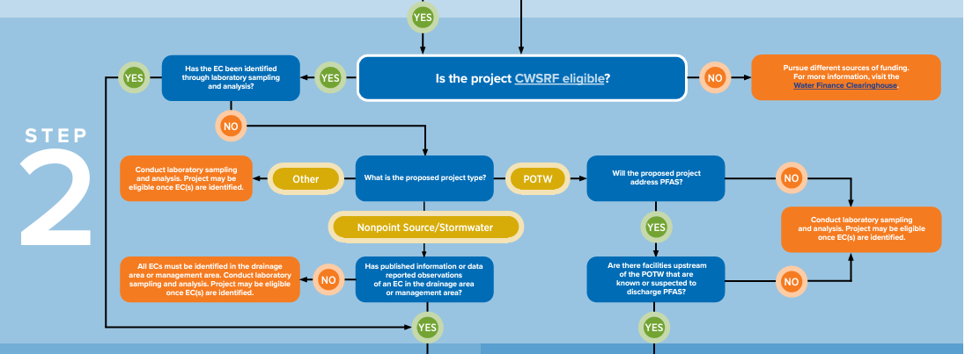

Slide 58
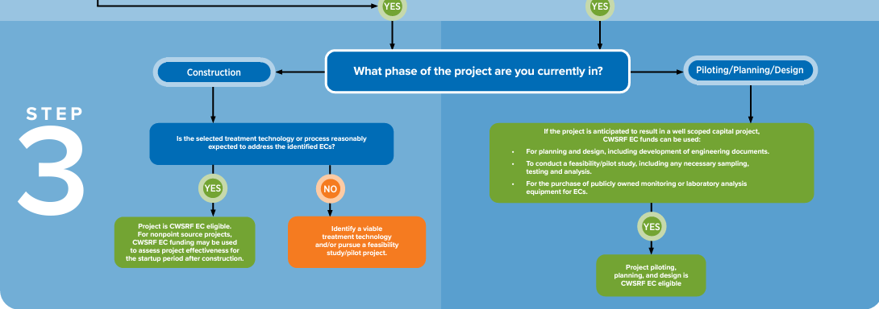

Slide 59
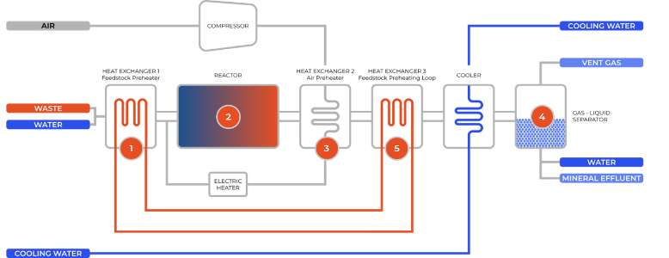
Project Implementation – Operation (AirSCWO Process)
1. Slurried wastes and compressed ambient air heated towards 374ºC
2. Waste/air mixture oxidizes in reactor at P>221 bar and T > 374ºC
3. Ambient air is compressed and pre-heated prior to mixing with slurried waste
4. Gasses, liquids, and solids (minerals) are separated by lowering the pressure and temperature
5. Heat is recycled to the front of the process, enabling economic operation amidst higher operating temperatures
The system operates continuously and is protected by multiple patents.
Page 59
Notes:
Here is a mechanical look at how the system operates, which we wont go through today, but illustrates how the components of the AirSCWO system are typical and do not require specialized certifications to maintain, troubleshoot, or operate. The system is designed for continuous operation.

