Slide 1
Big Data, Many Data
(on Water Utilities)
Shadi Eskaf
Senior Project Director
Environmental Finance Center at the University of North Carolina
CIFA Conference 2016
November 1, 2016
Austin, TX

Slide 2
Water Utility Data in 1 State
(using the example of North Carolina)
Number and types of systems and governance structures
Location of systems and service area maps
Interconnections of water systems
Water sources and water supply levels
Technical performance of systems
Financial performance of systems
Managerial performance of systems
Operator certification
Capital needs estimates and projections
Capital expenditures and costs
Debt history
Rates and charges
System-wide water demand trends and projections
Customer-level water demands
Non-revenue water
Growth rate of customers
Socioeconomic and demographic data of customers
and more but I ran out of space!
Notes:
Answers:
SDWIS. LGC. EFC/NCLM/NCACC/SOG/NCAWWA-WEA/RWA
SDWIS. NCOneMap. LWSP. EFC.
SDWIS. LWSP. EFC.
LWSP. No water permitting system in NC. No water markets.
SDWIS (violations). Sanitary Surveys.
Financial statements. LGC. Sanitary Surveys.
WSMP / combo of other related technical and financial indicators / PWSS sanitary surveys. Completion of trainings and workshops (EFC/SOG, RWA, NCAWWA-WEA)
NC water treatment facility operators certification board
EPA needs surveys. CIPs or planning documents of utilities. Funding applications (SWIA/DWI, Dept of Commerce, USDA)
Census of local governments finances. Financial statements. ENR’s CCI. Funding agencies.
LGC. Credit rating agencies.
Utility’s rate sheets and surveys conducted by entities (EFC, Logics). Listservs!
LWSP. LGC AFIR. Utilities themselves and entities that survey them (EFC)
Utilities themselves (and entities that get billing data: e.g. EFC/UNC
LGC AFIR. LWSP. No centralized database like TN or GA.
State demographers or Census Bureau. Trends in number of accounts. Master plans of towns. Developers’ permits.
Census Bureau and State demographers. Maybe universities. Customer Service surveys by utilities. Surveys conducted for funding purposes (e.g. CDBG)

Slide 3
Water Utility Data in 1 State
(using the example of North Carolina)
Number and types of systems and governance structures
Location of systems and service area maps
Interconnections of water systems
Water sources and water supply levels
Technical performance of systems
Financial performance of systems
Managerial performance of systems
Operator certification
Capital needs estimates and projections
Capital expenditures and costs
Debt history
Rates and charges
System-wide water demand trends and projections
Customer-level water demands
Non-revenue water
Growth rate of customers
Socioeconomic and demographic data of customers
Centralized data at
more than 20 organizations/departments,
not counting data at the individual utilities or towns.
And that’s just for the drinking water systems.
Notes:
EPA. PWSS. DWI/SWIA. DWR. WTFOCB. LGC. NCLM. NCACC. EFC/SOG/universities/Logics/RFC in general. NCAWWA-WEA. RWA. NCOneMap. NC Dept of Commerce. USDA. Credit Rating agencies (3). ENR. Census Bureau. State Demographers.

Slide 4
Consider the potential of connecting these data sources
Number and types of systems and governance structures
Location of systems and service area maps
Interconnections of water systems
Water sources and water supply levels
Technical performance of systems
Financial performance of systems
Managerial performance of systems
Operator certification
Capital needs estimates and projections
Capital expenditures and costs
Debt history
Rates and charges
System-wide water demand trends and projections
Customer-level water demands
Non-revenue water
Growth rate of customers
Socioeconomic and demographic data of customers
Notes:
Answers:
SDWIS. LGC. EFC/NCLM/NCACC/SOG/NCAWWA-WEA/RWA
SDWIS. NCOneMap. LWSP. EFC.
SDWIS. LWSP. EFC.
LWSP. No water permitting system in NC. No water markets.
SDWIS (violations). Sanitary Surveys.
Financial statements. LGC. Sanitary Surveys.
WSMP / combo of other related technical and financial indicators / PWSS sanitary surveys. Completion of trainings and workshops (EFC/SOG, RWA, NCAWWA-WEA)
NC water treatment facility operators certification board
EPA needs surveys. CIPs or planning documents of utilities. Funding applications (SWIA/DWI, Dept of Commerce, USDA)
Census of local governments finances. Financial statements. ENR’s CCI. Funding agencies.
LGC. Credit rating agencies.
Utility’s rate sheets and surveys conducted by entities (EFC, Logics). Listservs!
LWSP. LGC AFIR. Utilities themselves and entities that survey them (EFC)
Utilities themselves (and entities that get billing data: e.g. EFC/UNC
LGC AFIR. LWSP. No centralized database like TN or GA.
State demographers or Census Bureau. Trends in number of accounts. Master plans of towns. Developers’ permits.
Census Bureau and State demographers. Maybe universities. Customer Service surveys by utilities. Surveys conducted for funding purposes (e.g. CDBG)

Slide 5

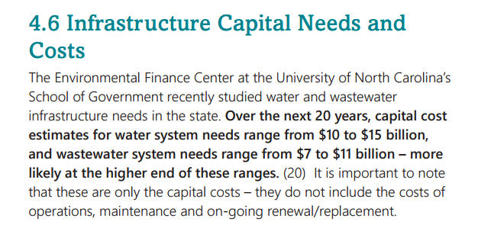
Example:
Examining the capital needs in NC
EPA needs surveys + utilities’ C.I.P.s →
projected statewide needs (beyond EPA’s
focus)

Slide 6
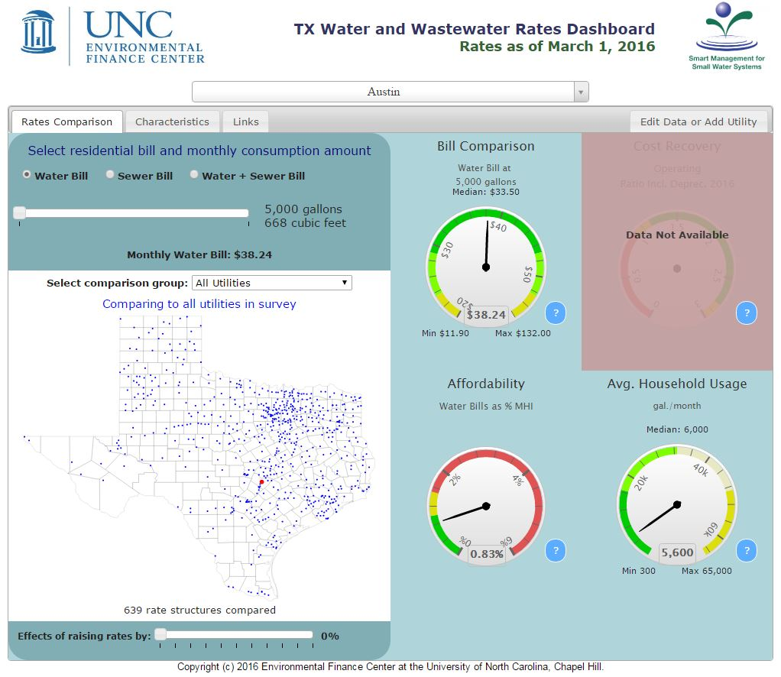
Example:
Rates Dashboard in Texas

Slide 7
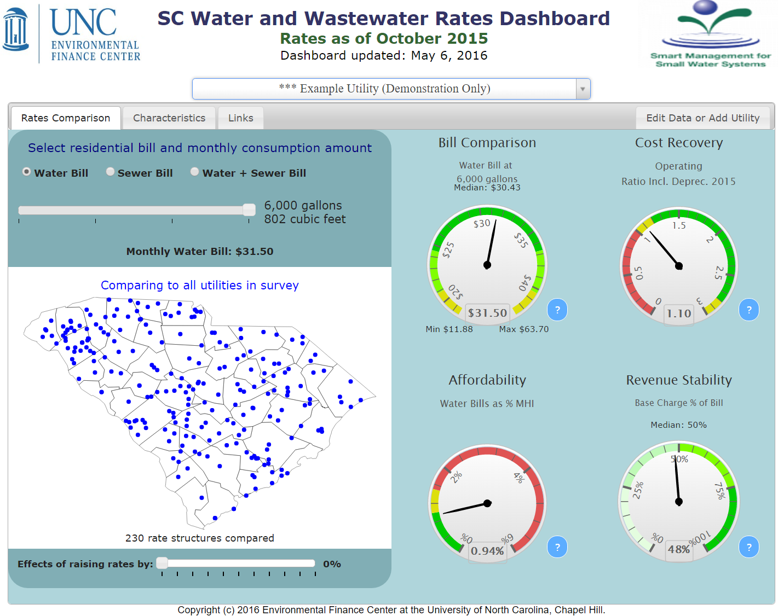
Example:
Rates Dashboards

Slide 8
Challenges
Access to the data
Merging the data
Purpose and definition of the data
Completeness of data (scope and scale)
Unfamiliarity and quality checking the data
Inconsistencies across data sources
Resources and skills required to merge, manage, and analyze the data

Slide 9
But the benefits are huge
Comprehensive statewide planning and policy-making
Better monitoring and assessment or performance measurement
Targeted actions based on trends and correlations identified
Collaboration between agencies with potential for consolidation of efforts and coordination of actions
Improved knowledge retention and transfer

Slide 10
Want to talk about the data in your state?
Shadi Eskaf
Senior Project Director
Eskaf@sog.unc.edu
919-962-2785
Environmental Finance Center at the University of North Carolina
School of Government, Knapp-Sanders Building
CB #3330
Chapel Hill, NC 27599-3330
USA

