Slide 1
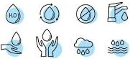
Water Finance Exchange:
CIFA SRF Workshop 2024

Slide 2
Comprehensive Technical Assistance
Organize Plan Prioritize Fund Impact
Water Finance Exchange (WFX), a 501(c)(3), is a trusted intermediary that works closely with federal and state stakeholders, communities, philanthropy, and the financial sector to address the water infrastructure funding shortage facing thousands of communities across the U.S.
WFX believes water infrastructure is more than pipes and pumps, it is a catalyst for economic development and a cornerstone for public health and environmental needs. All communities should have water and sanitation that is affordable and sustainable.
www.waterfx.org

Slide 3
Lessons Learned
North Texas – Investor-owned utilities under receivership wanting to be acquired. 283 connections, four wells, four neighborhoods.
Coastal Bend Texas – Economic development opportunity for a small WSC being operated by a regional Authority
South Texas – Small County with several colonias and WSCs in poor condition. County desires to step up
West Texas – Small disadvantaged county steps us to help 9 communities, including colonias and unincorporated areas
www.waterfx.org

Slide 4
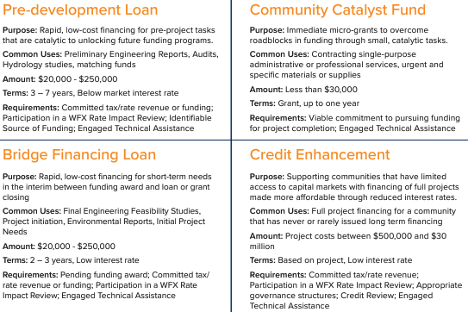

Innovative Financing
Learn more at:
www.waterfx.org

Slide 5

Questions? www.waterfx.org
Rogelio Rodriguez Director, Texas Infrastructure rrodriguez@waterfx.org | Lia Clark, EIT, MEng Community Engagement Manager, Texas lclark@waterfx.org

