Slide 1
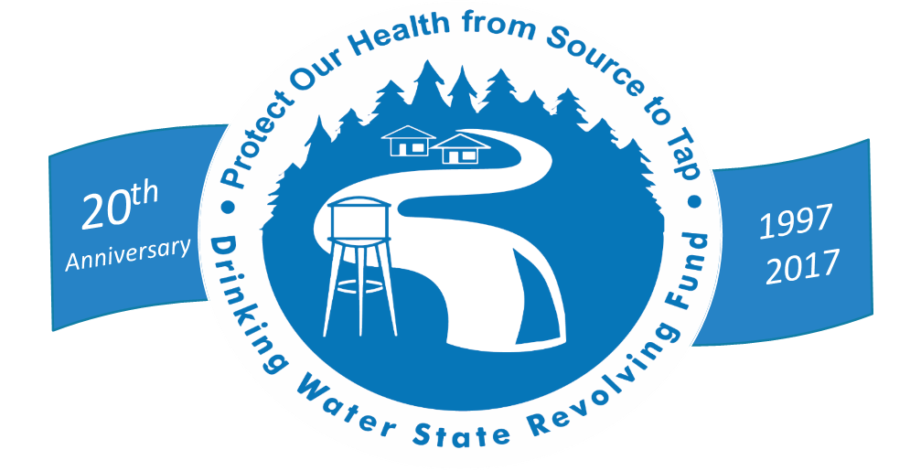
The DWSRF Looks Forward
Expanding the Reach of Safe Drinking Water

Slide 2
DWSRF Through 20 Years
$35.4 Billion
in Projects Funded
$3.0 Billion
for Capacity Building, Operator Certification DWSRF & PWSS Support
13,800
Loans Signed
$30.8 Billion
in Project Disbursements
Notes:
Since 1997, the DWSRF has turned $19 billion of the American Taxpayers investment (the capitalization grants) into $35 billion in assistance to projects
nearly 14,000 loans to drinking water systems.
nearly $31 billion disbursed to projects to improve DW infrastructure in communities.
We’ve allotted $3 billion to the non-infrastructure, capacity-building and prevention-focused set-asides.
The set-aside funds:
help communities implement cost-effective infrastructure projects,
Protect source water
Certify operators
Ensure that drinking water systems have TMF capacity.
You have had a big impact on the nation!
Just last year – in state fiscal year 2017 -- the DWSRF loan program touched the lives of nearly 78 million Americans
Gift that keeps on giving - benefits continue for useful life of project.
The DWSRF average interest rate in 2017 was 1.6%, compared to 3.3% market-value interest rate.
over $551 million in savings over the life of these loans.
We have a lot to be proud of.

Slide 3
Agency Priority Goal
By September 30, 2022, reduce the number of community water systems (CWSs) out of compliance with health-based standards from 3,600 to 2,700.
A 25% reduction
As of October 2017, 3508 CWSs were out of compliance with at least one health based standard in the previous 12 months.
Notes:
The FY 2022 target of 2,700 systems represents a 25% reduction (from FY 2017 baseline and universe

Slide 4
Population Category | Number of Community Water Systems | Population Served by CWS | CWSs w/HB Violation | % CWSs w/HB Violation by System Size
<=500 | 27,535 | 4,627,120 | 1,924 | 7.0% of this system size
501-3,300 | 13,405 | 19,252,089 | 983 | 7.3% of this system size
3,301-10,000 | 5,002 | 29,288,281 | 343 | 6.9% of this system size
10,001-100,000 | 3,886 | 111,503,116 | 239 | 6.2% of this system size
>100,000 | 431 | 142,221,107 | 19 | 4.4% of this system size
Grand Total | 50,259 | 306,891,713 | 3,508 | 7% of all CWSs
Based on FY17 SDWIS data (October 2017)

Slide 5
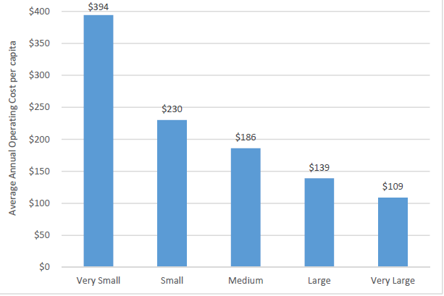
Smaller systems can face unique challenges
Average Annual Operating Costs Per Capita
Difficulty in recruiting and retaining operators
Lack of funding or knowledge of financing options
Diseconomies of scale
fewer households = higher costs per household
Rate structures that do not cover the current and future costs of providing service
Limited financial resources and technical knowledge make it difficult to address issues, such as inadequate or aging infrastructure and limited/poor source water quality/quantity
Indiana Finance Authority
Evaluation of Indiana’s Water Utilities. 2016.

Slide 6
Community Water Systems with Health-Based Violations for FY17
3,508 systems

Slide 7
2022 Target

Slide 8
PWSS and Finance Programs Work Hand-in-Hand to Ensure Public Health Protection and SDWA Compliance
System Compliance
Capacity Development Partnerships
Infrastructure
Asset Management
Technical Assistance
SDWA Implementation
Infrastructure Loans
State Program Funding
DWSRF
Set-Asides
PWSS
Grants

Slide 9
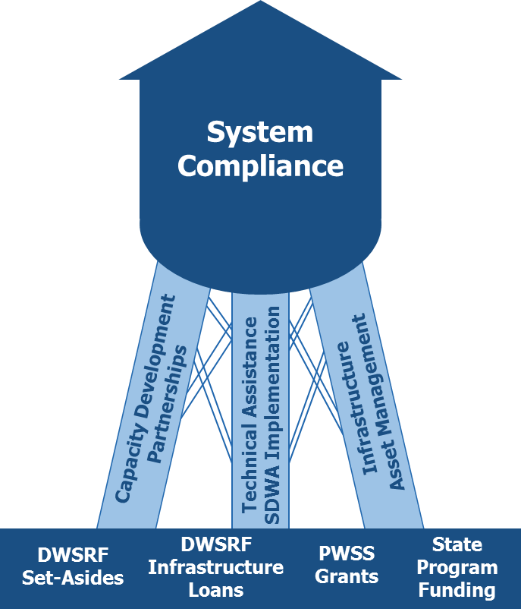
Program Collaboration to Achieve Success
Continue and enhance existing collaboration:
Give priority consideration to infrastructure projects addressing the most serious risk to public health, compliance and household affordability
Primacy and funding agencies collaborate when working with systems receiving DWSRF loans to ensure the DWSRF funds are put to effective use
Use capacity assessments conducted by the primacy program to ensure that a water system is viable before lending DWSRF funds to the system
Coordinate use of set-asides to provide technical assistance (e.g., board management training, operator training) to addresses capacity concerns
Collaboration between programs advances capacity development goals, making more water systems eligible to apply for infrastructure financing
Notes:
Along with establishing the DWSRF Program, the 1996 Amendments to SDWA also established the Capacity Development and Operator Certification Programs.
The DWSRF set-asides were intended to support the implementation of these programs and provide an incentive for state action on capacity development and operator certification. The Amendments also do not allow DWSRF assistance for systems lacking capacity, unless assistance will enable the system to gain capacity. The SDWA requires the state’s drinking water primacy agency, specifically the Public Water System Supervision (PWSS) program, to determine the state’s DWSRF priorities.
The PWSS program must lead annual development of the DWSRF Intended Use Plan (IUP) for infrastructure project funding and all of the set-asides.
This ensures that public health goals are met and that the water system will maintain or increase capacity, as well as ensuring a steady stream of DWSRF loan disbursements.
The state drinking water programs should work towards common goals and a shared vision of the DWSRF’s purpose to support the delivery of safe drinking water.

Slide 10
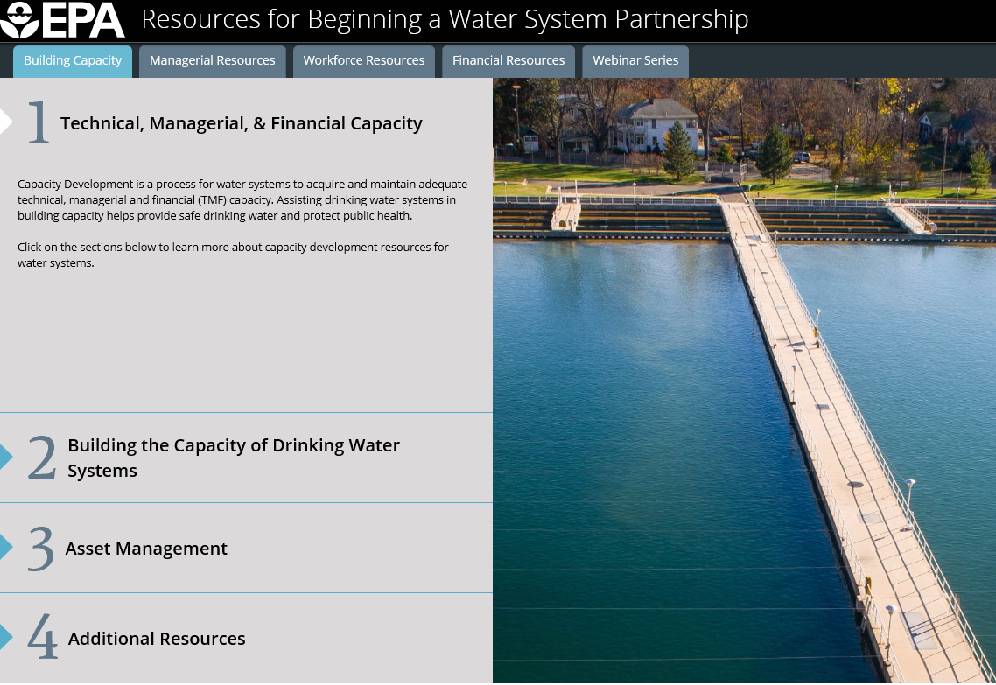
Water System Partnership Resources
Notes:
This website serves as a resource hub to help you access tools to get your partnership started.

Slide 11




Water Systems Partnerships
Partnerships provide opportunities to increase system capacity through collaboration
Benefits of Partnerships
For Systems
Economies of scale
Increase technical, financial, and/or managerial capacity
Long-term savings
Improved customer service
Planning for future operations
For State Programs
Improved compliance
Potential reduction in number of regulated systems
Resource savings
Improved customer relations
For Customers
Improved water quality
Reduced long-term cost/lower water bills
Increased reliability of supply
Notes:
Partnerships/Small Water Systems
More than 97% of the nation’s 156,000 public water systems are small systems, meaning they serve 10,000 or fewer people. A public water system (PWS) is a system that provides water for human consumption to at least 25 people or 15 service connections.
PWSs include:
Municipalities
Small towns
Homeowners associations
Other kinds of facilities like schools, restaurants or campgrounds
Small water systems can face unique financial and operational challenges in consistently providing drinking water that meets EPA standards and requirements. EPA works closely with states and our federal and tribal partners to assist small systems with financial and technical resources to sustainably provide safe drinking water.
Capacity development is a fundamental component of the 1996 Safe Drinking Water Act (SDWA) Amendments.
The SDWA Amendments provide a framework for states and water systems to work together to protect public health.
Every state has developed a Capacity Development Program to assist public water systems in building TMF capacity.
Partnership efforts are an effective means of protecting source water through land conservation, implementation of best management practices, and other measures. States, local governments and utilities must play a leadership role in these efforts, engaging stakeholders to: identify and implement source water protection measures; leverage funding opportunities and green infrastructure finance; establish partnerships with land trusts and U. S. Environmental Protection Agency organizations, such as the National Association of Conservation Districts and Trust for Public Land; and promote innovative approaches, such as The Nature Conservancy and Environmental Defense Fund’s efforts to expand land conservation in areas that are critically important for protecting drinking water.
Support collaborative approaches to source water protection through EPA grant programs and other government/private initiatives such as the Source Water Collaborative.
EPA will promote efforts to leverage 319 grants program and funding through the USDA Natural Resource Conservation Service Environmental Quality Incentives Program to contribute to critical source water protections efforts, including nutrient reductions in watersheds that serve as sources for community drinking water supplies.

Slide 12
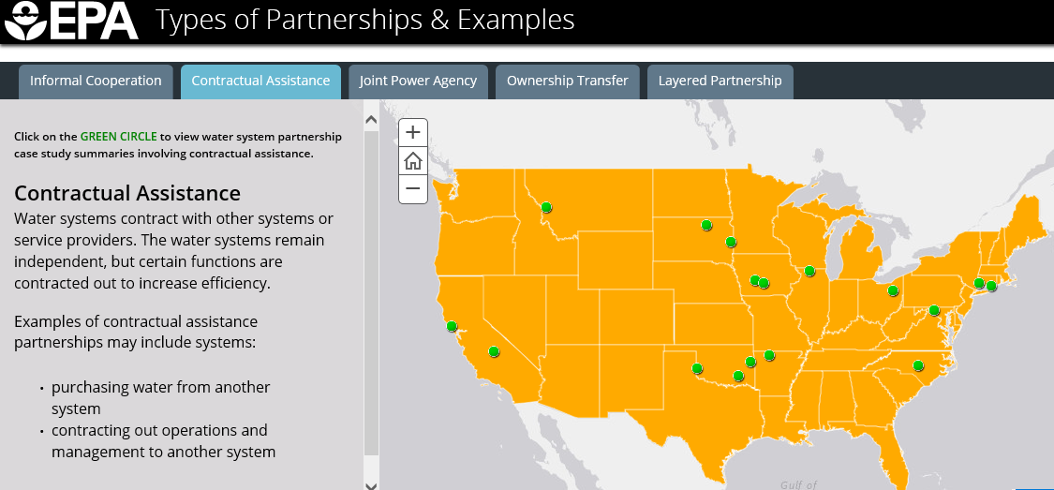
Interactive Case Study Map

Slide 13
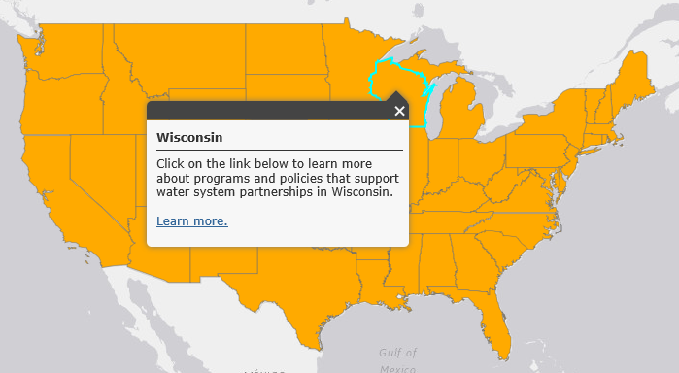
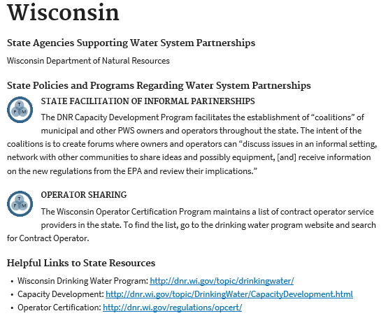
State Programs Supporting Partnerships

Slide 14
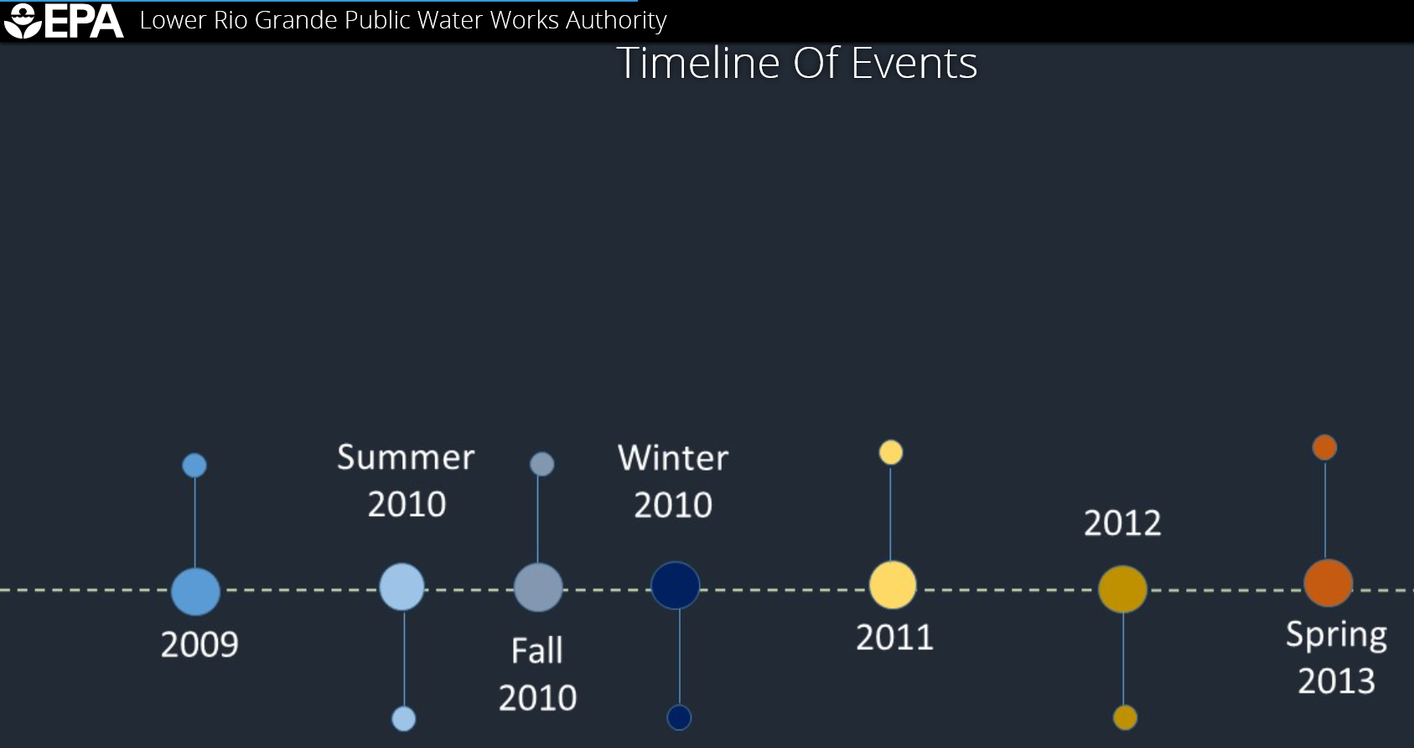

In-Dept Case Study: Lower Rio Grande
Key Players
With New Mexico OSE’s help, the Authority established LRGPWWA’s Service Area. The New Mexico State Legislature was also a key when it passed legislation that enabled the systems to merge.
Through a Community Development Block Grant (CDBG) from HUD, the Authority created a contract with Rural Community Assistance RCAC to develop the merger plan.
Notes:
2009
New Mexico passed House Bill 185, giving the LRGPWWA legal standing to discuss mergers with agencies. HB 185 allowed the systems to formally create the Authority in spring 2010 by meeting the following legal organizational requirements:
- Duns Number acquired
- Federal Tax ID number acquired
-State CRS number acquired
- Permanent address established
-Bank accounts opened
- Initial Board of Directors appointed
Summer 2010
The Authority had applied to the New Mexico Office of the State Engineer (OSE) for the Authority to transfer ownership and to combine and commingle the five founding associations’ water rights. The application process included several important steps.
1. The participating systems approved the transfer.
2. The systems transferred the relevant legal documents to OSE.
3. the Authority permitted mutual use of the combined water rights.
Fall 2010
The Authority contracted with the Rural Community Assistance Corporation (RCAC) to create a draft merger plan which was reviewed and approved by the Board of Directors. The merger plan included three key components: a regional governance structure and associated documents, an administrative and managerial approach, and an operations and implementation strategy. In addition, the LRGPWWA proposed and adopted uniform rates and fees across the partners.
Winter 2010
The LRGPWWA was fully operational, with the following components:
- A Public Water System ID Number, issued by NMED
- Staff hired with HR policies and procedures in place
- A fiduciary policy and procedure in place
- Accurate, uniform rates and fees
- A plan for existing and future debt
- Documented combined assets
2011
The founding mutual domestic water associations were dissolved and the Authority began preparing for its first board elections
2012
The Authority had grown by adding 3 additional systems to the partnership.
Spring 2013
The first board elections were held, resulting in a single board for all participating systems.

Slide 15
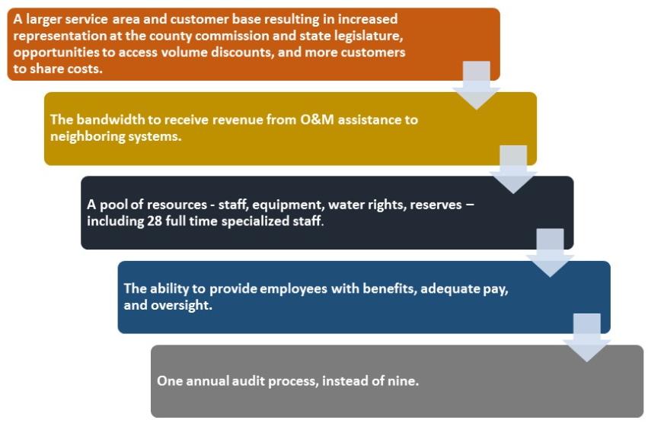
In-Dept Case Study: Lower Rio Grande
Notes:
Funding the Partnership
The funds to initially facilitate and merge the associations came from a refinanced USDA Rural Development (RD) loan provided by the New Mexico Finance Authority Public Project Revolving Fund. Over the year, additional funding was secured for partnership projects from state loan and grants programs including the New Mexico Colonias Initiative, Special Appropriation Program, Water Trust Board, NM – CITF, NM – Drinking Water State Revolving Loan Fund (DWSRLF), and New Mexico Finance Authority.
In addition, the Authority has also used federal funding programs, such as USDA RD and HUD CDBG, to fund partnership projects. Since inception, the LRGPWWA has secured $40M to fund 16 projects. The partnership allowed the systems to focus on their mission of providing safe affordable water services and allowed them to invest time in identifying and accessing funding to support their efforts
Realized Benefits
Water systems can realize significant benefits by combining through partnerships. The nine water systems that participate in the LRGPWWA currently serve 16 communities in three service areas that cover 100 square miles. The Authority includes two wastewater collection systems, one wastewater treatment facility, approximately 5,000 drinking water connections, and 500 wastewater connections. It serves a population of 15,000. The partnership has helped provide:

Slide 16
Keeping the Revolving Funds Revolving
Inflows
Federal Cap Grants State Match
Repayments
Interest Earnings Leveraging
Outflows
Project Disbursements
Notes:
With the significant drinking water need in mind, our next challenge is now clearly in focus: ensuring the deployment of the funds full power to deliver public health protection.
To do this, we need to make sure that fund inflows balance as much as possible with fund outflows.
This means that available cash is expeditiously moved to pay project disbursements, rather than being kept for a long time in bank accounts.
This balanced can be accomplished with cash flow management and program marketing.

Slide 17
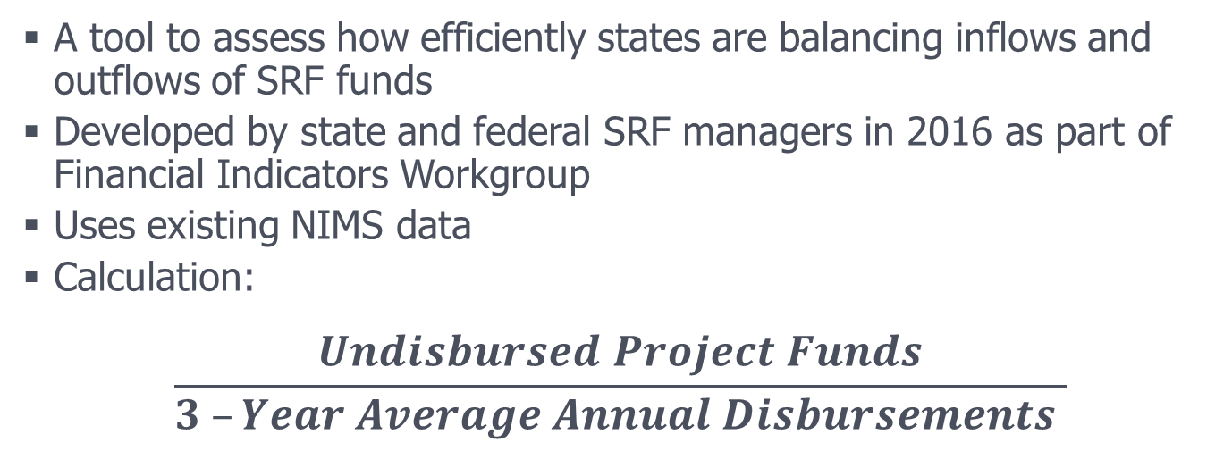
Disbursements Ratio
A tool to assess how efficiently states are balancing inflows and outflows of SRF funds
Developed by state and federal SRF managers in 2016 as part of Financial Indicators Workgroup
Uses existing NIMS data
Calculation:
$$\frac{Undisbursed Project Funds}{3 –Year Average Annual Disbursements }$$
Notes:
One tool that we have to assess this inflow-outflow balance is the “Disbursements Ratio.”
This was developed last year by the Financial Indicator Workgroup, of which many of you in the states were members. (states: AZ, DE, FL, IA, KS, LA, MN, MO, NC, WA)
This is one tool to assess how well the revolving funds are revolving.
It compares reported cash balances to reported average disbursements. It uses a 3-year disbursement average to smooth any large disbursement peaks or valleys occurring in that time period (including seasonal discrepancies, or exceptionally strong or slow years).

Slide 18
18
Notes:
This chart shows a snapshot of data at the end of each state fiscal year, as reported in NIMS, comparing cash balance at that time to average disbursement rates that the state had over the last 3 years.
Like the ULO challenge, states find themselves in very different places.
I’ve taken off the state names here, but the states on the left side of the chart have significantly more cash on hand than they typically disburse, on average.
[click] And yes, that bar at the very end – that is a state.
The question is: where do we want to be, nationally?
[click] Do we want to be here?
[click] Do we want to be here?
Or where do we want to be?
Today, I ask for CIFA’s assistance in working with us in the spirit of cooperative federalism to help every state get its excess liquidity to work funding public health protection investments in PWSs.
With the right cash flow management and outreach to communities, we could be financing more and/or larger projects.
Just like the ULO Strategy, we want to work with the CIFA Board as we move forward.
We want to work with you to see how we can get ALL states on cash flow management, and ALL states to be effective at marketing their programs.
We want a balanced portfolio of borrowers – small, medium and large systems.

