Slide 1
Development of a Sustainable
Asset Management and CIP Program
October 31, 2016

Slide 2
Why Initiate an
Asset Management Program?
Need to Better Understand and Manage Critical Assets
  Inventory and quantify current state of each significant asset
  Leverage existing data sources GIS/CMMS/Models
Aging Infrastructure Moving Agencies to Maximize Value of System Renewal Dollars
  Budget limitations has deferred new capacity/reliability projects, in general “do more with less”
  Replacing specific component areas instead of entire assets

Slide 3
Why Initiate an
Asset Management Program?
Continuous Demand to Improve Customer Service
  Proactive vs. Reactive diagnosis of infrastructure needs
  Faster responsiveness and reduced length of outages
Better Justification of Capital Investments
  Optimize maintenance and capital budget needs
  Provide graphical and operational fact-based answers to CIP needs

Slide 4
Asset Management (AM) linkage to Strategic Planning efforts
Identify objectives for Asset Management (AM) Program
Align AM Program with overall Strategic Mission & Goals of Agency
Defines AM Level of Service Goals (Customer Service – Renewal – Regulatory)
Establish Metrics to track Goals
Review Asset Management Metrics/Results Periodically for Continuous Improvement
Asset Management Goals
Asset Management Mission
Assure Alignment
Agency
Goals
Agency
Mission
Notes:
Important first step.

Slide 5
Benefits of Action
CMOM and Good Asset Management are Intertwined
Organizational Structure
Standards for Engineering Design
Sewer Use Ordinance
Collection System Main
Training
Safety
Budgeting
Customer Service
Internal Communications
Prioritized CIP Program
Closed-Circuit TV Inspection
Sewer System Mapping
Sewer Cleaning
Manhole Assessment
Capacity Assessment
Lift Station Assessment
Tracking SSOs
Overflow Emergency Response Plan

Slide 6
Benefits of Action
CMOM Planning is Focused Around EPA’s Asset Management Process
What Do I Own ?
What Condition is it in ?
How Does it Perform ?
How Do I Prioritize Renewal ?
What is my Funding Strategy ?

Slide 7
What are some challenges with
“Asset Management Programs”
Belief that Asset Management requires a large initial investment before experiencing benefits
Begin with known
information and
utilize CI to
enhance over
time
TOP DOWN
BOTTOM UP
Begin with
collecting all data
necessary to prepare
an AM Program

Slide 8
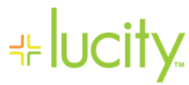
What are some challenges with
“Asset Management Programs”
Agencies Have Many Data Tools/Silos not Necessarily Developed With Others In Mind
  Various user groups have different priorities and needs
  Users not aware of full capabilities/applications of tools

Slide 9
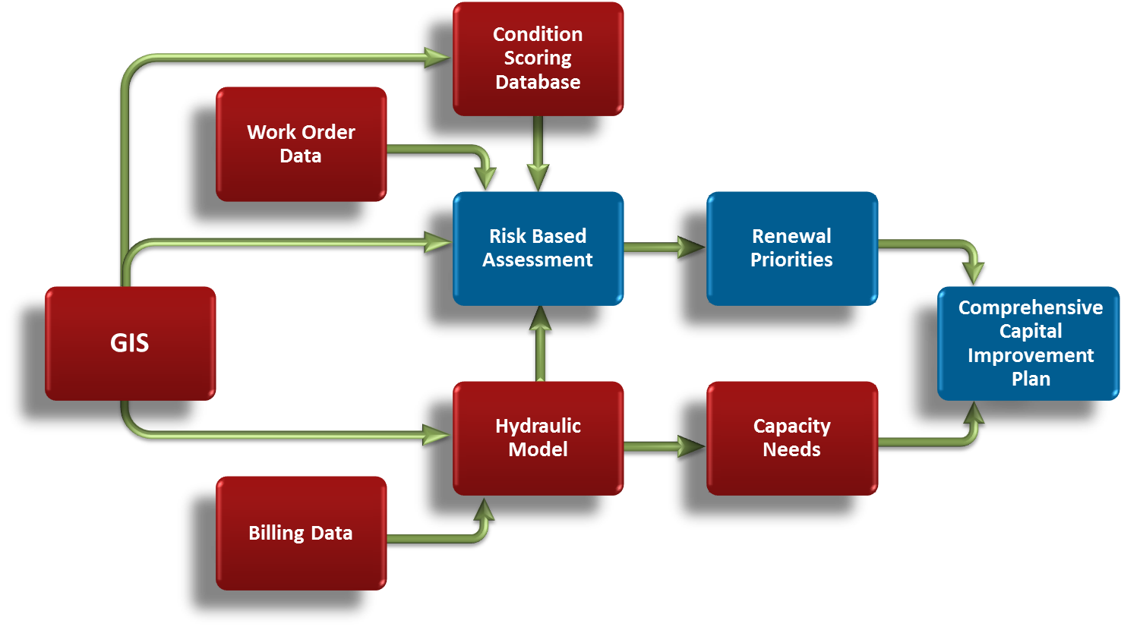
What are some challenges with
“Asset Management Programs”
Recognition This is Not Just a Software Issue
  Successful asset management requires updated business processes
    Need for Clear Roles/Responsibilities and defined “Work Flows”

Slide 10
Asset Management Framework and Process
What is Asset Management?
Asset Inventory & Mapping (GeoDatabase)
Level of Service Agreements
Condition & Criticality Evaluation of Critical Assets
Risk Based Assessment
Business Case Prioritized CIP
Continuous Improvement Process
Asset Performance & Tracking (CMMS)
“A set of processes to minimize infrastructure life cycle costs at an acceptable risk, while delivering a desired level of service”
Asset Management Framework

Slide 11
Implementing the Asset Management Framework
Asset Inventory & Mapping (GeoDatabase)
Level of Service Agreements
Condition & Criticality Evaluation of Critical Assets
Risk Based Assessment
Business Case Prioritized CIP
Continuous Improvement Process
Asset Performance & Tracking (CMMS)
Asset Management Framework
What Assets Do I Have and What Do I Know About Them?

Slide 12
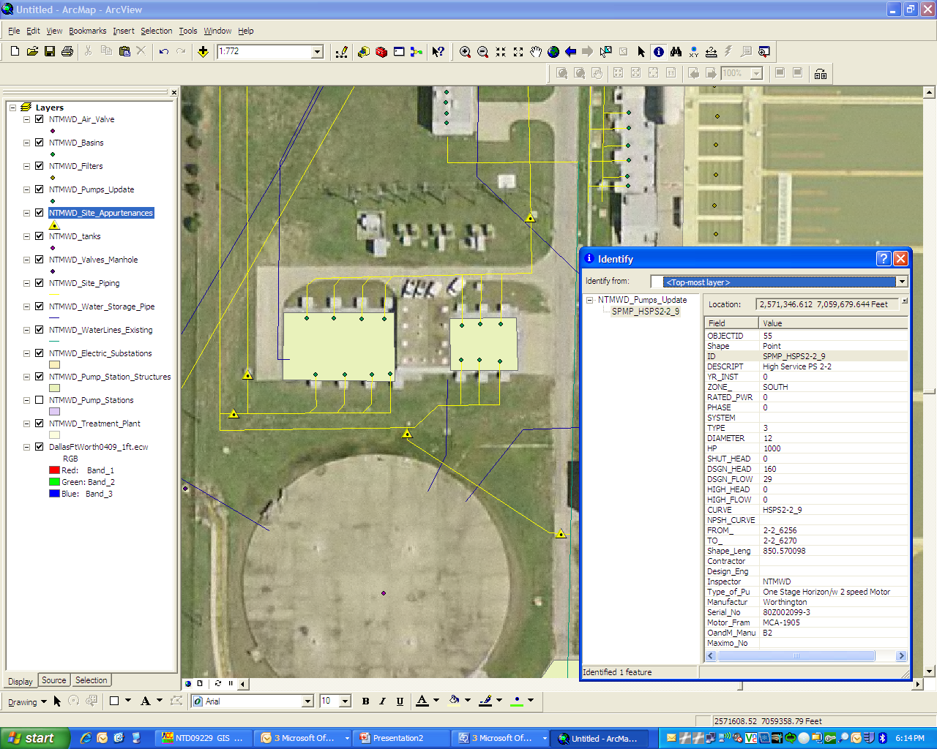
Asset Inventory (Geodatabase Development)
Asset X,Y,Z Reference
Pump Capacity
Pump Nameplate Data
Age & Materials
Asset Hierarchy
Connectivity to Other Assets
HSPS 2-3
HSPS 2-2

Slide 13
Implementing the Asset Management Framework
Asset Inventory & Mapping (GeoDatabase)
Level of Service Agreements
Condition & Criticality Evaluation of Critical Assets
Risk Based Assessment
Business Case Prioritized CIP
Continuous Improvement Process
Asset Performance & Tracking (CMMS)
Asset Management Framework
How Are My Assets Managed?

Slide 14
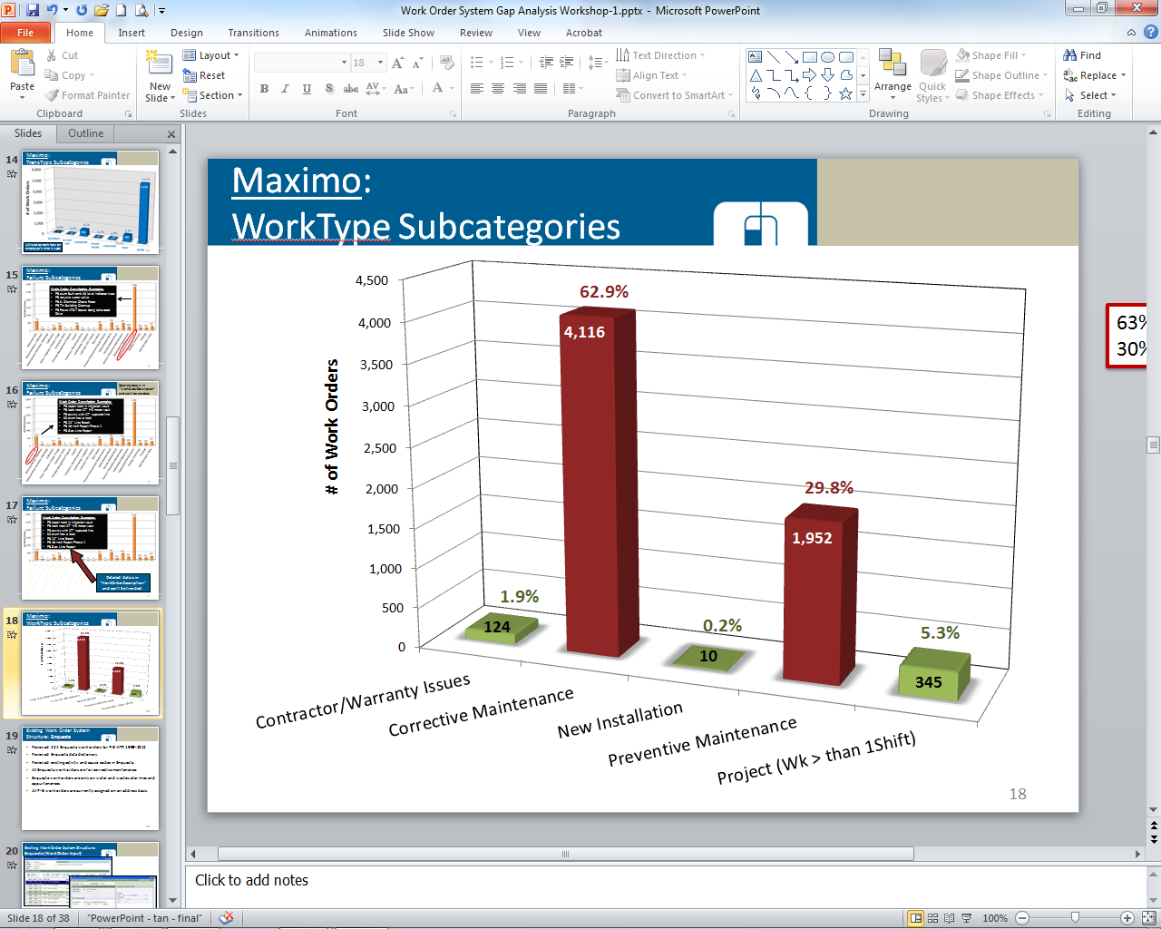

Asset Performance and Track (Applying the Best Tools)
GIS (Static Data)
Develop Unique ID
Hyperlink to As-Builts
GPS Assets
Data Hierarchy
CMMS (Dynamic Data)
Work Orders
O&M Manuals
Preventative Maintenance (PM)
Shop Drawings
Review of Historical Data
63% Corrective Maintenance
30% Preventive Maintenance

Slide 15

Update Preventative Maintenance (PM) Programs
Review Current PM Activities
  Pump & Motor Operational Checks and Maintenance
  Electrical Equipment Preventive Maintenance
Benchmark PM Programs with Other Utilities
Develop PM Program Enhancements
Section 1- Preventative Maintenance (PM) Program Comparisons | Utility A | Utility B | Utility C | Utility D
1. Maintain or track the status of maintenance issues? | Y | Y | Y | Y
2. Plan, prioritize and schedule PM assignments? | Y | Y | Y | Y
3. Plan, prioritize and schedule CM assignments? | Y | Y | Y | Y
4. Record completed maintenance activities? | Y | Y | Y | Y
5. Track overall maintenance costs? | Y | N | N | N
6. Track individual equipment or asset maintenance history/costs? | Y | Y | Y | Y
7. Monitor trends/problems for specific types/manufacturers of equipment? | N | N | N | Y
8. Predict future maintenance needs/ costs for individual assets? | N | N | N | N
9. Maintain a list of equipment assets? | Y | Y | Y | Y
10. Categorize equipment assets as “critical” or “non-critical”? | N | N | N | Y
11. Schedule “reminders” for personnel licensing, training? | N | Y | N | N
12. Generate reports mgmt or municipal officials? | Y | Y | Y | Y

Slide 16
Implementing the Asset Management Framework
Asset Inventory & Mapping (GeoDatabase)
Level of Service Agreements
Condition & Criticality Evaluation of Critical Assets
Risk Based Assessment
Business Case Prioritized CIP
Continuous Improvement Process
Asset Performance & Tracking (CMMS)
Asset Management Framework
What is My Desired Performance on High Priority Issues

Slide 17

Level of Service (LOS) Agreements
Ex.) Triple Bottom Line LOS Categories
Environmental:
  Meet Regulatory Requirements
  Managing Sewer Spills
  Regional Source Water Protection
Social:
  Track Customer Growth & Satisfaction
  Restore Sewer Service within 8 hours
  Training Hours Per Employee
Economic:
  New Borrowing will not exceed Annual CIP requirements
  User Fees should be sufficient to cover all O&M costs
  Annual Increase in collection, treatment cost shall increase no more than 10%

Slide 18
Level of Service Agreements
EXAMPLE: WATER SYSTEM LEVEL OF SERVICE AGREEMENTS
Category | Key Metric | Current Level of Service | Target Level of Service
System Capacity and Redundancy | Available supply during a major system outage | 85% of Average Day Demand | 100% of Average Day Demand
Customer Service | Service will be restored within 6 hours of a shut down | 95% of the time | 90% of the time
Economic Sustainability | System failures will be reduced annually | 7% reduction | 5% / year reduction
Environmental | Meet all state and federal regulatory standards | 100% | 100%
Staff Development | Training hours per employee | 53 hours / year | 45 hours / year

Slide 19
Level of Service Agreements
EXAMPLE: WASTEWATER SYSTEM LEVEL OF SERVICE AGREEMENTS
Category | Key Metric | Current Level of Service | Target Level of Service
Economic sustainability | Percent of treated effluent reclaimed | 5% | 15%
Environmental | Sanitary sewer overflows per 100 miles of lines | 0.85 | < 2.0
Customer service | New connection permits processed within 3 days | 70% | 90%
Economic sustainability | Annual increase in collection, treatment, and disposal costs per MGD | 7.8% | < 10%
System capacity and redundancy | Rainfall induced inflow and infiltration peaking factor | 3.3 | < 3.0

Slide 20
Implementing the Asset Management Framework
Asset Inventory & Mapping (GeoDatabase)
Level of Service Agreements
Condition & Criticality Evaluation of Critical Assets
Risk Based Assessment
Business Case Prioritized CIP
Continuous Improvement Process
Asset Performance & Tracking (CMMS)
Asset Management Framework
What Shape Are My Assets In ?

Slide 21
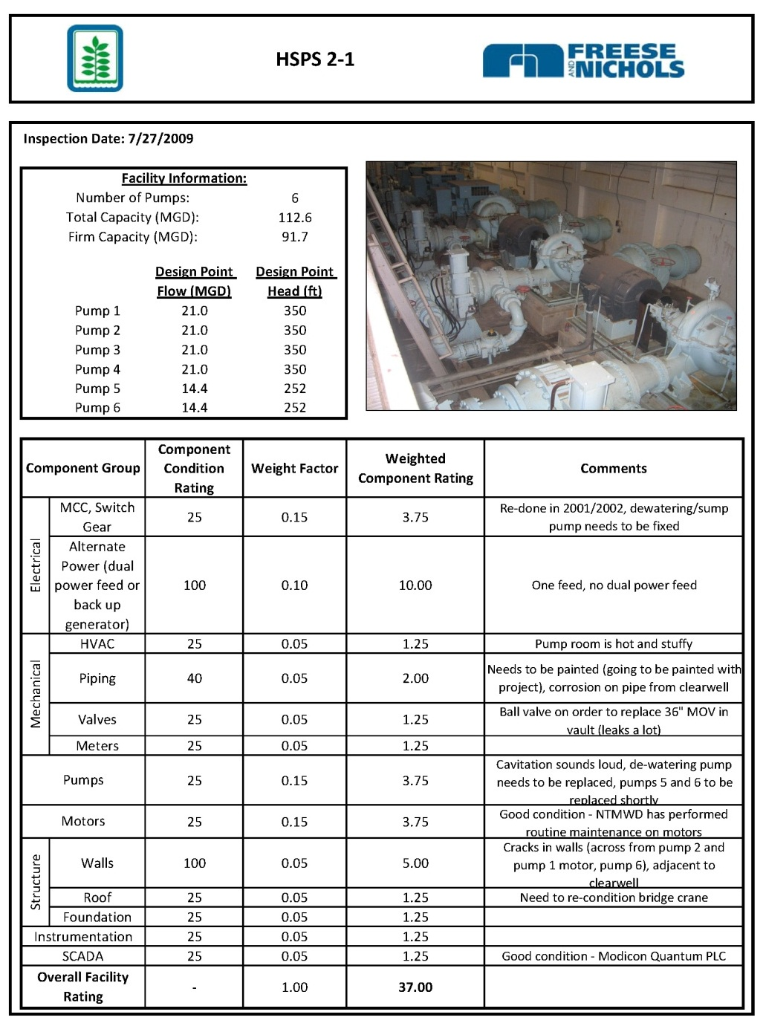
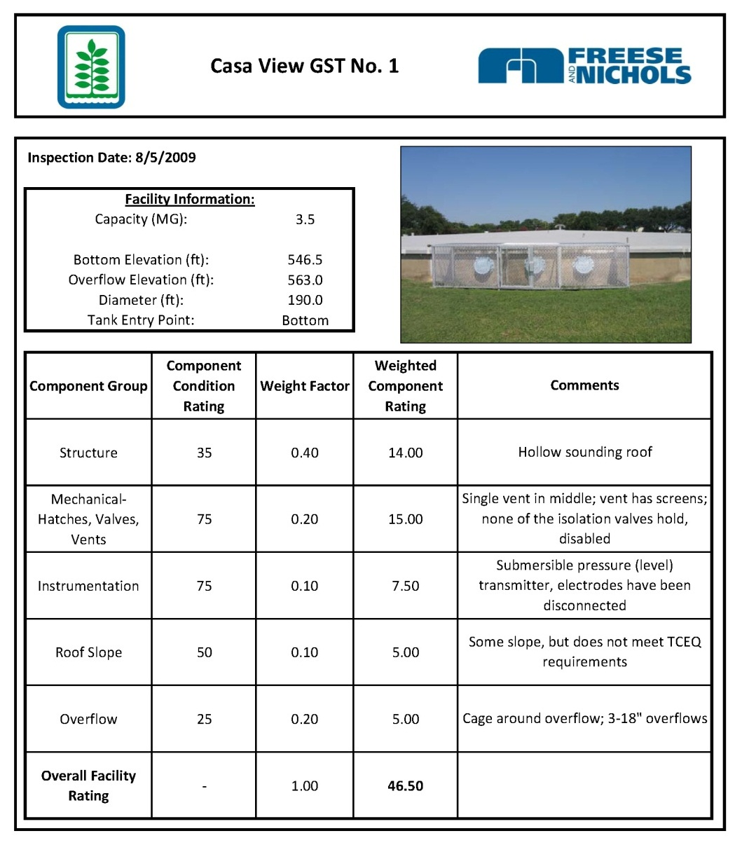
Condition Assessments (Vertical Assets)

Slide 22
Condition Assessments
(Vertical Assets)
Lift Station | Location | Condition Score
Lift Station #10 | Oakridge Dr 206 | 4.55
Lift Station #28 | Hills of Hays | 4.3
Lift Station #30 | Linda Dr | 3.95
Lift Station #12 | Oakridge 315 | 3.85
Lift Station #4 | Rio Vista | 3.78
Lift Station #36 | Baptist Academy | 3.56
Lift Station #20 | Browne Terrace | 3.50
Lift Station #25 | Weiner's | 2.95
Lift Station #14 | River Road | 2.84
Lift Station #5 | Care Inn | 2.65
Lift Station #22 | Holland St | 2.60
Lift Station #27 | Elm Hill | 2.55
Lift Station #34 | Coers Dr | 2.35
Lift Station #33 | Sign Shop | 2.25
Lift Station #21 | Blanco River Village | 2.15
Lift Station #16 | Franklin Square | 1.93
Lift Station #38 | Panorama | 1.85
Lift Station #46 | Gary Job Corp | 1.81
Lift Station #1 | Main | 1.72
Lift Station #31 | Blanco Vista | 1.64
Lift Station #50 | Asbury Place Apts | 1.60
Lift Station #11 | N LBJ Dr | 1.55
Lift Station #7 | Warehouse | 1.43
Lift Station #18 | Fire Station 4 | 1.2
Asset Remaining Useful Life
0 – 5 Years
6 – 15 Years
16 – 25 Years

Slide 23
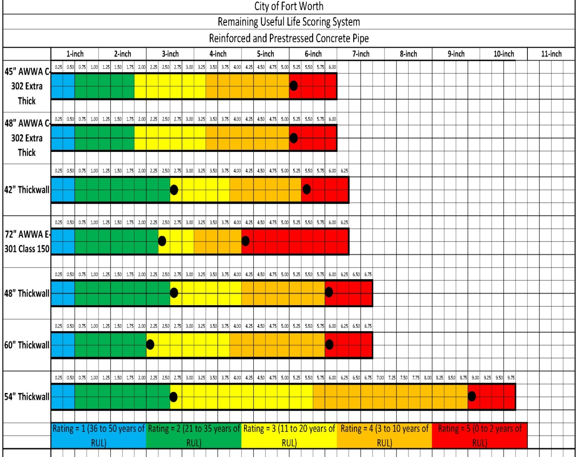
Condition Assessments (Linear Assets)
Calculating Remaining Useful Life (RUL) of Asset
Rating 1: Corrosion to 0.5” from inner wall
Rating 2: Corrosion 0.5” to first row steel.
Rating 3 Corrosion, Face of 1st row of steel to half dist. to 2nd row
Rating 4: Corrosion to the 2nd row of steel.
Rating 5: Corrosion from 2nd row of steel to outer wall

Slide 24
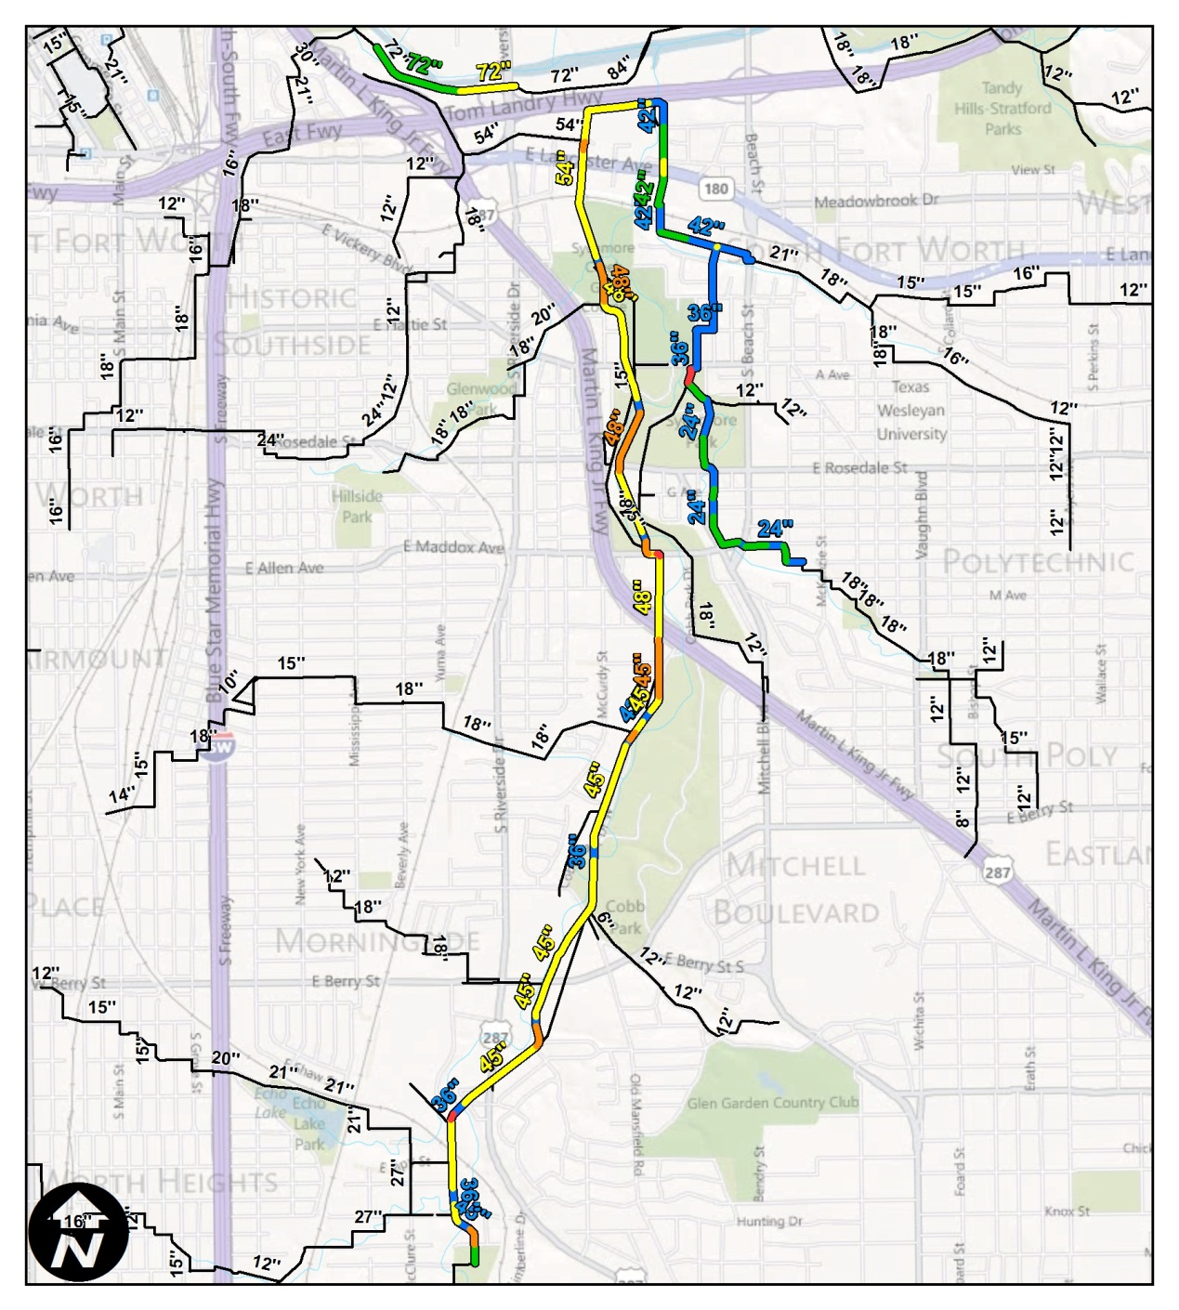
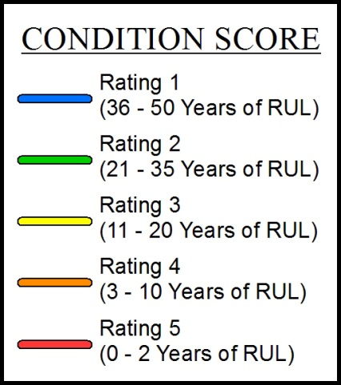
Condition Assessments (Linear Assets)
47%
25%
16%
10%
1%
% = percent of total work order length

Slide 25
Criticality Assessment (Vertical Assets)
Criticality Score | Criteria
A Minimal Impact | All other stations
B Low Impact | Non-regional lift stations with a capacity > 500 gpm and < 1,000 gpm
C Medium Impact | Non-regional lift stations with a capacity > 1,000 gpm Any station within 1,000 feet of a water body
D High Impact | Regional lift stations with a capacity < 2,000 gpm Any station within 300 feet of a water body Any station within 1,000 feet of a drinking water source
E Very High Impact | Regional lift stations with a capacity > 2,000 gpm Any station within 300 feet of a drinking water source
Criticality Assessment Parameters Used for the City of Fort Worth

Slide 26
Criticality Assessment
(Vertical Assets)
Lift Station | Reason for Criticality Score | Criticality Score
Castle Circle | Drinking water source < 1,000 feet | D
Dosier Cove (Lake Country #13) | Drinking water source < 300 feet | E
Dosier Creek | Regional LS > 2,000 gpm | E
Enchanted Bay | Drinking water source < 300 feet | E
Glenn Mills | Water body < 300 feet | D
Greenway | Non-regional station > 1,000 gpm | C
Hulen Bend | Water body < 300 feet | D
Intel #1 | Downgraded from C because not in use | A
Intel #2 | Downgraded from C because not in use | A
Jenkins Heights | Water body < 300 feet | D
Lake Country #2 | Drinking water source < 1,000 feet | D
Lake Country #3 | Drinking water source < 300 feet | E
Lake Country #4 | Drinking water source < 300 feet | E
Lake Country #5 | Drinking water source < 1,000 feet | D
Lake Country #11 | Drinking water source < 300 feet | E
Lake Country #12 | Drinking water source < 1,000 feet | D
Lake Worth | Drinking water source < 1,000 feet | D
Live Oak Creek | Regional LS > 2,000 gpm | E
Meadow Lakes | All others | A
Mossier Valley | All others | A
Ranch @ Eagle Mountain Lake | Water body < 1,000 feet | C
Richardson Slough | Regional LS > 2,000 gpm | E
Rosemary Ridge | Non-regional station > 500 & < 1,000 gpm | B
Sendera Ranch | Non-regional station > 1,000 gpm | C
Shield | Non-regional station > 500 & < 1,000 gpm | B
Spring Ranch | All others | A
Summer Creek | Water body < 3000 feet | D
Sunset Cove | Drinking water source < 300 feet | E
Winn Dixie | All others | A

Slide 27
Criticality Assessments (Linear Assets)
PROPOSED CRITICALITY PARAMETERS & WEIGHTING SYSTEM
Environmentally Sensitive Areas (30%) | Number of Customers per Piping Segment (25%)
In Edward's Aquifer Recharge Zone = 100 | Upstream Population >100,000 = 100
In Edward's Aquifer Contributing Zone = 95 | Upstream Population 25,001 – 100,000 = 70
Lake, Running River / Creek = 90 | Upstream Population 10,000 - 25,000 = 40
In Floodplain = 50 | Upstream Population < 10,000 = 10
In Wildlife Area = 40
High Impact (30%) | Access Issues (15%)
Hospital, Military Base, SA Airport, School, University, Vulnerable Well, Central Business District / River Walk = 100 | River / Creek Crossing = 100
Church, Fire Station, Golf Course, Historical District, Library, Mission, Park, Police Station, Public Meeting Place = 80 | Crosses Under Highway = 70
Commercial = 60 | Railroad Crossing = 40
Residential = 40
Criticality Assessment Used for San Antonio Water System SAWS

Slide 28
Implementing the Asset Management Framework
Asset Inventory & Mapping (GeoDatabase)
Level of Service Agreements
Condition & Criticality Evaluation of Critical Assets
Risk Based Assessment
Business Case Prioritized CIP
Continuous Improvement Process
Asset Performance & Tracking (CMMS)
Asset Management Framework
What Combined Exposure Do I Have With Each Asset?

Slide 29
Risk Based Assessment
Leveraging the Asset Condition and Criticality for Risk Based Assessments
Risk = ƒ (Criticality x Condition)
What is the Consequence of Asset Failure?
What is the Likelihood of Asset Failure?
Loss of service
Redundancy
Difficulty of repair
Damage to property
Public image
Regulatory Impact
Asset age
Asset material
Performance of asset
Annual maintenance costs
Available Capacity
GIS
CMMS
Hydraulic Model

Slide 30
Risk Based Assessment
Low Risk
Medium Risk
High Risk

Slide 31
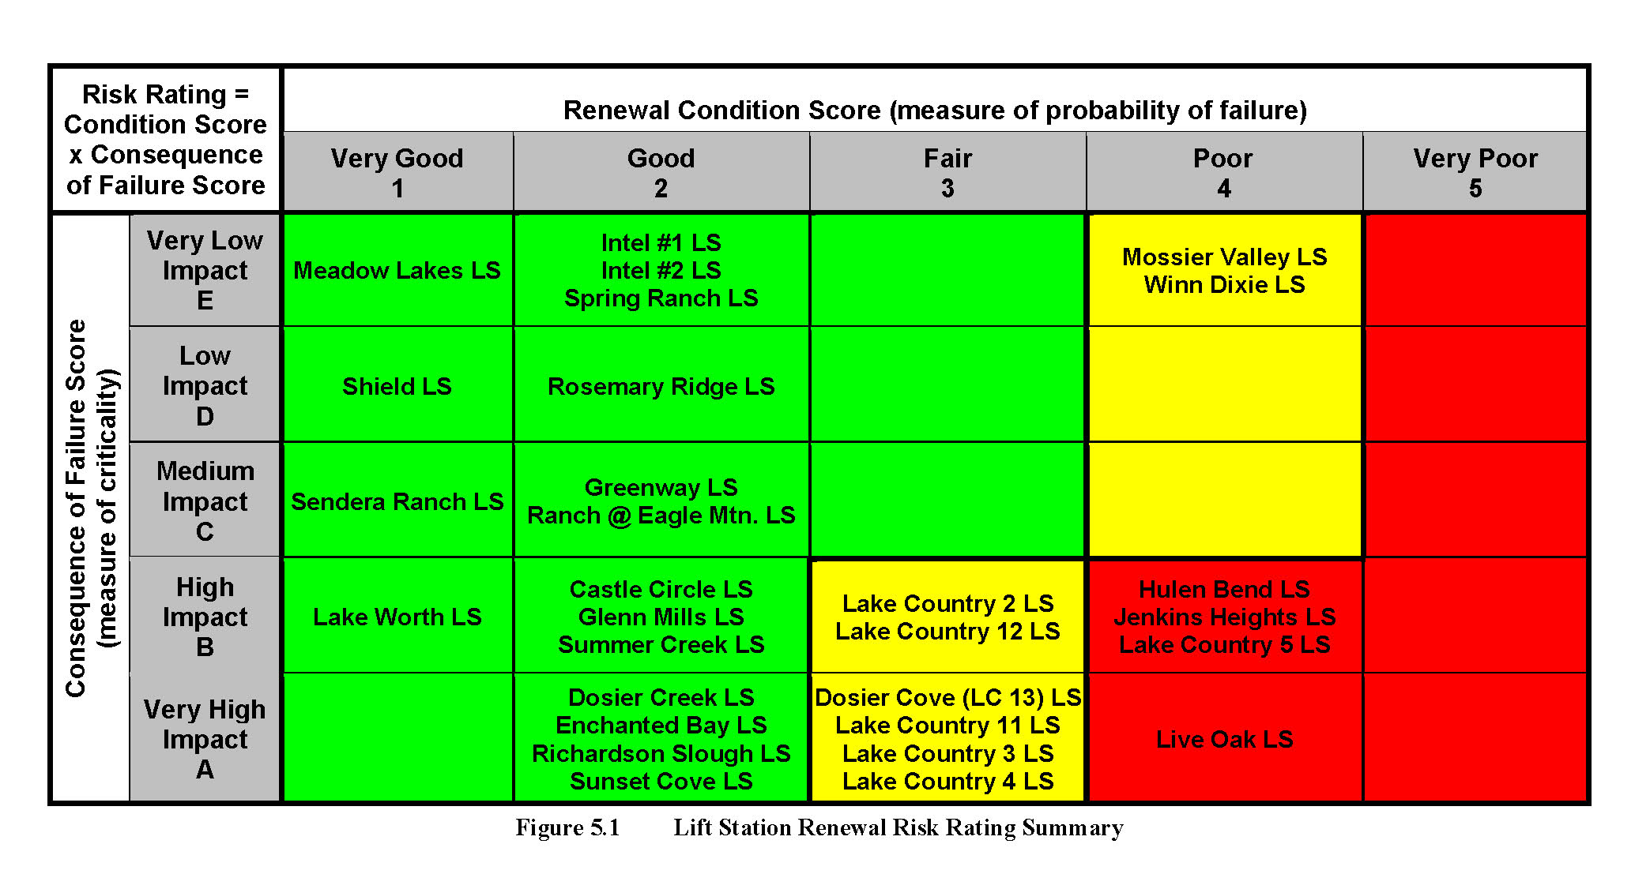
Risk Based Assessment
(Overall Asset Prioritization)
Risk Assessment for Fort Worth 30 Lift Stations
Four High Risk Lift Stations Identified
for Immediate Rehabilitation
Notes:
How you got from form to this matrix?

Slide 32
Implementing the Asset Management Framework
Asset Inventory & Mapping (GeoDatabase)
Level of Service Agreements
Condition & Criticality Evaluation of Critical Assets
Risk Based Assessment
Business Case Prioritized CIP
Continuous Improvement Process
Asset Performance & Tracking (CMMS)
Asset Management Framework
How Do I Justify and Phase In Infrastructure Renewal

Slide 33
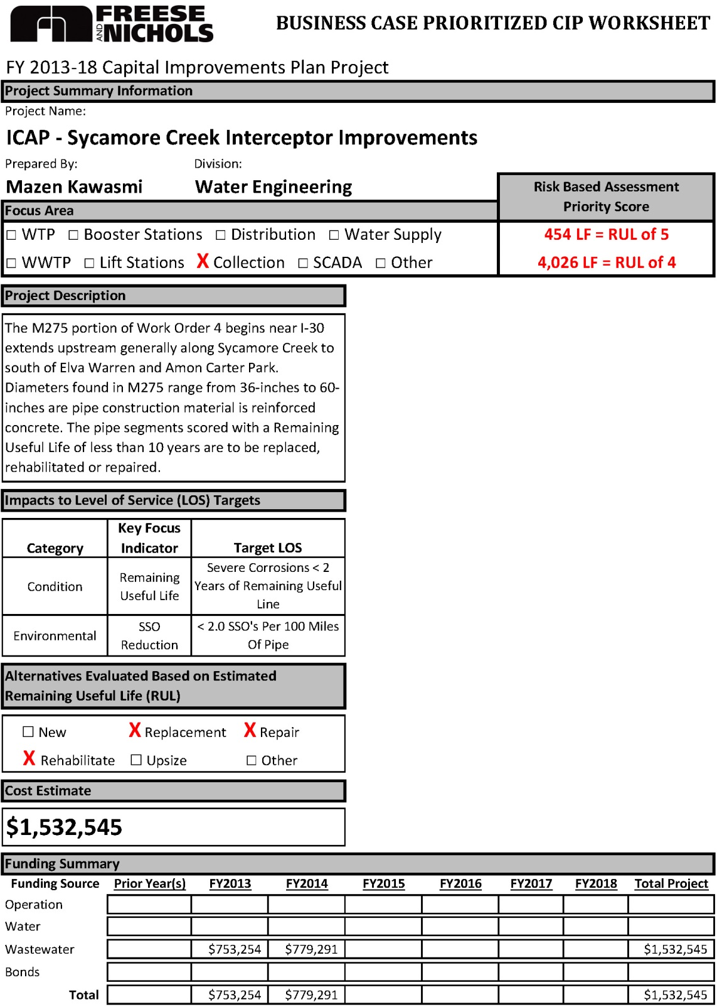
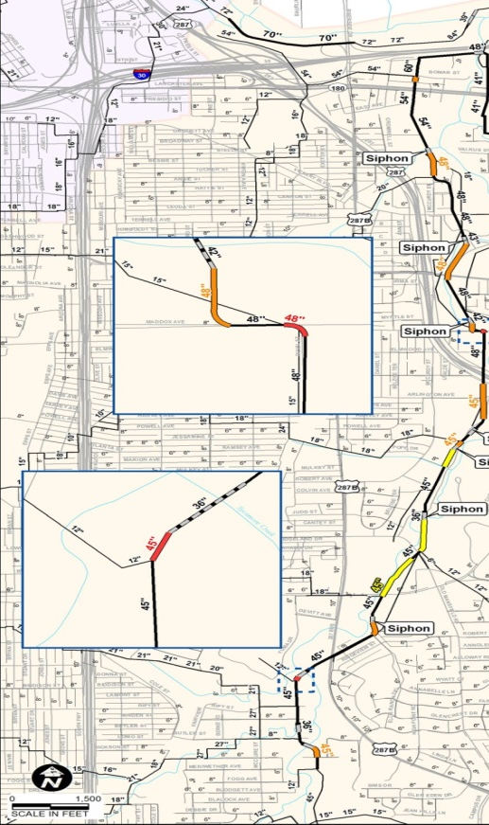
Developing Business Case Prioritized CIP
Business Case Requirements
Project Name & Focus Area
Risk Based Assessment Priority Score
Impacts to Level of Service (LOS) Targets
Alternatives Evaluated Based on RUL Estimates
  1) Repair
  2) Rehabilitation
  3) Replace or Upsize
Project Cost Estimates
Project Funding Source

Slide 34
Best Practices in Developing a “Business Case Prioritized CIP”
Cost Effective CIP Program is….
The Right Solutions at the Right Time
Balancing of Growth, Aging Infrastructure and Operational Needs
Prioritized CIP
Capacity
Redundancy
Water Quality
Rehabilitation

Slide 35
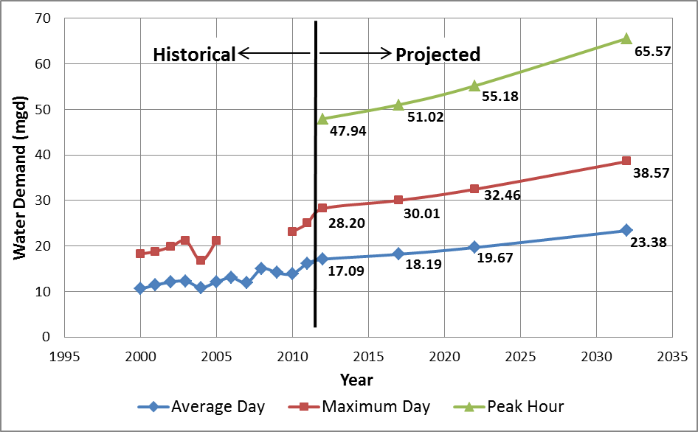
Best Practices in Developing a “Business Case Prioritized CIP”
Fact Based (Demand Driven) Capital Program

Slide 36
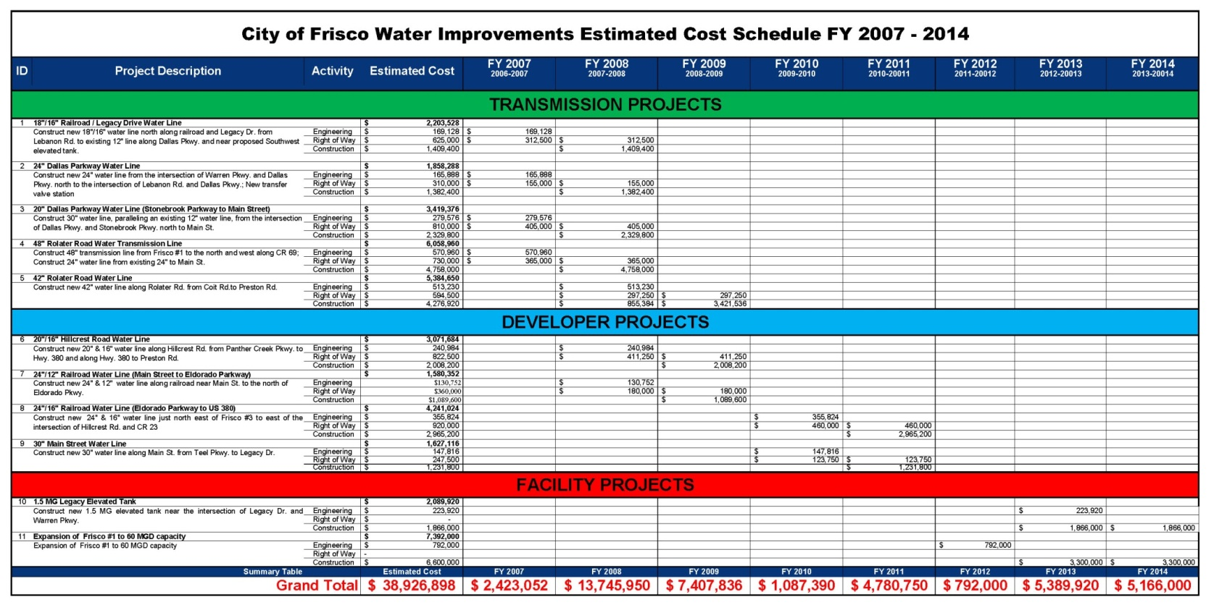
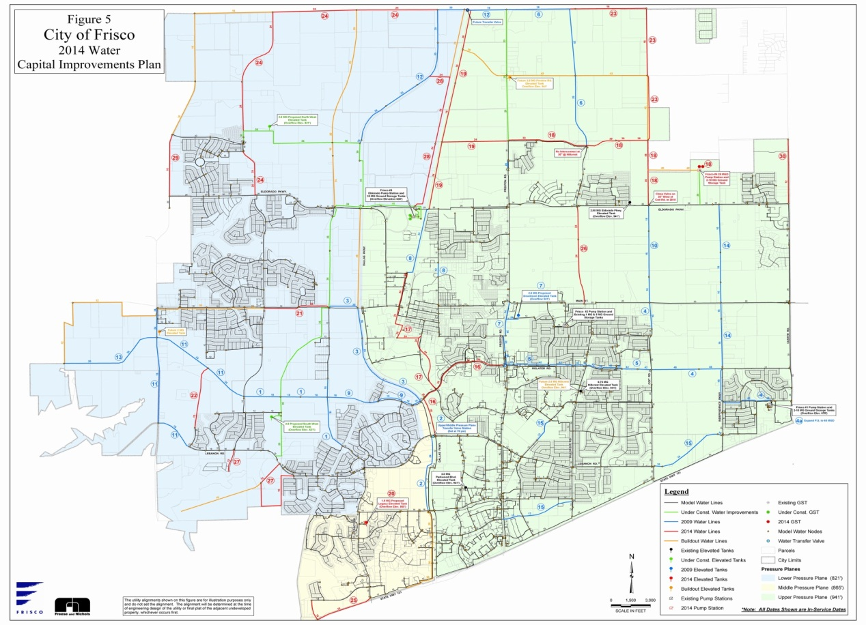
Best Practices in Developing a “Business Case Prioritized CIP”
Establishes an Annual CIP Tracking Program
Easy-to-follow CIP, customized to City’s Needs:
By category, funding source and fiscal year

Slide 37

Characteristics of Successful AM and CIP Programs
Sustainable with time and personnel changes
Leverage multiple existing data sources
Allow graphical communication of highest needs up & down Agency
Can be expanded over time easily
Creates early wins

Slide 38

QUESTIONS?
Thomas Haster, P.E.
Freese and Nichols, Inc.
Thomas.Haster@freese.com
817 735-7238 Direct

