Slide 1


U.S. Environmental Protection Agency
Community Grants Program
2024 CIFA SRF Workshop
November 18, 2024
www.uswateralliance.org

Slide 2

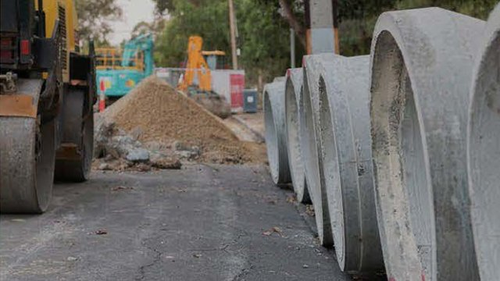
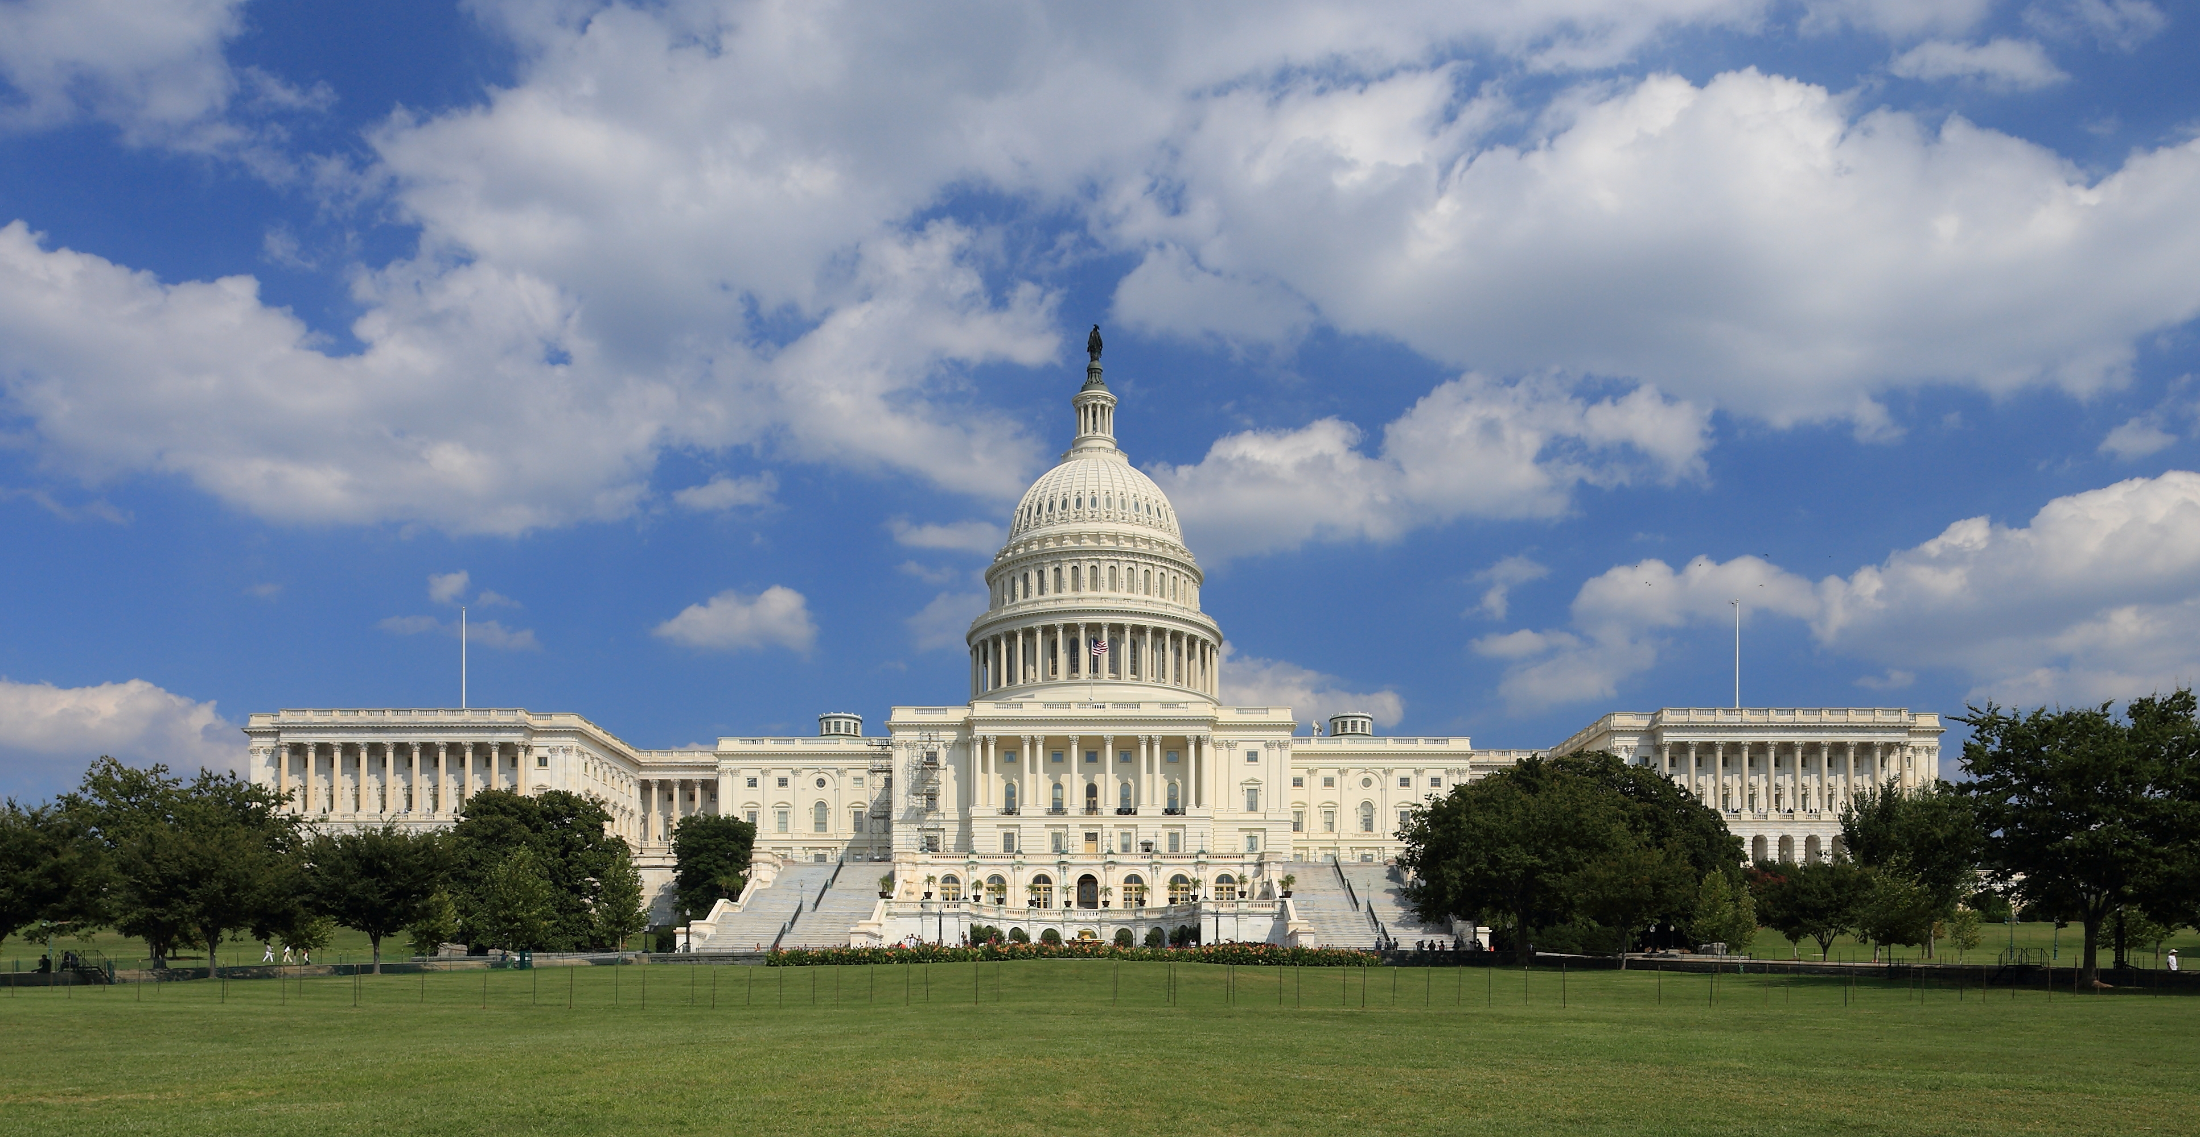
Community Grants Program
Overview
EPA Community Grants Program
  Background
  Steps to Award
  Key Requirements
EPA – SRFs: Co-Funding Community Grants Projects
  Identifying co-funded projects
  Requirements: EPA – SRF Coordination

Slide 3
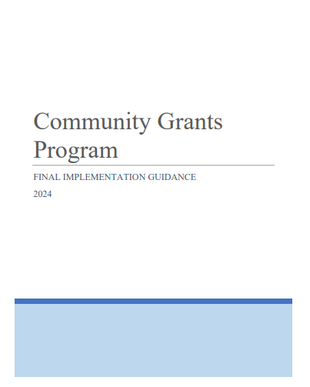
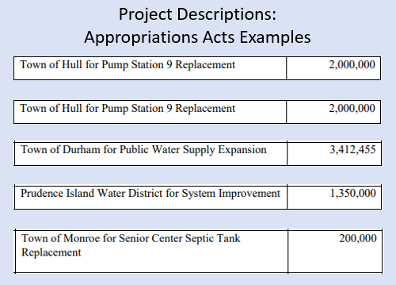
Community Grants Program
Background
FY 2022 | FY 2023 | FY 2024 | TOTAL
483 Projects | 715 Projects | 1,022 Projects | 2,220 Projects
$841,405,095 | $1,472,364,541 | $1.419,312,172 | $3.7 billion
  Congressionally identified drinking water, wastewater, stormwater infrastructure, and water quality protection projects
  New EPA Grant Program: Est. 2022
  Authorized in Appropriations Acts
  Direct grants to recipients: local governments, utilities, tribes, territories, states
  EPA Implementation Guidance
  Subject to federal grant requirements
Community Grants Projects are identified in Annual Appropriations Acts as Congressionally Directed Spending (CDS) / Community Project Funding (CPF) projects.
https://www.epa.gov/sustainable-water-infrastructure/epa-community-grants-program-basics

Slide 4
Community Grants Program:
Steps to Award
Appropriations Acts
Congress identifies specific projects & recipients, authorizes EPA to award direct grants
Implementation Guidance & Outreach
EPA issues Community Grants Program Implementation Guidance and initiates recipient outreach: notify recipients of fund availability, application instructions & applicable requirements. Individual project information: status, funding sources and more.
Requirements
NEPA, BABA, AIS, Cost Share, Procurement, Davis Bacon, EPA grant recipient training, and more.
Grant Applications
Recipients must apply for grant awards under the Community Grants Program: workplan, budget, SAM.gov, Grants.gov
Grant Awards
Project Implementation, federal grant requirements, payment requests
How Recipients Can Prepare to Receive Community Grants Funding

Slide 5
Community Grants Program
Key Requirements: Cost Share & Drawdowns
Statutory Requirement: 20% of the total grant project cost must be from nonfederal sources* unless waived by EPA
  May include SRF loan repayments, interest earnings, bond proceeds, and fees, or a state contribution to the SRF above the statutorily required 20% match
  Community Grants Program Cost Share Waiver criteria
Cost share requirement not applicable for Community Grants awards to tribes and territories
Drawdowns:
  Prior EPA review and approval
  Eligible costs: 80% EPA share + 20% Recipient share
Example: Community Grant Cost Breakout
Appropriations Act Amount (EPA Share) | Recipient Cost Share Amount | Grant Amount (EPA + Recipient Share)
$100K | $25K | $125K
80% (maximum) | 20% | 100%
*SRF funds can be used as the source of the recipient's cost share for the Community Grants award if those funds are: non-federal funds such as loan repayments, interest earnings, bond proceeds, and fees, or a state contribution to the SRF above the statutorily required 20% match.

Slide 6
Community Grants Program:
Key Requirements: Environmental Review
EPA, in coordination with each recipient, concludes the NEPA process through completion of one of the following:
A Categorical Exclusion (CATEX) determination
Environmental Assessment (EA) and Finding of No Significant Impact (FONSI)
Environmental Impact Statement (EIS) and Record of Decision (ROD)
EPA issues a NEPA determination document even if project has undergone State Environmental Review Process (SERP) or other federal agency review, and
All projects must undergo an environmental crosscutter review, including but not limited to the National Historic Preservation Act (NHPA) and Endangered Species Act (ESA).
https://www.epa.gov/sustainable-water-infrastructure/epa-community-grants-resources-recipients

Slide 7
Community Grants Program:
Key Requirements: Procurement
Applicable Federal procurement requirements for all services, supplies, equipment
2 CFR 200, 2 CFR 1500 and/or 40 CFR Part 33, 40 U.S.C. 1101 et seq. (Brooks Act) or equivalent state qualifications-based procurement as applicable.
Project (1) procured services or products through contracts entered into prior to March 9, 2024; and (2) complied with state and/or local laws governing competition (including laws/policies relating to participation by disadvantaged business enterprises or equivalent, as applicable, and method of procurement). (Contracts and contract amendments will be considered covered by the provision upon receipt of written confirmation from EPA.)
UNLESS
All recipients, including those that qualify for the procurement flexibilities discussed above must comply with the requirements in the Davis-Bacon Act, American Iron and Steel (AIS), and Build America, Buy America (BABA) in any procurements and resulting contracts as applicable; these requirements are not waived by this provision and include incorporation of prevailing wage determinations and AIS/BABA in solicitation documents.
https://www.epa.gov/system/files/documents/2024-06/procurement-and-subawards-community-grants-program.pdf

Slide 8
Community Grants: SRF Co-funding
Identifying Co-Funded Community Grants Opportunities – EPA Region 1 Approach
~60% of FY22 – FY24 Community Grants projects in EPA Region 1 are SRF co-funded
Early communication and collaboration with SRF programs
  Share state-specific list of projects with each SRF program
  Meet with each state’s SRF program discuss project lists and co-funding
  Discuss status of co-funded projects in the SRF (i.e., state environmental reviews, equivalency, BABA waiver information and eligibility, etc).
  EPA Region 1 – Recipient kick-off calls: include SRF when co-funding expected.

Slide 9
Community Grants: SRF Co-funding
Identifying Co-Funded Community Grants Opportunities – EPA Region 1 Approach
Continue open communication with the SRF program for co-funded projects
  EPA PO will include the state on correspondence with the recipient and will include the state in subsequent meetings as needed.
  Coordinate with SRF on comments provided on contract/specification documentation.
  EPA PO will invite the state on periodic construction visits and will share any resulting report from the site visit.
Most important benefit: open communication between EPA and the state SRF program to support successful completion of the funded project.

