Slide 1
Iowa SRF’s use of
Green Bonds
Lori Beary
Iowa Finance Authority

Slide 2

Iowa SRF Green Bonds
Iowa’s SRF has issued two Green Bond SRF issues
  February 2015 - $321,530,000
    included $208 million of refunding
  October 2016 - $163,275,000

Slide 3
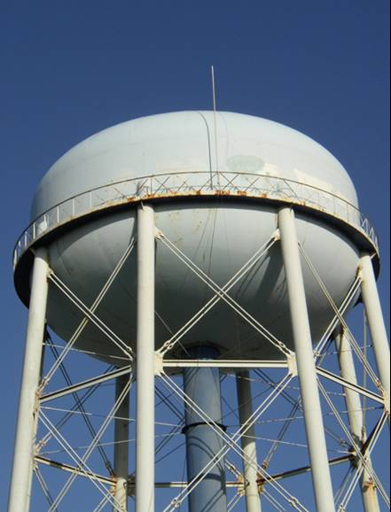
Iowa SRF Green Bonds
“Green” because projects comply with Clean Water Act or Safe Drinking Water Act
Projects:
  improve water quality
  protect the environment
  protect public health

Slide 4
Iowa SRF Green Bonds
Two factors weighed our decision:
  Wanted to attract new investors
  Compliance/reporting couldn’t be too difficult

Slide 5
Iowa SRF Green Bonds
Bond proceeds are used to reimburse for disbursements already made
Information for OS was readily available
  List of projects that were funded
  Amount funded
  Description of project
  Total loan amount and % complete

Slide 6
Exhibit in Official Statement

Slide 7
Ongoing Compliance
Annual Report prepared for EPA includes any reporting information:
  projects that have closed loans
  projects that have begun construction
  Projects that have completed construction

Slide 8

Iowa SRF Green Bonds
Other goal was to attract new investors
2015 bond issue had:
  7 new buyers for 44.3 million
  3 Green orders for $4.1 million

