Slide 1
Oklahoma’s Tools for Managing Drought
Presented by Lori Johnson
October 2017
Notes:
OK has a long history of living with drought. It was the record drought of 1957, that led to the creation of the OWRB

Slide 2
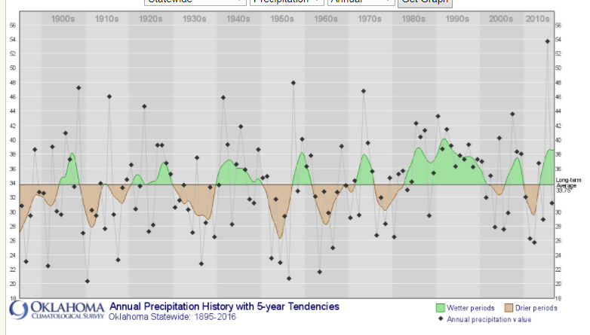
Oklahoma Precipitation History
Notes:
Like most other states in the Great Plains, Oklahoma has historically experienced prolonged periods of drought as part of its climate cycle. Since modern climatological record-keeping began in the 1890s, the state has suffered six major drought events. These major droughts are separated by multi-year periods of above average rainfall, making long-range water planning difficult yet critical for the state.

Slide 3
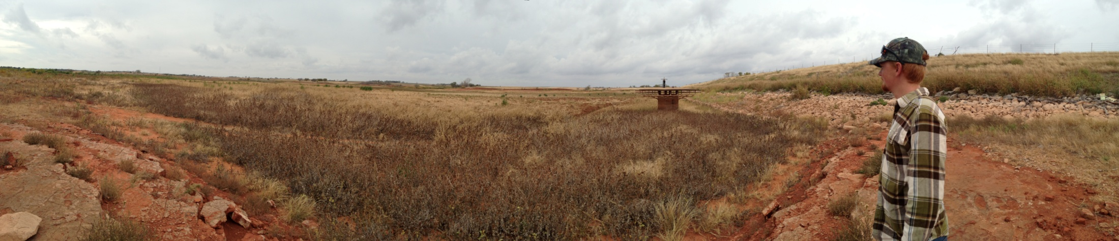
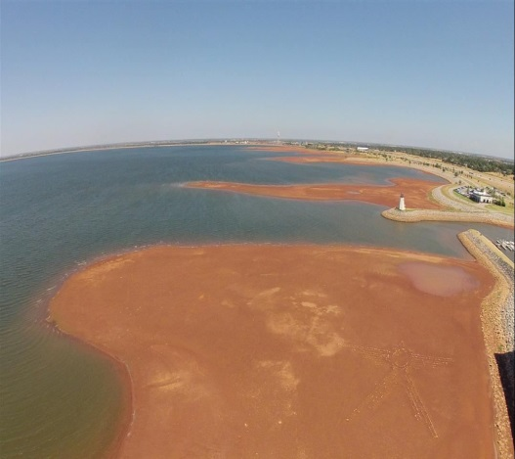
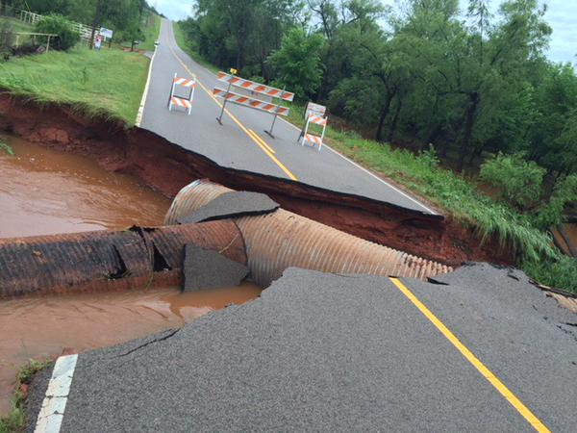
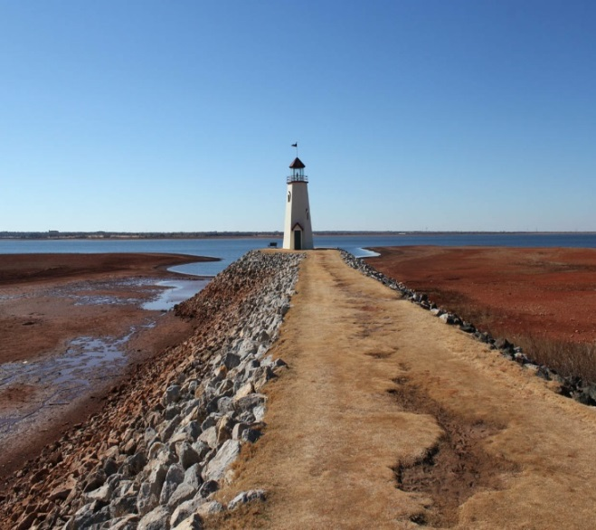
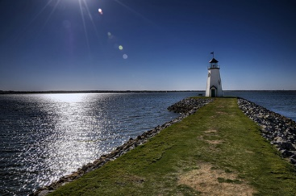
2015 Extremes – Drought to Flood

Slide 4
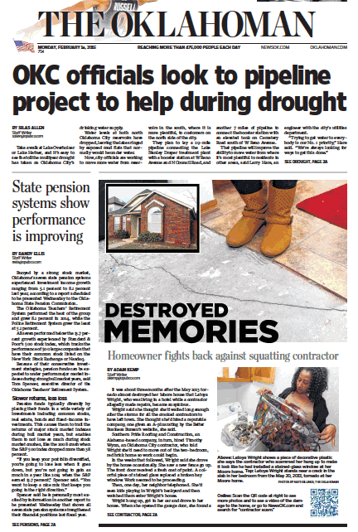
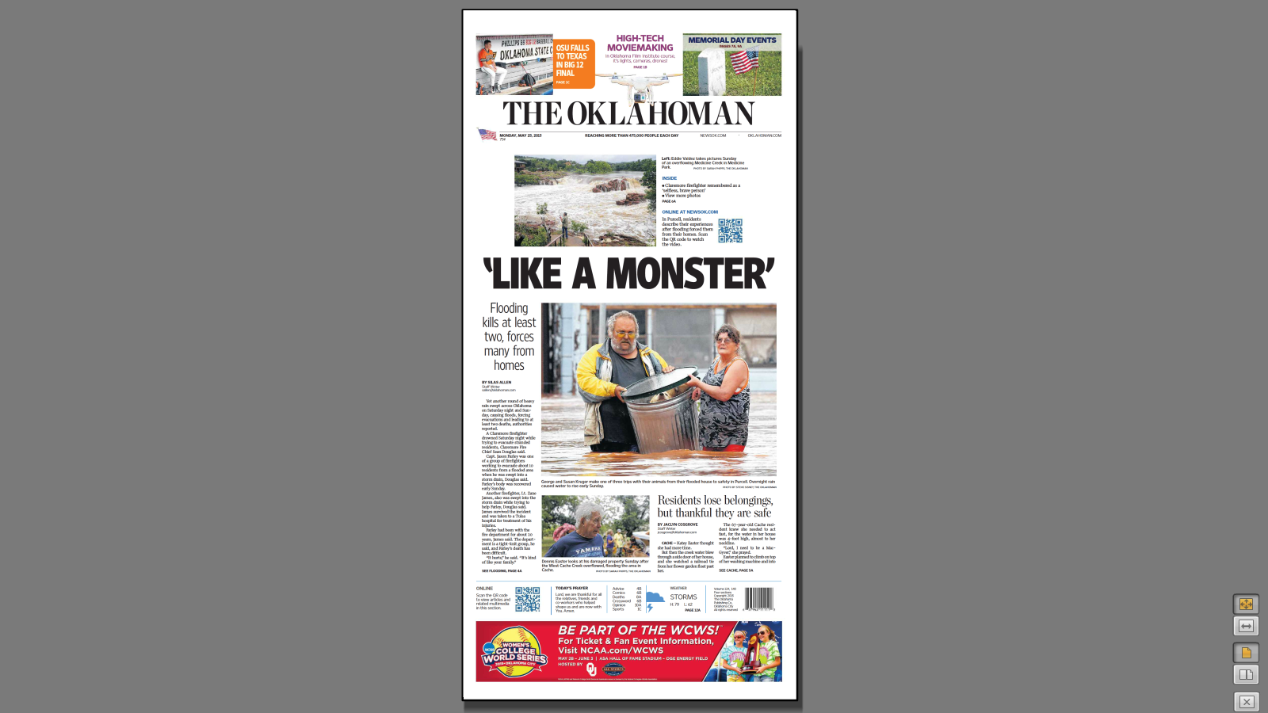
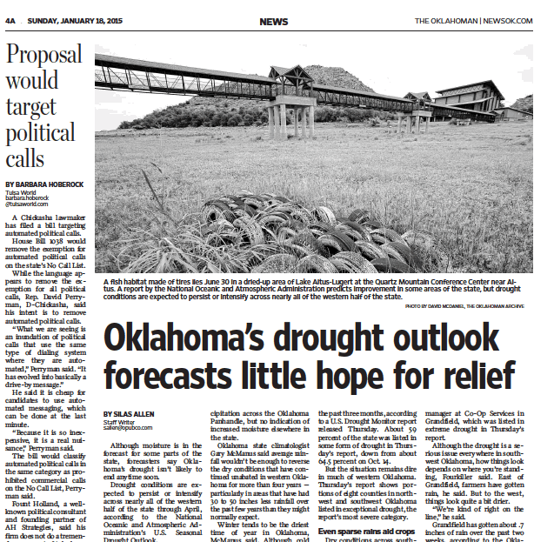

Slide 5
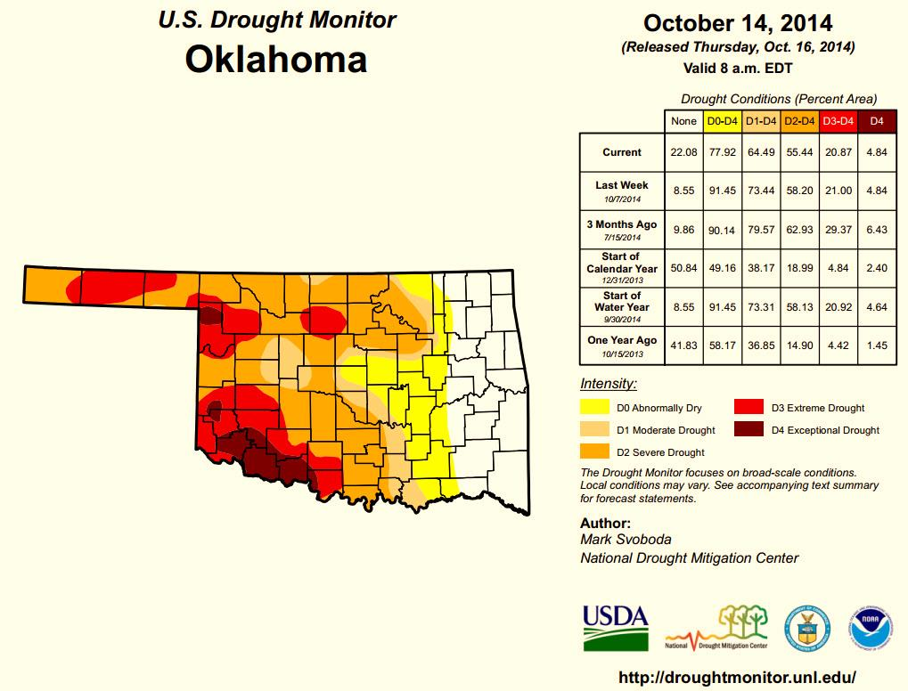
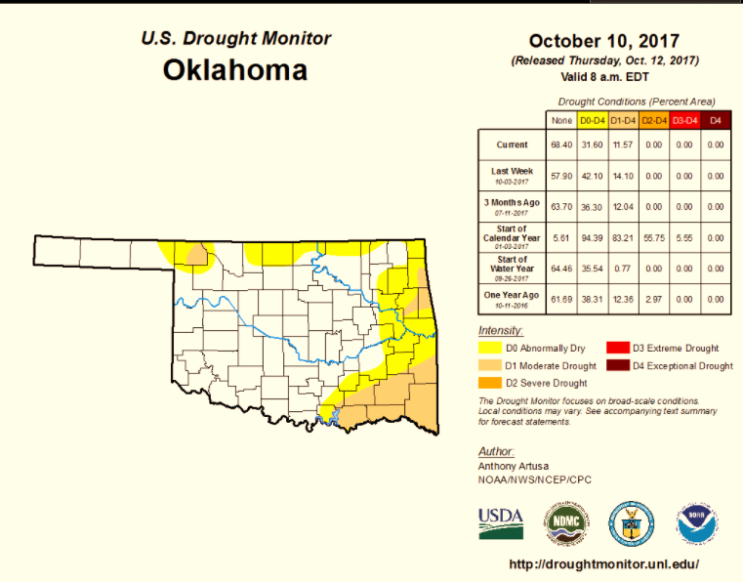
Oklahoma Drought Monitor
Notes:
Since May 2015, OK has had more flooding than drought and conditions have improved. However, long-term planning is essential in becoming drought resilient for when it does reoccur.

Slide 6
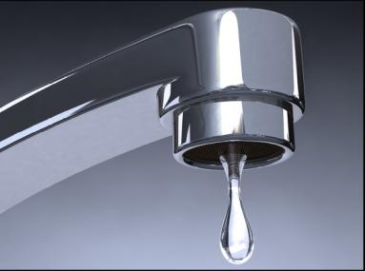
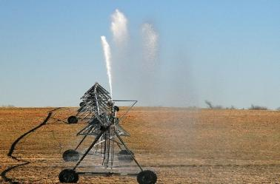
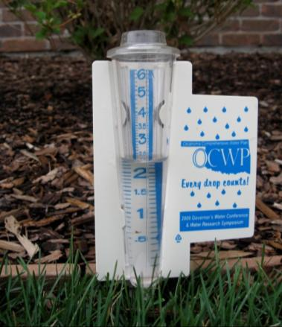
Water Supply Reliability
Reliable Supply
Physical Availability
Permit Availability
Water Quality
Infrastructure

Slide 7
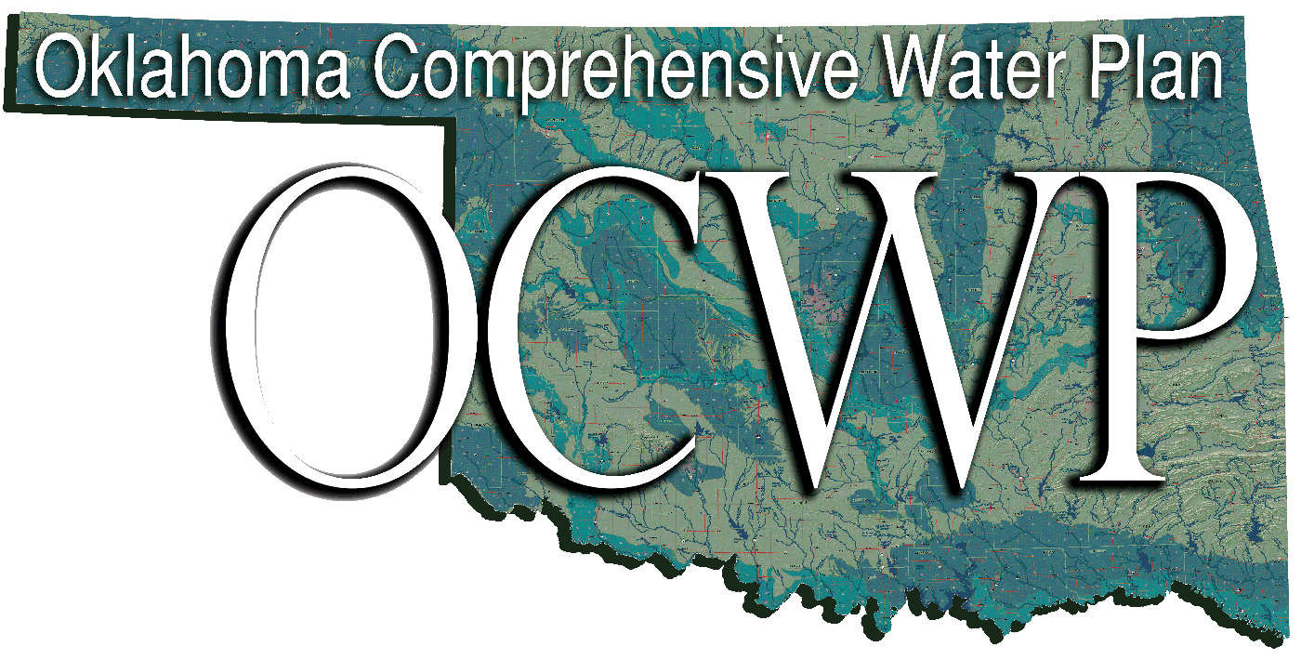




Addressing Drought
OK Comprehensive Water Plan
Water For 2060
Loans/Grants
Oklahoma Drought Tool
Water Loss Audits

Slide 8
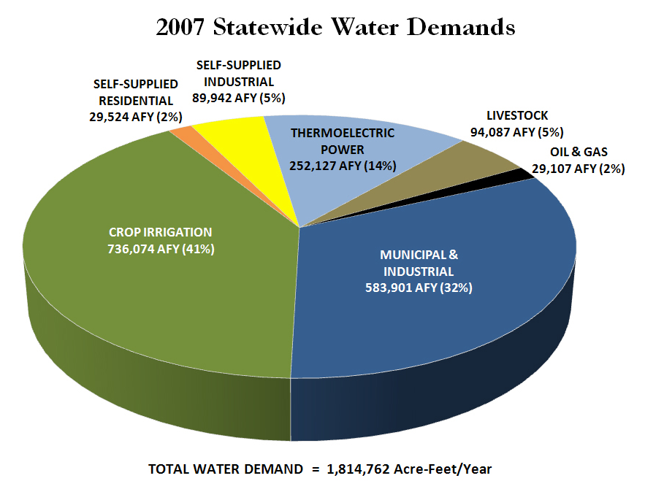
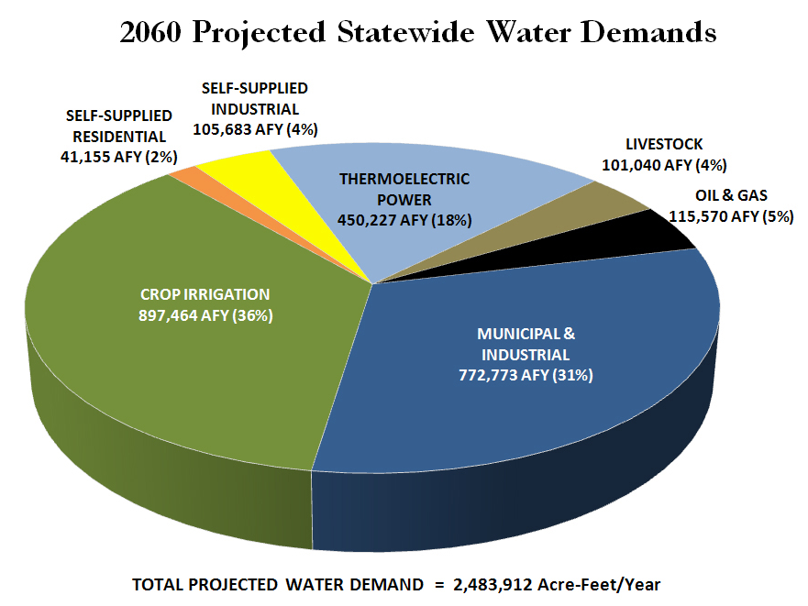
Statewide Water Demands
Notes:
From 1.9 Million AFY to 2.5 Million AFY – 33.3% increase
Crop irrigation is projected to use 20.4% more by 2060
M&I increase by 28.3%

Slide 9
OCWP Priority Recommendations
Infrastructure Financing
Conservation, Efficiency, Reuse, Recycling
Monitoring
Supply Reliability
Fish & Recreation Flows
Excess/Surplus Water
State/Tribal Water Consultation & Resolution
Regional Planning

Slide 10
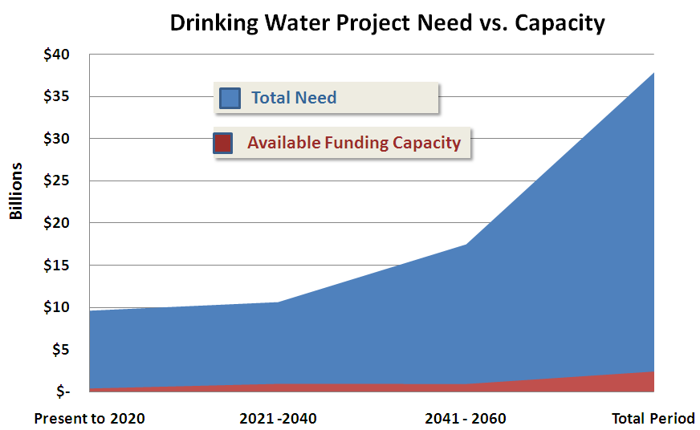
2012 Update of the OCWP
Infrastructure Financing
OCWP Priority
Address Oklahoma‘s projected $82+ billion water and wastewater infrastructure need by 2060
OWRB’s successful loan & grant programs could only satisfy 4-9% of this need
OCWP has a goal for OWRB to fund 60% of this need

Slide 11
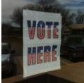
Water Infrastructure Credit Enhancement Reserve Fund (WICERF)
SQ 764 passed Nov. 2012
OK pledges $300M in state bonding authority to the reserve fund
  Gives OWRB the capacity to fund $3.5 billion in loans at any one time
  Allows OWRB to meet the 60% goal for funding of water/wastewater infrastructure in the state
Helps OWRB financing programs maintain AAA rating

Slide 12
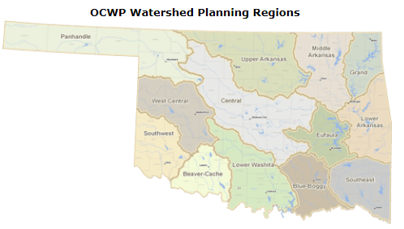
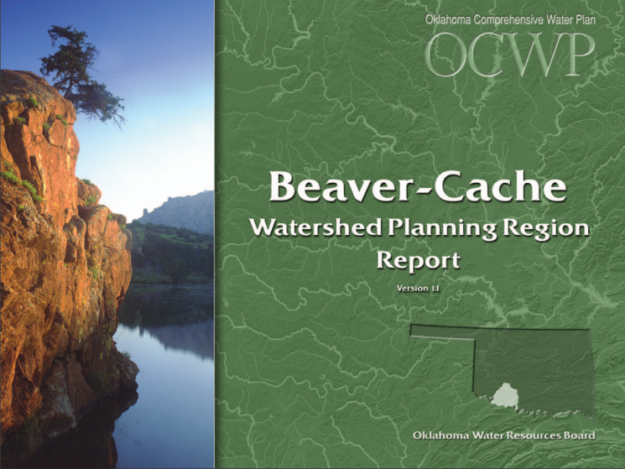
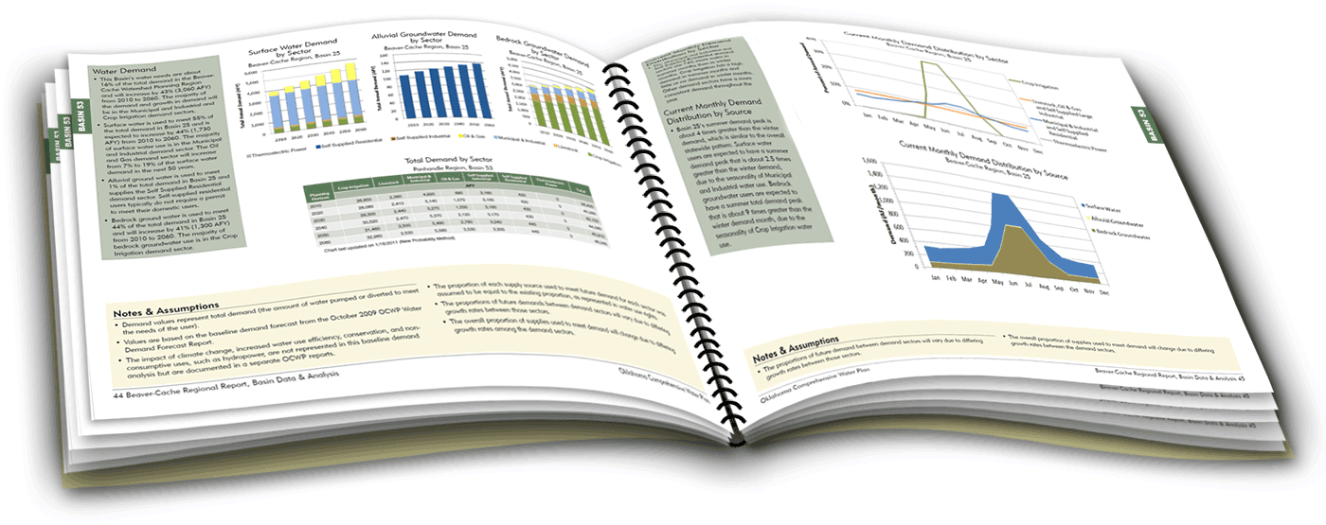
OCWP Summary
Overriding goal to provide safe, reliable water supplies to meet needs of all Oklahomans.
Notes:
Executive Report Summarizing 13 Watershed Planning Region Reports

Slide 13
Addressing Drought
OK Comprehensive Water Plan
Water For 2060
Loans/Grants
Oklahoma Drought Tool
Water Loss Audits

Slide 14
Water for 2060 Initiative
Ambitious GOAL of consuming no more freshwater in 2060 than we consume today

Slide 15
Water for 2060 Initiative
Advisory Council’s 15 members from various sectors investigate ways to incentivize conservation:
  Infrastructure Financing
  Public Water Supply
  Agriculture
  Industry, Oil and Gas
Meeting quarterly
Recommendations were due to Governor in 2015

Slide 16
Addressing Drought
OK Comprehensive Water Plan
Water For 2060
Loans/Grants
Oklahoma Drought Tool
Water Loss Audits

Slide 17
Financing for the Future
Programs for water and wastewater infrastructure that assist with drought related projects
  Emergency and Emergency Drought Grants
  Rural Economic Action Plan Grants
  Emergency Drought Relief – $1.125 M
  Water for 2060 Drought Grants - $1.5 M
  Financial Assistance Loan Program
  Clean Water State Revolving Fund
  Drinking Water State Revolving Fund
Notes:
EDR grant was used mostly for developing additional groundwater sources and adding new wells
W42060 grant was used for water efficiency projects and projects that support drought resiliency: had to document percent efficiency by the project
money was used for line replacement and AMR projects: Entities improved their water loss on average by about 50%

Slide 18
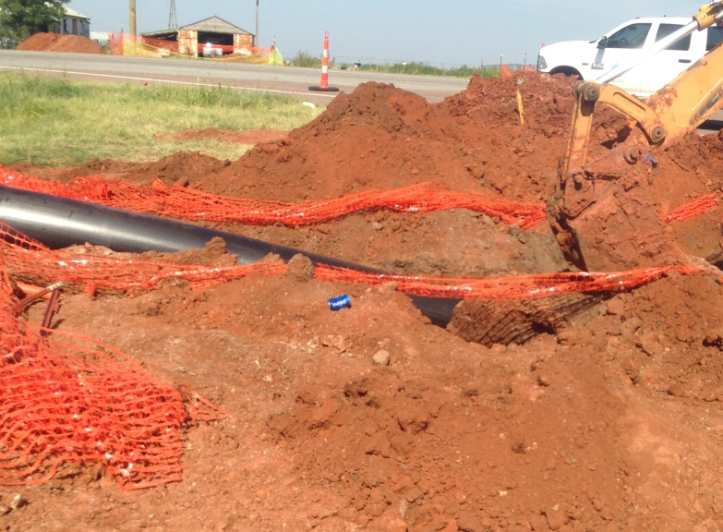
Altus Municipal Authority
$2.3 M DWSRF/$575K EDR Grant
Southwest Oklahoma located in a hot spot for drought
The water supply source for the City of Altus consisted of two lakes. Lake levels were reaching severe conditions due to evaporation and little rainfall.
Construction of a 10 mile 12” water line
to serve their existing rural customers
Converted an existing 18” water line
into a raw water supply line from
existing water well fields located in
Texas to the water treatment plant.

Slide 19
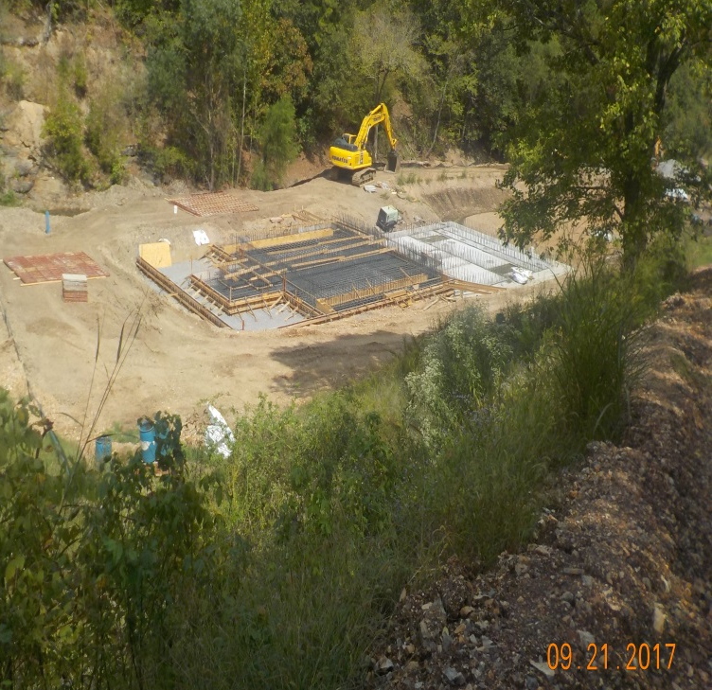
South Delaware Co. RWA
SDCRWA will take over Flint Ridge RWD water treatment plant and expand it
Project Cost $16M ($3.7M DWSRF)
  Other funding agencies include RD,
  IHS, and Cherokee Nation
New Utility formed to include 5
systems from that region
  Colcord PWA, Kansas PWA, West
  Siloam Springs, Delaware Co.
  RWSG&SWM No. 11, & Flint Ridge RWD

Slide 20
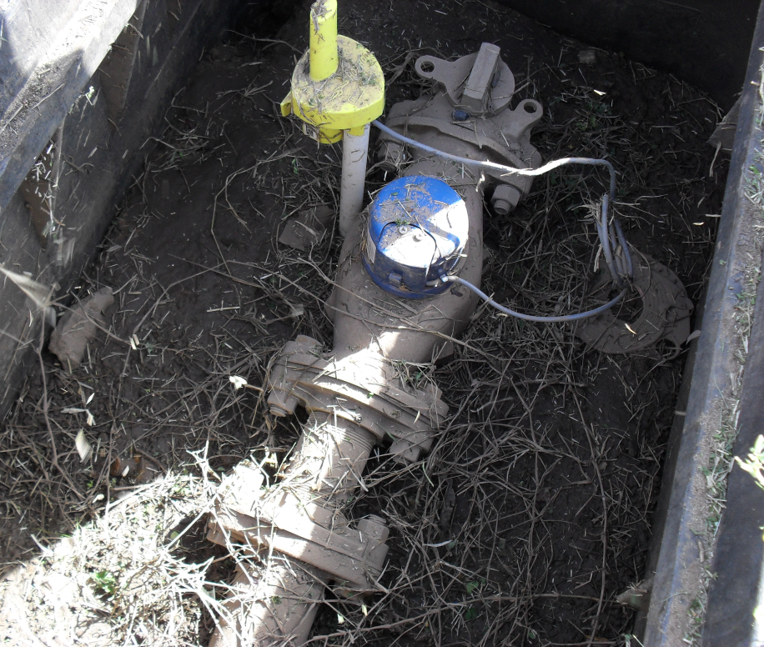
Automatic Meter Reader (AMR) Projects
Approximately $9.8M funded or have requested funds through CWSRF for Automatic Meter Reader projects
Greater than $1.1 Million Awarded in Principal Forgiveness

Slide 21
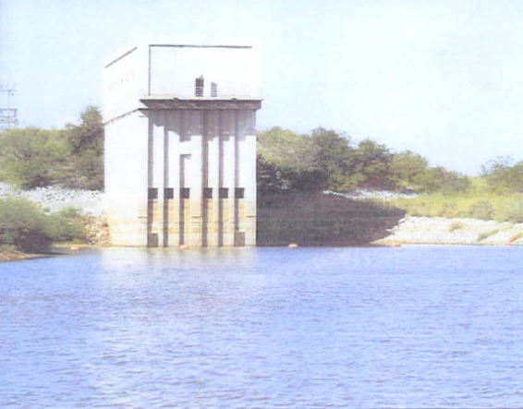
Waurika Lake MCD
$10M Loan through FAP
(state bond loan program)
Project planned Oct. 2014
Approved June 2015
Improvements to Waurika Lake
  Dredging 75,000 cubic yards of sediment from the intake channel
  Replacement of lower gates
  Installation of floating intake pumping structure at deepest point
  Extension of pipeline
Notes:
Waurika Lake dropped to 19% capacity in early 2015, approaching the lowest operable intake gate. By the time the project was approved, the lake was over 100% of capacity. However, the district still determined the project was critical to the water supply of the future and went forward with the project.
It was much harder to find a contractor to dredge the lake at capacity then during drought.

Slide 22
Addressing Drought
OK Comprehensive Water Plan
Water For 2060
Loans/Grants
Oklahoma Drought Tool
Water Loss Audits

Slide 23
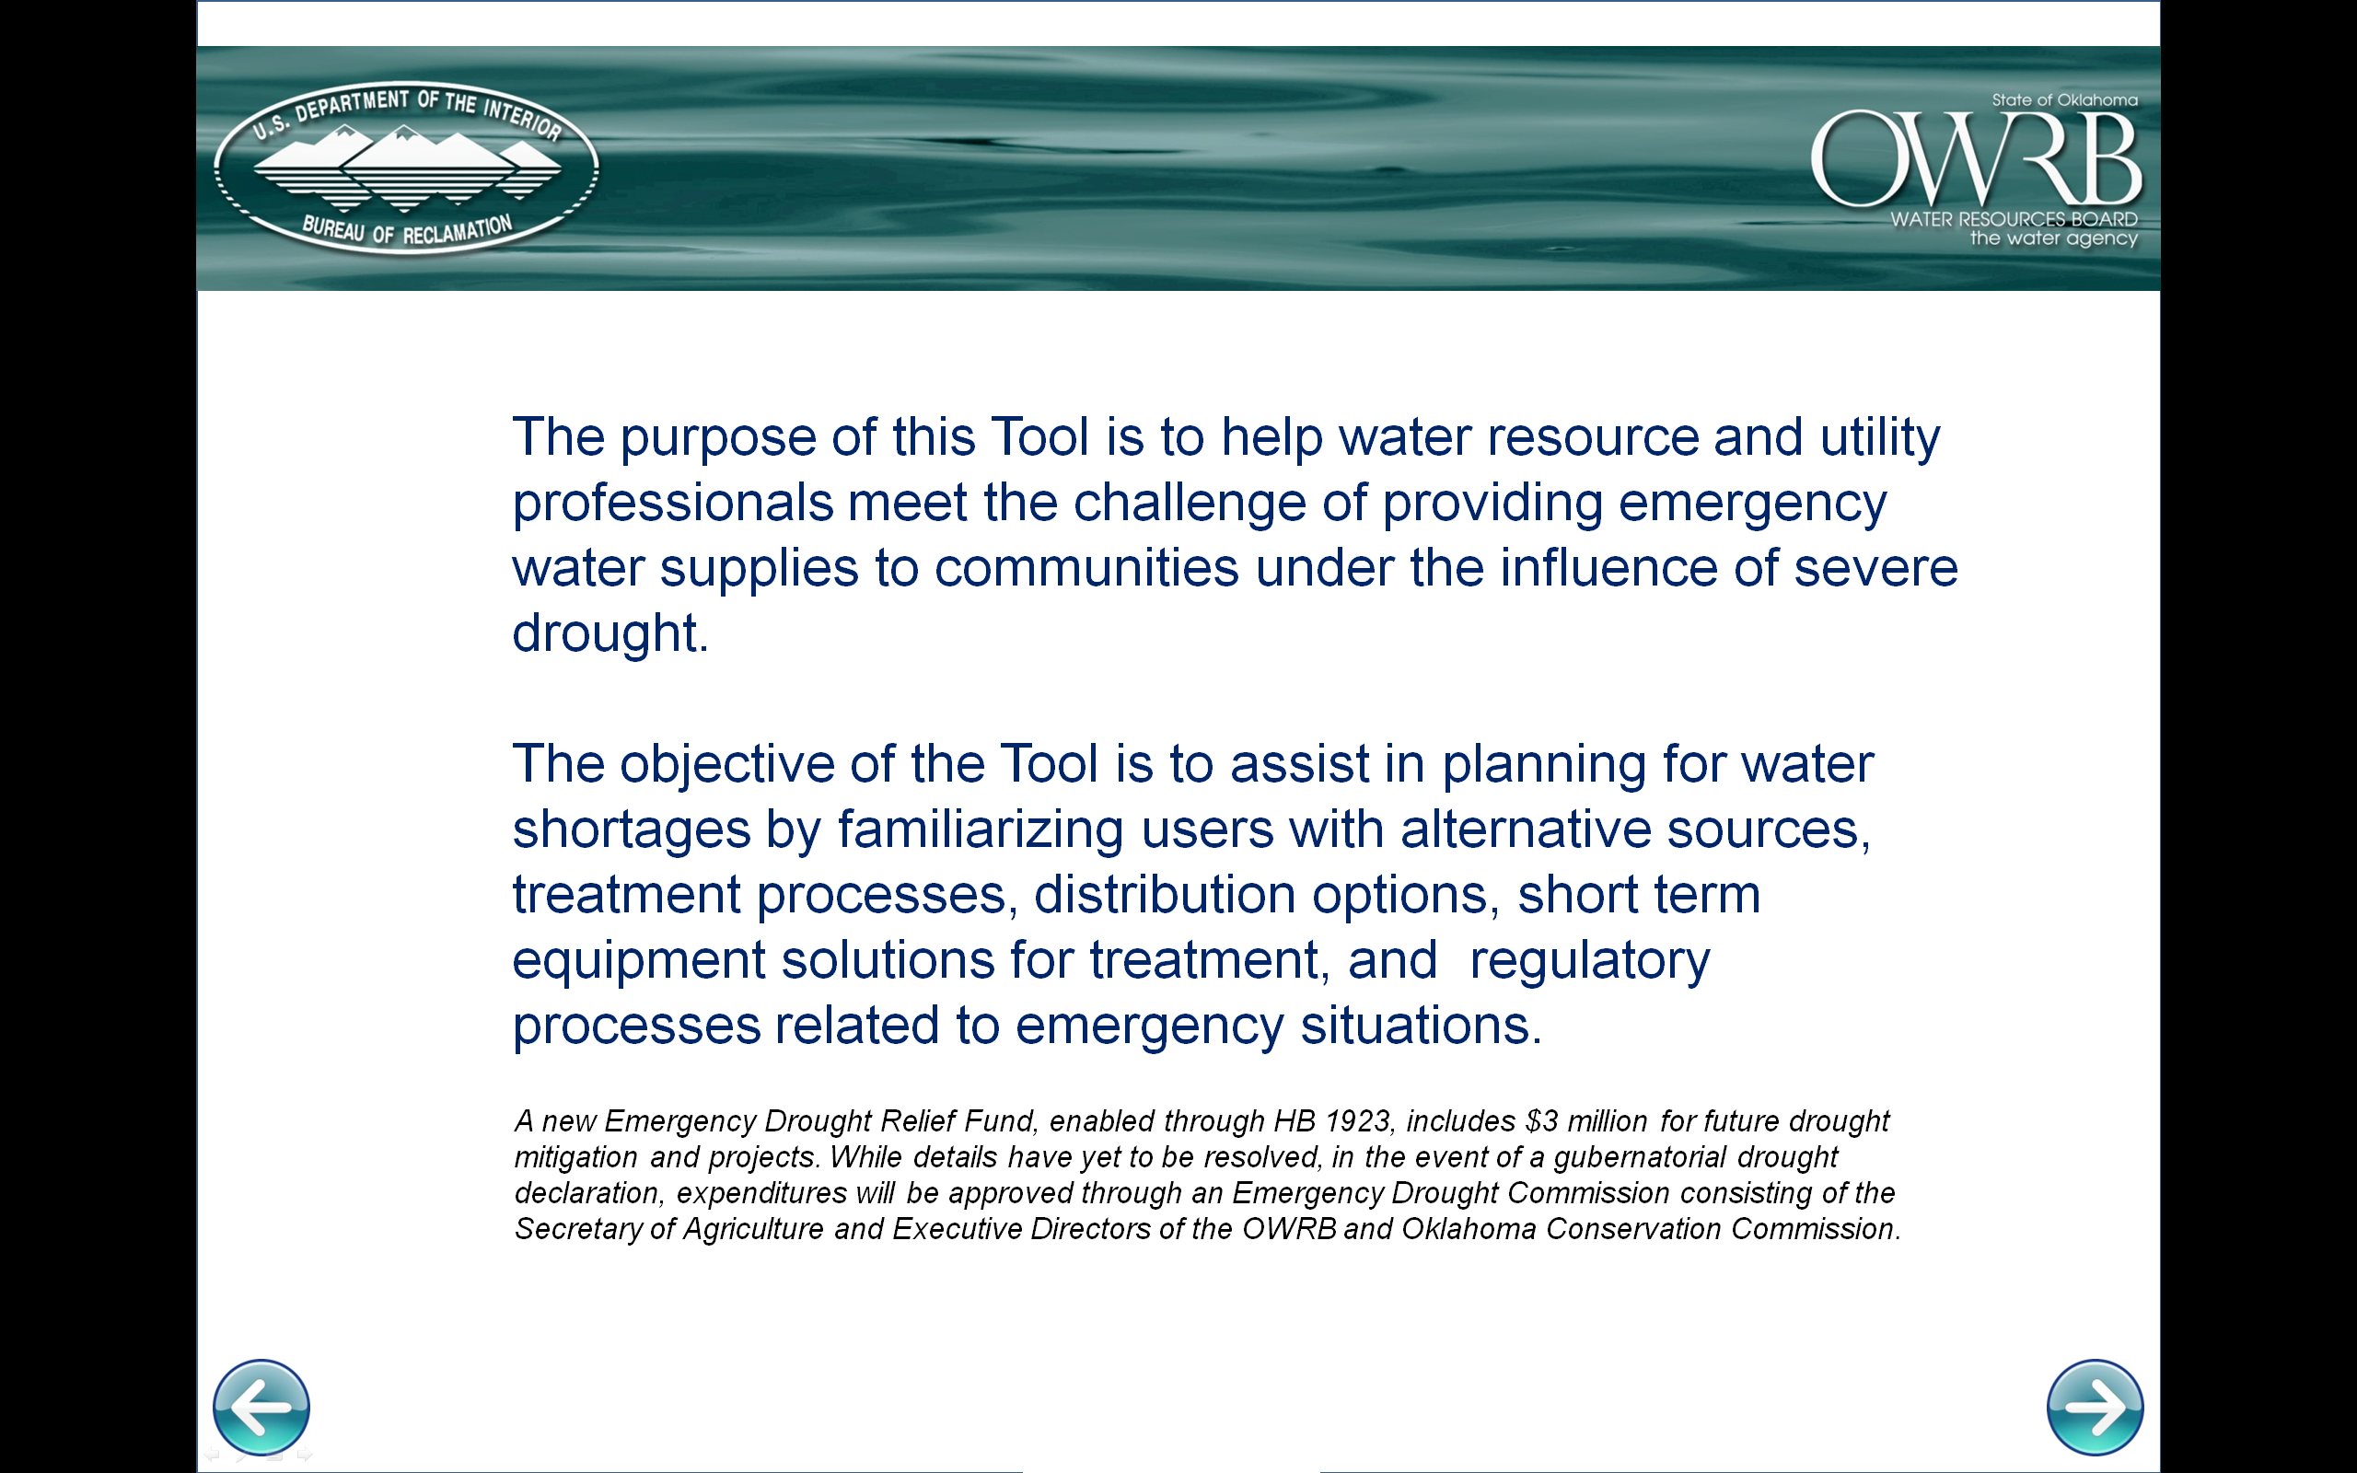
http://www.owrb.ok.gov/drought/

Slide 24
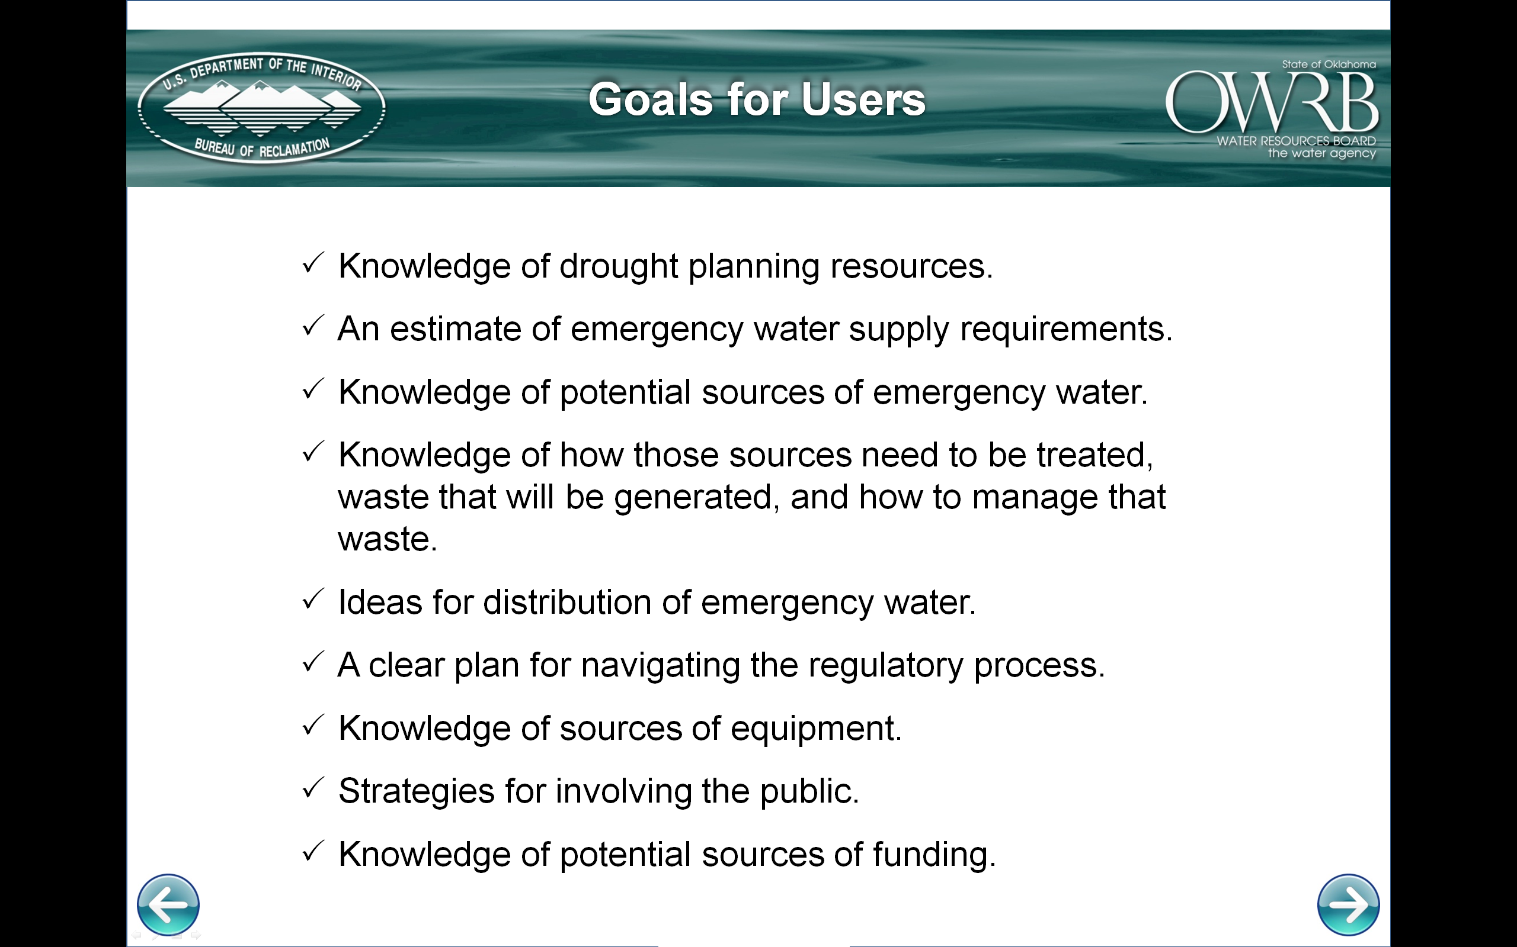

Slide 25
Addressing Drought
OK Comprehensive Water Plan
Water For 2060
Loans/Grants
Oklahoma Drought Tool
Water Loss Audits

Slide 26
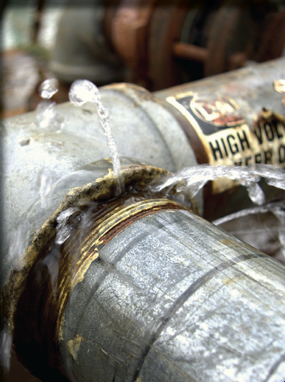
Water Loss Audits
Started with a Pilot Program in 2015 evaluating 40 volunteer water systems
Funded through DWSRF Source Water Protection Set-Asides
Contracted with NM EFC to conduct training using AWWA’s methodology
Goal to help small community water systems develop the information to find and correct sources of non-revenue water
Notes:
There was no standardized method of accounting for water loss prior to the pilot project

Slide 27
Water Loss Audits
Average results of the audits:
  Around 30% of water produced was nonrevenue water
    22% of that was determined to be real loss
    4.4% was apparent loss
DEQ then contracted with ORWA to perform leak detection and meter analysis at 18 of the communities
More information contact – Brandon Bowman, ODEQ brandon.bowman@deq.ok.gov

Slide 28
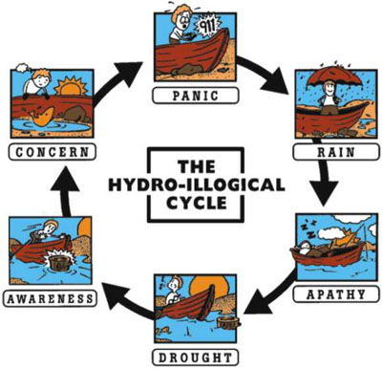
Hydro-LOGICAL Cycle
Plan ahead, and plan for the worst
Conserve as if we’re always in drought
Reuse/recycle as much as possible
Innovate – look for alternatives to freshwater for meeting every need
Minimize cost, both fiscal and political
© National Drought Mitigation Center

Slide 29
Lori Johnson
Thank You
Assistant Chief, Financial Assistance Division
Lori.johnson@owrb.ok.gov
Oklahoma Water Resources Board
3800 North Classen Boulevard
Oklahoma City, OK 73118
Phone: 405.530.8835

