Slide 1
Drinking Water State Revolving Fund and Performance Based Infrastructure
Janet Cherry, PE
Office of Drinking Water

Slide 2

Office of Drinking Water Mission
We work with others to protect the health of the people of Washington State by ensuring safe and reliable drinking water.

Slide 3
DWSRF Construction Loans
Washington receives 2.23 percent of national funding
SFY 2016: Funded $54 million in construction projects
SFY 2017: Received applications for $58 million
  Will fund $35 million in contracts

Slide 4
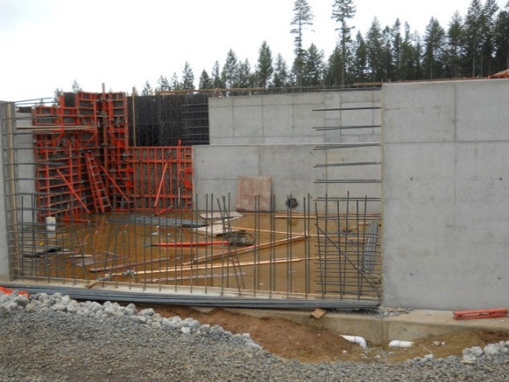
DWSRF Construction Loans
Eligible projects:
Address a public health risk.
Upgrade deteriorated facilities.
Can reimburse for eligible preconstruction activities (design, cultural report, permits).

Slide 5
DWSRF Construction Loans and PBI
How can Performance Based Infrastructure (PBI) be used with a DWSRF loan?
  Alternative procurement process
  Partnering with private funders

Slide 6
DWSRF Construction Loans and PBI
Alternative procurement process
  General Contractor/Construction Manager (GCCM)
  Design-Build
  Design-Build-Operate
  Bundling

Slide 7
GCCM:
Tacoma Green River Filtration Plant
Recently constructed Tacoma Green River Water Treatment Plant 150 MGD
Serves Tacoma and surrounding area--about 500,000 people
Constructed using General Contractor/Construction Manager (GCCM) contracting procedures
Had to obtain Capital Projects Advisory Review Board approval

Slide 8
GCCM:
Tacoma Green River Filtration Plant (contin.)
Total project cost: $200 million
Multiple funders
DWSRF: $45 million (multiple loans)
Bonds: $79 million
Partner Utilities: $66 million
Public Works Trust Fund: $10 million

Slide 9
GCCM:
Tacoma Green River Filtration Plant (contin.)
Benefits of using GCCM:
Can select most qualified contractor, don’t need to select lowest bidder.
Tacoma has qualified staff to operate plant and wanted to maintain ownership and operation.
Tacoma able to provide input throughout project, unlike in a design-build contract.
Able to receive contractor input on construction and sequence plant layout revisions that saved money.

Slide 10
GCCM:
Tacoma Green River Filtration Plant (contin.)
Benefits realized by Tacoma:
Able to receive contractor input on construction and sequence plant layout revisions that saved money .
City realized cost savings if project finished for less than maximum project cost.
Fewer claims and change orders than past projects.

Slide 11
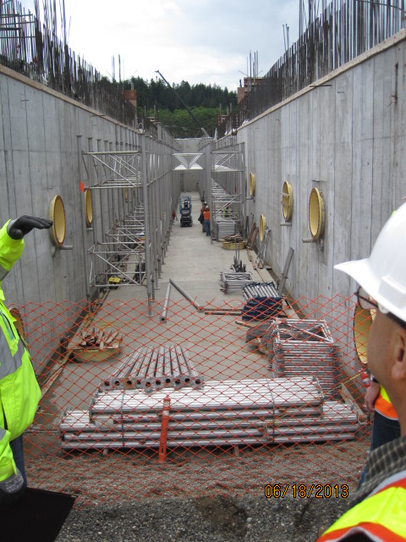
GCCM:
Tacoma Green River Filtration Plant (contin.)

Slide 12
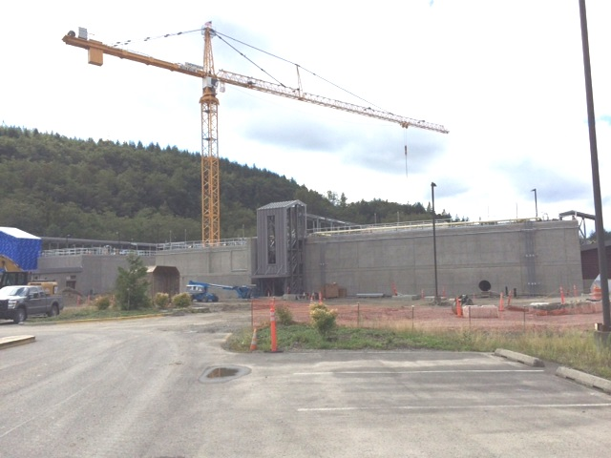
GCCM:
Tacoma Green River Filtration Plant (contin.)

Slide 13
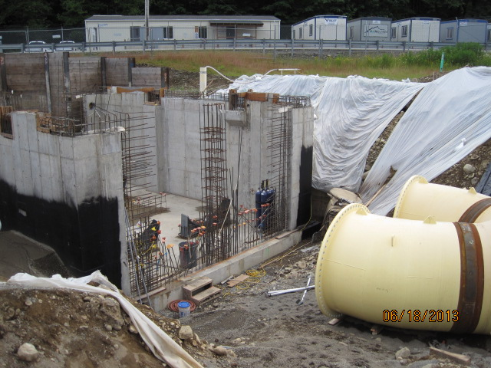
GCCM:
Tacoma Green River Filtration Plant (contin.)

Slide 14
GCCM:
Walla Walla UV Project
Funded with two $12 million DWSRF loans
Project started as 24 MGD slow sand filter plant, but is now a 24 MGD UV Plant
Contractor selected early in project development
  Assisted with developing accurate cost estimate of slow sand filter plant
  Resulted in City abandoning slow sand filter plant design and commenced with UV design

Slide 15
GCCM:
Walla Walla UV Project
Other benefits of GCCM
  Less change orders
  Able to identify and minimize risks of working within footprint of existing infrastructure that is 90 years old
  Better specifications and to ensure qualified contractors bid on project
  Able to maintain existing plant operations with minimal interruptions

Slide 16
GCCM:
Walla Walla UV Project

Slide 17
Example of Design/Build/Operate:
Seattle Water Treatment Plants
Constructed using design/build/operate
City did not have operational staff and contractor very invested in outcome
Less risk to the city
Treatment plants are around 20 years old
Recent issues with decision making and assignment of responsibility

Slide 18
DWSRF Construction Loans and PBI:
Bundling Projects
Bundling projects will allow combining multiple similar projects to be bid together
  Example: Water main or lead service line replacement
Will most likely result in lower bid and cost savings to loan recipients
Each loan recipient would receive individual DWSRF loan contracts
  Would need to coordinate design and bidding of projects
Process still under development for DWSRF

Slide 19
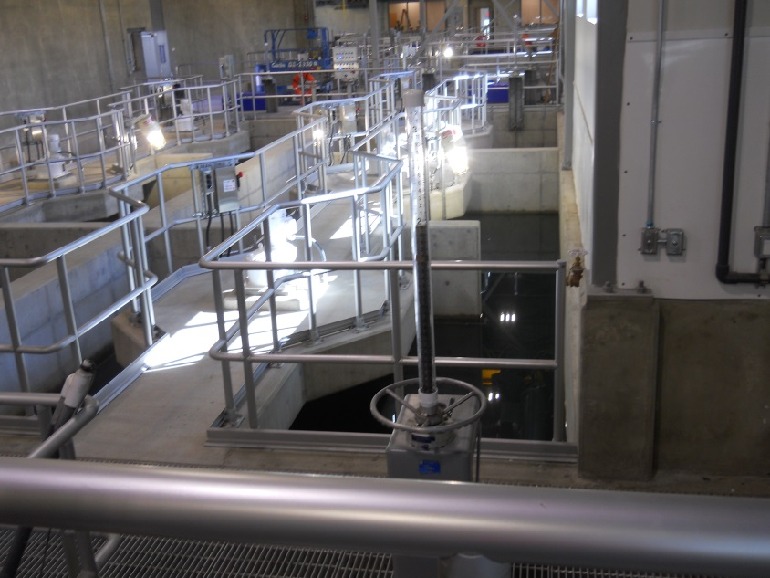
DWSRF Construction Loans and PBI:
Partnering with Multiple Funders
City of Lynden 8.0 MGD WTP
Multiple funders
DWSRF: $18 million
Whatcom County ED Grant: $2 million
Whatcom County ED Loan: $4 million
PWTF: $12 million

Slide 20
DWSRF Construction Loans and PBI:
Partnering with Private Investors?
Grand Mound water system expanding to serve growth (hotel and other businesses)
Need a new storage tank to provide fire flows and system redundancy
$1.5 million project
DWSRF cannot be used for growth or fire flows, but can pay for the portion of the tank needed for system redundancy
Need to develop business model for private investors to contribute

Slide 21
Questions?

Slide 22
Contact Information
Janet Cherry
Drinking Water State Revolving Fund
Office of Drinking Water
360-236-3153
Janet.cherry@doh.wa.gov

