Slide 1
State Revolving Fund Programs
CWSRF Trends in Florida
Council of Infrastructure Financing Authorities:
2016 SRF National Workshop
Austin, TX
October 31, 2016

Slide 2
CWSRF Funds Available
Notes:
The funds available in Florida are similar to the national trend. Bond proceeds, which is the gray area in the graph, increased the available funds in 2002, 2003, 2009, and 2011. The American Recovery and Reinvestment Act funding in 2009 provided an additional spike in funding, as you’ll notice in blue. Florida has no plans for additional leveraging at this time.

Slide 3
Funds Available by Source (Percentage)
Notes:
Repayments, represented in yellow, now generate over 60% of the annual funding and cap grants, shown in blue, are now less than 30% of the available funds. The green portion is interest earnings, orange is state match and gray is bond proceeds.

Slide 4
CWSRF Program Overview: Total Loans and Annual Assistance
Notes:
Our annual total assistance provided has generally trended up over the years, but it has been somewhat erratic. Between 2004 and 2009 we over-obligated funds in anticipation of leveraging. In 2010, we had to scale the program back to catch up, then ramped the program back up in 2011 and 2012 after our most recent bond issue. We are currently providing between $180 and $250 million annually and we project that will continue until the allocation formula for the federal capitalization grants has been revised. The number of loans fell sharply between 2010 and 2015 primarily as a result of the additional costs associated with the new requirements in the appropriations and WRRDA. We have revised our interest rates and procedures significantly to entice potential borrowers back into the program. Because of the addition of Davis-Bacon and American Iron and Steel, we lowered our interest rates by a full percent to offset additional costs. In addition, while we have had preconstruction loans since the inception of the program, in 2014 we revised the program rules to split preconstruction loans into planning loans and design loans, making it easier for very small systems to navigate through the process. That has resulted in a uptick in the number of loans provided.

Slide 5
Assistance Provided and Disbursements as a Percentage of Funds Available
Notes:
Florida has typically committed nearly 100 percent of available funds. Currently the committed funds and disbursed funds are right at the national averages of 98% for assistance provided and 86% for funds disbursed. We anticipate the percent disbursed will gradually trend up over time.

Slide 6
SRF Average Interest Rate Compared to Market Interest Rate
Notes:
Our interest rates have been a bit less linear than the national average as a result of various interest rate formulas. The latest change in 2014 was a direct result of the additional requirements of WRRDA. We reduce the interest rate on construction loans by 1 percent for Davis-Bacon and American Iron and Steel. We also reduce the interest rate by 0.1 percent for projects that qualify as green and for project sponsors that have implemented an asset management plan. Currently, with the exceptionally low market rate, most of our CWSRF construction loans will be at or very near 0%. Planning and design loans do not receive that reduction and those loans currently average just over 1%.

Slide 7
Annual Assistance by Needs Category (Percentage)
Notes:
In Florida, projects associated with advanced wastewater treatment, represented in orange, have been a major focus for the past 20 years. New collection systems to serve areas previously served by septic tanks has also been a priority, those are in yellow. For smaller systems, projects that correct inflow and infiltration issues have been the most common projects, those are in gray. Local governments constructing recycled water distribution systems have been a significant borrower in the past, but for the past two years, few sponsors have requested funds for these projects. Tim wanted me to pass along that he was happy that there is now a category for energy efficiency in CBR.

Slide 8
Total Annual Green Project Reserve 2009 - 2016
Notes:
Meeting the green project reserve requirement has not generally been an issue in Florida since historically there has been a relatively steady number of reclaimed water projects. In 2015, there was a reuse project the did not proceed as expected and there was a sharp drop off in green projects, though the requirement was met. Going forward, we are encouraging energy efficiency projects. One of these projects that will likely be funded this year involves a pilot project that will optimize aeration in digesters using various sensors and automated controls. This optimization is not only intended to dramatically reduce the aeration requirements, but will also reduce the phosphorous returned to the headworks.

Slide 9
Percentage of Assistance and Number of Loans by Population Size (10,000 Cutoff)
Notes:
Of note on this slide is the downward trend since 2010 for loans to sponsors serving less than 10,000 people, indicated by the blue line. That trend could be related to increasing federal requirements. The uptick in the number of loans made to small systems in 2016 is deceiving because it is the result of including planning and design loans. Ten of the 15 new loans made to small systems in 2016 were for planning and design and all of these included principal forgiveness.

Slide 10
Hardship/Disadvantaged Community Assistance
Notes:
In Florida, the net hardship assistance has trended down since ARRA funding, however, beginning in 2017, this assistance will be increasing substantially as a result of the additional subsidy required in recent cap grant awards and the return of our state grant program. We provide our subsidy using principal forgiveness and that along with state grants are both administered under the same rule. Note that the state grant program subsidizes CWSRF loans as if it were principal forgiveness. The increase in the number of loans to disadvantaged communities in 2016 was a product of the new planning loans and design loans.

Slide 11
Hardship/Disadvantaged Community Assistance: Funding and Percentage of Total Loans
Notes:
In this graph, orange represents annual assistance from 2009 to 2016, blue is hardship assistance and the black line is the percent of hardship agreements. As loans funded from repayments become a larger percentage of the total assistance provided, the percentage of loans with principal forgiveness will generally decline. However in 2017, we will be providing approximately $13 million in grants to disadvantaged communities which should reverse that trend to some extent.

Slide 12
Moving Forward
Marketing and Outreach
Basin Management Action Plan Meetings
Funding Workshops
Technical Assistance Focus Groups
Press Releases
Notes:
Offering interest rate incentives has been helpful in attracting projects, but moving forward, we would like to target our assistance more to the most beneficial projects. Working with local governments on projects identified in Basin Management Action Plans is one of our major efforts. A BMAP is a comprehensive set of strategies designed to reduce pollutant loadings to meet allowable standards. We hope that by partnering with these systems in the very beginning of the process, more high priority projects will result. We also are continuing our funding workshops with our funding partners and actively seek cooperative funding opportunities.

Slide 13
Cooperative Funding
Funders Meetings
USDA
CDBG
Water Management Districts
319 Grants
Other State Grant Funding Sources
Notes:
As in most other states, we work closely with our funding partners to leverage our limited resources. We try to meet quarterly as a group to discuss projects we are struggling with in an effort to bring all of the best programs to the table. Cooperative funding is such an important element that our Department recently reorganized all water infrastructure funding programs into one division to facilitate these synergies to the maximum extent possible.

Slide 14
Customer Feedback
Notes:
More recently, we have been conducting surveys that provide feedback on how we are doing and what we can do better. Information obtained from these surveys will help us develop a marketing plan that will result in more high priority projects.

Slide 15
Asset Management Planning
Identification of all assets and useful life remaining
Capital projects
Funding requirements
Notes:
Through our partnership with the FRWA, we are providing the development of Asset Management Plans, at no charge, to small disadvantaged systems. One of the primary components of an AMP is the identification of all assets and an evaluation of the criticality and useful life. Once this has been accomplished, the operation, maintenance, repair, and replacement of this assets is detailed and needed capital projects are identified and prioritized. Finally the funding requirements are analyzed and we are included as one of the possible financing tools these projects. Since we are involved from the beginning, we can work with these communities to fund the projects that fit best in our program.

Slide 16
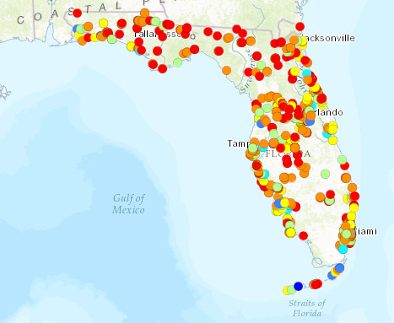
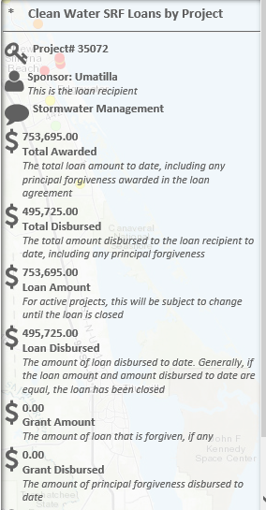
Interactive Mapping
http://ca.dep.state.fl.us/mapdirect/?focus=cwsrf
Basic information on all projects is readily available by clicking on any project. More detailed information, including a full description of the project, is available by opening the table.
Notes:
One of the comments stated in the recent SRF survey was that the local government did not think their project was eligible for the SRF program. Interactive mapping, as shown in this slide, allows anyone to view the projects statewide or in their particular area. By clicking on any of the dots, detailed information any CWSRF project can be viewed. Many other features are also available on this site, such as all active SRF projects, grant funded projects, and DWSRF projects. The different colors of the dots represent different funding levels of the loans.

