Slide 1
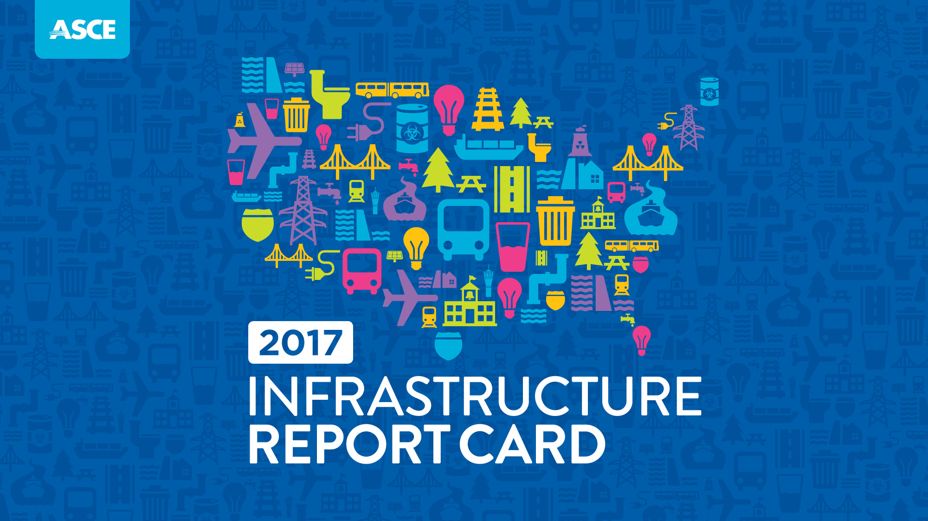
January 29, 2013
Notes:
Good morning.
Thank you for the opportunity to discuss an issue that increasingly dominates the news across the country, with serious consequences for our nation’s economy: America’s infrastructure.
The American Society of Civil Engineers is the nation’s oldest engineering society and represents the 150,000 civil engineers who serve as stewards of infrastructure here in the U.S. and around the globe.
Every four years since 1998, ASCE has prepared a comprehensive assessment of the nation’s 16 major infrastructure categories in its Infrastructure Report Card. Using a simple, familiar A to F school report card format, the Report Card examines current infrastructure conditions and needs, assigning grades and making recommendations to raise them.
And how does ASCE determine these grades?
Nearly 30 civil engineers volunteer their time and expertise across the Report Card’s 16 categories to serve on the ASCE Committee on America’s Infrastructure. Working with ASCE staff, they review relevant reports and data, meet with technical and industry experts, and assess each category according to the following eight key criteria:
Capacity
Condition
Funding
Future Need
Operation and Maintenance
Public Safety
Resilience
Innovation
Upon determining the grades in the 16 categories, the grades are averaged just as on a school report card to determine an overall grade for the nation.
Needless to say, since ASCE’s first Infrastructure Report Card, the grades have not been ones to make Lady Liberty proud; ASCE has yet to give an overall grade out of the Ds.

Slide 2
Notes:
That remains true in the 2017 Infrastructure Report Card: America’s cumulative GPA is once again a D+.
The cumulative grade of D+ reflects the significant backlog of needs facing our nation’s infrastructure writ large, particularly in the three categories that experience a decline in grade this year: Parks, Solid Waste, and especially Transit, the Report Card’s lowest grade at a D-.
Six categories’ grades remain unchanged from 2013: Aviation, Bridges, Dams, Drinking Water, Energy, and Roads, with all but Bridges stalled in the D’s.
Yet there are signs of progress – seven categories saw slight improvements: Hazardous Waste, Inland Waterways, Levees, Ports, Rail, Schools, and Wastewater.
Where we see areas of infrastructure that improved, those benefited from:
Strong leadership
Thoughtful policymaking
Investments that garnered results.
These improvements demonstrate what can be accomplished when innovative solutions that move projects forward are implemented.
A quick look at the highest and lowest grades:
Rail is the highest grade , rising to a B from a C+.
The private freight rail industry owns the majority of the nation’s rail infrastructure, and has made significant investment in recent years to meet current and future needs and accommodate changing cargo trends, including investment $27 billion in 2015 alone. This investment has led to the significant jump in grade.
However, U.S. rail still faces clear challenges, particularly on the passenger rail side, including addressing increasingly congested corridors, meeting safety technology demands, replacing 100-year old bridges, and improving rail interconnections with other aspects of the freight network for a more efficient system.
Transit received the lowest grade of a D-, a drop from a D in 2013.
Transit in America is hitting ridership records –10.75 billion trips in 2014 – yet the symptoms of overdue maintenance and underinvestment have never been clearer or, in some cases, more dangerous.
Despite increasing demand, the nation’s transit systems have been chronically underfunded, resulting in aging infrastructure and a $90 billion maintenance backlog.
While some communities are experiencing a transit boom, many Americans still don’t have access to public transit.

Slide 3
Notes:
Now let’s look more closely at the water categories you are especially interested in:
Drinking Water
Grade: D
The 2017 grade for our nation’s drinking water remains at a D.
Drinking water is one of the most vital, yet underappreciated resources in the United States, and the infrastructure that supports its preparation and delivery is similarly overlooked. Significant new investment and increased efficiencies are needed as filtration plants, pipes, and pumps age past their useful life.
The United States uses 42 billion gallons of water a day to support daily life from cooking and bathing in homes to use in factories and offices across the country.
Around 80% of drinking water in the U.S. comes from surface waters such as rivers, lakes, reservoirs, and oceans, with the remaining 20% from groundwater aquifers.
In total, there are approximately 155,000 active public drinking water systems across the country. Most Americans receive their drinking water from one of the nation’s 51,356 community water systems. About 5.5% percent of these systems serve more than 92% of the total population.
Drinking water is delivered via one million miles of pipes across the country. Many of those pipes were laid in the early to mid- 20th century with a lifespan of 75-100 years. With utilities averaging a pipe replacement rate of 0.5% per year, it will take an estimated 200 years to replace the system – nearly double the useful life of the pipes.
Every day, nearly six billion gallons of treated drinking water are lost due to leaking pipes, with an estimated 240,000 water main breaks occurring each year.
It is estimated that leaky, aging pipes are wasting 14 to 18% of each day’s treated water; the amount of clean drinking water lost every day could support 15 million households.
According to the American Water Works Association, upgrading and expanding existing water systems and meeting the drinking water infrastructure needs of a growing population will require at least $1 trillion.
The majority of funding for drinking water infrastructure comes from revenue generated by rate payers, and in the nation’s largest 50 cities, the rate users pay varies greatly. The lowest average monthly water bill is $14.74 in Memphis, while Seattle residents pay the most at $61.43.
As you well know, the federal government offers financial support to local governments and utilities in the form of loans through the Drinking Water State Revolving Fund, but needs far surpass the program’s budget.
The Water Infrastructure Finance and Innovation Act (WIFIA) program provides a new avenue for supporting water infrastructure.
In 2016 Congress appropriated $17 million in funds for the program. It is estimated that using WIFIA’s full financial leveraging ability that a single dollar injected into the program can create $50 dollars for project lending.
Under current appropriations, EPA estimates that current budget authority may provide more than $1 billion in credit assistance and may finance over $2 billion in water infrastructure investment.
The quality of drinking water in the United States remains high, but legacy and emerging contaminants, including lead, continue to require close attention.
Wastewater
Grade: D+
The national grade for wastewater has improved to a D+ from a D- in 2013.
Nearly 240 million Americans – 76% of the population – rely on the nation’s 14,748 treatment plants for wastewater sanitation. By 2032 it is expected that 56 million more people will connect to centralized treatment plants, rather than private septic systems – a 23% increase in demand.
In the U.S., there are over 800,000 miles of public sewers and 500,000 miles of private lateral sewers connecting private property to public sewer lines. Each of these conveyance systems is susceptible to structural failure, blockages, and overflows. The U.S. Environmental Protection Agency (EPA) estimates that at least 23,000 to 75,000 sanitary sewer overflow events occur in the United States each year.
As new users are connected to centralized treatment, older conveyance and treatment systems must manage increasing flow or new treatment facilities must be constructed. It is estimated 532 new systems will need to be constructed by 2032 to meet future treatment needs.
Stormwater collection and treatment infrastructure is similarly critical. 39 states have one or more stormwater utility and seven states have 100 or more stormwater utilities. The number of communities with stormwater utilities or fees has grown from approximately 1,400 in 2013 to 1,600 in 2016.
In approximately 772 communities in the U.S., wastewater and stormwater drain into the same treatment system. Data on stormwater infrastructure and combined sewer overflows are limited. After non-point source pollution, combined sewer overflows are a leading source of water pollution in the U.S.
In 2016, the EPA released a report to Congress on CSOs in the Great Lakes region. For the 184 CSO communities that discharge CSOs in the Great Lakes Basin, there were 1,482 CSO events in 2014, discharging an estimated 22 billion gallons of untreated wastewater into the Great Lakes Basin. Even these numbers were on the low side, as several communities did not report or have data available.
In 2015, EPA finalized the National Pollutant Discharge Elimination System (NPDES) electronic reporting rule, requiring the filing of discharge monitoring reports; this will make more CSO data available to the public.
The EPA estimates $271 billion is needed for wastewater infrastructure over the next 25 years. While the federal government provides some funding through the Clean Water State Revolving Fund (CWSRF), according to the U.S. Conference of Mayors 95% of spending on water infrastructure is made at the local level.
The federal government has provided on average $1.4 billion per year over the past five years through the Clean Water State Revolving Fund (CWSRF) program. In 2015 the annual assistance agreement for the CWSRF was $5.6 billion and in 2016 that number increased by $2 billion to $7.6 billion.
Of the major infrastructure categories the federal government funds, water services receive less than 5%. It is estimated local governments spend $20 billion a year on capital sewer expenditures and $30 billion annually on O&M.
Funding both capital projects and O&M is difficult because the public often does not see or appreciate the modern convenience of wastewater treatment, making it difficult to convey the need for sewer rate increases.
The majority of treatment facility expenses are supported by rate payers; in a 2014 survey of the nation’s 50 largest cities, average monthly sewer bills ranged from $12.72 in Memphis to $149.35 in Atlanta.
Given treatment plants’ common locations at the bottom of watersheds or coastal and riverine areas, many utilities have recently undertaken studies to assess vulnerability to more extreme flooding events and sea level rise, and to develop resilience plans and infrastructure fortification.
New methods and technologies allow plants to:
treat more wastewater, often discharging a cleaner product back into the environment;
turn waste into energy; and
help communities to better manage precious water supplies through reuse.

Slide 4
Notes:
The grades across the 16 categories, including Drinking Water and Wastewater, are cause for concern and reflect the fact that America’s infrastructure bill is long overdue.
In addition to grading the nation’s infrastructure, every four years, ASCE estimates the investment needed in each infrastructure category to maintain a state of good repair and earn a grade of B.
Between 2016 and 2025, the estimated Investment Gap totals just over $2.0 trillion.
According to our economic study, titled “Failure to Act,” the gap in Drinking Water and Wastewater Infrastructure totals $105 billion.
Even though Congress and some states have recently made efforts to invest more in infrastructure, these efforts do not come anywhere close to what’s needed; we’ve simply failed to invest for too long and now are struggling to catch up.
Failing to close this infrastructure investment gap brings serious economic consequences. According to ASCE’s latest economic study, prepared in 2016, if we do not address the infrastructure investment gap:
$3.9 trillion in U.S. GDP will be lost by 2025;
Businesses will lose $7 trillion y 2025; and
2.5 million jobs will be lost in 2025.
On top of that, each American family is already losing $3,400 in disposable income each year -- $9 a day – due to poor infrastructure. That’s income we could be saving or spending on other things that make our lives better, but instead are spending on car repairs, wasted time and gas, and increased costs for goods.

Slide 5
Notes:
To raise the national infrastructure grade over the next four years, ASCE urges the following starting points:
Investment
Leadership & planning
Preparation for the needs of the future

Slide 6
Notes:
Investment:
If the United States is serious about achieving an infrastructure system fit for the 21st century, some specific steps must be taken, beginning with increased, long-term, consistent investment.
Delaying investment escalates costs and risks of an aging infrastructure system – something the nation can no longer afford.
To close the $2.0 trillion 10-year investment gap, meet future need, and restore our global competitive advantage, we must increase investment from all levels of government and the private sector from 2. 5 percent to 3.5 percent of U.S. Gross Domestic Product (GDP) by 2025.
This investment must be consistently and wisely allocated, and must begin with the following steps:
Put the “trust” back into “trust funds.” Dedicated public funding sources on the local, state, and federal levels need to be consistently and sufficiently funded from user-generated fees, with infrastructure trust funds never used to pay for or offset other parts of a budget.
Fix the Highway Trust Fund by raising the federal motor fuel tax. To ensure long-term, sustainable funding for the federal surface transportation program the current user fee must be raised and tied to inflation to restore its purchasing power, fill the funding deficit, and ensure reliable funding for the future.
Authorize programs to improve specific categories of deficient infrastructure and support that commitment by fully funding them in an expedient, prioritized manner.
Infrastructure owners and operators must charge, and Americans must be willing to pay, rates and fees that reflect the true cost of using, maintaining, and improving all infrastructure.
To raise the Drinking Water and Wastewater grades, ASCE recommends the following steps to invest in water infrastructure:
Reinvigorating the Drinking Water SRF program through permanent reauthorization and tripling the amount of annual appropriations, and reauthorizing the minimum federal funding for the Clean Water SRF – $20 billion over five years.
Fully funding WIFIA at its authorized level.
Preserving tax exempt municipal bond financing. To help keep lending for drinking water upgrades accessible for communities of all sizes.
Establishing a federal Water Infrastructure Trust Fund.
Eliminating the state cap on private activity bonds for water infrastructure projects to bring an estimated $6 to $7 billion annually in new private financing.

Slide 7
Notes:
Leadership & Planning:
Smart investment will only be possible with leadership, planning, and a clear vision for our nation’s infrastructure.
Leaders from all levels of government, business, labor, and nonprofit organizations must come together to ensure all investments are spent wisely, prioritizing projects with critical benefits to the economy, public safety, and quality of life, while also planning for the costs of building, operating, and maintaining the infrastructure for its entire lifespan.
To do so, we must:
Require all projects greater than $5 million that receive federal funding use life cycle cost analysis and develop a plan for funding the project, including its maintenance and operation, until the end of its service life.
Create incentives for state and local governments and the private sector to invest in maintenance.
Develop tools to ensure that projects most in need of investment and maintenance are prioritized, to leverage limited funding wisely.
Streamline the project permitting process across infrastructure sectors, with safeguards to protect the natural environment, to provide greater clarity to regulatory requirements, bring priority projects to reality more quickly, and secure cost savings.
Identify a pipeline of infrastructure projects attractive to private sector investment and public-private partnership.

Slide 8
Notes:
Preparing for the Future:
We must utilize new approaches, materials, and technologies to ensure our infrastructure is more resilient and sustainable.
This can be achieved by:
Developing active community resilience programs for severe weather and seismic events to establish communications systems and recovery plans to reduce impacts on the local economy, quality of life, and environment.
Considering emerging technologies and shifting social and economic trends – such as autonomous vehicles, distributed power generation and storage, and larger ships – when building new infrastructure, to assure long-term utility.
Improving land use planning at the local level to consider the function of existing and new infrastructure, the balance between the built and natural environments, and population trends in communities of all sizes, now and into the future.
Supporting research and development into innovative new materials, technologies, and processes to modernize and extend the life of infrastructure, expedite repairs or replacement, and promote cost savings.

Slide 9
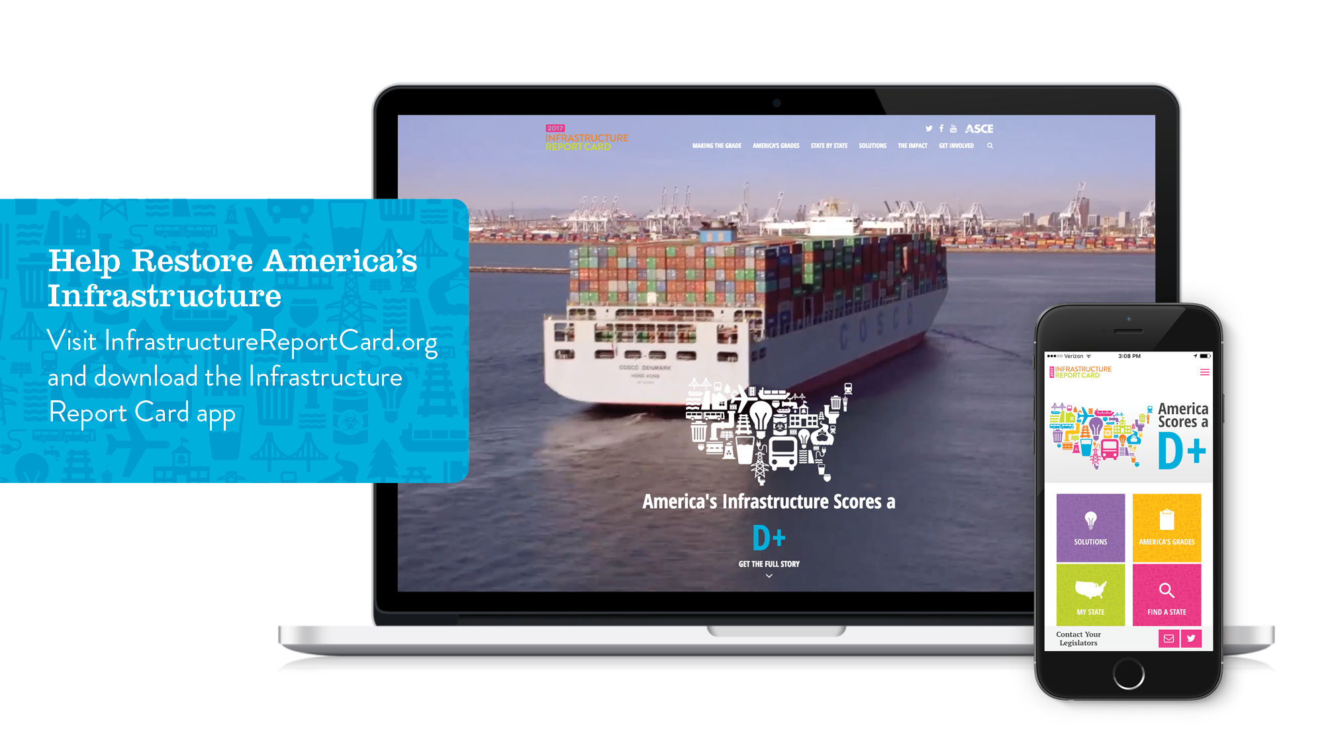
Notes:
Opportunity exists right now to make good on these recommendations to solve our nation’s infrastructure crisis, as the Trump Administration and U.S. Congress weigh infrastructure legislation and state and local governments around the country look to take action in their communities.
ASCE is encouraged by the signs from President Trump and leaders in Congress to potentially work together on this bipartisan issue that will contribute to significant gains for the American economy and families.
But Congress – and the American public – will have to pay for it; there’s no magic money to address this crisis, either from an infrastructure giving tree or from the private sector so often touted as the key to revitalizing infrastructure.
All levels of government and the private sector must partner to close our infrastructure deficit, commit to a future in which we improve infrastructure, and value it as key to our quality of life and economic prosperity.
Every day of delay escalates our shared costs, jeopardizes our health and risks our security – an option our country, economy and communities can no longer afford.
We urge you all to take the first step by visiting InfrastructureReportCard.org and downloading the Save America’s Infrastructure App. Explore the Report Card, videos, infographics, and interactive content, and share it with others.

Slide 10
Notes:
Thank you again for the opportunity to share the Report Card with you today, and for your interest in this critical topic that underpins our quality of life, public safety, public health, and the success of the American economy.
ASCE looks forward to working with you to help to continue to make infrastructure a priority across the country.
I’d be happy to take any questions, or you can contact us at ReportCard@asce.org.

