Slide 1
Building Partnerships to Finance Sustainable Rural Water and Wastewater Infrastructure
CIFA, March 27 2018
Rural Development

Slide 2

What is a Partnership?
“A collaborative relationship between entities to work toward shared objectives through a mutually agreed division of labor.” (World Bank, Partnerships Group)
Notes:
According to the World Bank a partnership is “a collaborative relationship between entities to work toward shared objectives through a mutually agreed division of labor. (World Bank, Partnerships Group, Strategy and Resource Management, “Partnership for Development: Proposed Actions for the World Bank” (discussion paper, May 20, 1998), p. 5.)
I like to think of a good partnership like a fine wine and cheese pairing. If it is done right, the outcome is truly amazing and quite tasty.

Slide 3
Infrastructure Funding Partnership
To be effective:
Creates a platform amongst entities
Efficient use of resources
Formal or Informal
Notes:
For infrastructure, an effective partnership should create a platform amongst the various public, private and non-government stakeholders in a way that allows their financial, physical and other resources to be efficiently utilized to provide needed infrastructure.
They can be formal in nature, such as large-scale working relationships like shared buildings, services, MOUs.
However, partnerships do not always need to be formal such as collaborations and be as simple as weekly, monthly or quarterly calls between agencies. Partnerships can also take many forms and evolve over time, starting from sharing information to aligning processes and engaging in joint ventures.

Slide 4
Program Priorities = Shared Objectives
EPA SRF Initiatives
Communities can operate in a safe and healthy environment
Compliance with state and federal regulations (i.e. Nutrient Impacts Reduction)
Affordable to communities
RD Rural Prosperity Initiatives
Infrastructure
Partnerships
Innovation
Create jobs and promote economic development
Notes:
Since the 1990s, EPA and USDA have partnered formally and informally to provide improved access to clean and safe water to small communities across the country. In the past ten years, these partnerships have resulted in the development of joint review and policy documents that have provided better customer service to small and rural communities.
When we first sat down and thought about what we would talk about we thought about our respective agency initiatives. After doing this, we realized that a number of our respective initiatives were similar in nature.
And ultimately both of our programs create jobs…

Slide 5
Types of Partnerships
Project Based
Programmatic
Notes:
And when we thought about how our programs partner, we thought of two types of partnerships…
On a project level we co-fund, where one partner provides interim financing on predevelopment work such as design where the other funds construction.
Programmatically we can coordinate on Cross Cutting Federal Requirements.

Slide 6

Benefits of a Partnership
Efficient and effective government
Funding resources & timeframes
Bridges the gap between public and private sectors
Expedite timelines
Allows for shared resources (leadership, staff, funds, technology, expertise etc..) on co-funded projects
Standard contracts, site visits
Notes:
Next we looked at some of the benefits to partnering…
On a project level…
Streamlining similar requirements: NEPA, AIS, various OMB requirements and streamlining the application process for federal assistance for water and waste infrastructure
Working with the private sector to help move projects towards construction more efficiently
Use of standard contracts, shared site visits on co-funded projects

Slide 7
Benefits of a Partnership
Vehicle for system change and organizational development
Streamline common requirements: NEPA, AIS
Achieves greater visibility and influence
OMB, White House
Improves access and engagement
One application
Notes:
Programmatically,
Streamlining requirements and processes could lead to inherent change within agencies ultimately benefitting the communities we serve
For example with legislators, OMB, Whitehouse it is important that we show how our respective programs implement the same federal requirements consistently.
Streamlined/Unified application process provides easier/improved access to water and waste infrastructure funding to communities we serve
When entities share common or aligned goals, rights and responsibilities, they can improve effectiveness, visibility and influence all through forming partnerships.

Slide 8
Partnering opportunities – RD & SRF
Shared expertise provides resilient & efficient projects.
Streamlining and coordination of common requirements (AIS, NEPA) reduces paperwork and time for customers and government.
Leveraged funding provides financial flexibility for customers, specifically for small/rural systems.
Notes:
We are in times where demonstrating government efficiency is key, that we make sure we fund projects that make sense and ultimately that we are good stewards of tax payers dollars.
For example, with the new disaster related funding our program received we would like to ensure that we fund projects that promote resilient infrastructure especially in areas prone to repeat natural disasters vs. investing in rebuilding with traditional infrastructure.
With that said, our program is looking to our partners to see if there are existing policies and/or standards in place that can be replicated in our program reducing the amount of time and effort to implement new policy.
As we all know, the need far outweighs the funding available and therefore it is crucial to streamline processes, creatively finance infrastructure, leverage resources as much as possible to invest in sustainable and resilient systems and make funding for water and waste infrastructure affordable and accessible. Partnerships between various stakeholders is a win-win for everyone.

Slide 9
Unique Challenges to Small System/Rural Water Infrastructure
97% of the nation’s 156,000 public water systems are small systems serving 10,000 or fewer people
EPA and USDA are the largest federal funders of small systems. Combined annual budget is less than $4 billion
$600 billion in cost projected in 20 years for small systems
Notes:
Now I would like to introduce Karen Sanchez, the USDA RD State Engineer from the great state of Montana. She will be talking about the needs of small and rural systems and how they benefit from partnerships.
Challenge – LACK OF FUNDING: More than 97% of the nation’s 156,000 public water systems are small systems, meaning they serve 10,000 or fewer people. According to the United States Environmental Protection Agency’s State Revolving Funds (SRF) Programs’ Needs Survey, the projected cost for drinking water and wastewater projects in United States communities with populations of 10,000 and fewer people, which are often defined as rural communities, is estimated to be almost $600 billion in the next 20 years.
Although a number of federal and state agencies provide grants, subsidized loans and technical assistance to rural communities for drinking water and clean water infrastructure development, the demand outstrips the available funding. The largest sources of federal funding for rural communities to support water infrastructure comes from the United States Department of Agriculture's (USDA) Rural Development (RD) Rural Utility Service (RUS) Water Environmental Program (WEP) and EPA’s SRF Programs. The Agencies also provide technical and financial assistance for water and waste infrastructure projects. In a typical fiscal year, RD provides about $1.5 billion in loans and grants for water and waste infrastructure projects to rural communities. The SRF Programs finance water and waste infrastructure projects across the United States. And the combined Drinking Water and Clean Water State SRF Programs fund about $2.258 billion in water and waste infrastructure projects. The other five federal agencies that provide funding or technical assistance to rural communities are the Department of Housing and Urban Development; Department of Health and Human Service's Indian Health Service; Department of Commerce's Economic Development Administration; U.S. Army Corps of Engineers; and Department of the Interior's Bureau of Reclamation. The resources provided by all these agencies barely addresses existing need.

Slide 10

Challenges for Rural Communities
High poverty
Remoteness and sparse settlement
Low population base
Outmigration
Challenges with Financial, Technical , and Management Capacity
Potentially duplicative application requirements
Notes:
CHALLENGE: UNIQUE RURAL PROJECT CHARACTERISTICS
Rural communities face additional and unique challenges in financing the cost to replace or upgrade aging and obsolete drinking water and wastewater infrastructure. Examples of these unique challenges include:

Slide 11
2015 GAO Report
Highlighted that rural communities faced duplicative application requirements when applying to multiple state or federal program for infrastructure funding, increasing the cost and time needed to complete each application process.
Notes:
CHALLENGE: DEMONSTRATE EFFICIENT GOVERNMENT Here is a 2015 GAO Report that focused on Federal agencies’ efficiency.
For example, engineers GAO interviewed estimated that preparing additional preliminary engineering work could cost anywhere from $5,000 to $50,000 and that the cost of an additional environmental analysis could add as little as $500 to a community’s costs or as much as $15,000…

Slide 12
Interagency Preliminary Engineering Report (PER) Template
Agencies response to GAO report.
2012 MOU signed by EPA, USDA, HUD, IHS and other state entities and agreed to a unified approach and a baseline set of engineering requirements needed to appropriately scope a project.
Intent was to streamline the requirements and lessen the burden of duplicative requirement amongst various funding sources.

Slide 13
Technical Assistance to Small/Rural Systems
National Rural Water Association (NRWA)
Rural Community Assistance Partnerships (RCAP)
AWWA
CECorps
Notes:
NRWA, RCAP, AWWA have local chapters and a large on the ground network to help the SRFs and RD provide critical technical assistance to small and rural communities and their systems to help build their technical, managerial and financial capacity.

Slide 14

Why does it makes sense to partner?
Notes:
ASK AUDIENCE:
How many SRF representatives here have a relationship with your Rural Development?
IF LOTS: Lets discuss specifics of what audience does. (New York, what others?)
IF FEW: Here are ways to get started / what we do.
Since the 1990s, EPA and USDA have partnered formally and informally to provide better access to clean and safe water to small communities across the country. In the past ten years, these partnerships have resulted in the development of joint review and policy documents that can help provide better customer service to rural communities.

Slide 15
CASE STUDY: Montana’s Infrastructure Funding Partnership

Slide 16
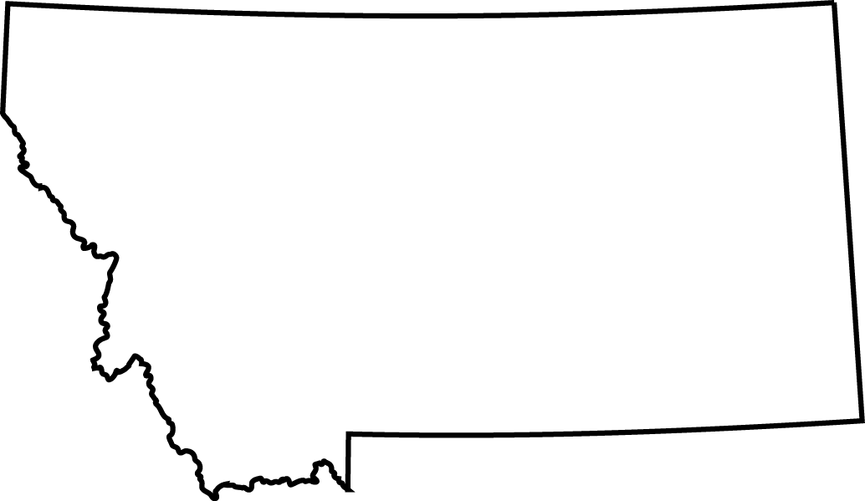
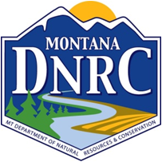
Co-Funding in Montana
Rural Development &
Revolving Fund Loan Program
Anna Miller

Slide 17
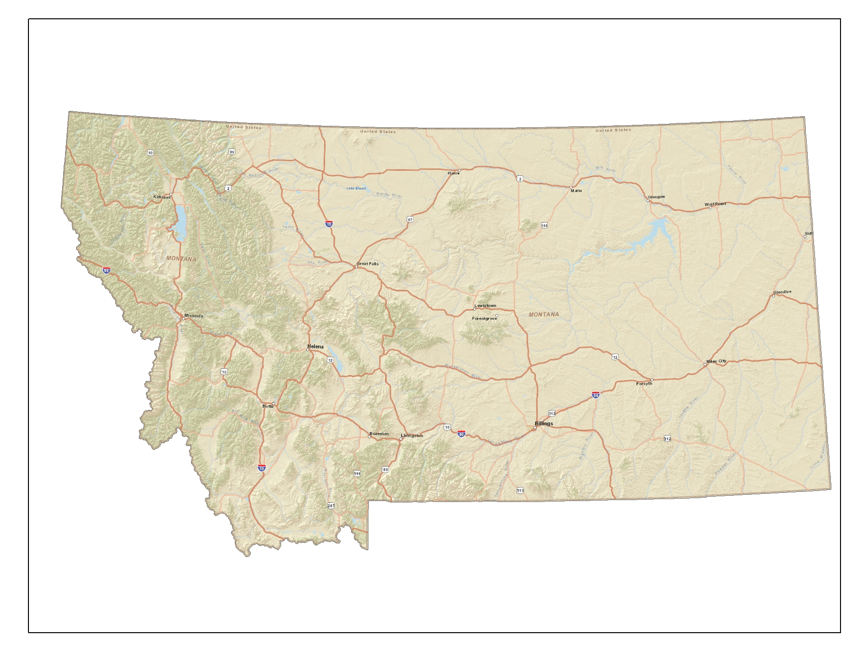
Montana

Slide 18
Montana’s Geography
650 Miles East to West
250 Miles North to South
Area is 150,000 square miles
Elevation is 2,000 to 13,000 MSL
Population is 1,025,000
7 people per square mile
1% is covered by surface water

Slide 19
Water Systems in Montana
Population Population
Per System # of Systems Overall
< 500 1,896 213,338
< 1500 165 128,255
< 3200 61 122,764
< 10000 31 168,842
< 25000 4 66,208
< 50000 3 96,005
< 100000 2 116,335
<=1000000 1 114,000
2,163 1,025,747

Slide 20
W2ASACT
Water,
Wastewater and
Solid Waste
Action Coordinating Team

Slide 21
W2ASACT
In 1982, a group of professionals from state, federal and non-profit organizations that finance, regulate, or provide technical assistance for community water and wastewater systems, decided to start meeting to coordinate and enhance their efforts. W2ASACT meets several times a year to find ways to improve our state's environmental infrastructure.

Slide 22
W2ASACT
Goals
Coordination for community water, wastewater and solid waste capital projects.
Operational and managerial technical assistance to those communities for water and solid waste infrastructure.
Improve government’s responsiveness to communities’ needs.
Generally improve our state’s water and solid waste infrastructure.

Slide 23
W2ASACT
30+ years of coordinating infrastructure needs. Networking among stakeholders to benefit utility development.
NOT a funding source
Is a forum to work together and assist communities with project needs.

Slide 24
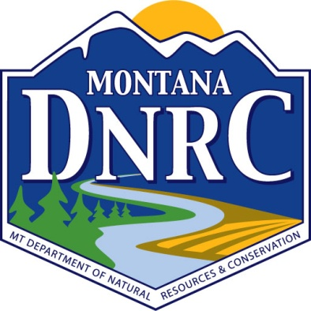
W2ASACT Members
Federal Agencies (e.g. DOI, HUD, EPA, USDA RD, IHS, BOR)
State Agencies (e.g. MTDNRC, EPA R8, MTDEQ, MT Dept. of Commerce, Intercap Program)
Others (e.g. MT Assoc. of County Water &Sewer Systems, MT Assoc. of Counties, MT League of Cities and Towns, Governors Office of Indian Affairs )
TATs (e.g. MAP, MTRWA, RATES, Montana State University)
Consulting Engineers
Notes:
MT Department of Commerce
Community Technical Assistance Program
Community Development Block Grant
Local Government Services Bureau
Montana Coal Board
Treasure State Endowment Program
MT Department of Environmental Quality
Public Water supply
Municipal Waste Water Assistance Program
Technical and Financial Assistance Bureau
State Drinking Water Revolving Fund - technical
State Wastewater Revolving Fund - technical
Department of Natural Resources and Conservation
Renewable Resources Gant and Loan Program
State Drinking Water Revolving Fund - financial
State Wastewater Revolving Fund - financial

Slide 25
W2ASACT TOOLS
Uniform Application
Uniform Preliminary Engineering Report
Uniform funds tracking
Uniform invoice tracking
Workshops
Web site
http://dnrc.mt.gov/divisions/cardd/wasact

Slide 26
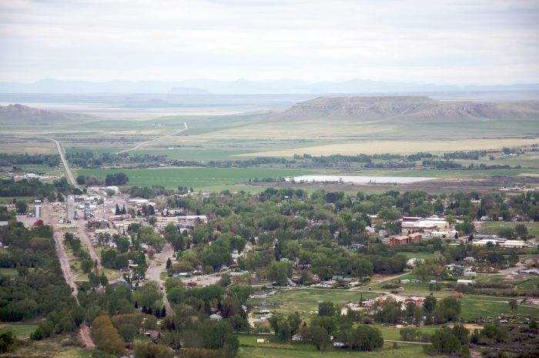
Choteau, Montana
Photo from onlyinourstate.com

Slide 27
Funded Projects
City of Choteau WWTP
Applicant $ 148,000
Treasure State Endowment Program $ 750,000
Renewable Resource Grant $ 100,000
SRF Loan $ 2,974,000
SRF Loan Forgiveness $ 646,000
RD Loan $ 3,860,000
RD Grant $ 1,625,000
TOTAL $10,057,000

Slide 28
Funded Projects
City of Choteau WWTP
If funded just by SRF Loan = $8,459,000
On 30 yrs/2.5% = $404,172/year (est.)
$56.30/edu/month
As funded RD/SRF = $288,589/year –
$44.00/edu/month
$115,582/yr savings in 30 yrs = $3,467,460
Savings of $8.30/edu/month in rate

Slide 29
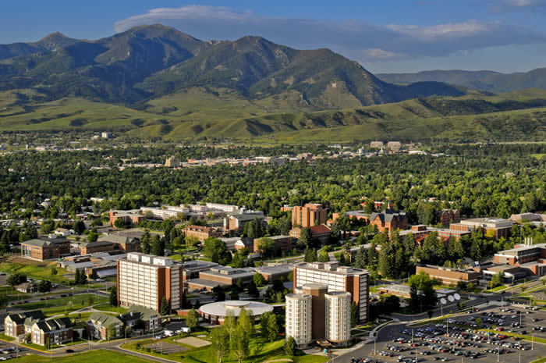
Bozeman, Montana
Photo from Montana.edu

Slide 30
Funded Projects
Four Corners Water and Wastewater District
Applicant $ 81,000
SRF Loan $ 9,300,000
Coal Tax Fund Loan $ 3,060,000
RD Loan $ 3,940,000
RD Loan $ 6,700,000
TOTAL $23,081,000
RD funded awarded project in 28 calendar days because of the coordination and communication.
Obligated 9/25/2015 closed on 12/23/2015.

Slide 31
Uniform Status of Funds
UNIFORM STATUS OF FUNDS SPREADSHEET FOR: Dawson County DATE: |  |  |  |  |  |  |  |  |  |  |  |  |  |  |  |  | 10/26/2017
 | Funding Source: State Revolving Fund (SRF) |  |  |  | Funding Source: SRF Loan Forgiveness |  |  |  | Funding Source: TSEP |  |  |  | Funding Source: RRGL |  |  |  | Total Budget
ADMINISTRATIVE/ FINANCIAL COSTS: | Budgeted | Previously Expended | Amount of Draw | Balance Remaining | Budgeted | Previously Expended | Amount of Draw | Balance Remaining | Budgeted | Previously Expended | Amount of Draw | Balance Remaining | Budgeted | Previously Expended | Amount of Draw | Balance Remaining | Budgeted | Expended | Balance
Personnel Costs |  |  |  | $0.00 |  |  |  | $0.00 |  |  |  | $0.00 |  |  |  | $0.00 | $0.00 | $0.00 | $0.00
Office Costs |  |  |  | $0.00 |  |  |  | $0.00 |  |  |  | $0.00 |  |  |  | $0.00 | $0.00 | $0.00 | $0.00
Professional Services |  |  |  | $0.00 |  |  |  | $0.00 |  |  |  | $0.00 |  |  |  | $0.00 | $0.00 | $0.00 | $0.00
Legal Costs | $12,400.00 | $5,053.00 |  | $7,347.00 | $100.00 | $100.00 |  | $0.00 |  |  |  | $0.00 |  |  |  | $0.00 | $12,400.00 | $5,053.00 | $7,347.00
Audit Fees | $10,000.00 |  |  | $10,000.00 |  |  |  | $0.00 |  |  |  | $0.00 |  |  |  | $0.00 | $10,000.00 | $0.00 | $10,000.00
Travel & Training |  |  |  | $0.00 |  |  |  | $0.00 |  |  |  | $0.00 |  |  |  | $0.00 | $0.00 | $0.00 | $0.00
Loan Fees |  |  |  | $0.00 |  |  |  | $0.00 |  |  |  | $0.00 |  |  |  | $0.00 | $0.00 | $0.00 | $0.00
Loan Reserves | $171,888.00 |  |  | $171,888.00 |  |  |  | $0.00 |  |  |  | $0.00 |  |  |  | $0.00 | $171,888.00 | $0.00 | $171,888.00
Interim Interest |  |  |  | $0.00 |  |  |  | $0.00 |  |  |  | $0.00 |  |  |  | $0.00 | $0.00 | $0.00 | $0.00
Bond Cost | $12,000.00 |  |  | $12,000.00 |  |  |  | $0.00 |  |  |  | $0.00 |  |  |  | $0.00 | $12,000.00 | $0.00 | $12,000.00
 |  |  |  | $0.00 |  |  |  | $0.00 |  |  |  | $0.00 |  |  |  | $0.00 | $0.00 | $0.00 | $0.00
 |  |  |  | $0.00 |  |  |  | $0.00 |  |  |  | $0.00 |  |  |  | $0.00 | $0.00 | $0.00 | $0.00
 |  |  |  | $0.00 |  |  |  | $0.00 |  |  |  | $0.00 |  |  |  | $0.00 | $0.00 | $0.00 | $0.00
 |  |  |  | $0.00 |  |  |  | $0.00 |  |  |  | $0.00 |  |  |  | $0.00 | $0.00 | $0.00 | $0.00
 |  |  |  | $0.00 |  |  |  | $0.00 |  |  |  | $0.00 |  |  |  | $0.00 | $0.00 | $0.00 | $0.00
 |  |  |  | $0.00 |  |  |  | $0.00 |  |  |  | $0.00 |  |  |  | $0.00 | $0.00 | $0.00 | $0.00
 |  |  |  | $0.00 |  |  |  | $0.00 |  |  |  | $0.00 |  |  |  | $0.00 | $0.00 | $0.00 | $0.00
Total Administrative Costs | $206,288.00 | $5,053.00 | $0.00 | $201,235.00 | $100.00 | $100.00 | $0.00 | $0.00 | $0.00 | $0.00 | $0.00 | $0.00 | $0.00 | $0.00 | $0.00 | $0.00 | $206,288.00 | $5,053.00 | $201,235.00
ACTIVITY COSTS:
Land Acquisition/ROW/Addl Services | $67,000.00 | $43,920.89 |  | $23,079.11 |  |  |  | $0.00 |  |  |  | $0.00 |  |  |  | $0.00 | $67,000.00 | $43,920.89 | $23,079.11
Preliminary Design | $141,000.00 | $44,745.56 |  | $96,254.44 |  |  |  | $0.00 |  |  |  | $0.00 | $95,000.00 | $95,000.00 |  | $0.00 | $236,000.00 | $139,745.56 | $96,254.44
Final Design/Bidding | $72,000.00 | $45,989.37 |  | $26,010.63 |  |  |  | $0.00 |  |  |  | $0.00 |  |  |  | $0.00 | $72,000.00 | $45,989.37 | $26,010.63
Construction Engineering | $319,190.00 | $92,595.00 |  | $226,595.00 |  |  |  | $0.00 |  |  |  | $0.00 |  |  |  | $0.00 | $319,190.00 | $92,595.00 | $226,595.00
Construction | $849,440.00 |  |  | $849,440.00 | $399,900.00 |  | $399,900.00 | $0.00 | $707,740.00 |  | $131,175.65 | $576,564.35 | $5,000.00 |  |  | $5,000.00 | $1,962,080.00 | $131,175.65 | $1,962,180.00
 |  |  |  | $0.00 |  |  |  | $0.00 |  |  |  | $0.00 |  |  |  | $0.00 | $0.00 | $0.00 | $0.00
Construction Alternate | $563,250.00 |  |  | $563,250.00 |  |  |  | $0.00 |  |  |  | $0.00 |  |  |  | $0.00 | $563,250.00 | $0.00 | $563,250.00
Paving | $216,000.00 |  |  | $216,000.00 |  |  |  | $0.00 |  |  |  | $0.00 |  |  |  | $0.00 | $216,000.00 | $0.00 | $216,000.00
 |  |  |  | $0.00 |  |  |  | $0.00 |  |  |  | $0.00 |  |  |  | $0.00 | $0.00 | $0.00 | $0.00
Contingency | $246,732.00 |  |  | $246,732.00 |  |  |  | $0.00 | $42,260.00 |  |  | $42,260.00 |  |  |  | $0.00 | $288,992.00 | $0.00 | $288,992.00
Total Activity Costs | $2,474,612.00 | $227,250.82 | $0.00 | $2,247,361.18 | $399,900.00 | $0.00 | $399,900.00 | $0.00 | $750,000.00 | $0.00 | $131,175.65 | $618,824.35 | $100,000.00 | $95,000.00 | $0.00 | $5,000.00 | $3,724,512.00 | $853,326.47 | $2,871,185.53
TOTAL PROJECT COSTS | $2,680,900.00 | $232,303.82 | $0.00 | $2,448,596.18 | $400,000.00 | $100.00 | $399,900.00 | $0.00 | $750,000.00 | $0.00 | $131,175.65 | $618,824.35 | $100,000.00 | $95,000.00 | $0.00 | $5,000.00 | $3,930,800.00 | $858,379.47 | $3,072,420.53
*SRF Draw is pending loan approval-County is paying with anticipation of reimbursement
*Land Acquisition includes engineering plus possible cost to acquire easements

Slide 32
Uniform Invoice Tracking
UNIFORM INVOICE TRACKING SPREADSHEET FOR: DATE: |  |  | Dawson County Sewer |  |  |  |  |  |  | DATE: |  | 10/26/2017
Vendor's Name | Invoice or Pay Estimate Number | Invoice Date or Time Period Covered | Total Amount of Invoice | Warrant Number | Date Paid |  |  |  |  |  |  | Funding Source, Amount Expended, Drawdown Number |  |  |  | Total Amount Paid This Invoice
 |  |  |  |  |  | Funding Source: |  |  |  | Funding Source: |  | Funding Source:
 |  |  |  |  |  | SRF Loan B | # | SRF Loan A | # | TSEP | # | RRGL
Great West Engineering | 12851 | 10/28/14 | $1,175.00 | 85551 | 10/30/14 | $0.00 |  | $0.00 |  | $0.00 |  | $1,175.00 |  |  |  | $1,175.00
Great West Engineering | 12662 | 09/24/14 | $8,803.29 | 85551 | 10/30/14 | $0.00 |  | $0.00 |  | $0.00 |  | $8,803.29 |  |  |  | $8,803.29
Great West Engineering | 12966 | 11/24/14 | $7,485.50 | 85748 | 12/03/14 | $0.00 |  | $0.00 |  | $0.00 |  | $7,485.50 |  |  |  | $7,485.50
Great West Engineering | 13110 | 01/20/15 | $6,167.00 | 86160 | 01/29/15 | $0.00 |  | $0.00 |  | $0.00 |  | $6,167.00 |  |  |  | $6,167.00
Great West Engineering | 13067 | 01/05/15 | $12,181.25 | 86160 | 01/29/15 | $0.00 |  | $0.00 |  | $0.00 |  | $12,181.25 |  |  |  | $12,181.25
Great West Engineering | 13283 | 03/02/15 | $3,641.00 | 86586 | 03/31/15 | $0.00 |  | $0.00 |  | $0.00 |  | $3,641.00 |  |  |  | $3,641.00
Great West Engineering | 13308 | 03/24/15 | $4,459.00 | 86794 | 04/30/15 | $4,459.00 |  | $0.00 |  | $0.00 |  | $0.00 |  |  |  | $4,459.00
Great West Engineering | 13444 | 04/23/15 | $11,944.51 | 86794 | 04/30/15 | $4,087.00 |  | $0.00 |  | $0.00 |  | $7,857.51 |  |  |  | $11,944.51
Great West Engineering | 13562 | 05/21/15 | $25,623.99 | 87242 | 07/01/15 | $1,460.00 |  | $0.00 |  | $0.00 |  | $24,163.99 |  |  |  | $25,623.99
Great West Engineering | 13667 | 06/29/15 | $31,474.30 | 87390 | 07/07/15 | $7,948.84 |  | $0.00 |  | $0.00 |  | $23,525.46 |  |  |  | $31,474.30
Great West Engineering | 13946 | 08/21/15 | $27,765.35 | 87748 | 08/31/15 | $27,765.35 |  | $0.00 |  | $0.00 |  | $0.00 |  |  |  | $27,765.35
Great West Engineering | 14049 | 09/29/15 | $21,712.90 | 88165 | 09/30/15 | $21,712.90 |  | $0.00 |  | $0.00 |  | $0.00 |  |  |  | $21,712.90
Great West Engineering | 14154 | 10/22/15 | $21,433.50 | 88477 | 11/30/15 | $21,433.50 |  | $0.00 |  | $0.00 |  | $0.00 |  |  |  | $21,433.50
Great West Engineering | 14284 | 11/25/15 | $33,281.81 | 88607 | 11/30/15 | $33,281.81 |  | $0.00 |  | $0.00 |  | $0.00 |  |  |  | $33,281.81
Great West Engineering | 15675 | 12/31/16 | $3,136.80 |  |  | $3,136.80 |  | $0.00 |  | $0.00 |  | $0.00 |  |  |  | $3,136.80
Great West Engineering | 15585 | 11/10/16 | $3,592.75 |  |  | $3,592.75 |  | $0.00 |  | $0.00 |  | $0.00 |  |  |  | $3,592.75
Crowley Fleck Attorney | 801310 | 07/31/16 | $136.00 |  |  | $136.00 |  | $0.00 |  | $0.00 |  | $0.00 |  |  |  | $136.00
Crowley Fleck Attorney | 803570 | 08/31/16 | $68.00 |  |  | $68.00 |  | $0.00 |  | $0.00 |  | $0.00 |  |  |  | $68.00
Crowley Fleck Attorney | 805425 | 09/30/16 | $34.00 |  |  | $34.00 |  | $0.00 |  | $0.00 |  | $0.00 |  |  |  | $34.00
Great West Engineering | 15785 | 01/23/17 | $4,125.62 |  |  | $4,125.62 |  | $0.00 |  | $0.00 |  | $0.00 |  |  |  | $4,125.62
Great West Engineering | 15898 | 02/21/17 | $2,423.25 |  |  | $2,423.25 |  | $0.00 |  | $0.00 |  | $0.00 |  |  |  | $2,423.25
Great West Engineering | 16032 | 03/22/17 | $17,497.68 |  |  | $17,497.68 |  | $0.00 |  | $0.00 |  | $0.00 |  |  |  | $17,497.68
Great West Engineering | 16145 | 04/17/17 | $6,679.94 |  |  | $6,679.94 |  | $0.00 |  | $0.00 |  | $0.00 |  |  |  | $6,679.94
Great West Engineering | 16325 | 05/25/17 | $17,761.25 |  |  | $17,761.25 |  | $0.00 |  | $0.00 |  | $0.00 |  |  |  | $17,761.25
Great West Engineering | 16372 | 06/20/17 | $49,885.13 |  |  | $49,885.13 |  | $0.00 |  | $0.00 |  | $0.00 |  |  |  | $49,885.13
Crowley Fleck Attorney | 815745 | 02/23/17 | $4,915.00 |  |  | $4,815.00 |  | $100.00 |  | $0.00 |  | $0.00 |  |  |  | $4,915.00
COP Construction | 1 | 07/18/17 | $531,075.65 |  |  | $0.00 |  | $399,900.00 |  | $131,175.65 |  | $0.00 |  |  |  | $531,075.65
 |  |  | $0.00 |  |  | $0.00 |  | $0.00 |  | $0.00 |  | $0.00 |  |  |  | $0.00
 |  |  | $0.00 |  |  | $0.00 |  | $0.00 |  | $0.00 |  | $0.00 |  |  |  | $0.00
 |  |  | $0.00 |  |  | $0.00 |  | $0.00 |  | $0.00 |  | $0.00 |  |  |  | $0.00
 |  |  | $0.00 |  |  | $0.00 |  | $0.00 |  | $0.00 |  | $0.00 |  |  |  | $0.00
 |  |  | $0.00 |  |  | $0.00 |  | $0.00 |  | $0.00 |  | $0.00 |  |  |  | $0.00
Copy and submit to the applicable funding agency with each drawdown request. |  | TOTALS | $858,479.47 |  |  | $232,303.82 |  | $400,000.00 |  | $131,175.65 |  | $95,000.00 |  |  |  | $858,479.47

Slide 33
Workshops
Meetings held in several locations across the state
All state and federal funders share application and funding information
Focus on key elements:
Planning
Hiring an Engineer
Project funding plan

Slide 34
Summary of Co-Funding Goals
By working together, we can get more done.
Combine resources to fund expensive projects.
Solve enforcement problems.
Work with technical providers to help provide support for the communities.

Slide 35
Community Benefit
Provide Health and Safety for communities
Working to better the environment
Economic Benefits – Jobs
Solve problems

Slide 36
Developing a Partnership with Rural Development
Notes:
So how do we develop a partnership?

Slide 37
What YOU CAN Do…
Identify Partners (Do you know who your Rural Development counterparts are in your state?)
Identify specific partnership needs.
Establish an Informal Group State or Regional Level
Define need and tools to coordinate efforts and collaborate effectively
Decide to communicate regularly
Join the Small Community Water Infrastructure Exchange (SCWIE)
Notes:
It’s simple…
State Level Partnerships – State Support Groups
Some states have developed funding committees/ state support groups to help small water systems in navigating the process and use several potential funding sources for water projects. The state support groups are composed of state, federal, and non-profit organizations that finance, regulate, or provide technical assistance for community water and wastewater systems. Serving as a hub of the state funding groups, the Small Community Water Infrastructure Exchange (SCWIE) facilitates communication among state workgroup members throughout the US about what they are doing in their respective states to assist small and/or rural communities with their environmental infrastructure needs. http://www.scwie.org/.
Future collaboration opportunities: The level of collaboration is different between states and regions. As state wide support groups continue to experiment and grow, creating cross pollination opportunities, where state groups can share ideas, challenges and best practices with one another can help state wide support groups evolve and grow more effectively.

Slide 38
Build on Existing National Program Coordination
Joint Preliminary Engineering Report (PER)
American Iron and Steel (AIS)
Streamlined Environmental Review Guidance
Notes:
Build on existing interagency coordination.
ePER
One of the significant outcomes from this partnership was to form a working group that developed an interagency template the Preliminary Engineering Report (PER), which provided some common and essential elements needed for the application process required to access funding for water and waste infrastructure from federal and state agencies.
The goal of establishing these common elements by adopting a joint PER template is to provide communities with a streamlined application process that reduces the time, effort and expense they face when applying to multiple agencies for infrastructure funding.
The USDA-led working group included 36 individuals representing 4 federal agencies (USDA, EPA, HHS-IHS, and HUD), 16 state agencies, the Border Environment Cooperation Commission, the North Carolina Rural Center and by the Small Community Water Infrastructure Exchange.
On January 16, 2013, the principals of the federal participants executed an interagency memorandum supporting use of the interagency template.
Currently in addition to the four federal agencies,
- 22 States have adopted the multi-agency PER template directly or with minor modifications for state and federal funded projects (adopted template without modification: DE, ID, IN, MD, MS, MT, NE. NV, ND, OK, OR, PR, and WA;
- 9 States have adopted the template with some modification: CA, KS, MI, NJ, NY, NC, OH, SD, and WV) and
- 5 states have adopted the multi-agency template only for jointly funded projects (AL, AK, FL, KY, and UT).
To further streamline the application process and improve access, USDA developed an electronic PER form (ePER), to enable consulting engineers develop a PER online. This tool includes automated features such as a built in population projection tool as well as a built in life cycle cost analysis tool. It is safe and secure, allowing access to primary user with delegated roles if desired. It is flexible in that it allows for various types of file uploads to accommodate different agency and state funding requirements. ePER is currently being integrated into USDA’s online funding application platform (RD Apply).
Future opportunities could explore integrating ePER into other federal and state water infrastructure online funding application platforms. If you are interested in hearing more about this tool, we are planning for a webinar April 19. Please reach out to Steve Grossman for registration information.
AIS
EPA and USDA worked collaboratively to implement AIS provision for USDA’s WEP program. Since AIS’s provision was a requirement to EPA’s programs three years before it applied to USDA’s programs, information sharing between the two agencies led to speed up the development of USDA’s policy document. Coordination, weekly meetings and peer review led to elimination of inconsistencies between the agencies’ AIS implementation.
Future opportunities: Coordination of site visits could lead to reduction in resources and funding required to complete the oversight site visits. As EPA and USDA’s policy documents are now aligned, it is easier now to streamline AIS implementation and waiver requests, especially in jointly funded projects.
Environmental Review
EPA and USDA have begun taking steps to develop guidelines to assist states in developing uniform environmental analyses. The agencies are participating in a work group, along with other federal agencies that fund rural water infrastructure projects (Department of Housing and Urban Development, the Department of Health and Human Services’ Indian Health Service, and the Department of the Interior).
The work group has developed a matrix that describes the environmental analyses required by each agency that is to be a tool that communities applying for funding can use to identify and complete appropriate environmental analyses. The workgroup also gathered information and discussed barriers and solutions to completing environmental reviews for Indian housing and housing-related infrastructure. The interagency produced a report in December 2015 recommending measures that could be taken to coordinate agencies’ environmental review processes within the existing framework and presents herein short- and long term recommendations. https://www.hud.gov/sites/documents/COORENVIRREVIEW.PDF
Best practice - Pennsylvania’s Uniform Environmental Review: The Uniform Environmental Review (UER) process is intended to standardize the process for documenting the environmental effects of proposed drinking water and wastewater infrastructure projects requesting financial assistance from various federal funding sources in Pennsylvania, including the CWSRF, DWSRF, USDA, and HUD. The UER streamlines environmental review and facilitates interagency communication allowing assistance recipients to avoid duplication of effort, particularly where multiple sources of funding are involved. Once the funding source(s) are determined, communities can provide any supplemental information required for that specific program. Guidelines for Pennsylvania’s UER can be found at http://www.elibrary.dep.state.pa.us/dsweb/Get/Document-47475/381-5511-111.pdf
Finally, we would like to look at some of the factors that individual states have used in order to build strong partnerships and develop some best practices to implement across the country.

Slide 39

Factors for success
Communication
Shared interest/objective/goal
Build on existing partnerships
Leverage resources
Mutually agreed and clear division of labor
Continued, purposeful and frequent communication
Develop metrics to document success and share best practices
Notes:
KAREN

Slide 40
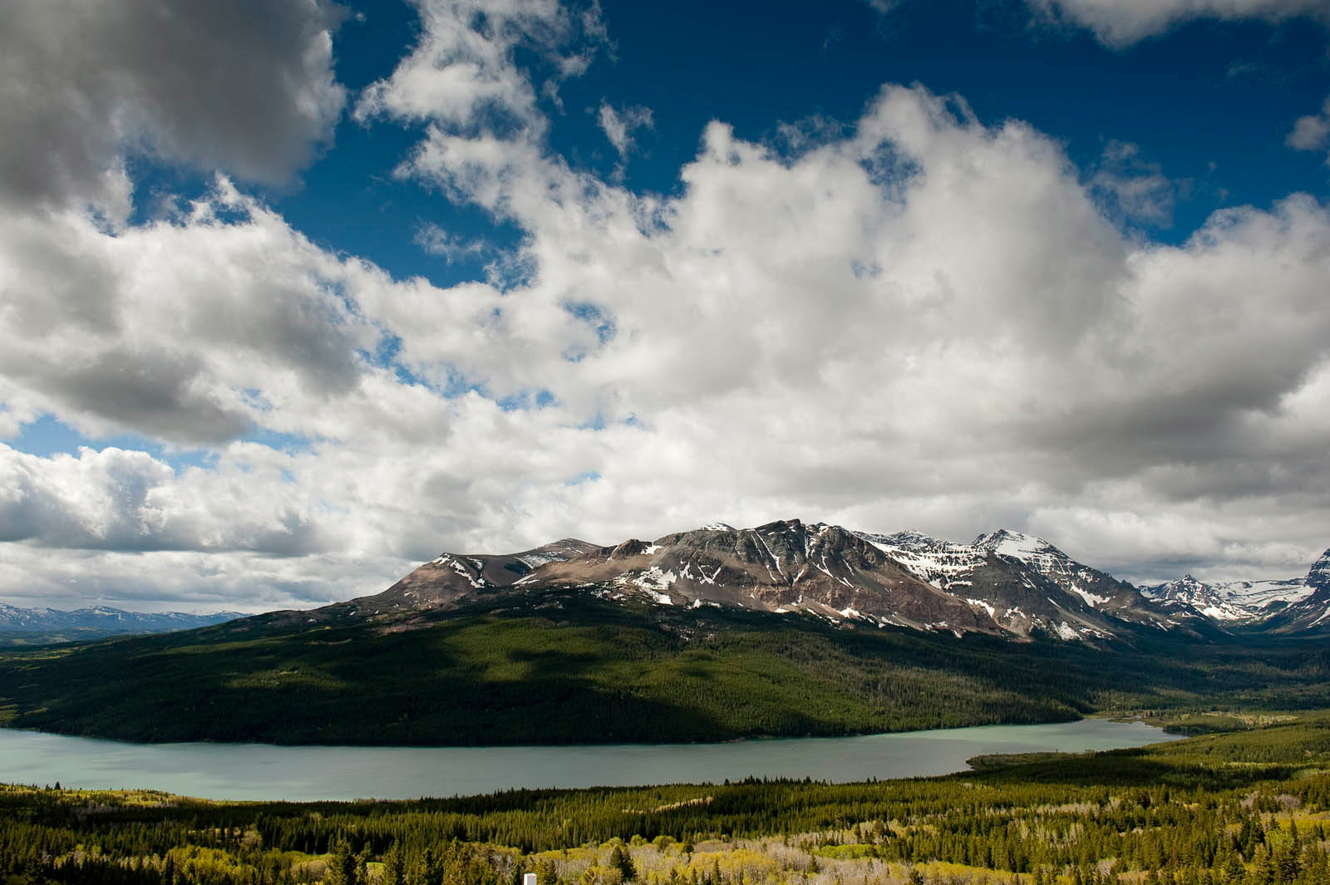
Together we can solve problems… Partnership makes sense…
Notes:
According to EPA’s clean water and drinking water needs surveys, there is over 600 billion in overall need and 132 billion in need for small and rural water and wastewater systems over the next 20 years. Even with combined EPA and USDA’s annual budgets the need for partnering has never been greater.
Partnering not only maximizes both our annual budgets to meet these needs but also helps avoid duplication of effort so that we continue to be good stewards of taxpayers dollars. It just makes sense.
Conclusion
Consensus building, or in other words identifying shared objectives and mutually agreed division of responsibilities, is the backbone of building successful partnership. Consensus building is also a process that takes time, effort and commitment. As demonstrated in this documents, partnerships can be formed at National/program level, state level, or project level. These varying level of partnerships also enforce each other. For instance aligning programs and policies to coordinate processes and procedures, makes state level coordination and project level joint funding opportunities easier. Correspondingly, successful examples of jointly funded or implemented projects encourage more partnership at state and national level.

Slide 41
Anna Miller, Financial Advisor Montana Department of Natural Resources and Conservation (406) 444-6689 annam@mt.gov Nicole M. Schindler, Senior Engineer USDA, Rural Utilities Service Water and Environmental Programs (202) 720-7817 Nicole.Schindler@wdc.usda.gov Karen Bucklin Sanchez, P.E., State Engineer USDA Montana Rural Development Karen.Sanchez@mt.usda.gov

