Slide 1
Co-Funding to Encourage Regionalization -
The Greensboro/Goldsboro MD Example
Elaine Dietz
MD Water Quality Financing Administration
CIFA 2016 SRF National Workshop
Notes:
Thank you to Steve Grossman for inviting Maryland to participate in this discussion. Best wishes from Jag, who hopes everyone has a good conference and a great time at the social event this evening.

Slide 2

Notes:
Regionalization is a good thing. Jim McGoff of Indiana Finance Authority made the case for regionalization case at last year’s conference, but it is not without its challenges - there are many pieces that need to come together to create a viable project, not the least of which is financing. Co-funding to make the project affordable to the communities involved is often the way to complete the picture. Today, I’ll share one example of a successful regionalization project in MD that the MWQFA is co-funding with CDBG and USDA.

Slide 3
Regionalization in Maryland
Septic decommisions/sewer extensions to public WWTP
  Motivated by Chesapeake Bay TMDL to reduce nutrients from all sectors.
  Along with reductions in the point source and agriculture sectors, eliminating septics is an “easy” way to achieve required load limits:
  Septic → Secondary WWTP = 9.5 lb/yr TN reduction per EDU
  Septic → BNR WWTP = 17.1 lb/yr TN reduction per EDU
  Septic → ENR WWTP = 20.9 lb/yr TN reduction per EDU
  Scoring system revised to prioritize such projects.
  SRF and State’s Bay Restoration Fund (BRF) Grant
Notes:
So, “regionalization good” – in MD, regionalization projects are most often sewer extensions are being run to provide public sewer to communities currently on septic systems. MD TMDL assumes TN from standard septic system = 23.2 mg/l TN

Slide 4
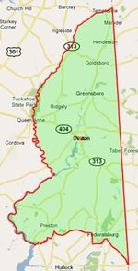
Regionalization in Caroline Co MD
Goldboro had 125 homes on marginal septic systems, which are blamed for high fecal coliform levels in a nearby recreational lake (since closed).
+
State under pressure to “do something” regarding the lake and failing septics.
+
Caroline County required by Maryland’s Watershed Implementation Plan to find ways to reduce nutrients to meet the Chesapeake Bay TMDL (as were all MD counties).
+
Possible for BRF to fund upgrade of minor WWTPs, like the one in Greensboro
=
REGIONAL WASTEWATER SYSTEM
Notes:
On Maryland’s Eastern Shore – Caroline Co is bounded on the east by Delaware. No County owned/operated WWTPs – either municipal WWTPs or septic systems. So what was going on here that motivated regionalization? (Review listed circumstances). The original concept was a “Northern County Regional Wastewater System” to include towns from Greensboro north thru Templeville. These are small (Greensboro is largest at pop = 2,000; down to Templeville = 120 pop) disadvantaged towns and ~$25M project was too expensive, so was scaled back to…

Slide 5
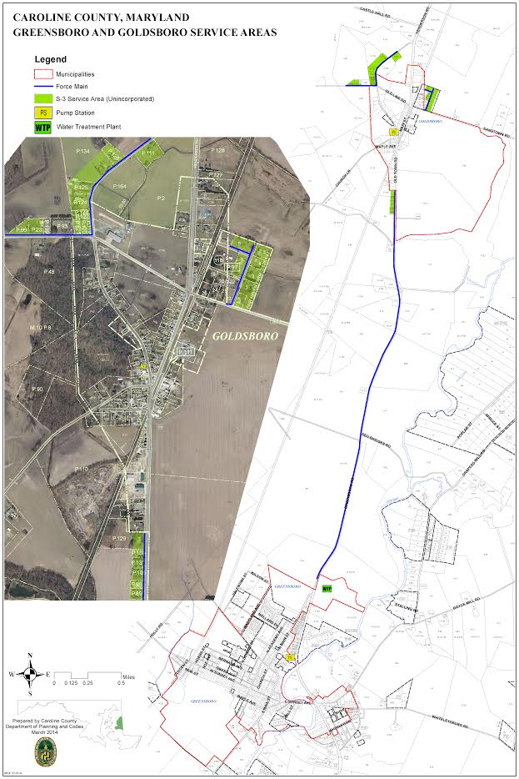
Greensboro Regional WW System
Four phases ($15.89M):
1- Replace Greensboro WWTP w/new regional
0.332 MGD ENR WWTP in Greensboro with capacity for Greensboro and Goldsboro ($9.62M)
2 – Construct a new pump station and conveyance line to convey flow from old to new WWTP ($1.63M)
3 - Construct ~5 mile force main sized to convey flow from Goldsboro (and further north) to Greensboro ($1.75M)
4 – Construct a new collection/conveyance system in Goldsboro for flow to Greensboro WWTP $2.89M)
Future – Possible WWTP expansion and
new collection/conveyance to serve
towns further north.
Notes:
Project is scaled back to the Greensboro Regional Wastewater System, which is focused on the southern area of the region (Greensboro and Goldboro), with Caroline County serving in a coordination role. Phase 1 and 2 will be completed in early 2017. Phase 3 should be completed by mid-2017. Phase 4 – including connection of homes on septics - is expected to be completed in Fall 2017.

Slide 6
Greensboro Regional WW System (cont)
 | MDE Grant | CDBG Grant | USDA Grant | USDA Loan
Phase 1 | $5.78M | $0.91M | $0.45M | $2.48M
Phase 2 | --- | $0.14M | $0.56M | $0.93M
Phase 3 | $1.5M | $0.09M | $0.16M | ---
Phase 4 | --- | $1.07M | $1.53M | $0.3M
TOTAL | $7.28M | $2.21M | $2.7M | $3.71M
Co-funding with package made mostly of grants made the project possible. Even so, rate ~$700 per home per year.
Notes:
MDE Grant was substantially BRF. Although MDE has SRF funding, none was used for this project. USDA was only lender, which was advantageous: 1) simpler for borrower to cut one loan with one agency and 2) USDA has 40-year terms.

Slide 7
Greensboro Regional WW System (cont)
Regional system can be funded in phases, which is more feasible to the funding agencies (esp. regarding grant resources)
Project results in nutrient reductions toward meeting Chesapeake Bay TMDL
  Replace secondary WWTP w/ENR = 12,785 lb/yr TN
  Connect 125 homes on septics to ENR = 2,612 lb/yr TN

Slide 8
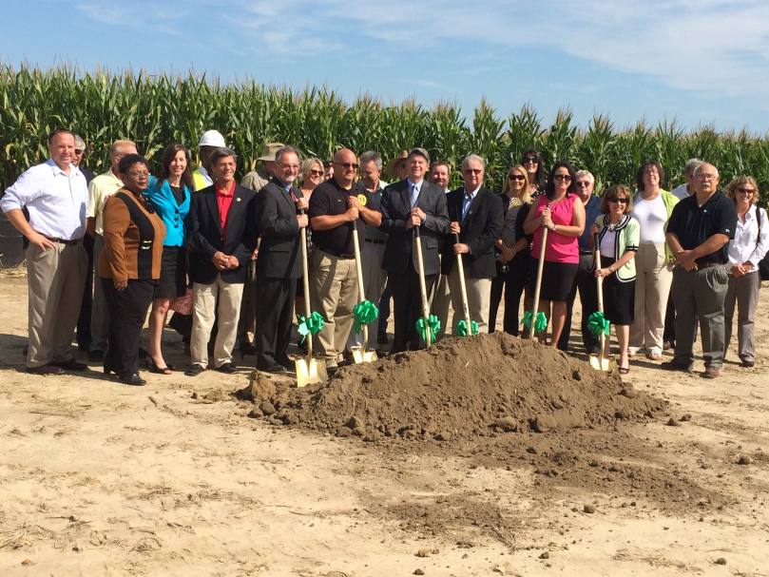
“All for one and one for all”
Notes:
Cooperation is the key to success with projects such as these. This is the motto Greensboro, Goldsboro, and Caroline County adopted and it has served them well. Greensboro really went above and beyond: not only did they agree to serve Goldboro, the Town has assumed the entire project debt for entire project on its books (charging Goldboro as customer, with MOU mechanism whereby uncollected bills become responsibility of Goldsboro).

